Slide 1
<A38 The Silent Owl>
Member | Role | Experience
Ghaith AL SABAGH | Lead | RFICs: 2x tapeouts in open-source SG13G2 for a D-Band Radar and a D-Band Antenna
Ahmed Moustafa | Designer | ADC, TDC, LNA, LC-VCO, ReRAM Programmable Analog Blocks, SiC Gate Drivers, USB-C, BGR and LDOs
Arjun Ananth | Designer | Mixed Signal ICs: 12 Bit 2 GSps Folding Interpolating ADC in IHP SG25H5 EPIC BiCMOS, & 8 Bit SAR ADC in GF 28nm cmoslpe
Ilir Shala | Designer | Mixed-Signal ICs: Design of an open-source Current Steering DAC in SG13G2

Slide 2
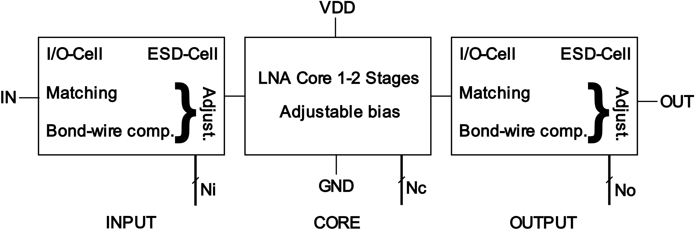
Project information
Goal: The RF-limitation in the PDK is the ESD-Cells. Goal is to design an RF-LNA by compensating the reactance of the ESD-Cells.
Design - High Level Proposal
Input/output cells: I/O-Cell, ESD, adjustable bond-wire compensation+matching.
Core cell: LNA core of 1-2 Stages + adjustable bias.
Application: Initial goal is Bluetooth operation (2.4 GHz), could be settled down to sub-GHz applications (e.g. LoRa EU868 or EU433).
References
Oleg Semenov, Hossein Sarbishaei, Manoj Sachdev - ESD Protection Device and Circuit Design for Advanced CMOS Technologies
Jung-Hoon Chun - ESD Protection Circuits For Advanced CMOS Technologies

Slide 3
Questions, Suggestions, Doubts?
How much area is available for designs?
How much pins are dedicated for each design?
Is it possible to place circuits under the broken shield of an inductor?

