Slide 1
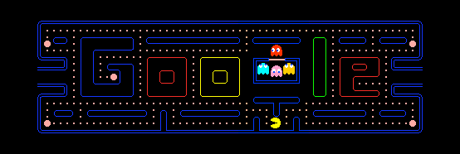
Pacman (AI)

Slide 2
pacman
Team:
Ahmed Saad
Abdallah Adel
Haggag Fawzy
Mohamed Tarek
Zeyad Sameh
Hekmat Reda
Ebtsam Saber

Slide 3

Project Goal
Teaching AI to Play Pac-Man Using Reinforcement Learning.
From DQN , A2C and PPO
- A Deep Dive into RL Algorithms

Slide 4
Introduction to Pac-Man
Content:
Classic arcade game developed by Namco (1980)
Player controls Pac-Man to eat dots while avoiding ghosts
Game elements:
Pac-Man (player)
4 ghosts with different behaviors
Dots (small and power pellets)
Fruits (bonus points)
Objective: Maximize score by eating all dots while avoiding ghosts

Slide 5
Using RL for Pac-Man?
Complex environment with:
Partial observability (ghosts move unpredictably)
Delayed rewards
Multiple objectives (dots, fruits, ghosts)
Perfect testbed for RL algorithms:
Discrete actions (4 directions + neutral)
Clear reward structure
Observable game state (pixels or RAM values)

Slide 6

Reinforcement Learning Basics
RL framework:
Agent takes actions in environment
Receives rewards and new states
Learns policy to maximize cumulative reward
Key components:
State (S)
Action (A)
Reward (R)
Policy (π)
Value function (V/Q

Slide 7
Algorithm used
DQN (Deep Q-Network):
Value-based method
Uses replay buffer and target network
Learns Q-values for state-action pairs
A2C (Advantage Actor-Critic):
Policy-based + value-based
Actor: Learns policy directly
Critic: Evaluates state values
Uses advantage function (A = Q – V(

Slide 8
Algorithm used
PPO (Proximal Policy Optimization):
Plays rounds and accumulates experience
Calculates gains and benefits
A "trust logic" is necessary
A3C (Asynchronous Advantage Actor-Critic):
Several copies of the environment run in parallel.
Each copy has its own experiences.
Synchronous updates to the main network.

Slide 9

Training Process
Environment setup (ALE/Gymnasium)
Frame preprocessing
N-step trajectory collection
Advantage calculation
Network updates:
Policy gradient with advantage
Value function regression
Entropy bonus for exploration

Slide 10
Results and Challenges
Results:
Average score improvement over time
Learned strategies (ghost avoidance, pellet timing)
Challenges:
High variance in rewards
Long-term credit assignment
Exploration vs. exploitation tradeoff
Hardware requirements

Slide 11
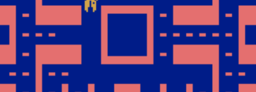
thanks

