Slide 1
Statistical Learning: final project
Applying statistical analysis and modeling for Bank marketing campaign
Maksim Kokot (ID: 2072065)
Yelnur Shauketbek (ID: 2078709)

Slide 2

Project Introduction
Goal: predict if the client will accept a term deposit (classification task)
Dataset: Real dataset with social and economic context provided by Portuguese banking institution
The image has been taken from https://www.kaggle.com/datasets/berkayalan/bank-marketing-data-set

Slide 3
Expected results
Understanding the processes which lay behind the marketing campaign by analyzing the data
Estimating the impact of predictors on the target variable
Building a statistical model which will help us to select the clients who will probably accept a term deposit.

Slide 4
Dataset
41188 instances
20 features + 1 target variable
Missing values
Class imbalance
No | Yes
36548 | 4640

Slide 5

The features related to client
Feature | Description
Age (numeric) | client's age
Job (categorical) | client's type of job
Marital (categorical) | client's marital status
Education (categorical) | client's education level
Default (categorical) | client's default status (has credit in default?)
Housing (categorical) | client's house loan status (has client a house loan?)
Loan (categorical) | client's loan status (has client a loan?)

Slide 6
The features related to the current marketing campaign
Feature | Description
Contact (categorical) | contact type
Month (categorical) | last contact month
Day of week (categorical) | last contact day of the week
Duration (numeric) | last contact duration (in purpose of preventing data leakage, we will not use that feature, because we can't retrieve this feature for future clients)
Campaign (numeric) | shows number of contacts during current marketing campaign

Slide 7
The features related to the previous marketing campaign
Feature | Description
Pdays (numeric) | shows number of days passed after last contact in current campaign (999 – means this client wasn't contacted before)
Previous (numeric) | shows number of contacts in previous marketing campaign
Poutcome (categorical) | shows the results of previous marketing campaign

Slide 8
Features related to the bank
Feature | Description
Emp.var.rate (numeric) | employment variation rate - quarterly indicator
Nr.employed (numeric) | number of employees - quarterly indicator

Slide 9
Social and economic context features
Feature | Description
Cons.price.idx (numeric) | consumer price index - monthly indicator
Cons.conf.idx (numeric) | consumer confidence index - monthly indicator
Euribor3m (numeric) | the Euro Interbank offered 3-month rate - daily indicator

Slide 10
Group the features
Continuous features | Binary features | Ordinal features | Nominal features
age | default | education | job
duration | housing |  | marital
campaign | loan |  | month
pdays | contact |  | day of week
previous |  |  | poutcome
emp.var.rate
cons.conf.idx
euribor3m
nr.employed

Slide 11
Initial data preprocessing and feature engineering
Creating factor representations for categorical variables.
Constructing year and date feature.

Slide 12
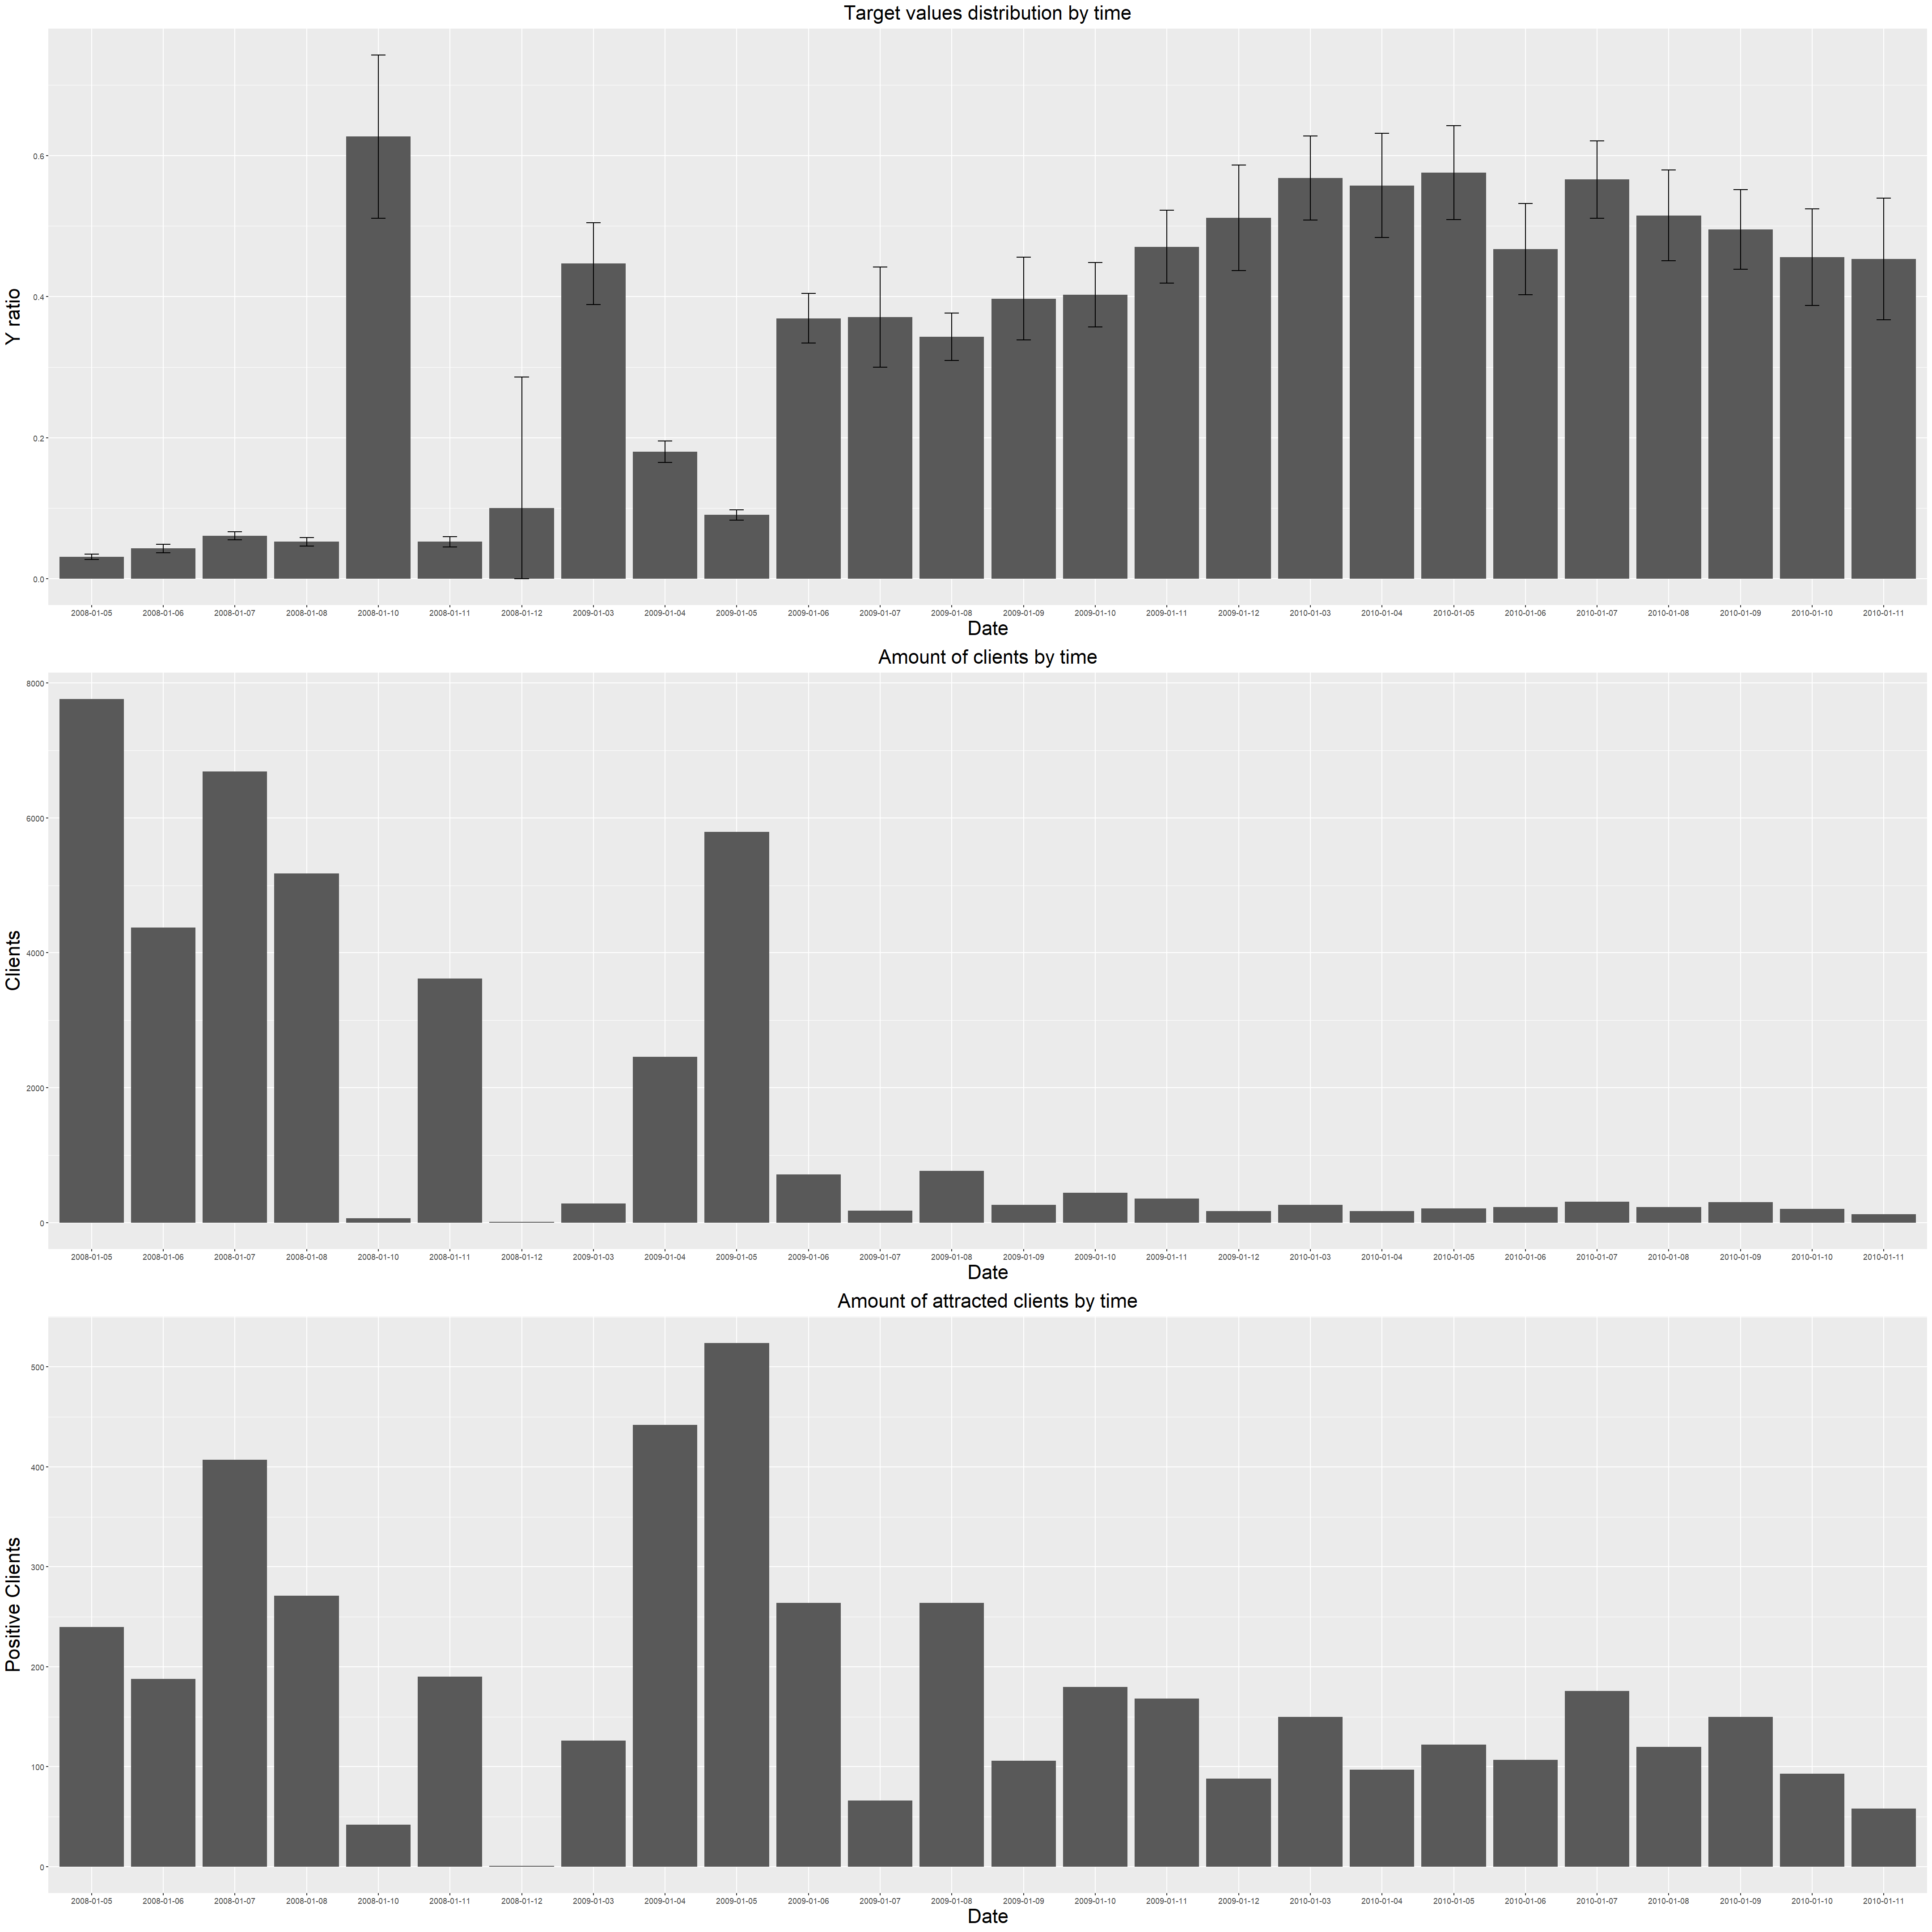
Temporal dynamics of target variable

Slide 13
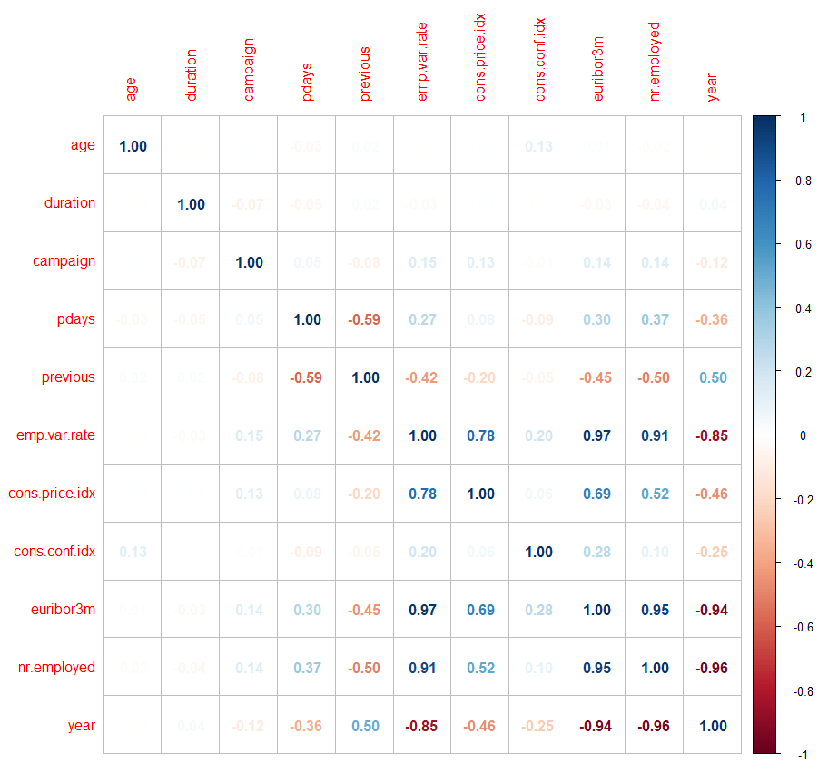
Correlation matrix

Slide 14
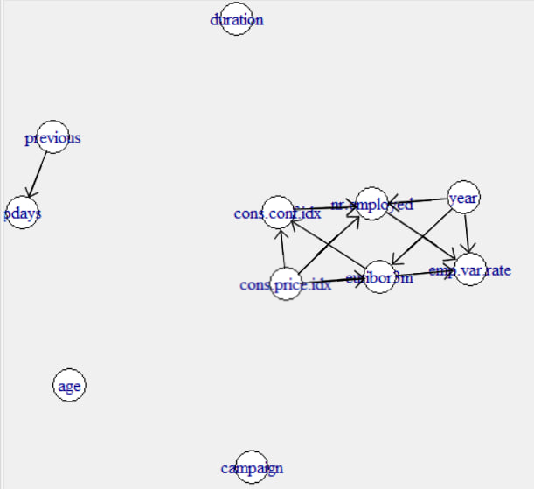
Independence graph

Slide 15
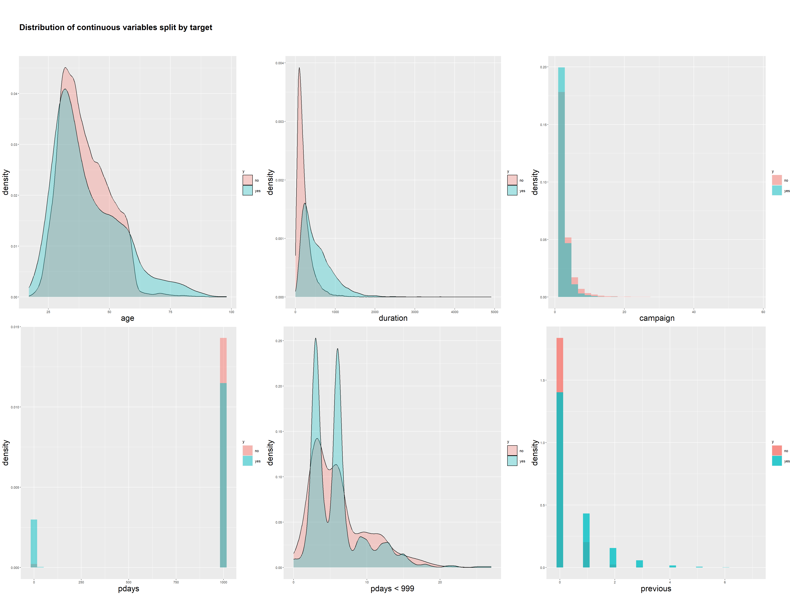
Distribution plots of continuous variables split by target value

Slide 16
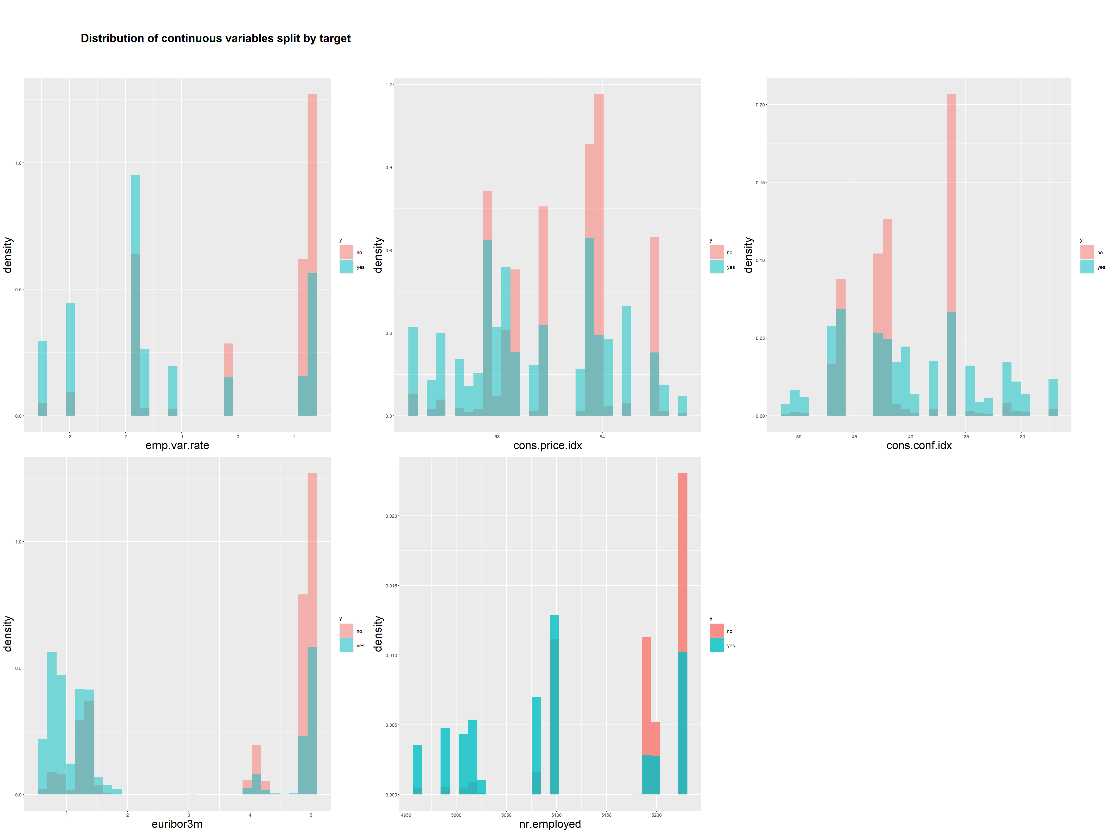
Distribution plots of continuous variables split by target value

Slide 17
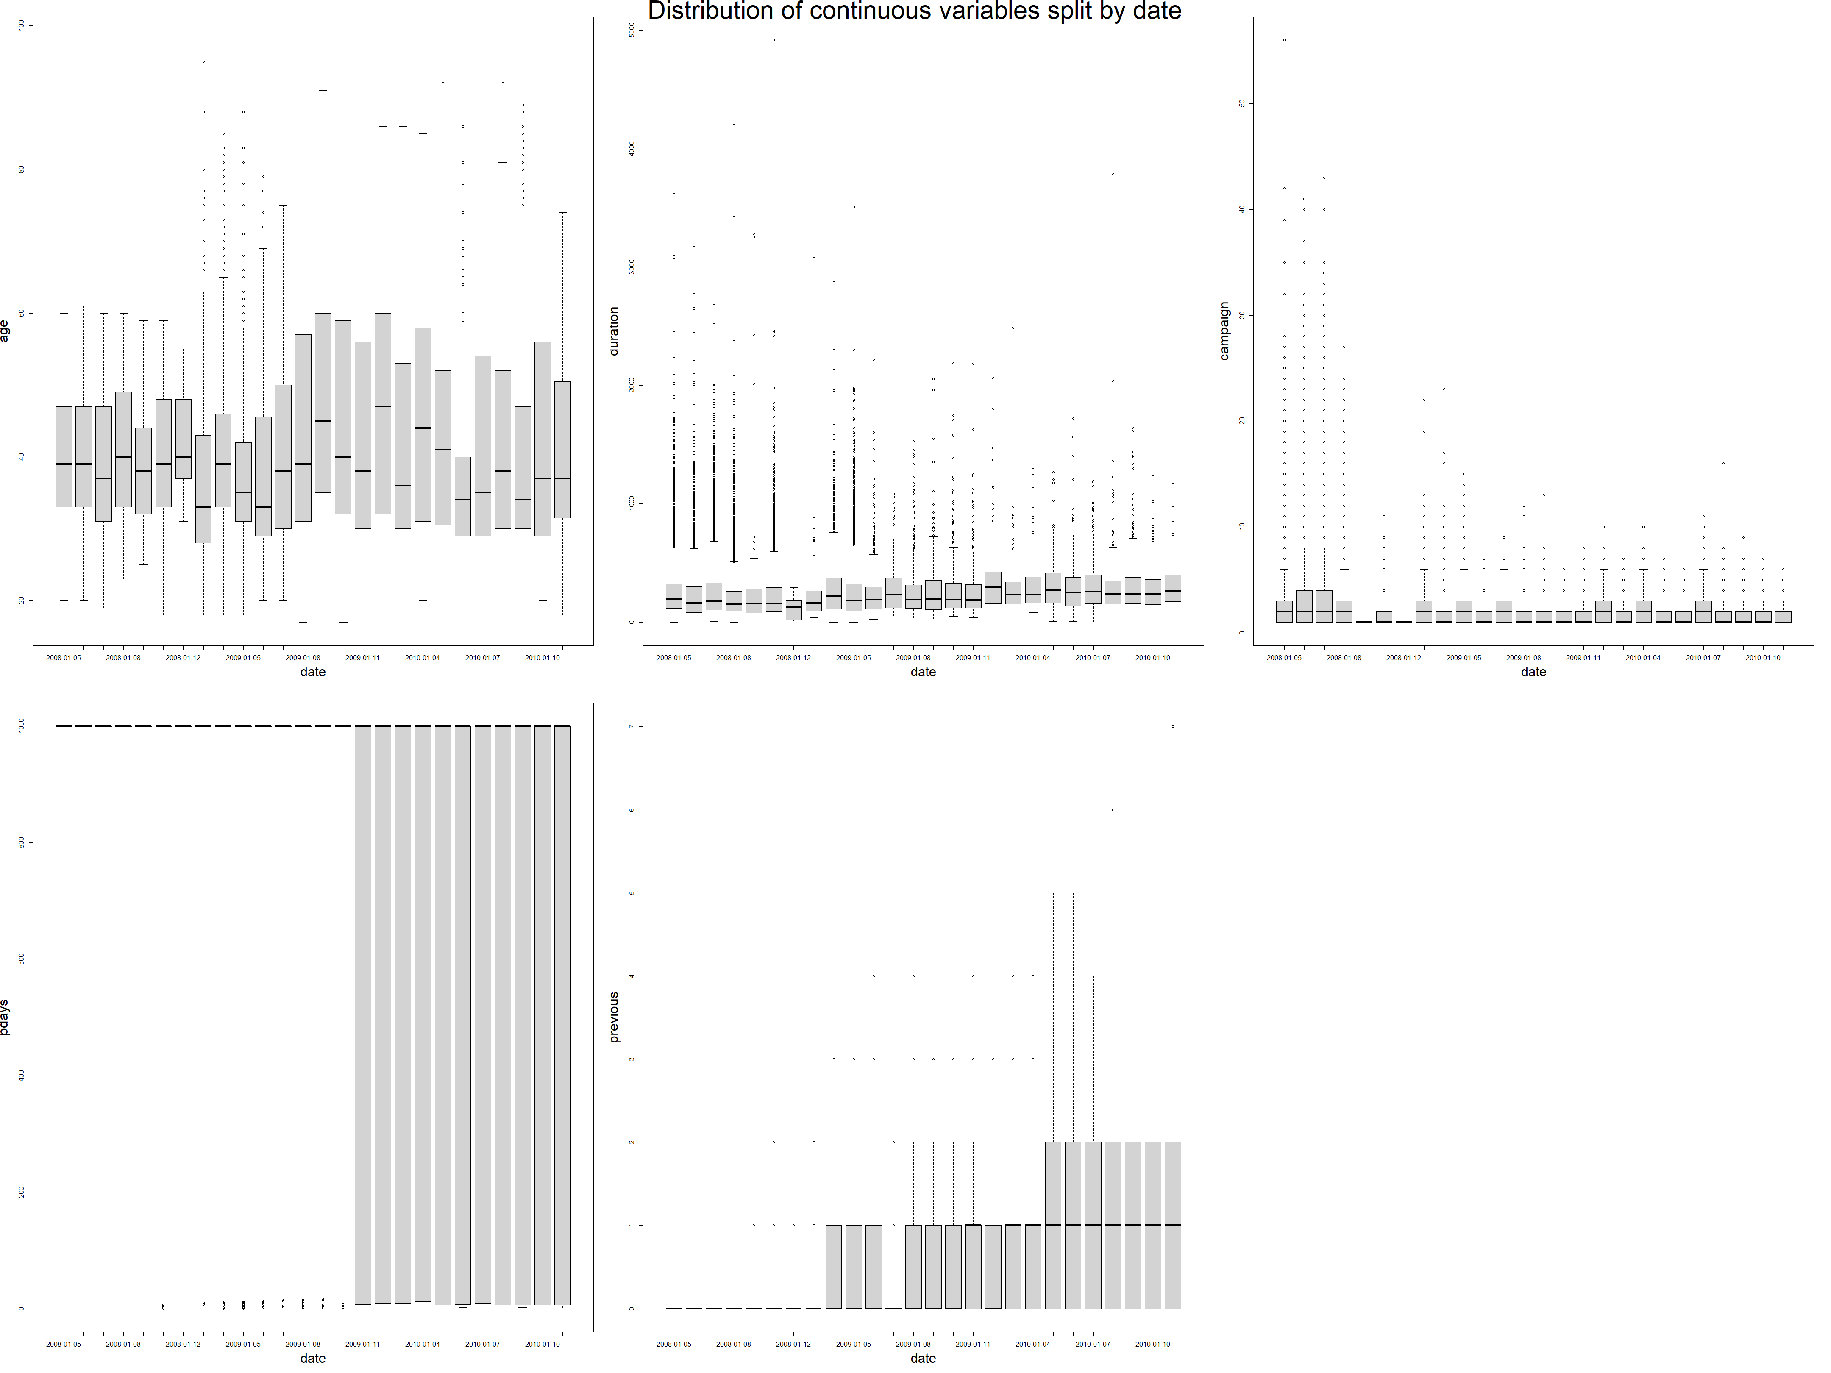
Distribution plots of continuous variables splitted by date

Slide 18
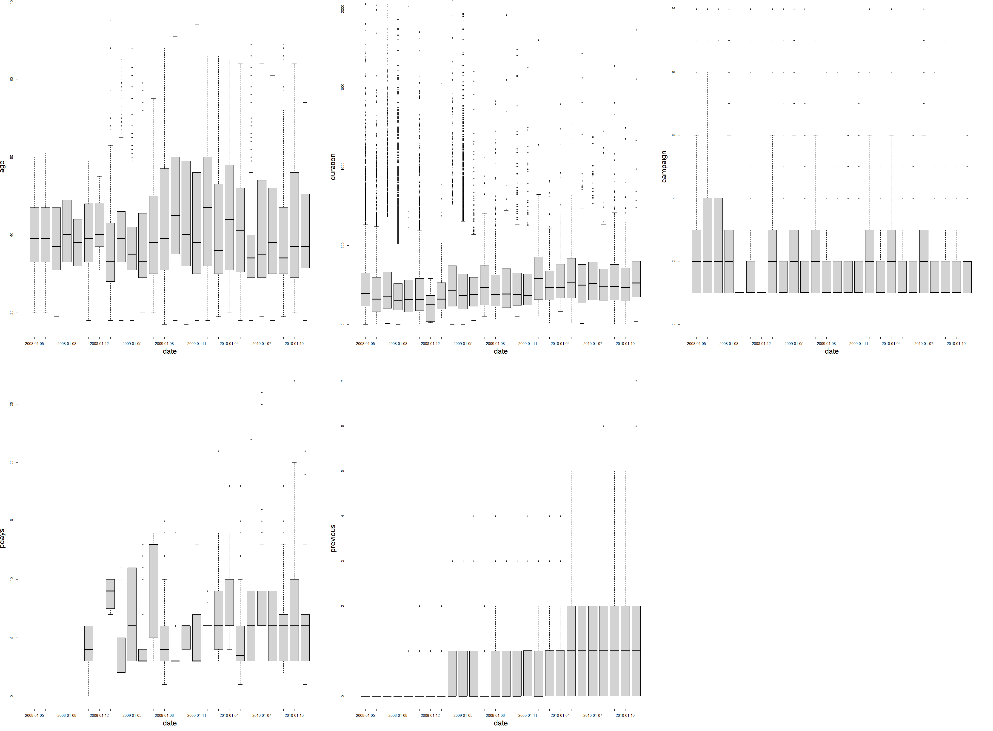
Distribution plots of continuous variables splitted by date (after eliminations of some outliers with extremely huge values)

Slide 19
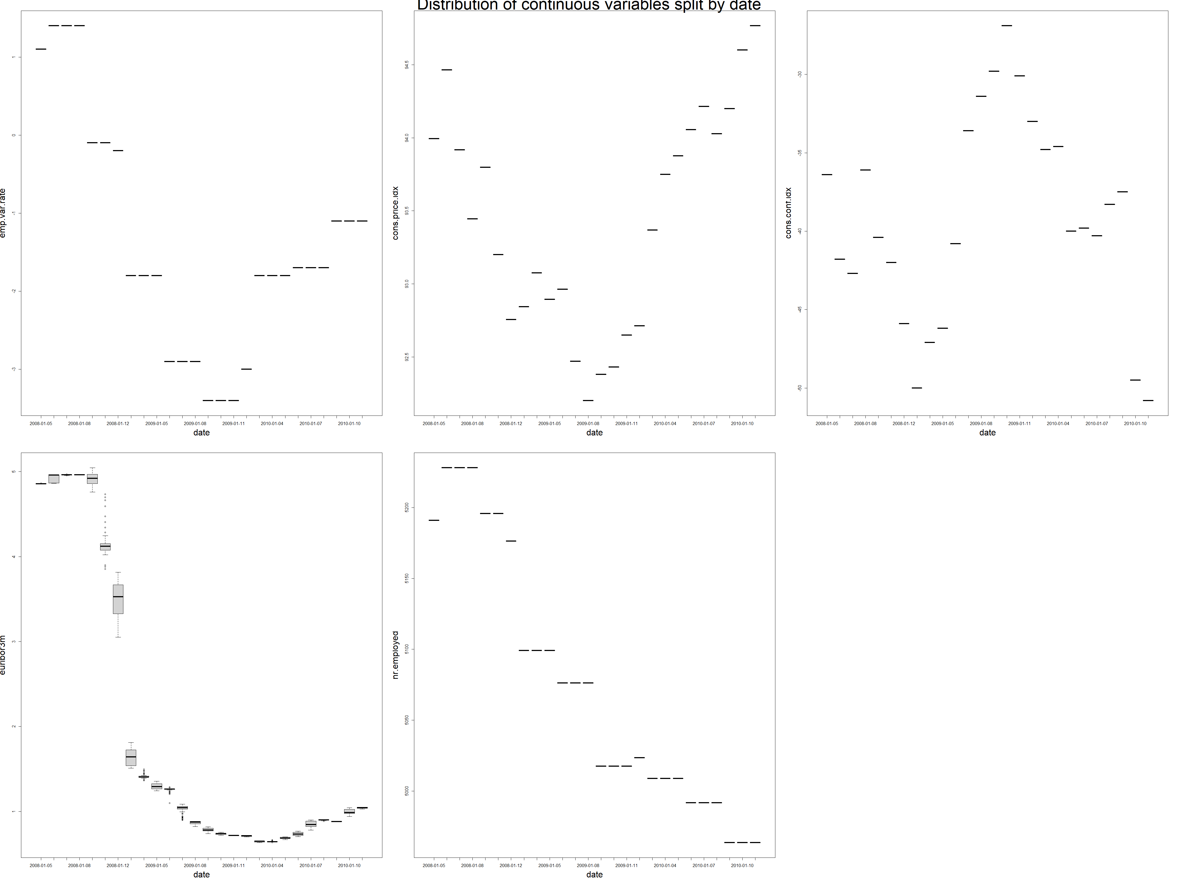
Distribution plots of continuous variables splitted by date (part 2)

Slide 20
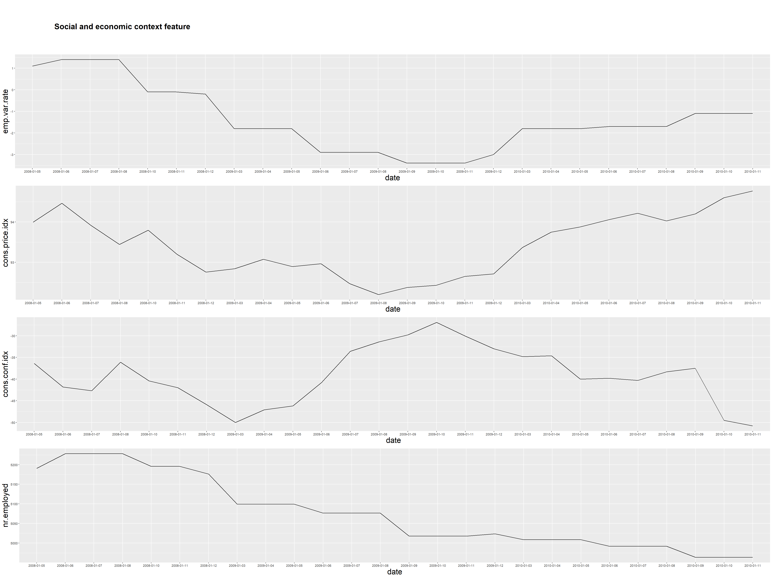
Other kind of distribution plots of continuous variables splitted by date (for some features that are constant during a month or three months)

Slide 21
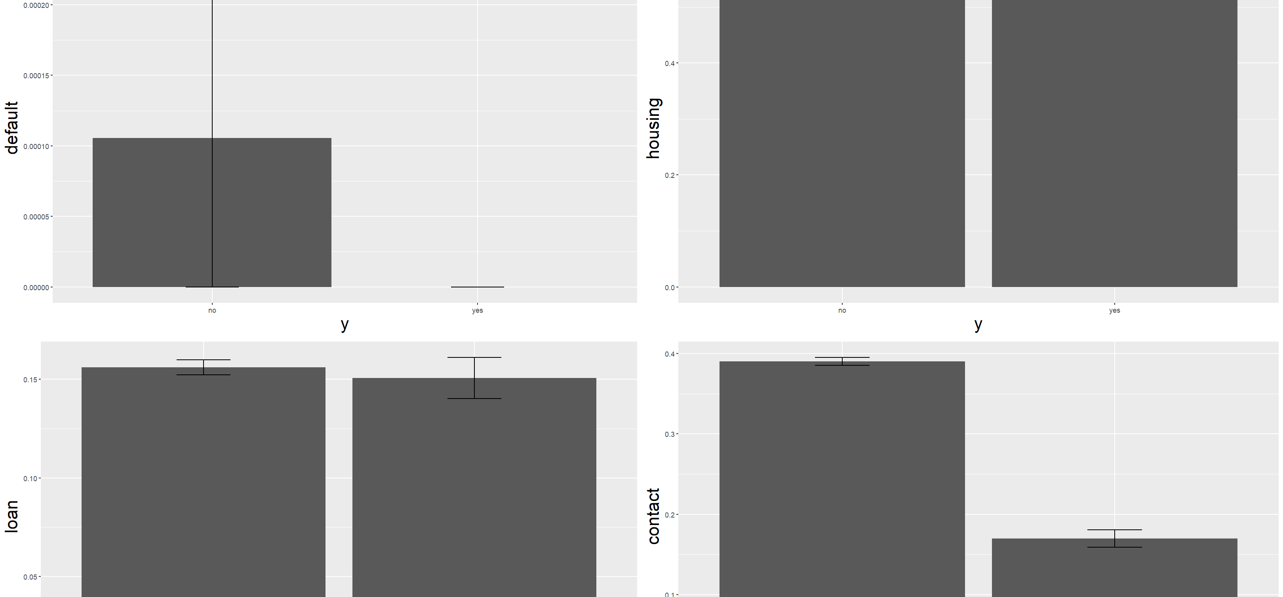
Distribution plots of binary variables splitted by target value

Slide 22
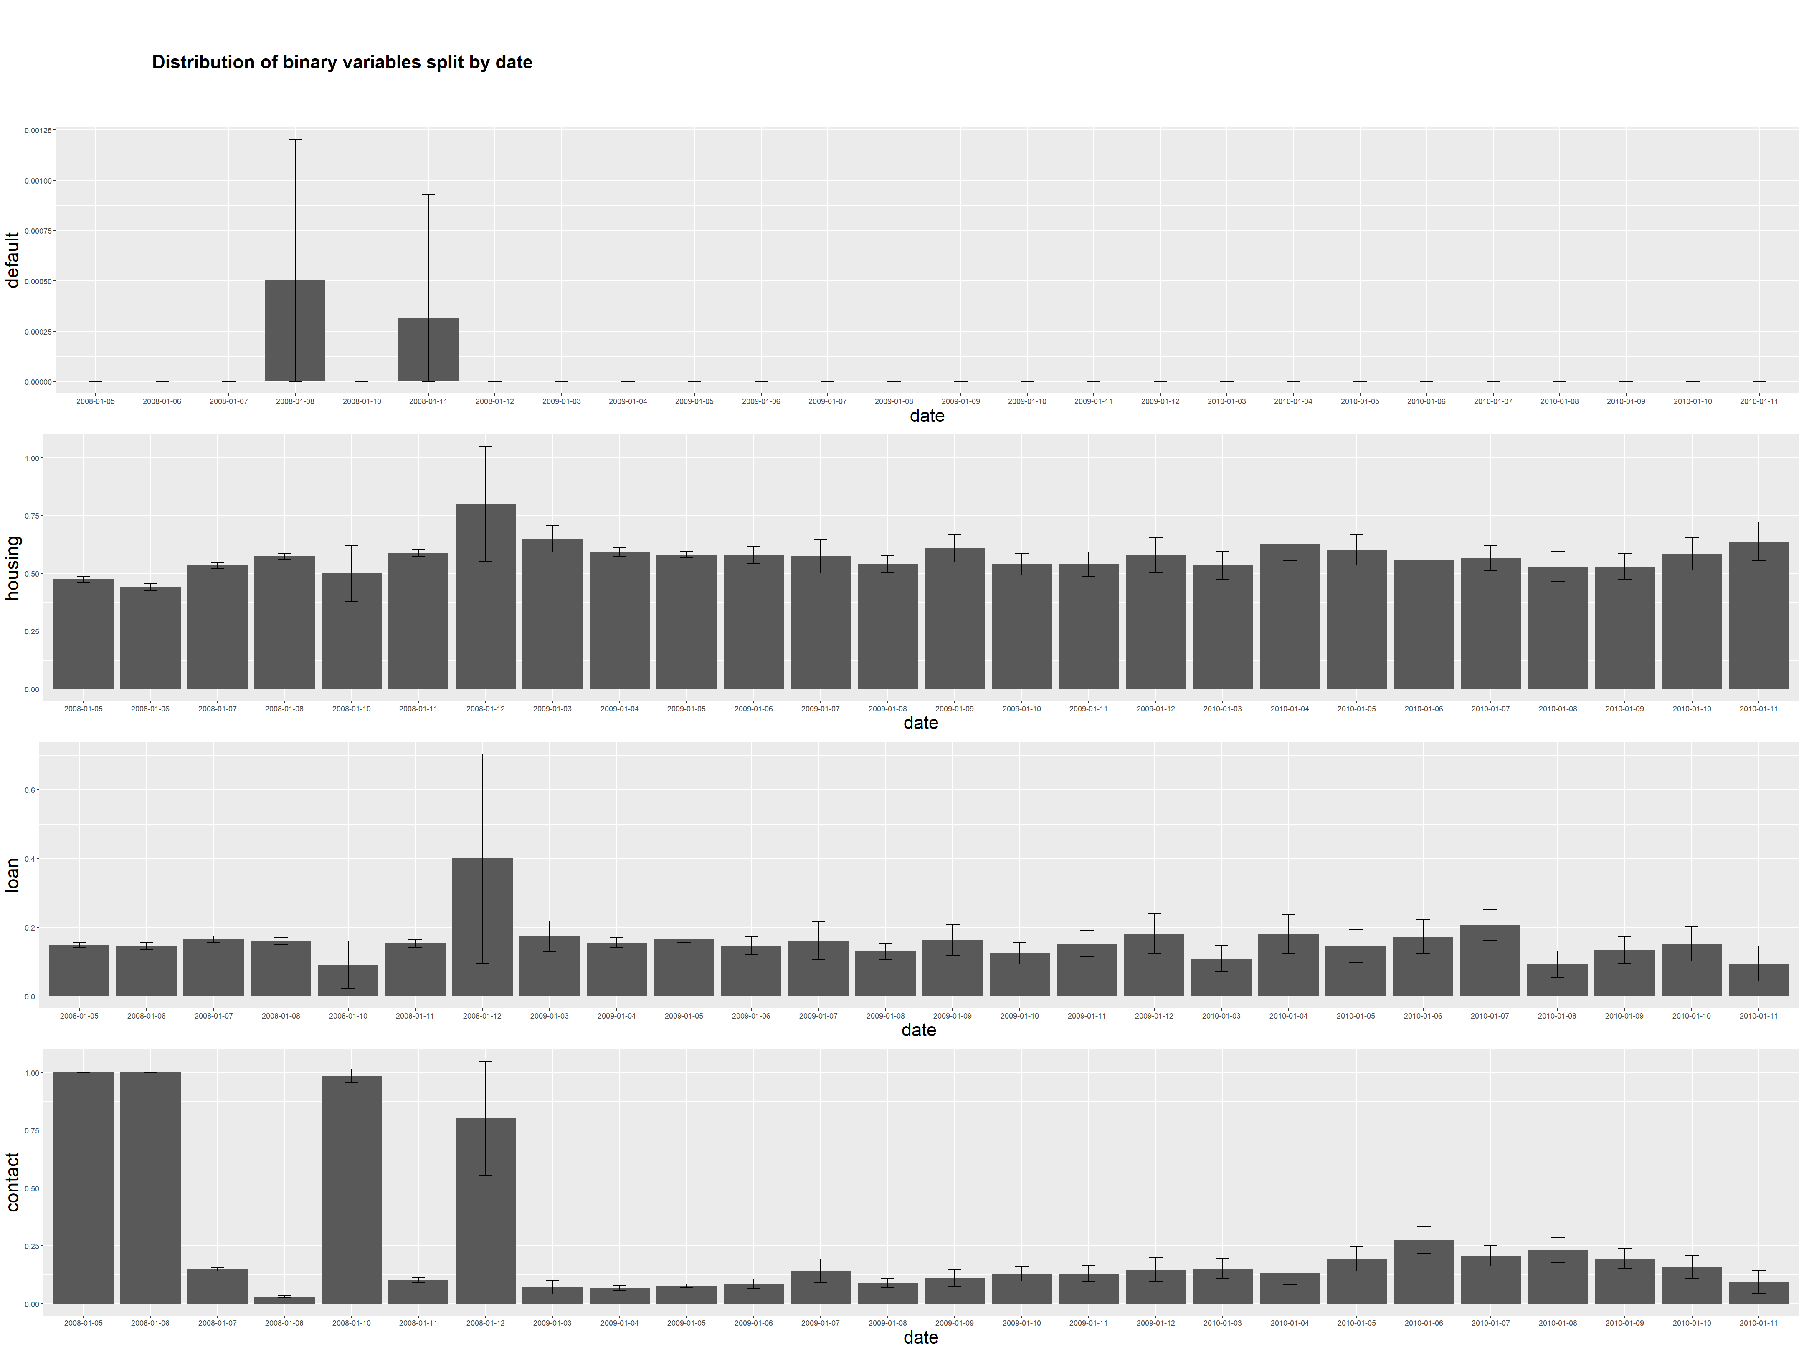
Distribution plots of binary variables splitted by date

Slide 23
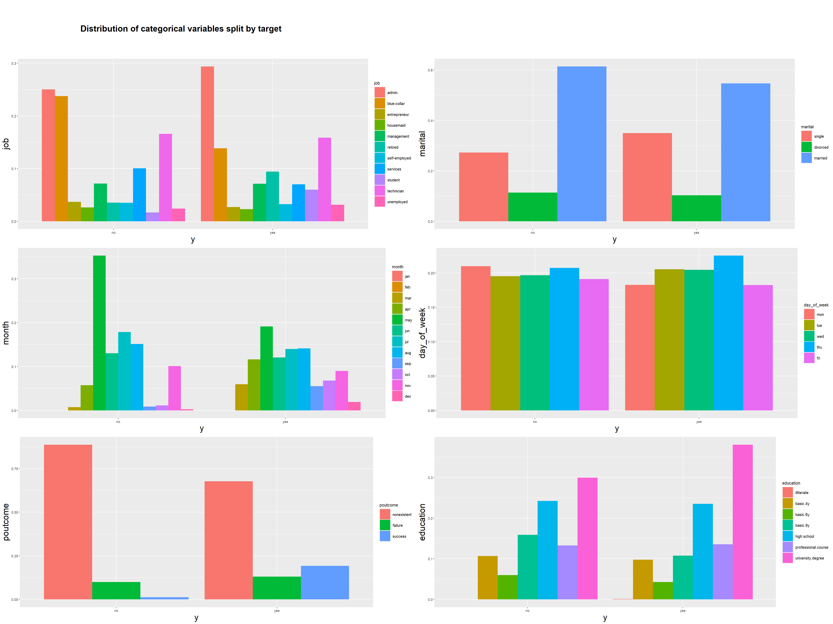
Distribution plots of categorical variables splitted by target value

Slide 24

Distribution plots of categorical variables splitted by date (we can consider only two periods: before and after changing policy)

Slide 25
General conclusions on data analysis
By looking at the plots, we can provide general conclusion:
After June 2009, the bank policy has changed. It started making less calls and the calls became more aimed on clients which had accepted previous propositions.
This solution could be made because of reducing inflation and interest rate (euribor3m). The bank probably expected demand for term deposit to become lower.
This is also the reason why the bank decreased number of employees involved in the campaign.

Slide 26
Building classification models
In our project we used several predictive models that was covered during this course:
Logistic regression
Ridge classifier
Lasso classifier
Linear discriminant analysis (LDA)
Quadratic discriminant analysis (QDA)
Naïve Bayes
K-NN

Slide 27
Initial features selection
Continuous features | Binary features | Ordinal features | Nominal features
age | default | education | job
duration | housing |  | marital
campaign | loan |  | month
pdays | contact |  | day of week
previous |  |  | poutcome
emp.var.rate
cons.conf.idx
euribor3m
nr.employed

Slide 28
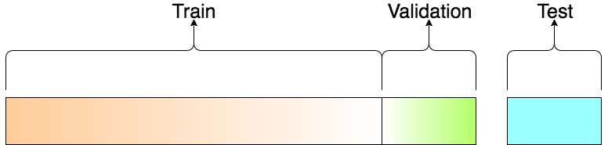
Validation strategy
We have split the data in the way that the most recent examples go to train set and the last ones go to test set. Validation set has been obtained by selecting the latest examples from training set.
The image has been taken from https://towardsdatascience.com/train-validation-and-test-sets-72cb40cba9e7

Slide 29
Final data preprocessing
For all the methods:
Filling missing values by mode
Removing outliers from train set
Additionally for Ridge classifier, Lasso classifier and K-NN:
One Hot Encoding for categorical variables
Min Max Scaling
 | Default | Campaign
Outliers removing strategy | Exclude clients who has credit in default | IQR method for outlier detection

Slide 30
Metric choice
As we work with unbalanced dataset, we are going to use area under the ROC Curve as an evaluation metric.
Also we are going to take a look at confusion matrices in order to understand what kind of errors models make.

Slide 31
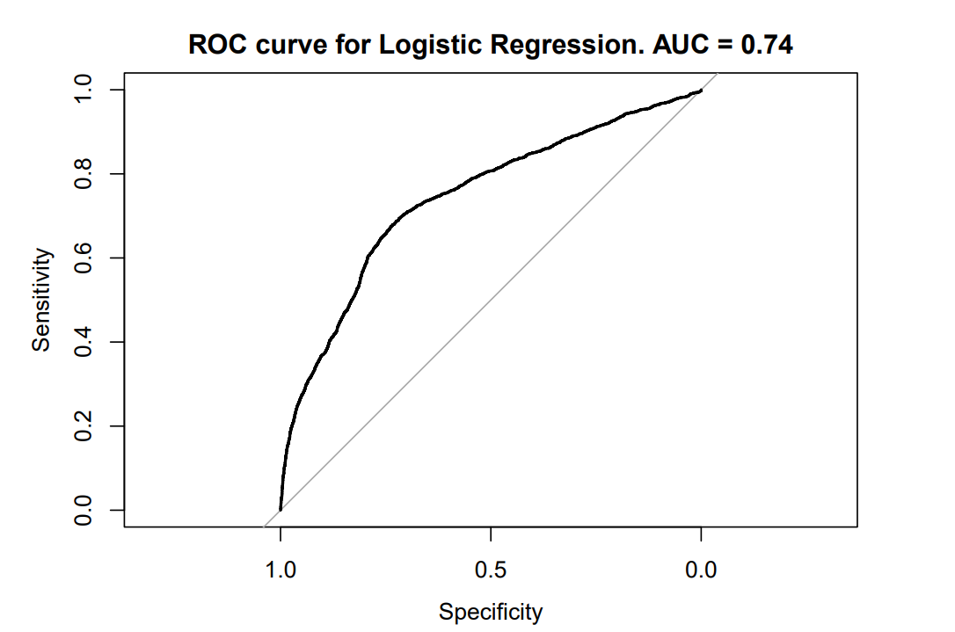
Logistic regression
 | Reference
Prediction | no | yes
no | 6277 | 1283
yes | 1362 | 1375

Slide 32
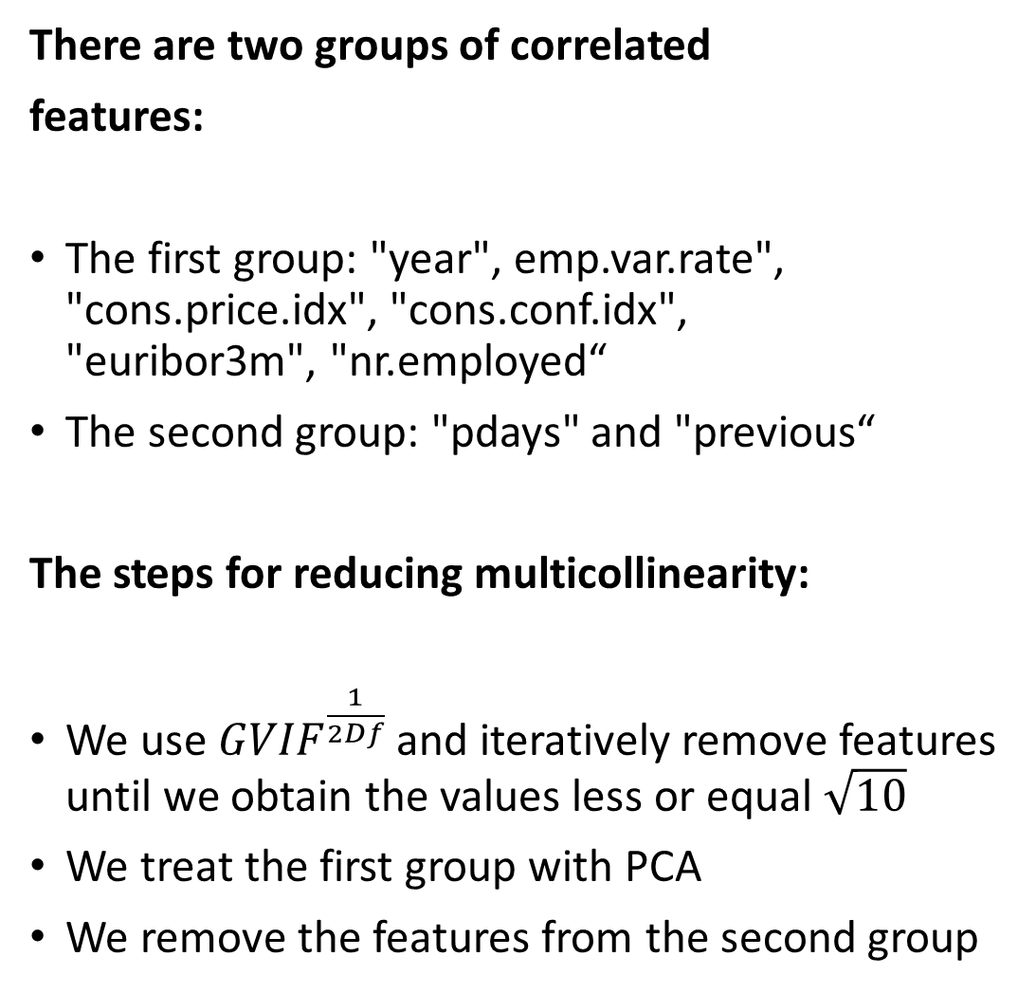
Reducing multicollinearity
There are two groups of correlated
features:
The first group: "year", emp.var.rate", "cons.price.idx", "cons.conf.idx", "euribor3m", "nr.employed“
The second group: "pdays" and "previous“
The steps for reducing multicollinearity:
We use ${GVIF}^{\frac{1}{2Df}}$ and iteratively remove features until we obtain the values less or equal $\sqrt{10}$
We treat the first group with PCA
We remove the features from the second group

Slide 33
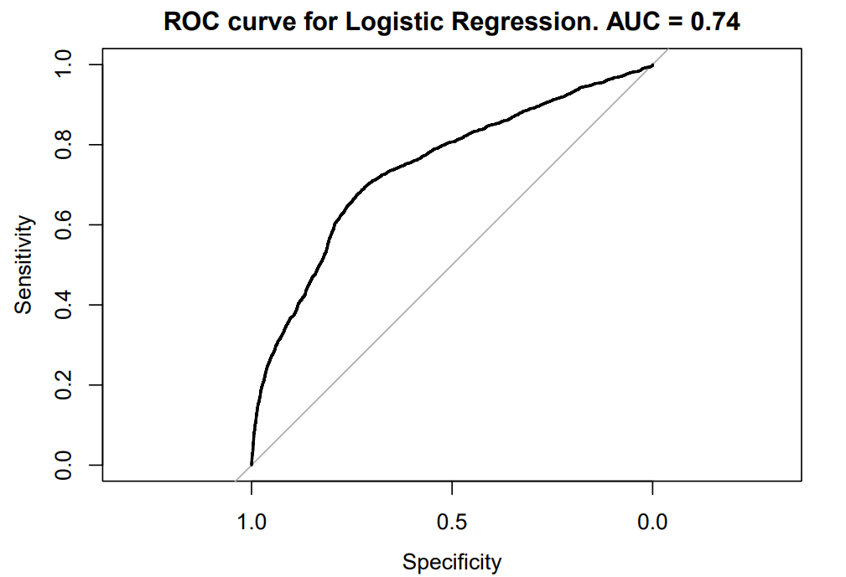
Logistic regression + PCA
 | Reference
Prediction | no | yes
no | 6289 | 1300
yes | 1350 | 1358

Slide 34
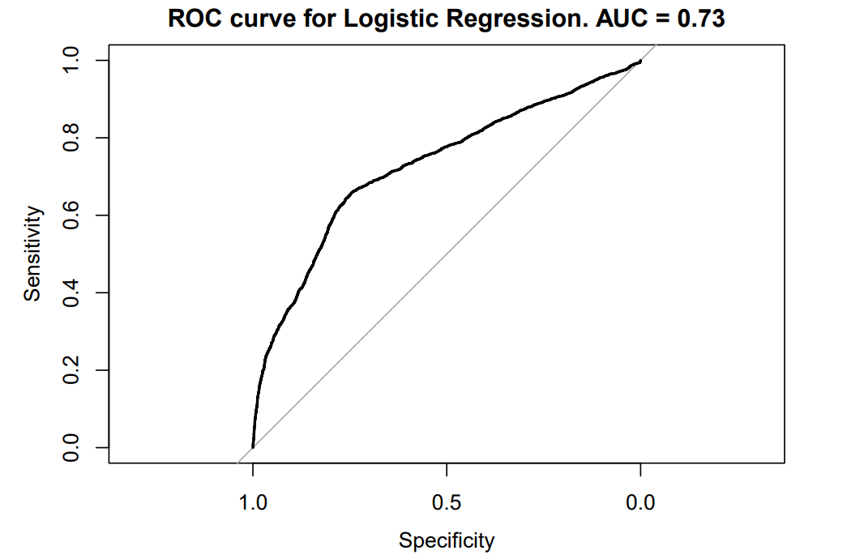
Logistic regression + PCA + oversampling
 | Reference
Prediction | no | yes
no | 510 | 89
yes | 7129 | 2569

Slide 35

Logistic regression + Backward and Forward stepwise selection
 | Reference
Prediction | no | yes
no | 6336 | 1340
yes | 1303 | 1318

Slide 36
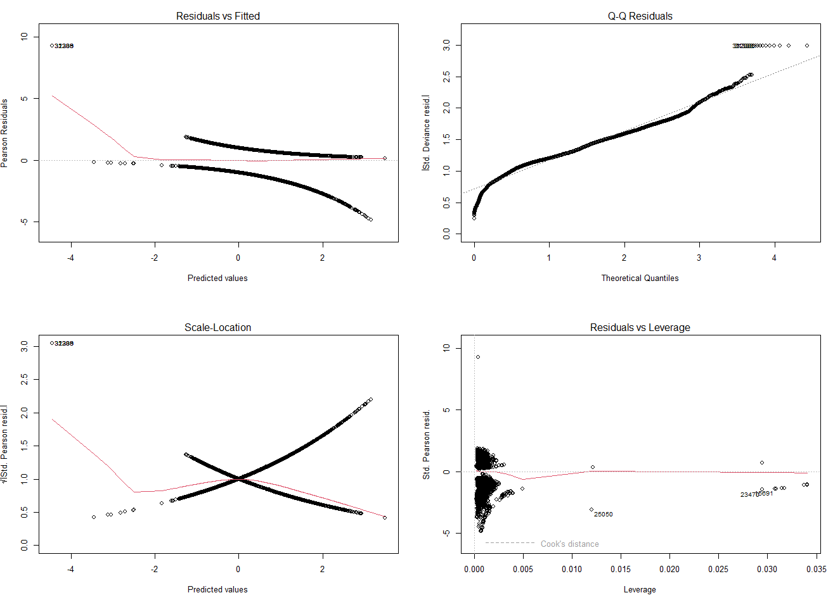
Residuals diagnostics

Slide 37
The most important features
The most important features according to logistic regression are:
Job (is the client retired or student)
Day of week
Poutcome
Cons.conf.idx

Slide 38
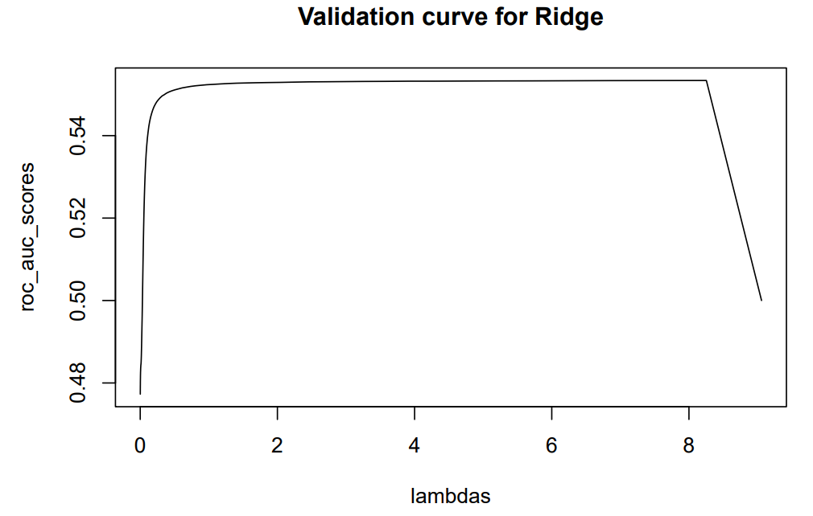
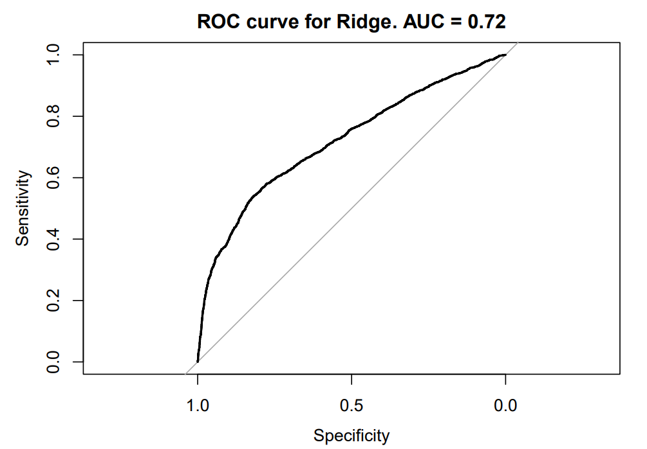
Ridge classifier
Without oversampling | Reference
Prediction | no | yes
no | 7639 | 2658
yes | 0 | 0
With oversampling | Reference
Prediction | no | yes
no | 0 | 0
yes | 7639 | 2658

Slide 39
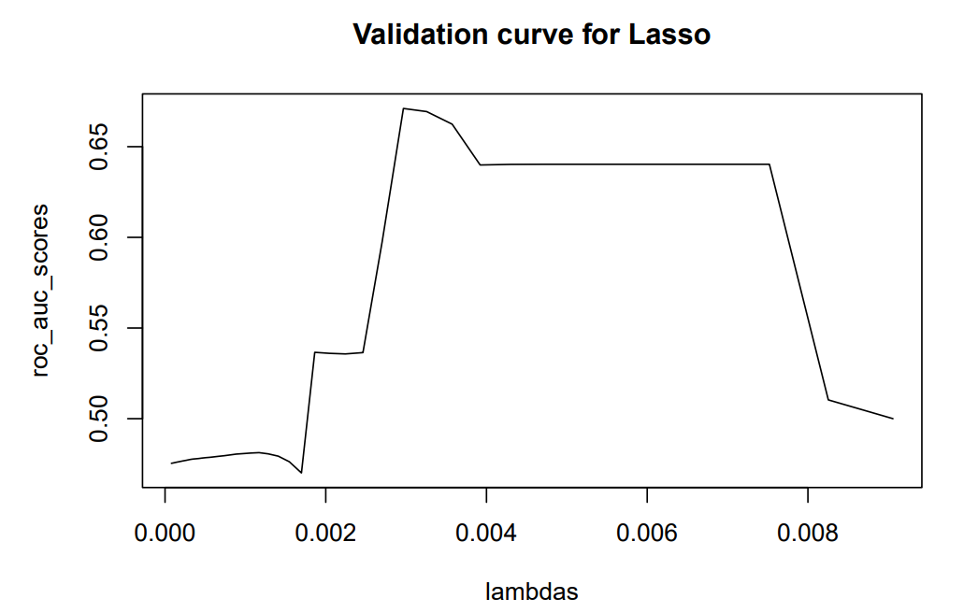
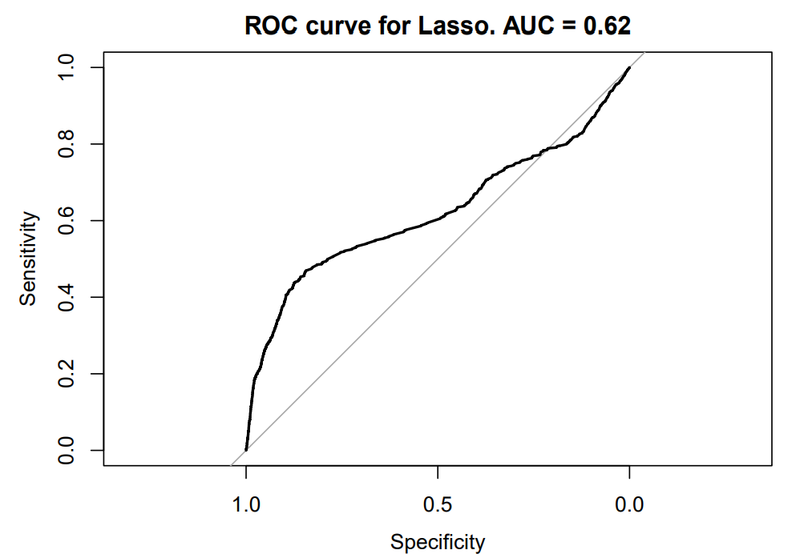
Lasso classifier
Without oversampling | Reference
Prediction | no | yes
no | 7523 | 2300
yes | 116 | 358
With oversampling | Reference
Prediction | no | yes
no | 152 | 68
yes | 7487 | 2590

Slide 40
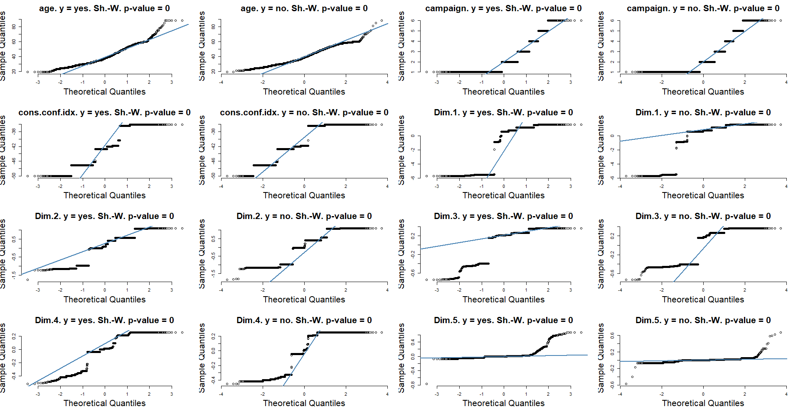
LDA + QDA : checking the assumptions

Slide 41
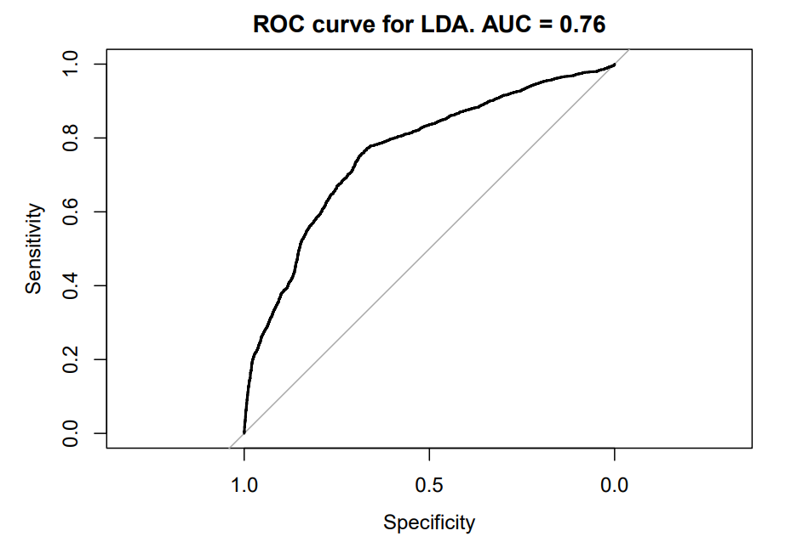
Linear discriminant analysis (LDA)
Without oversampling | Reference
Prediction | no | yes
no | 5787 | 916
yes | 1852 | 1742
With oversampling | Reference
Prediction | no | yes
no | 339 | 65
yes | 7300 | 2593

Slide 42
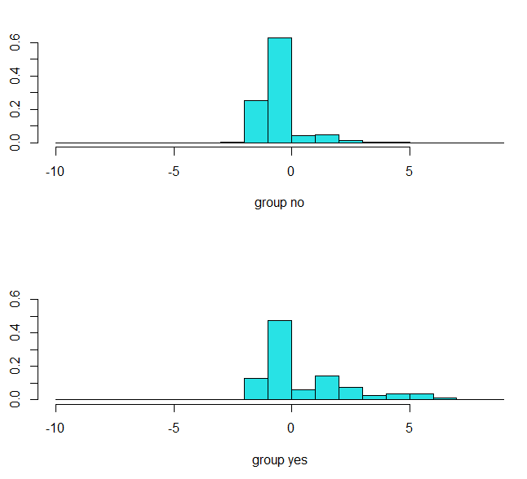
Distribution of discriminant function values

Slide 43
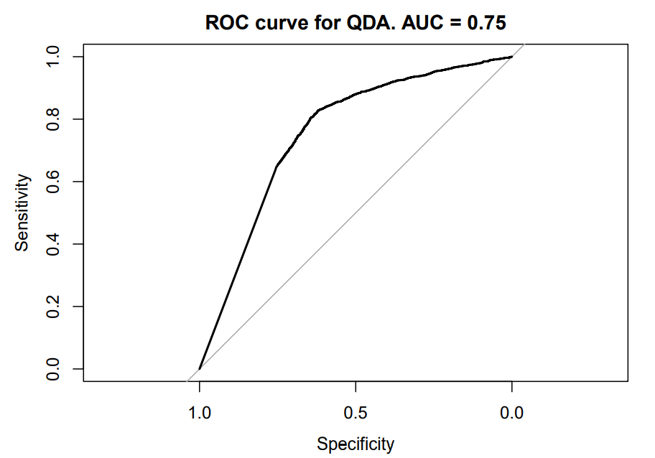
Quadratic discriminant analysis (QDA)
Without oversampling | Reference
Prediction | no | yes
no | 2143 | 158
yes | 5496 | 2500
With oversampling | Reference
Prediction | no | yes
no | 459 | 35
yes | 7180 | 2623

Slide 44
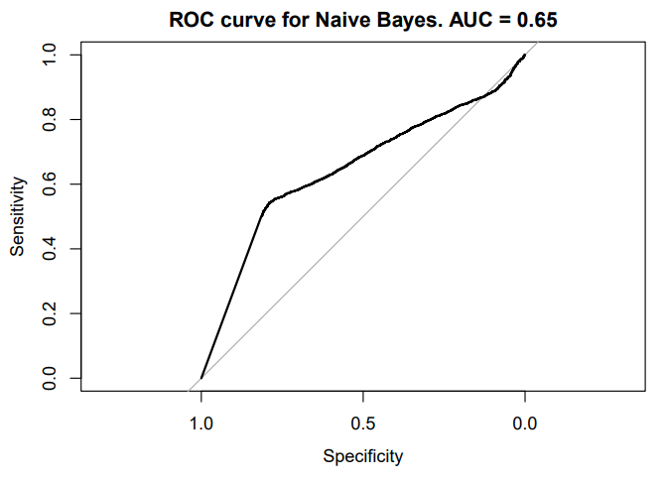
Naive Bayes
 | Reference
Prediction | no | yes
no | 52 | 27
yes | 7587 | 2631

Slide 45
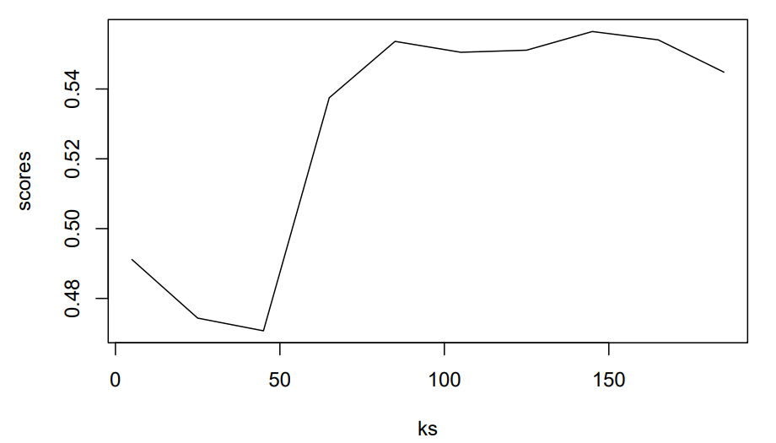
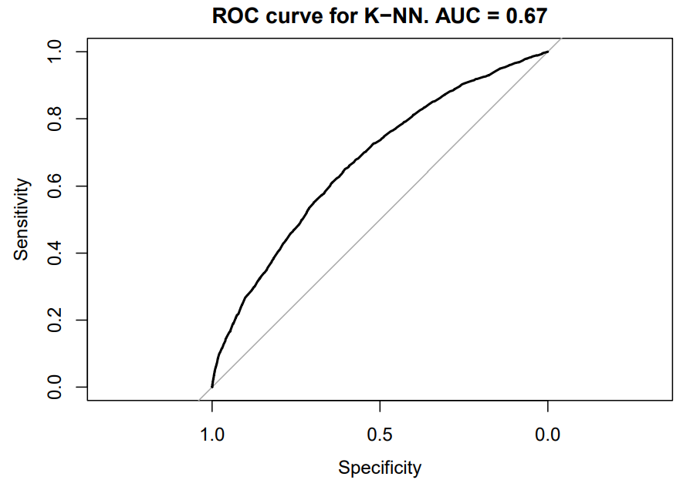
K-Nearest Neighbors (K-NN)
Without oversampling | Reference
Prediction | no | yes
no | 0 | 0
yes | 7639 | 2658
With oversampling | Reference
Prediction | no | yes
no | 15 | 3
yes | 7624 | 2655

Slide 46
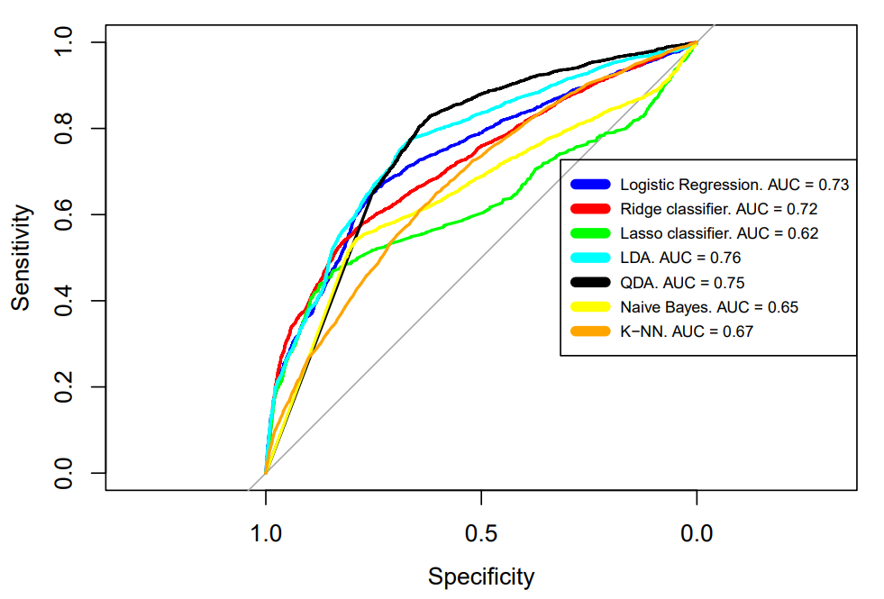
Model comparison

Slide 47
Conclusions
While working on the project, we performed
following main steps and achieved following results:
We’ve analyzed the data, revealed certain patterns, understood the way campaign was going and made assumptions about casual interaction between features.
According to business task, the proper metric and validation strategy has been chosen
During the modeling part, seven different classification models have been tested. As result, we obtained two models with suitable quality for this kind of tasks. Obviously, those models could be used in production phase for improving the bank’s business processes.

