Slide 1
Data Science: Whitworth Group 2
Ethan Loghry, Nathanael Van Liew, Liam Hunt

Slide 2


Project Overview
Notes:
Our group decided to focus on the impacts of education at Whitworth as a decision to enroll. The data we received had a series of prompts, of which, we decided upon ten to represent what we considered “educational”.

Slide 3
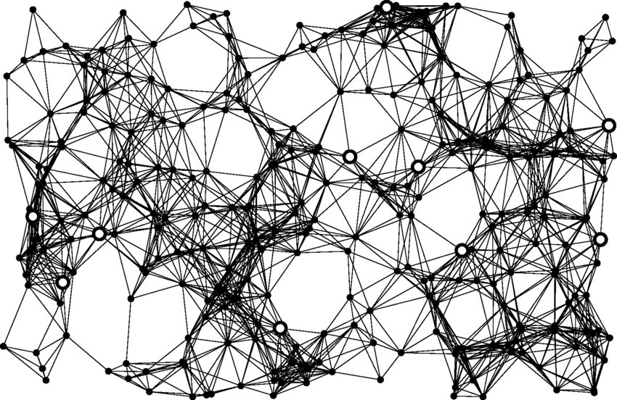
Models Used & Problems Faced
Principal Component Analysis
Linear Regression
Neural Networking
Bayesian Network
Notes:
We tried to apply the data to a Bayesian Analysis but the data did not have a lot of examples of each major to train on so we resulted in trying other models.

Slide 4
2018
Model | Neural Network | PCA | Linear Regression
Accuracy | 0.5926 | 0.5556 | 0.6341
Error Rate | 0.4074 | 0.4444 | 0.3659
Sensitivity
Precision
Specificity
MCC

Slide 6
2021

Slide 7
2024

Slide 8
Comparison

