Slide 1
CropAI
Crop Health Prediction + Website Demo
Machine Learning for Smart Agriculture

Slide 2
Objective
Predict Crop Health
Real-time Analysis
→ Classify wheat crops as healthy or unhealthy
→ Instant predictions using environmental data
Practical Solution
Data-Driven
→ Accessible tool for farmers using a web-based interface
→ Decisions powered by agricultural data

Slide 3
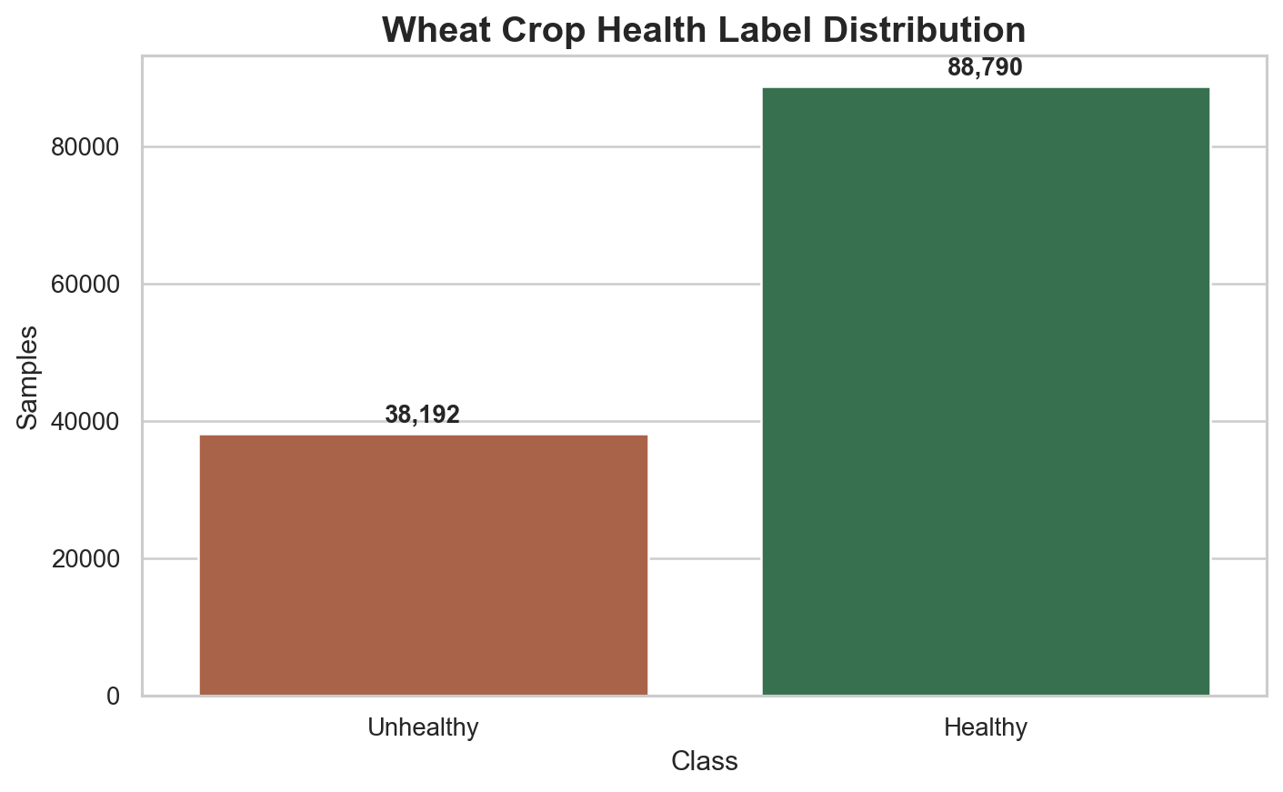
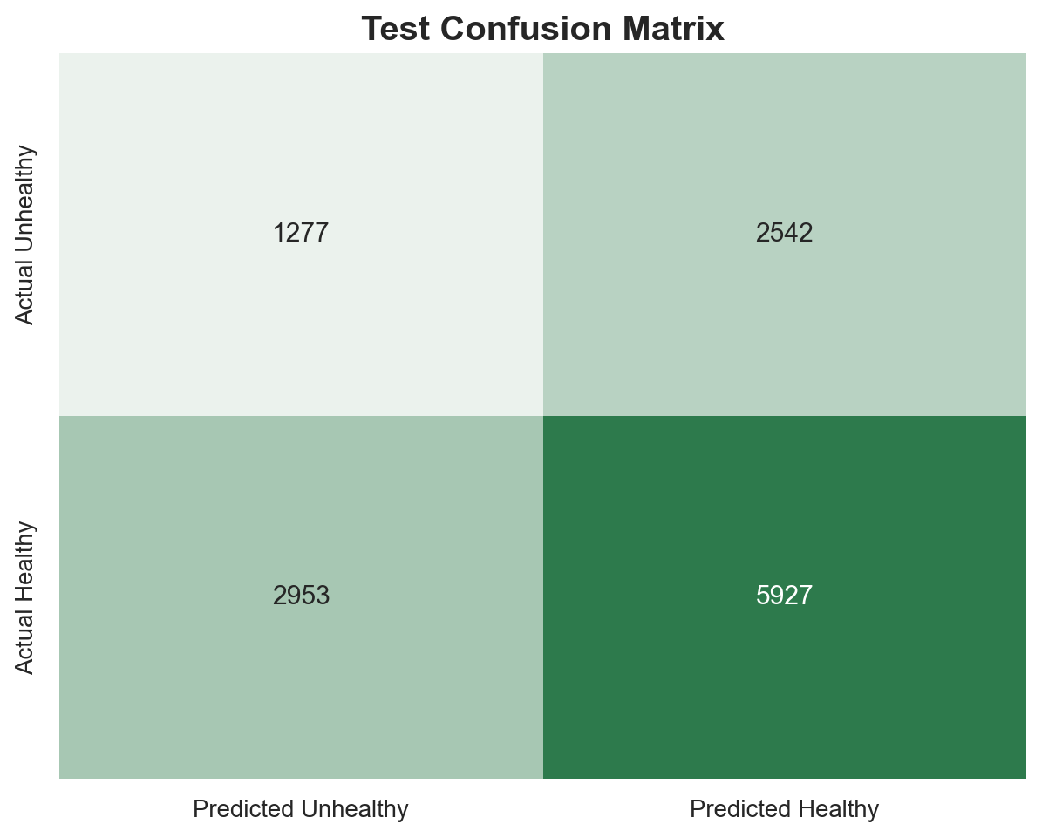
Dataset & Data Preprocessing
Data Source
Kaggle Crop Health Dataset
Diverse crop samples with labels
Filtered to wheat crops only
Balanced healthy/unhealthy data
Preprocessing
Remove invalid/missing values
Standardized numeric features
Split into train/validation/test sets

Slide 4
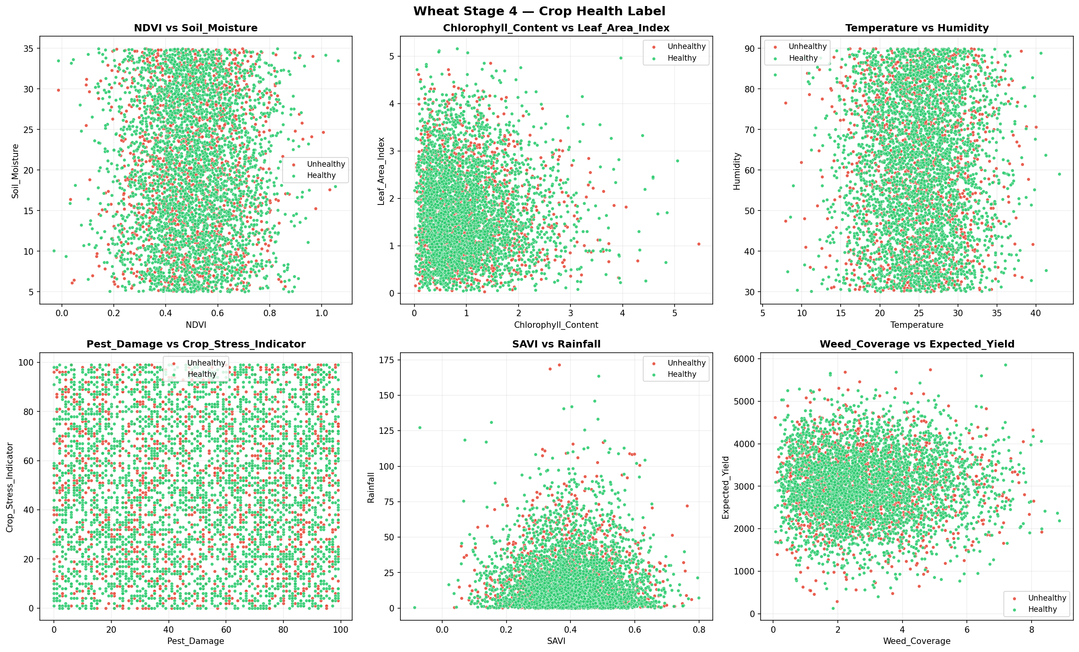
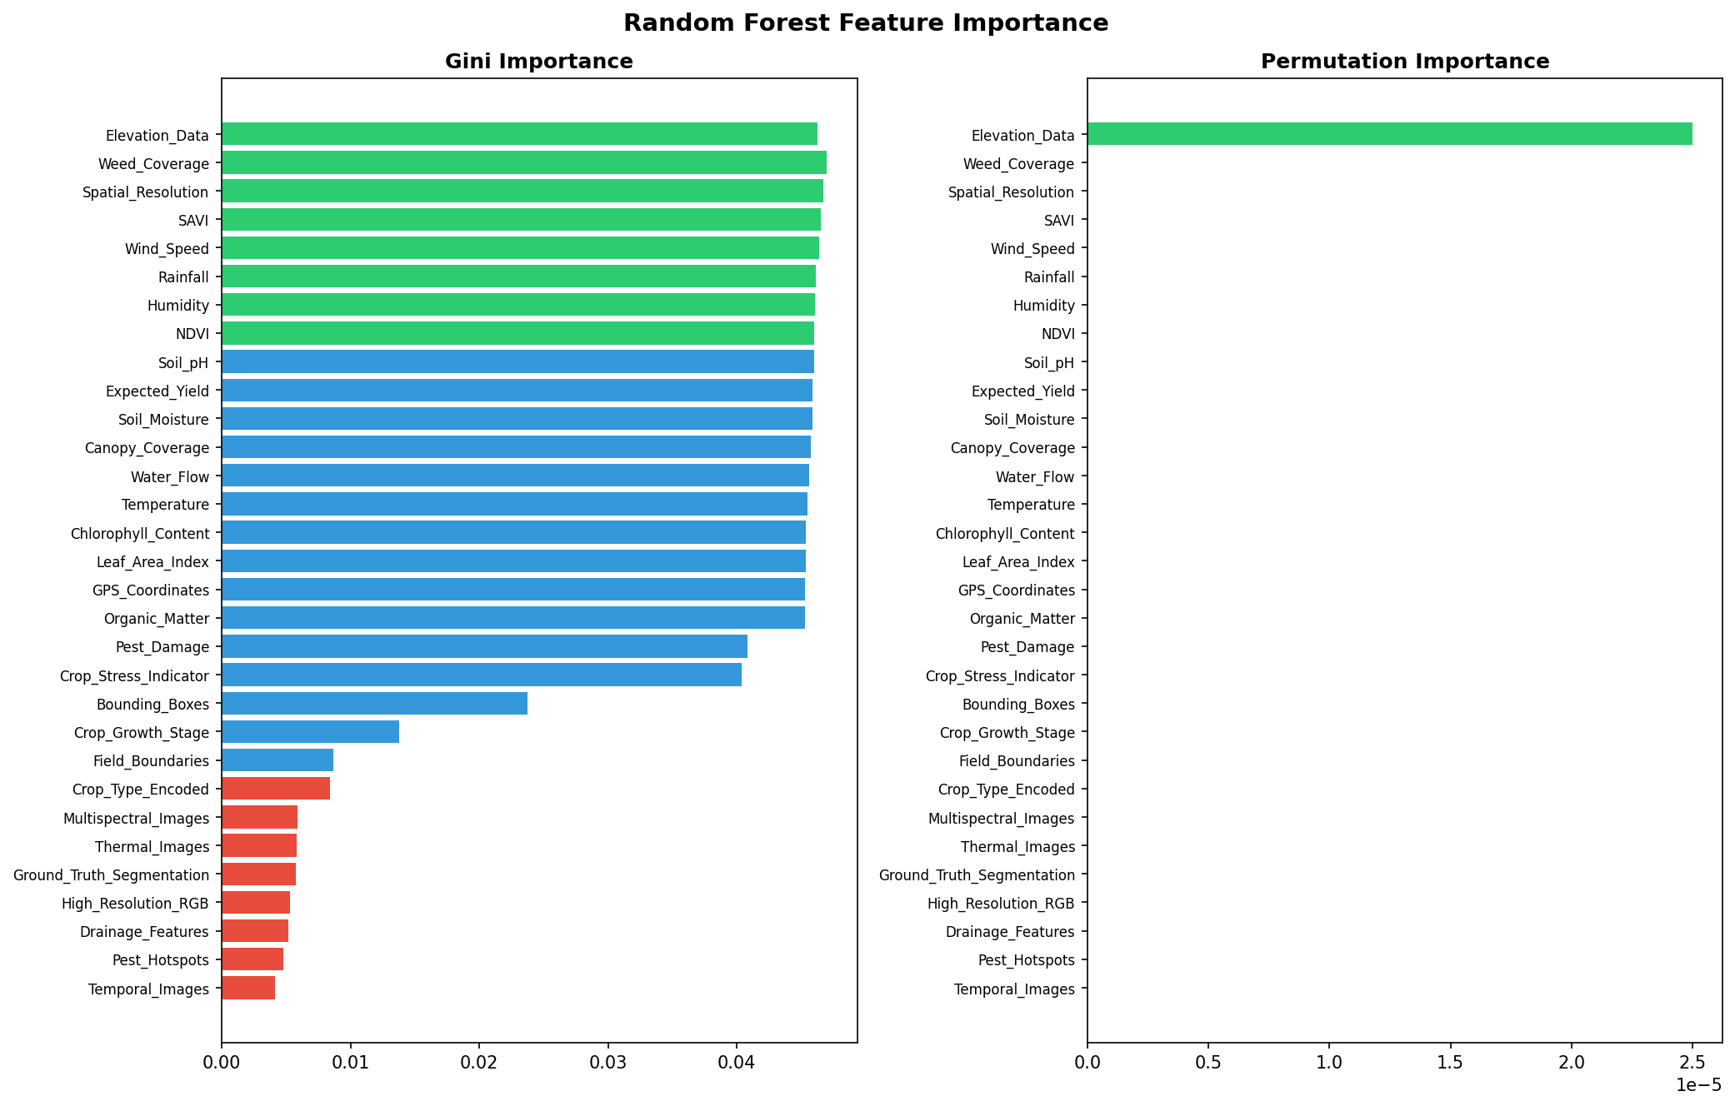
The graphs show how healthy and unhealthy wheat samples are distributed across different feature pairs in the dataset. It helps us visually explore relationships between important variables.
The right graph shows the feature importance from the Random Forest model. It explains which input variables had the biggest influence on the prediction.

Slide 5
Key Features Analyzed
Soil Conditions
Weather
Vegetation
Moisture
pH
Organic matter
Temperature
Humidity
Windspeed
NDVI*
SAVI*
Chlorophyll content
NDVI gives a general signal of vegetation health
SAVI gives a similar signal but with better correction for soil influence
Crop Conditions
Field Factors
Crop Stress Indicator
Pest damage
Weed coverage
Elevation factor
Water flow

Slide 6
Training Model
Model Performance Metrics
Model Used
Accuracy shows how often the model is correct.
Precision shows how reliable positive predictions are.
Recall shows how many true cases the model detects.
F1-score gives a balance between precision and recall.
CropAI currently uses a Random Forest classifier
It predicts Healthy or Unhealthy wheat crops
The model learns from 17 agricultural input features
A scaler is applied before prediction to keep inputs consistent
69.92%
69.92%
Accuracy
Precision
100%
82.30%
Recall
F1-Score

Slide 7
System Architecture
📝
⚙️
🤖
📊
User Input
Preprocessing
Model Prediction
Result Dashboard
Website Application
Frontend
Backend
Flask manages requests
Input data is preprocessed
Model and scaler return prediction
User-friendly form for entering crop data
Displays prediction, confidence, and charts
Provides a simple and interactive interface

Slide 8
Challenges & Limitations
Data Quality
Temporal parameter
Missing values and invalid rows required cleanup
Healthy labels outnumber unhealthy labels
The dataset does not include temporal parameters such as changes over time, seasonal trends, or time-series crop monitoring.
The model makes predictions from a single snapshot of crop conditions
Computational
Scalability needs
Scaling to more crops will need more experimentation

Slide 9

Future Improvements
Use a better dataset for the training model
Expand the system to support other crop types
Deploy the website online for easier access
Integrate real-time sensor or weather data

Slide 10
Time for the demo!

