Slide 1
kanan
your trusted right hand
A booking system built for Malaysian dental clinics
by Kanan Digital Enterprise
kanan.my · hello@kanan.my · WhatsApp +60 12-347 8126

Slide 2
Short-staffed and stretched thin?
Most days end the same way at a small dental clinic.
● 50+ WhatsApp messages a day — just to confirm and remind appointments
● A no-show wastes a 1-hour slot, and the patient never paid a deposit
● The owner has no idea who's busy and who's coasting
● Patient records: half in a notebook, half in a Sheet, half in someone's head
● When anyone takes leave, the schedule unravels for a week
Kanan Digital Enterprise · kanan.my
2 / 22
Notes:
Let them nod. Don't oversell. Ask: 'Which of these sounds like your Tuesday?'

Slide 3
We've been there. So we built the right hand.
Kanan ("KAH-nahn") means right in Malay — as in right hand. The dependable hand on the right side of your business.
[photo]
[photo]
[Founder name 1]
[Founder name 2]
Co-founder · [role]
Co-founder · [role]
A Malaysian software studio. We build for the businesses around us — not for venture capital.
Kanan Digital Enterprise · kanan.my
3 / 22

Slide 4
One product. The whole booking lifecycle.
📱
💬
📊
Patient self-books
Nurse runs the day
Owner sees everything
via your /book page. EN · 中文 · BM.
Pending queue, WhatsApp, reminders, recall.
Bookings, performance, audit log.
All three views, one shared database. No double entry, no copy-paste between systems.
Kanan Digital Enterprise · kanan.my
4 / 22

Slide 5
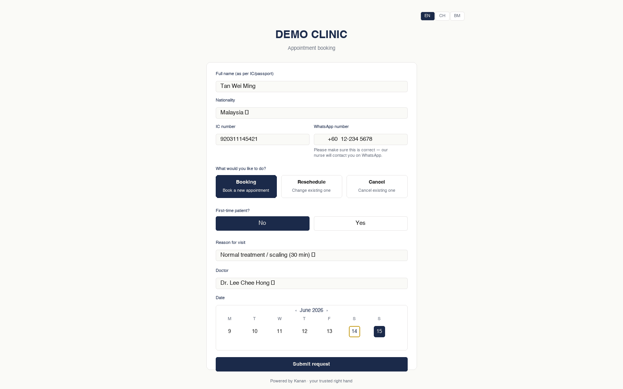
Patient self-books, no phone tag.
Identity first, then they pick book / reschedule / cancel.
● Mobile-first form. 4 taps to a request.
● Language toggle: EN · 中文 · BM (name input stays Romanized for IC)
● 5-week future window. Real-time slot availability — no fake slots.
● Submissions land in your nurse's queue, never directly on the calendar
● Branded with your clinic's logo + colours, not Kanan's
Kanan Digital Enterprise · kanan.my
5 / 22

Slide 6
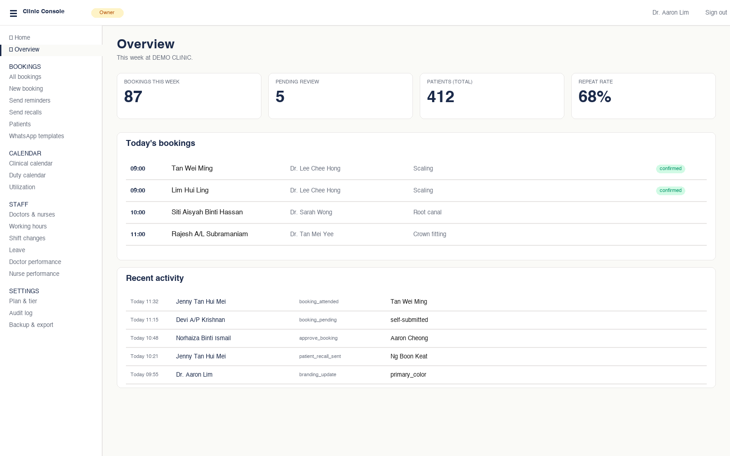
Owner dashboard — a clinic you can actually see.
This week + today's bookings + recent activity, one screen.
Kanan Digital Enterprise · kanan.my
6 / 22

Slide 7
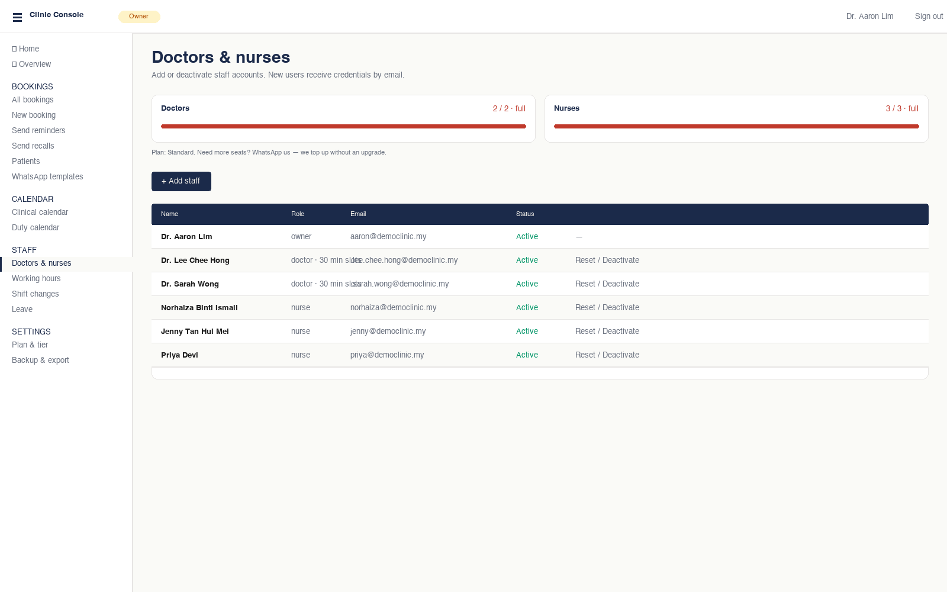
Staff management with hard seat caps.
Your plan defines what you can grow to. Top-up out-of-band when you need more.
● Live seat meters show capacity at a glance
● Server-side enforcement — adding a 3rd doctor on Standard fails with a clear message
● Deactivated staff don't consume seats — leave handling is free
● Top-up via WhatsApp: 'Add 2 more nurses' — no forced tier upgrade
Kanan Digital Enterprise · kanan.my
7 / 22

Slide 8
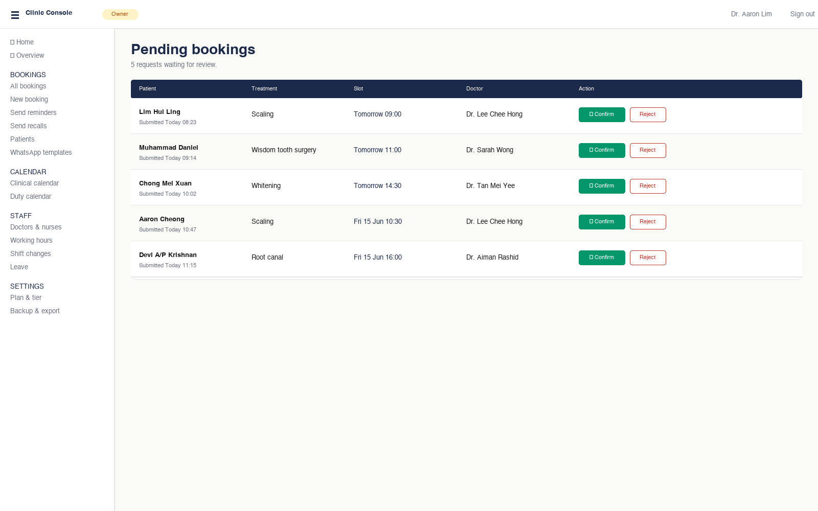
Pending queue — one click to confirm.
Patient requests land here for nurse review. Never directly on the calendar.
Kanan Digital Enterprise · kanan.my
8 / 22

Slide 9
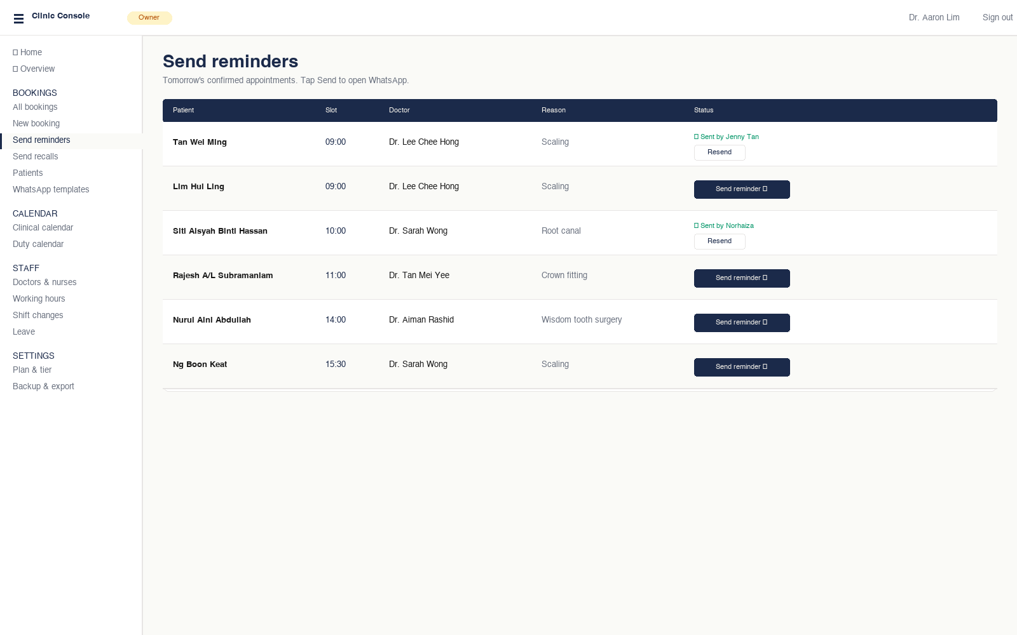
Tomorrow's reminders, pre-written.
Click 'Send' — WhatsApp opens with the message + slot already in it.
Kanan Digital Enterprise · kanan.my
9 / 22
Notes:
Highlight: nurse audit trail visible — owner can verify who sent what.

Slide 10
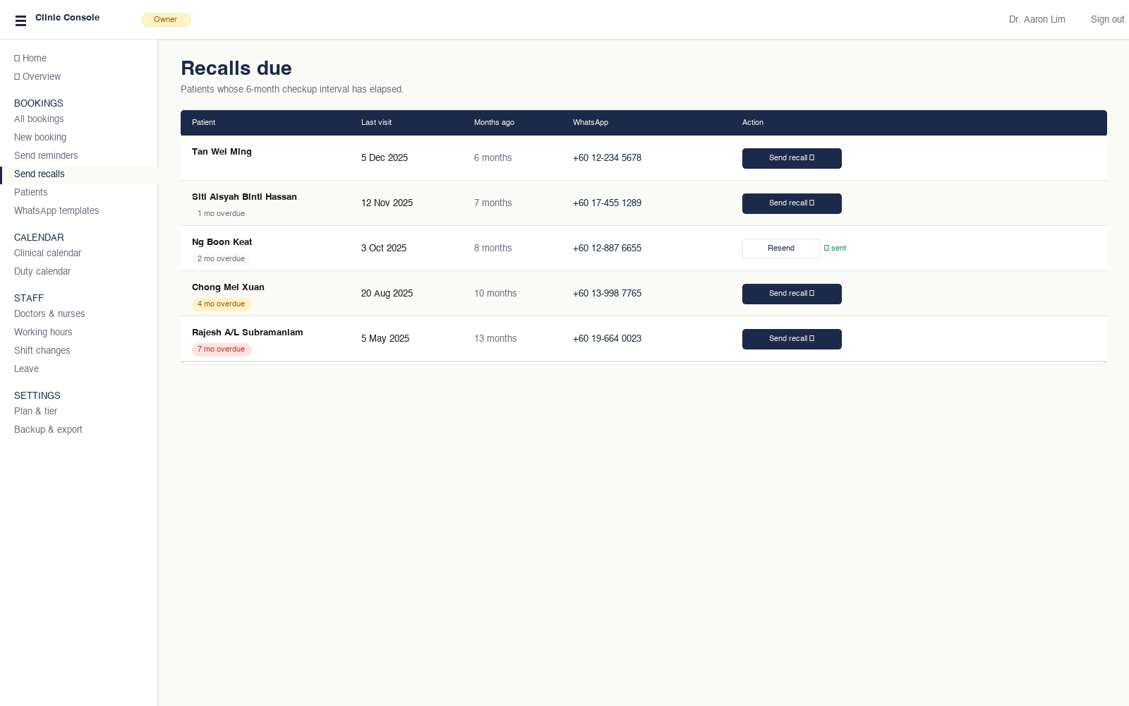
6-month recall — automatically surfaced.
Every patient overdue for a checkup appears here, sorted by how overdue.
Kanan Digital Enterprise · kanan.my
10 / 22
Notes:
Recall is the most reliable revenue lever in dentistry. Until now, it was a nurse's memory + a sticky note.

Slide 11
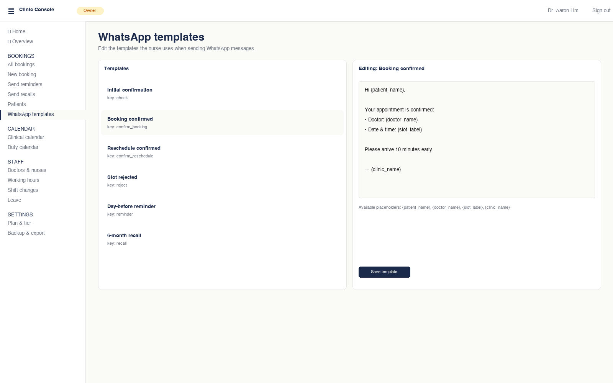
WhatsApp templates — owner-editable.
6 templates: check, confirm, reject, cancel, reminder, recall.
Kanan Digital Enterprise · kanan.my
11 / 22

Slide 12
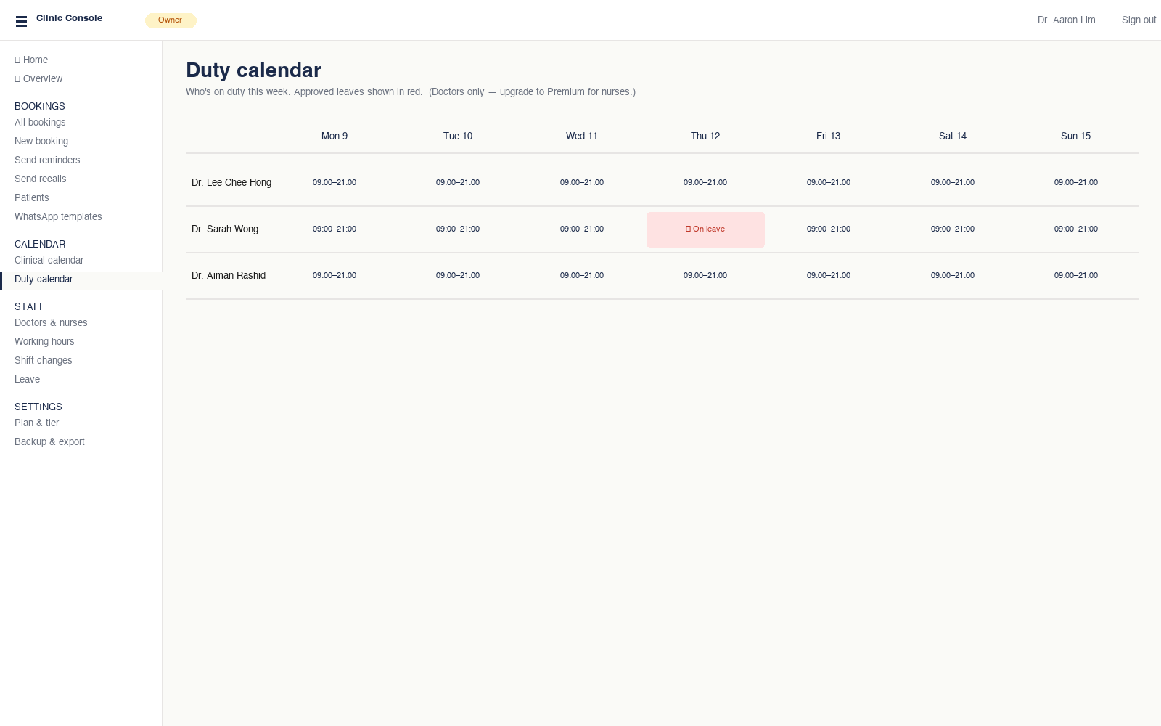
Duty calendar — Standard tier
Doctor schedules at a glance. Leaves shown in red.
Kanan Digital Enterprise · kanan.my
12 / 22

Slide 13
What you unlock with Premium
Nurse duty · doctor + nurse performance · utilization · audit log
+ larger seat caps · roadmap items below
Kanan Digital Enterprise · kanan.my
13 / 22

Slide 14
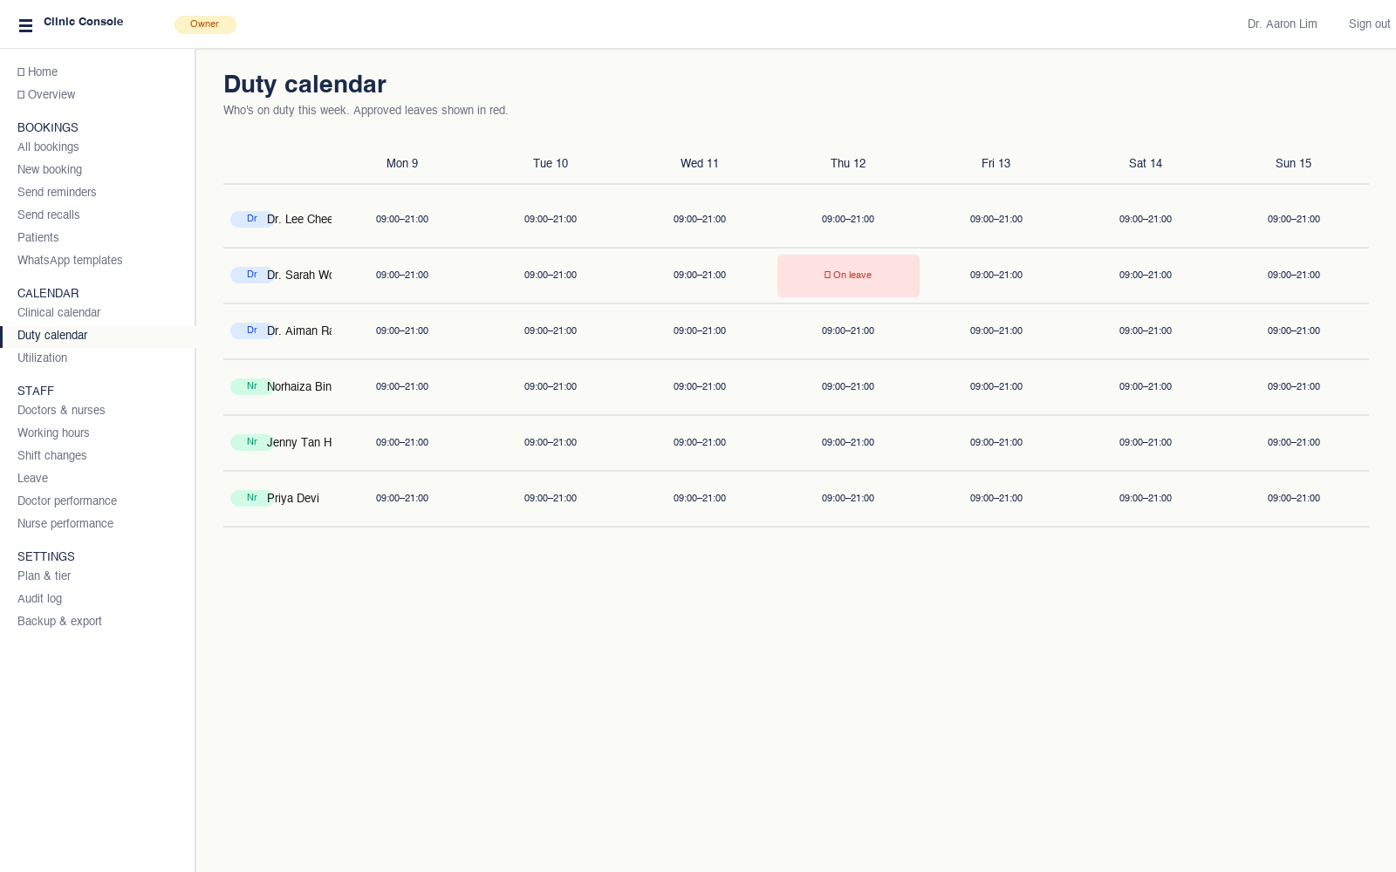
Duty calendar — Premium
Premium only
Both doctors AND nurses on one calendar. Role badges for clarity.
Kanan Digital Enterprise · kanan.my
14 / 22

Slide 15
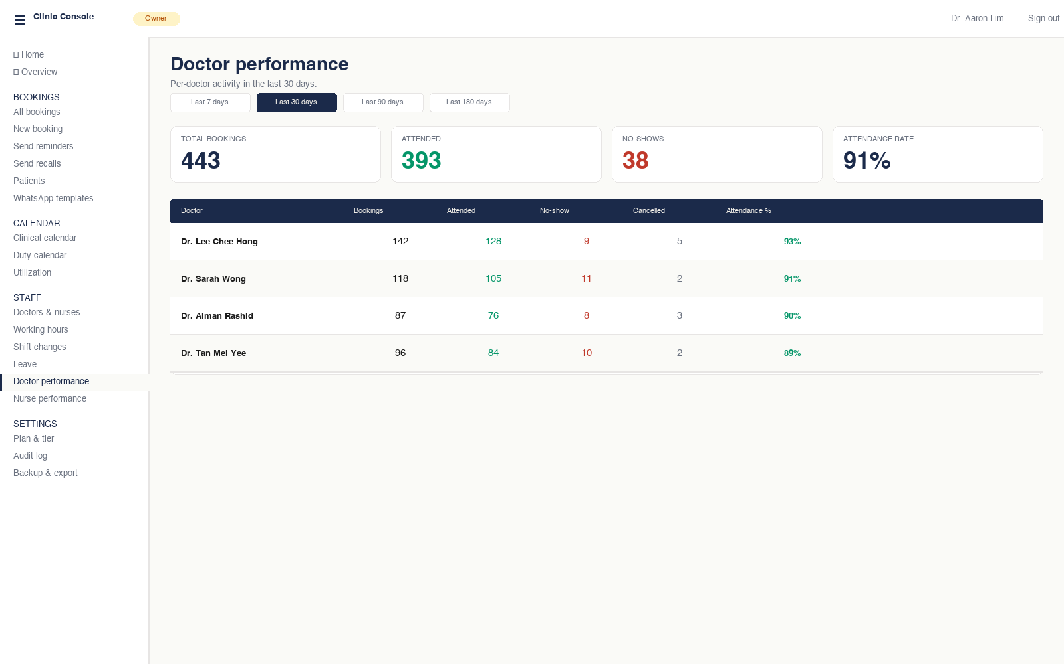
Doctor performance — who's earning your chair-time.
Premium only
Per-doctor attendance + no-show metrics, last 7 / 30 / 90 / 180 days.
Kanan Digital Enterprise · kanan.my
15 / 22
Notes:
Attendance % colour-coded: green ≥85, amber ≥70, red below. Surfaces underperformance fast.

Slide 16
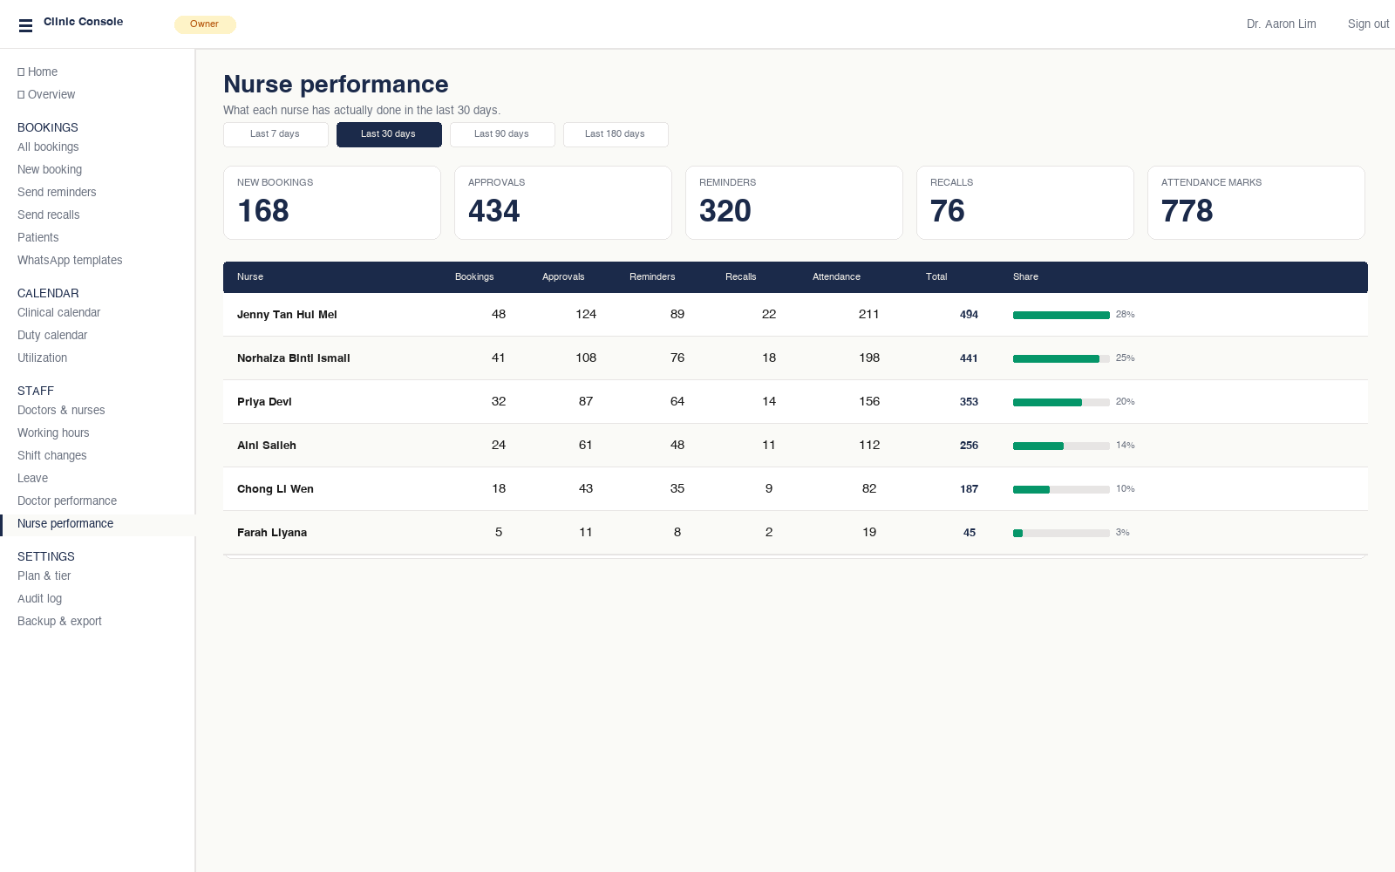
Nurse performance — derived from the audit log.
Premium only
Every approval, reminder, recall and attendance mark, attributed.
Kanan Digital Enterprise · kanan.my
16 / 22
Notes:
Owners love this. They finally know who's actually working vs who's coasting.

Slide 17
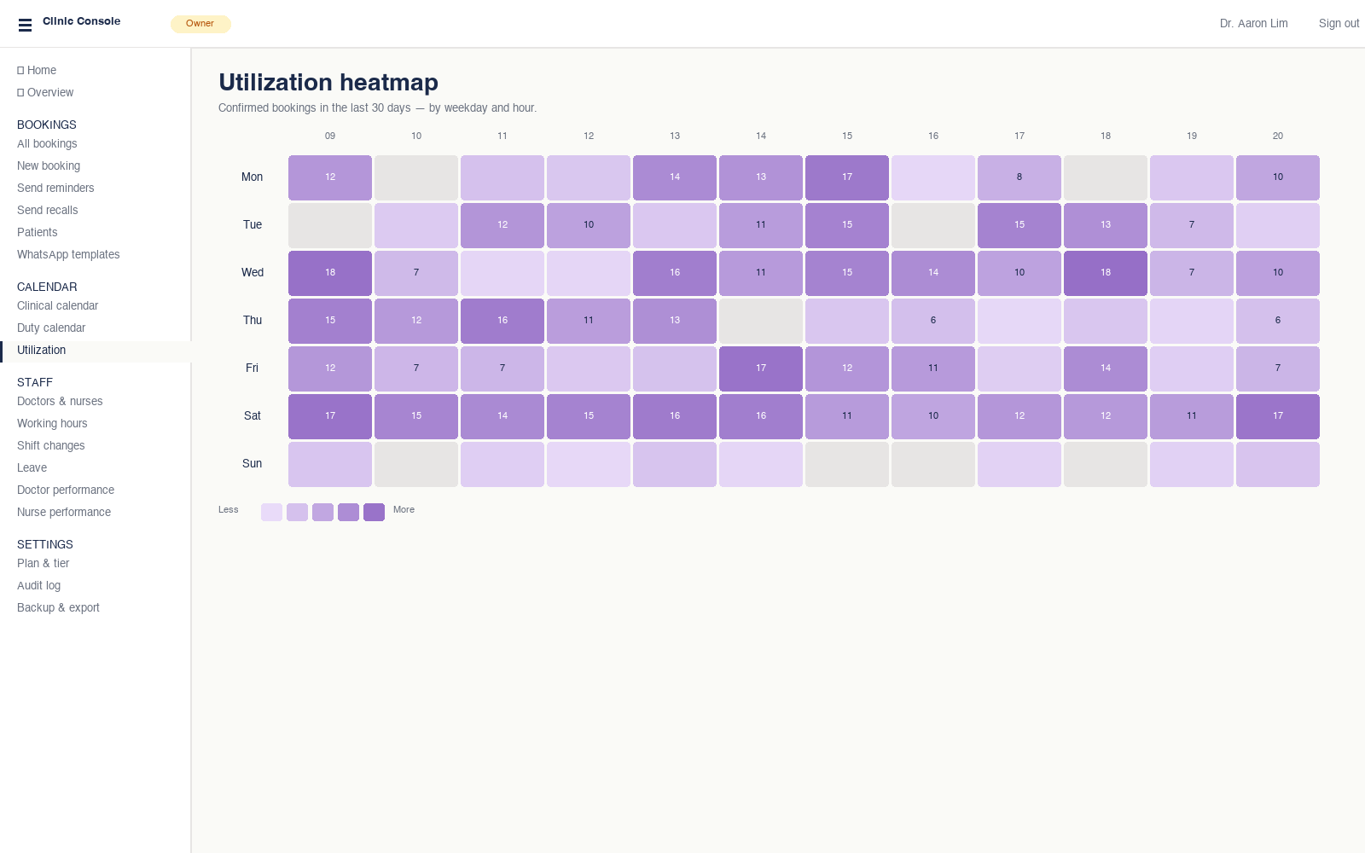
Chair utilization — when are you actually full?
Premium only
Heatmap of confirmed bookings by weekday × hour.
Kanan Digital Enterprise · kanan.my
17 / 22
Notes:
Use this to decide working-hour changes or which doctor needs a Saturday shift.

Slide 18
Seat top-ups — when you grow within your tier
You don't have to upgrade to add one more doctor or nurse.
1
2
3
Hit your cap
Tell us on WhatsApp
Pay only for what you add
You try to add a 3rd doctor while on Standard (2-doctor cap).
One message: "Hi Kanan, please add 1 more doctor seat."
Per-seat top-up: RM 30/mo per extra doctor, RM 20/mo per nurse.
Server rejects with: "Seat limit reached — your plan allows 2 doctors."
We respond within hours during MY business time. No paperwork.
Far cheaper than forcing a full Premium upgrade.
💡 Top-up pricing is indicative — confirm during commercial discussion.
Kanan Digital Enterprise · kanan.my
18 / 22

Slide 19
Standard vs Premium — at a glance
Both single-clinic. Franchise is parked until you ask.
Standard
Premium
Monthly price
RM 150
RM 280
Owner / Doctor / Nurse seats
1 / 2 / 3
1 / 4 / 6
Per-seat top-up available
✓
✓
Patient self-book + WhatsApp templates
✓
✓
Recall reminders
✓
✓
Duty calendar — doctors
✓
✓
Duty calendar — nurses
—
✓
Doctor performance analytics
—
✓
Nurse performance analytics
—
✓
Chair utilization heatmap
—
✓
Audit log
—
✓
CSV backup + email backup
✓
✓
Branding (logo + colours)
✓
✓
Kanan Digital Enterprise · kanan.my
19 / 22
Notes:
Let them stare for 10 seconds. Don't walk through line by line.

Slide 20
Start to finish — no surprises
1
2
3
4
Talk to our team
Schedule a discussion
Workflow & framework
Proposal & strategic review
WhatsApp or quick call.
Longer working session, your pace.
Map ops + where software fits.
1-page scope, timeline, price.
5
6
7
8
Demo
Commercial discussion
Setup & training
Done — and still here
Working prototype on your real data.
Full commercial agreed.
Go-live, team trained.
Support continues. No ghosting.
Kanan Digital Enterprise · kanan.my
20 / 22

Slide 21
Your data stays yours
Trust before technology.
● Hosted in Malaysia wherever possible (Supabase + Vercel)
● PDPA-aware — patient data export any time, schema visible on request
● We don't train external AI models on your operational data
● CSV backup any day. Daily auto-email backup if you want it.
● Sterilization log, X-rays, treatment notes stay in your EMR — not in our system
Kanan Digital Enterprise (SSM Reg: 2026060600274 / AS0516554-D) · Kuala Lumpur, Malaysia
Kanan Digital Enterprise · kanan.my
21 / 22

Slide 22
Try the demos. Set up in 4 weeks.
Standard demo
Premium demo
standard-demo.kanan.my
premium-demo.kanan.my
RM 150/month · 2 doctors · 3 nurses
RM 280/month · 4 doctors · 6 nurses · analytics
Hi Kanan team — I'd like to enquire.
WhatsApp +60 12-347 8126 · hello@kanan.my · kanan.my
Kanan Digital Enterprise — your trusted right hand
Kanan Digital Enterprise · kanan.my
22 / 22
Notes:
Don't close on this slide. Ask if they have 30 seconds to try the demo on their phone right now.

