Slide 1

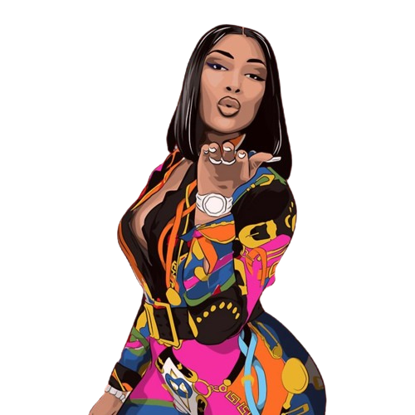

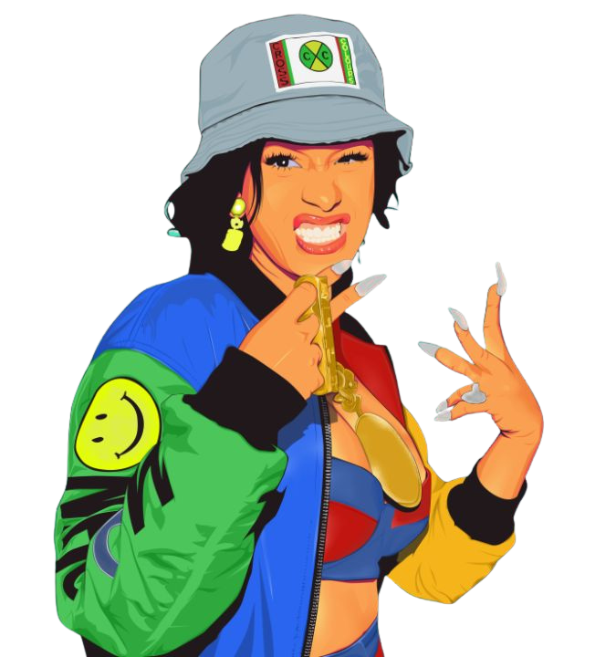

MAPPING THE RISE:
Success of Female Rappers by City
Eloise Bouton
Capstone Project | July 2025

Slide 2
Why This Matters
• The success of rap tracks often depends on geography.
• Female rappers are more visible than ever, yet still underrepresented in charts, playlists, and industry spaces.
• This project explores the link between city of origin and streaming success for female rap artists.

Slide 3
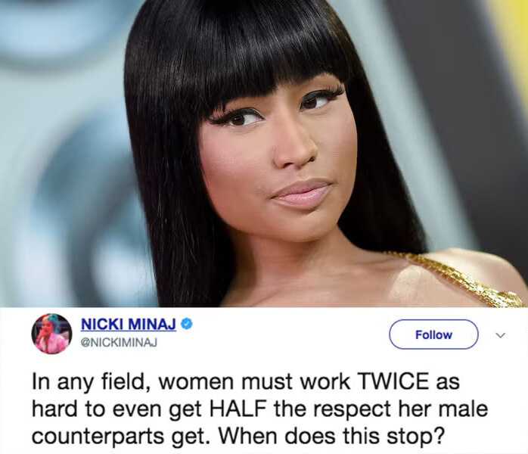

Slide 4
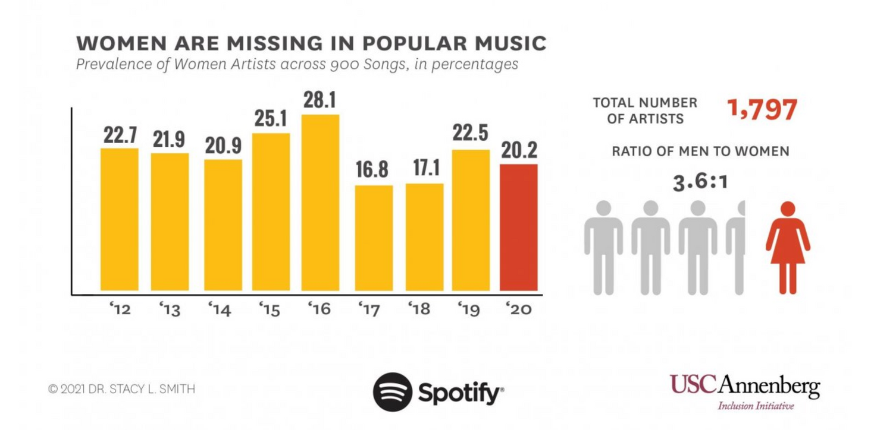
Industry Context
• Female rappers face persistent gender disparities in a male-dominated industry.
• Women made up only 23.3% of Billboard Hot 100 artists in 2021.
• Successful figures like Nicki Minaj are exceptions.

Slide 5

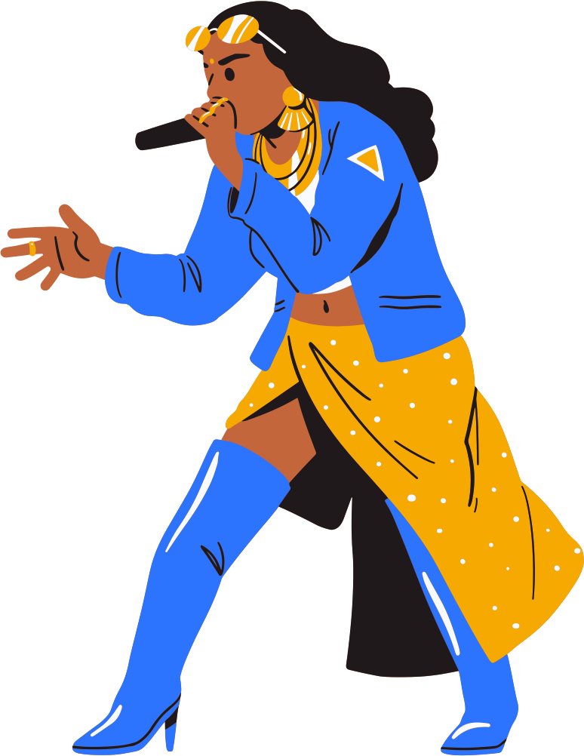

Research Questions
Which U.S. cities produce the most successful female rappers?
How are female rappers represented across streaming and chart platforms?
Can we predict which artists are likely to succeed based on city
and platform data?

Slide 6




Datasets Used
Top Hip Hop Artists & Tracks
Top 10K Streamed Songs
Female Rappers Playlist
Hot 100 Songs
Best Rap Cities

Slide 7
Methodology: Data Cleaning
• Manually reviewed and tagged artists by gender and city of origin.
• Normalized location data (e.g., grouped NYC boroughs under “NYC”).
• Filtered out non-rap artists and singers like Beyoncé.

Slide 8
Methodology: Feature Engineering & Modeling
• Created a “mention count” from artist appearances across platforms.
• Defined hit artists as those with 5+ mentions.
• Preprocessed data: one-hot encoded cities, scaled numerics, imputed missing values.
• Trained a Random Forest Classifier to predict hit probability.

Slide 9

Key Findings: New York City Dominates
• New York City leads in artist representation and mentions.
• Home to legends like Nicki Minaj and Cardi B.
• Highest cross-platform presence (Spotify, TIDAL, Billboard.)

Slide 10
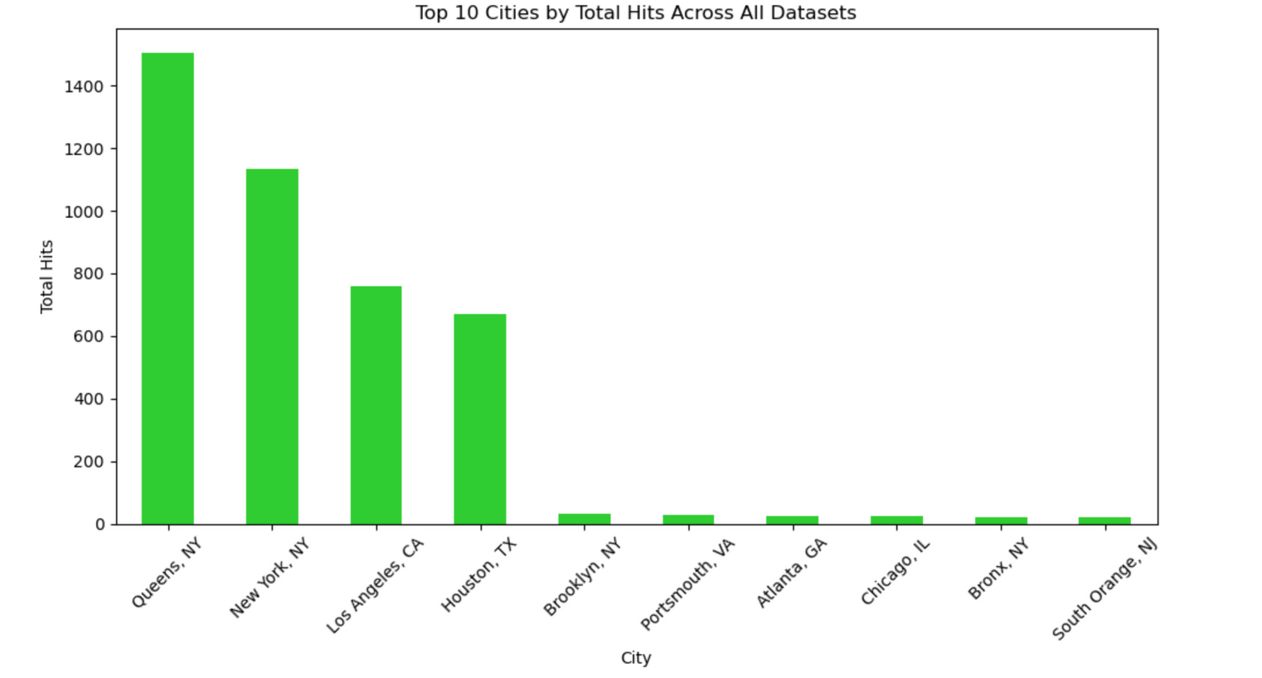
Houston and LA Dominate Too
These cities provide the cultural and industrial ecosystems female rappers need to thrive.

Slide 11
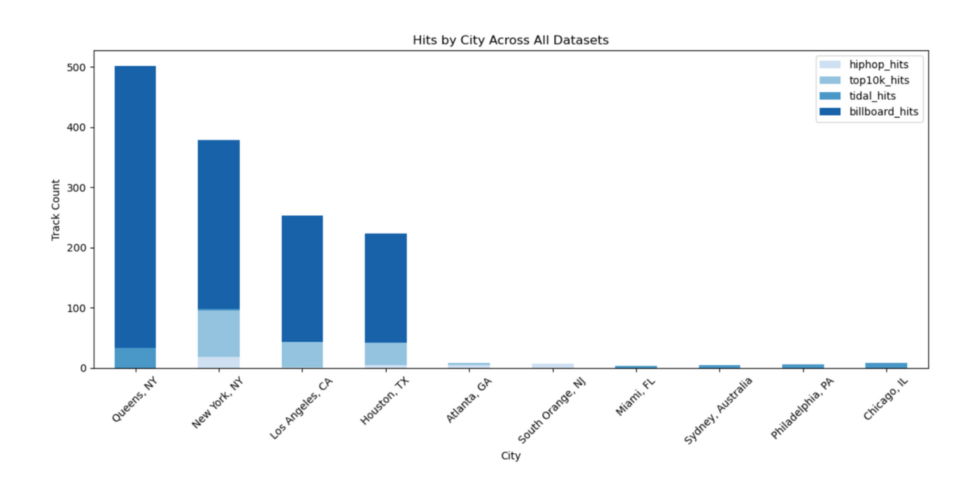
Cross-Platform Dominance
NYC, Houston and LA artists top:
Spotify playlists (user behavior)
TIDAL playlist (editorial)
Billboard charts (commercial success).

Slide 12
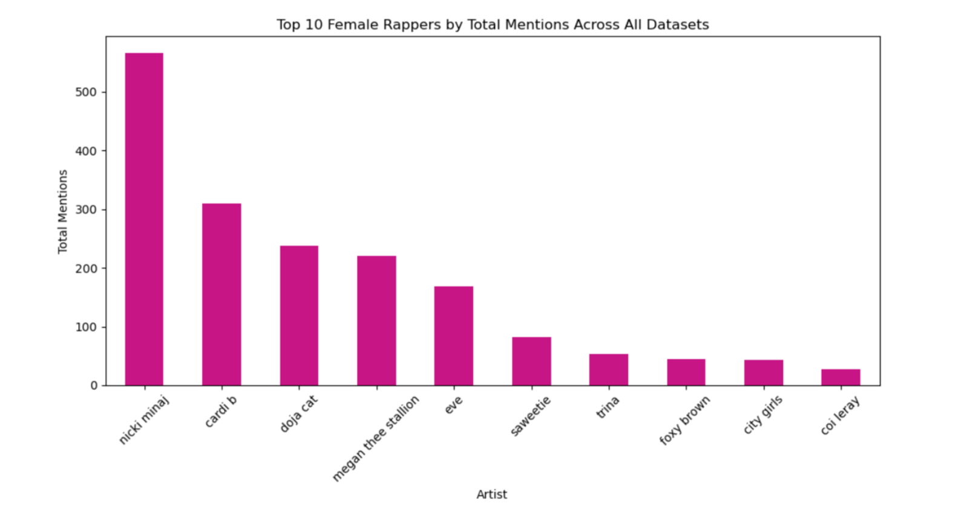
Artist Highlights

Slide 13




Artist Highlights
Nicki Minaj: Highest total mentions, cross-generational icon.
Cardi B: Viral success, Grammy winner.
Megan Thee Stallion: Southern flair, Gen Z empowerment.
Doja Cat: Internet-savvy, pop/rapcrossover.

Slide 14
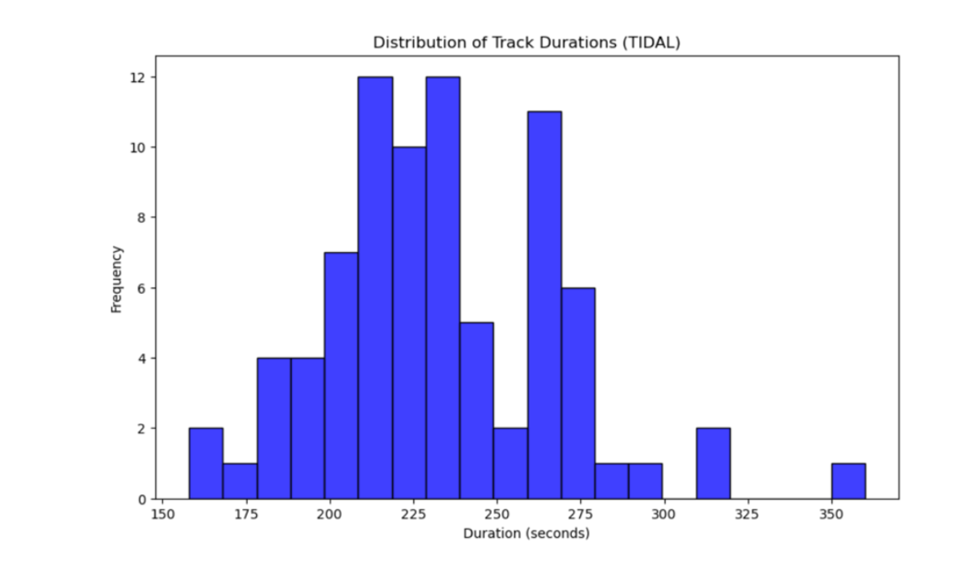
Other Findings
• Most successful tracks are 3 to 4.5 mins (streaming-friendly).
• Billboard and Spotify Top 10k are strong indicators of future success.
• TIDAL and Complex better capture early/emerging talent.

Slide 15
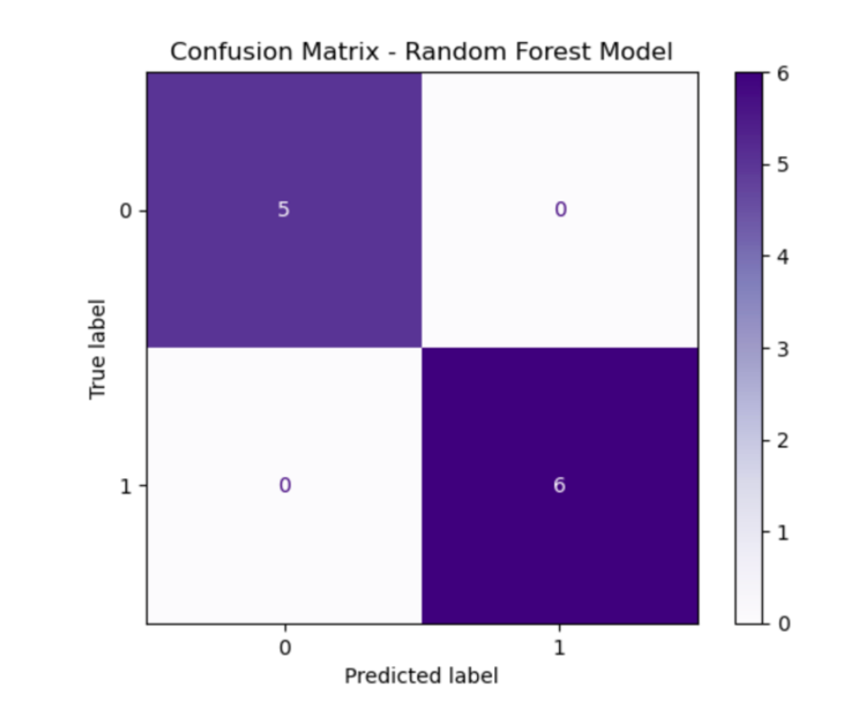
Model Performance
• 100% test accuracy (small test size n=11).
• 88% mean accuracy via cross-validation.
• Requires larger datasets for robustness.

Slide 16
Recommendations
✅ Focus scouting in New York City, Houston, Los Angeles and Atlanta.
✅ Track early momentum via Spotify Top 10k and Billboard.
✅ Use predictive models in A&R to identify high-potential artists.

Slide 17




Future Work
Add lyrical, audio, and collaboration features.
Expand to global scenes (UK, France, Brazil, South Africa).
Explore TikTok virality and social media signals.
Build a dashboard for label executives to filter artists by city, genre, and hit probability.

Slide 18
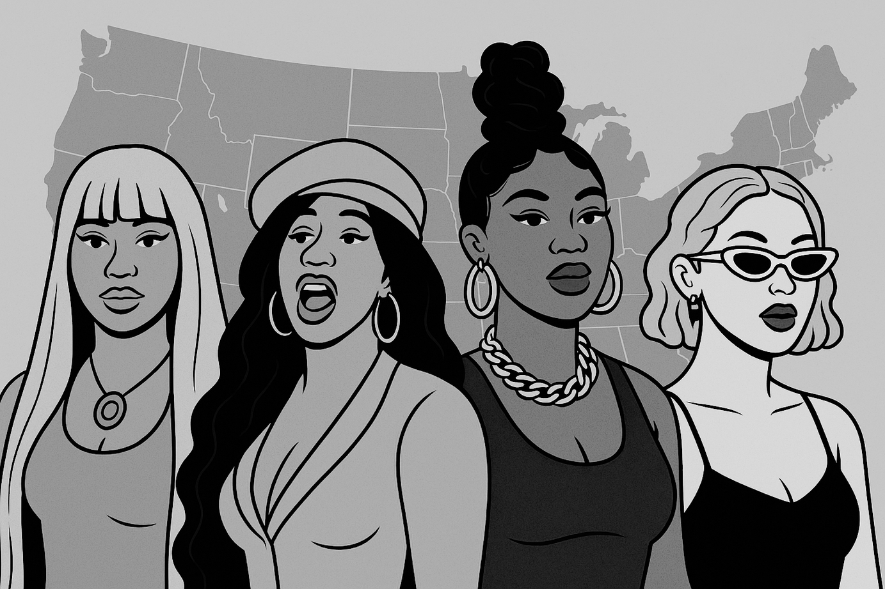
THANK YOU!
Eloise Bouton
https://www.linkedin.com/in/eloisebouton/
Project report: https://github.com/eloiseelle/capstone/blob/41b1b23f8e838fcfd516d93009e6f58c3721ab5d/06_capstone_final_report.pdf

