Slide 1
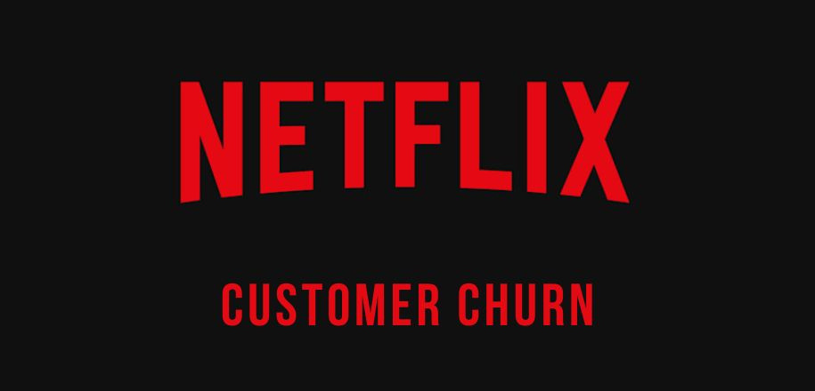
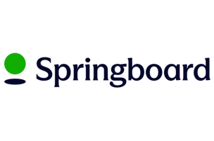
Identifying the Behavioral Drivers of User Retention
Eloise Bouton
Capstone Project 3 | September 2025
1

Slide 2

Problem & Context
Netflix loses revenue when customers churn.
Competition from Disney+, Amazon Prime, Apple TV+ drives up acquisition costs.
Subscribers face fatigue from too many streaming options.
Retaining high-value customers is more profitable than new acquisition.
2

Slide 3
Stakeholders & Success Criteria
Build churn prediction model despite imbalance.
Identify key behavioral drivers.
Provide actionable business recommendations.
Stakeholders: marketing, product, finance, data science.
3

Slide 4
Dataset Overview
Netflix 2025 User Behavior Dataset: ~210k records, 6 tables.
Watch history, users, searches, reviews, recommendations, movies.
Engineered 33 features for 10 000 users.
4

Slide 5
Data Wrangling
Removed duplicates and filled missing values.
Engineered features: watch time, completion, searches, ratings, rec CTR.
Output: clean user-level dataset ready for EDA and modeling.
5

Slide 6
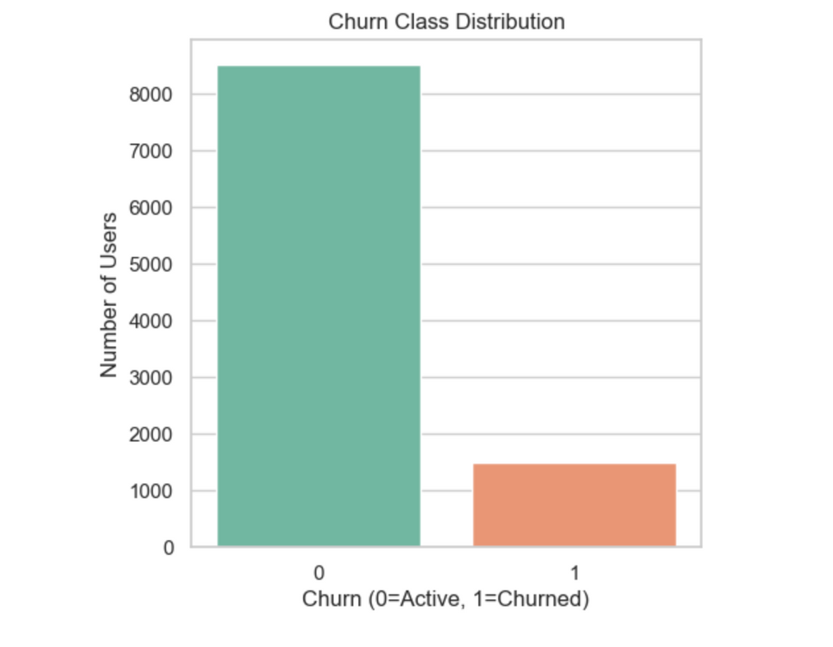
Churn Distribution
85% active vs 15% churn.
Strong imbalance: accuracy can be misleading and recall is better as key metric.
6

Slide 7
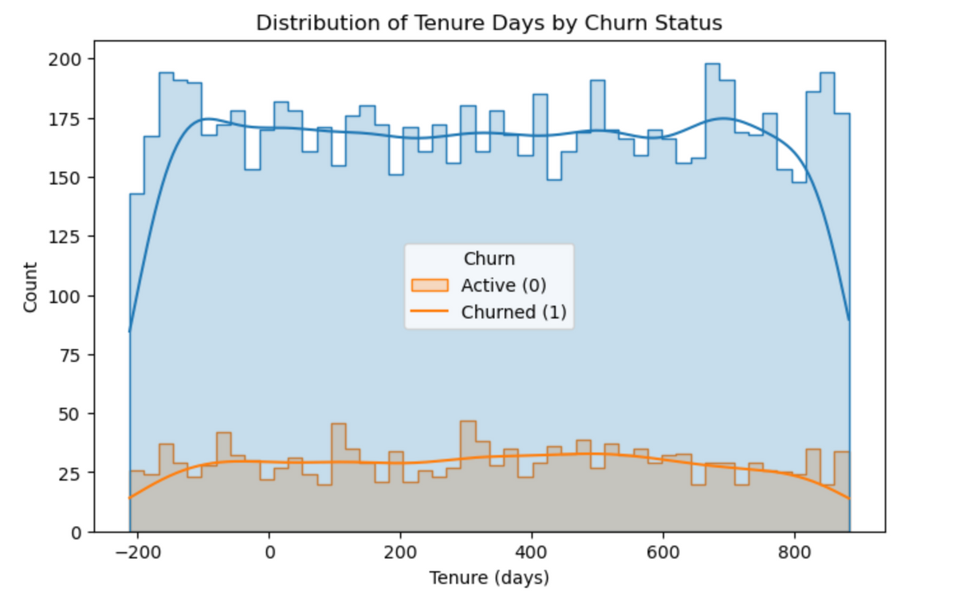
EDA: Tenure
Most churn occurs within first 90 days.
Onboarding is the critical risk period.
7

Slide 8
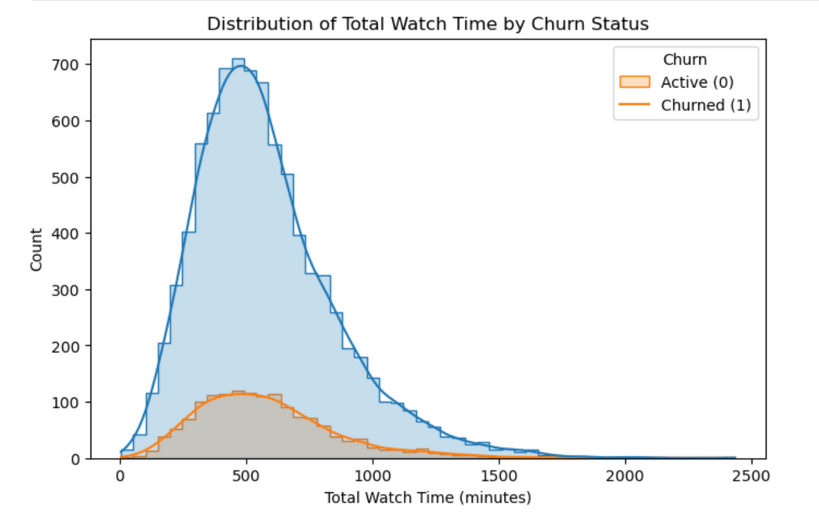
EDA: Engagement
Heavy watchers stay longer.
Lower completion means higher churn risk.
8

Slide 9
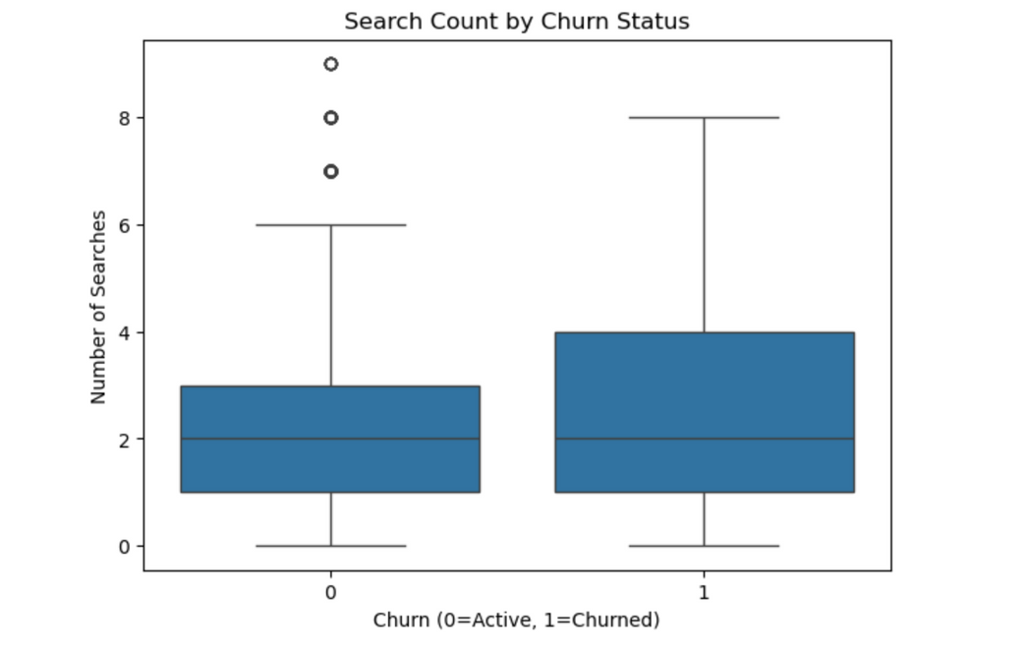
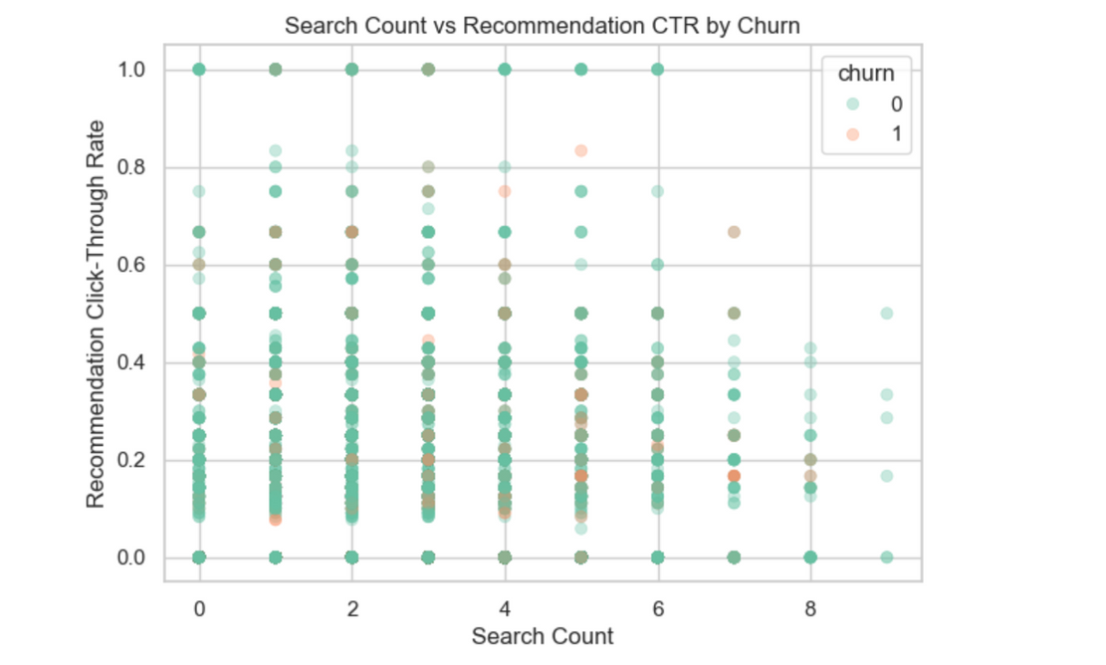
EDA: Discovery
Active searchers and recommendation clickers churn less.
9

Slide 10
Modeling Approach
Target: churn (binary outcome: churned or active).
Preprocessing: one-hot encoding, scaling and imputation.
Train/test split: 80/20, stratified to keep churn ratio.
Evaluation: PR AUC (main metric for imbalanced data), plus ROC AUC, recall, precision, and F1 score.
10

Slide 11
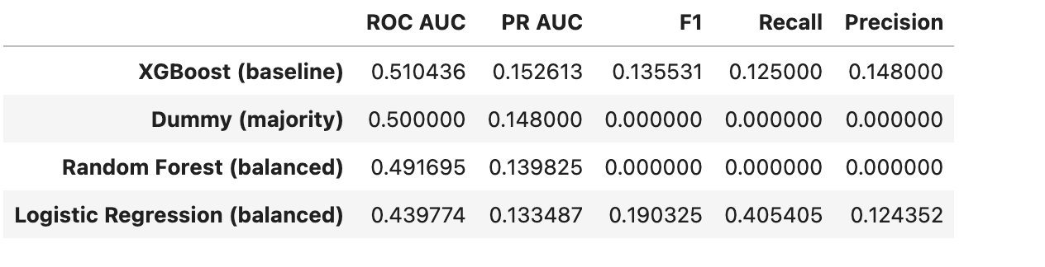
Model Comparison
Dummy: PR AUC: 0.148 (baseline).
Logistic Regression: recall: 41%, precision : 2% and PR AUC: 0.133.
Random Forest collapsed.
XGBoost: PR AUC 0.153 (best, small but consistent improvement).
11

Slide 12
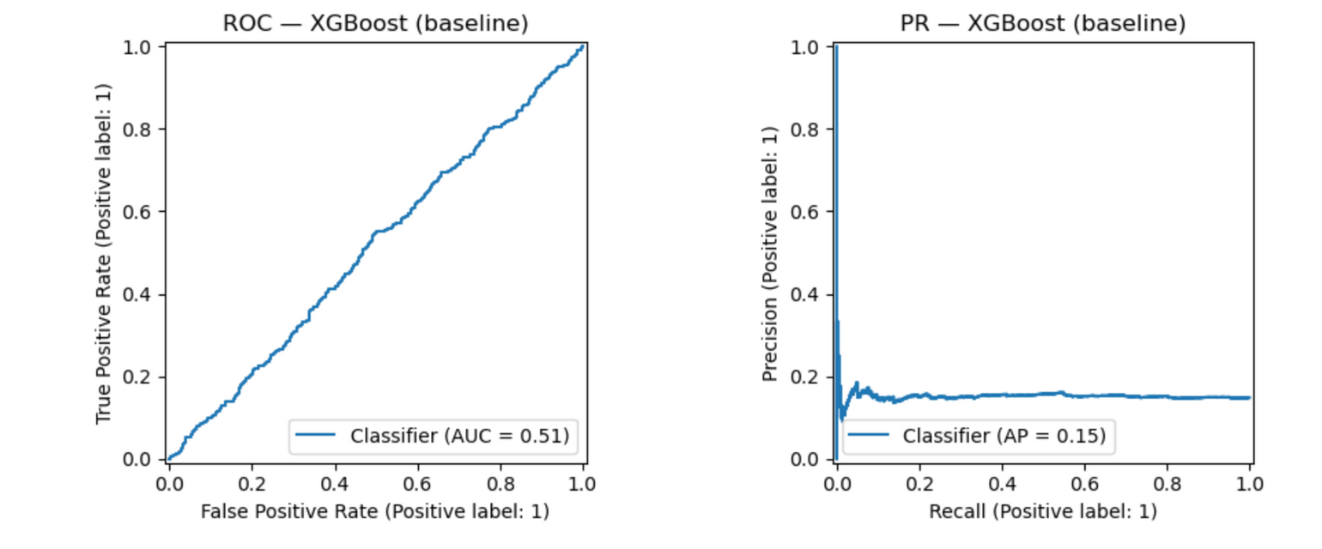
XGBoost Results
Recall: 12.5%, Precision: 14.8%, F1 = 0.136.
Slightly outperforms baseline.
Captures weak but real behavioral signals.
12

Slide 13

Key Findings
Engagement is the strongest predictor.
Discovery reduces churn risk.
Negative satisfaction predicts churn.
Early tenure is the riskiest period.
Demographics have little impact.
13

Slide 14

Recommendations
Strengthen onboarding (personalized starter packs, reminders, rec features).
Monitor satisfaction (flag low ratings and intervene early).
Focus on high-value customers (CLV-based retention).
14

Slide 15

Limitations
Churn labels may include inactivity.
Revenue data limitation: Revenue is not tracked per title so CLV had to be approximated.
Modeling challenge: The strong class imbalance limited the model’s ability to achieve both high recall and high precision.
15

Slide 16

Future Work
Engineer richer features (recency and interactions).
Use survival analysis to study churn risk over time.
Validate via A/B testing.
16

Slide 17

Conclusion
Netflix churn prediction is challenging but key behavioral drivers are clear.
XGBoost outperformed baseline, proving boosting can detect weak signals.
By improving onboarding, proactively monitoring satisfaction and targeting high-value customers, Netflix can reduce churn and ensure long-term revenue.
17

Slide 18

THANK YOU!
Eloise Bouton
https://www.linkedin.com/in/eloisebouton/
Project report: https://github.com/eloiseelle/capstone/blob/41b1b23f8e838fcfd516d93009e6f58c3721ab5d/06_capstone_final_report.pdf
18

