Slide 1


Identifying the Behavioral Drivers of User Retention
Eloise Bouton
Capstone Project 3 | September 2025
1

Slide 2

Problem & Context
Netflix loses revenue when customers churn.
Competition from Disney+, Amazon Prime, Apple TV+ drives up acquisition costs.
Subscribers face fatigue from too many streaming options.
Retaining high-value customers is more profitable than new acquisition.
2

Slide 3
Stakeholders & Success Criteria
Build churn prediction model despite imbalance.
Identify key behavioral drivers.
Provide actionable business recommendations.
Stakeholders: marketing, product, finance, data science.
3

Slide 4
Dataset Overview
Netflix 2025 User Behavior Dataset: ~210k records, 6 tables.
Watch history, users, searches, reviews, recommendations, movies.
Engineered 33 features for 10 000 users.
4

Slide 5
Data Wrangling
Removed duplicates and filled missing values.
Engineered features: watch time, completion, searches, ratings, rec CTR.
Output: clean user-level dataset ready for EDA and modeling.
5

Slide 6
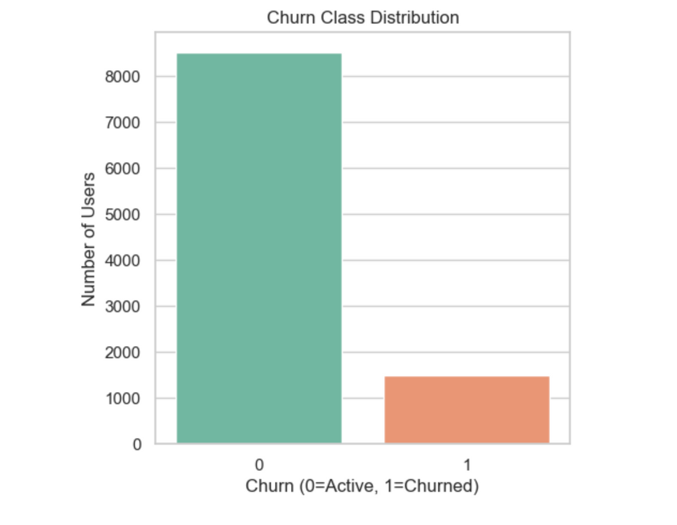
Churn Distribution
85% active vs 15% churn.
Strong imbalance: accuracy can be misleading and recall is better as key metric.
6

Slide 7
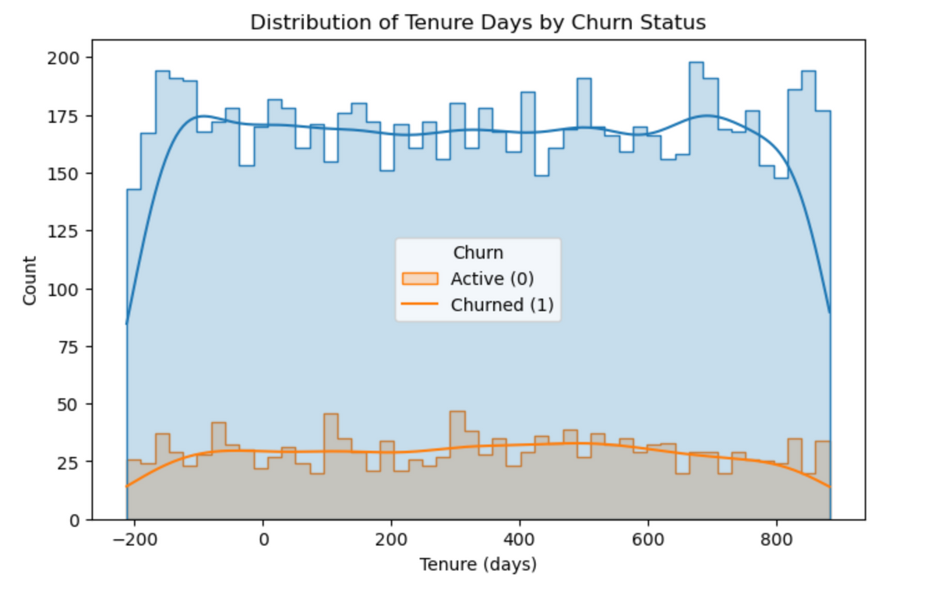
EDA: Tenure
Most churn occurs within first 90 days.
Onboarding is the critical risk period.
7

Slide 8
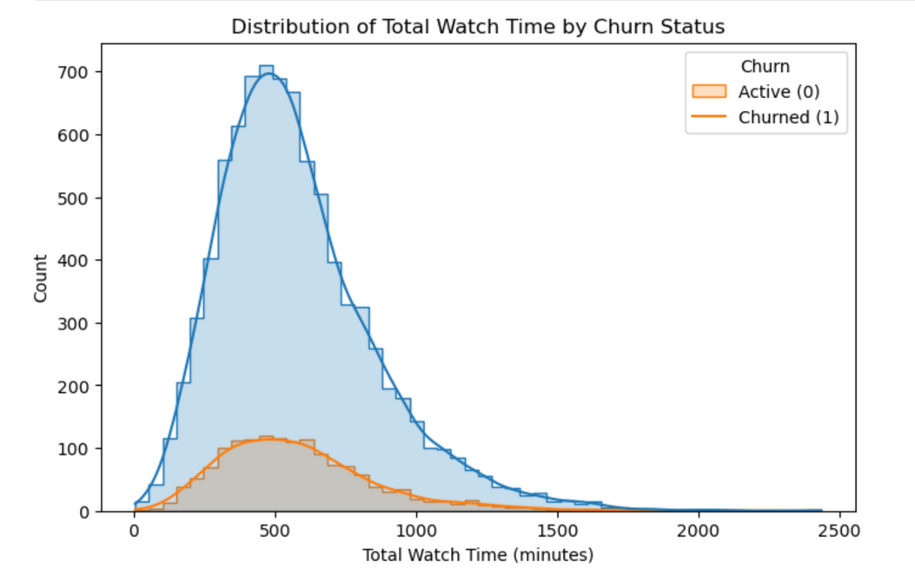
EDA: Engagement
Heavy watchers stay longer.
Lower completion means higher churn risk.
8

Slide 9
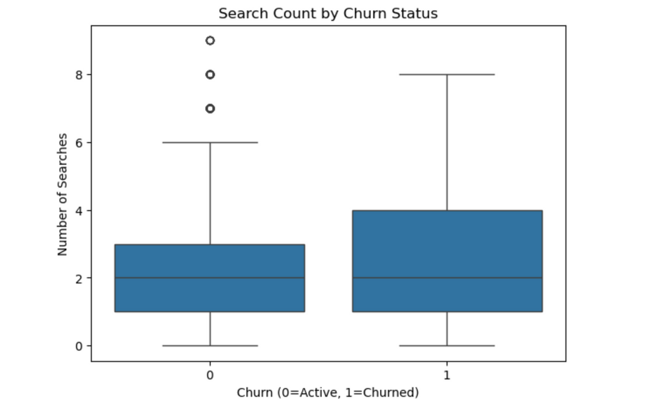
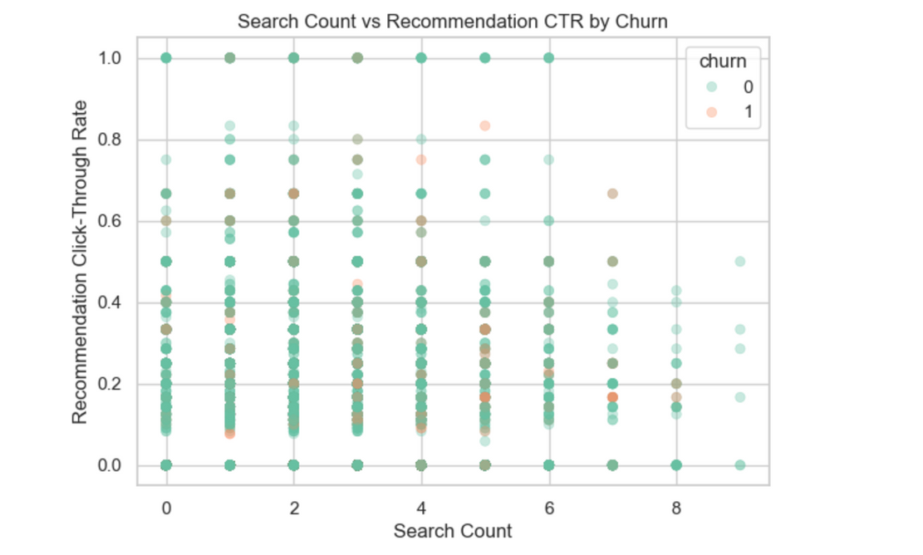
EDA: Discovery
Active searchers and recommendation clickers churn less.
9

Slide 10
Modeling Approach
Target: churn (binary outcome: churned or active).
Preprocessing: one-hot encoding, scaling and imputation.
Train/test split: 80/20 split, maintaining churn ratio.
Evaluation: PR AUC (main metric for imbalanced data), plus ROC AUC, recall, precision, and F1 score.
10

Slide 11
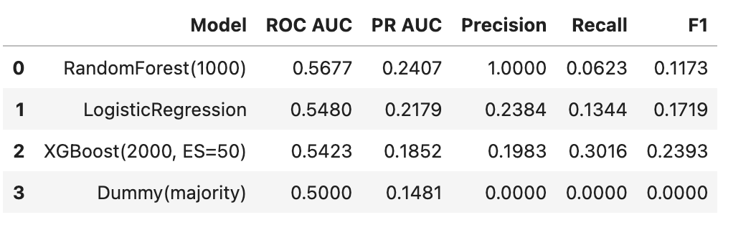
Model Comparison
Random Forest gives the best PR AUC (0.241) but shows low precision at permissive thresholds.
Random Forest modestly outperformed Logistic Regression and XGBoost, but all models remain near baseline.
11

Slide 12

Key Findings
High engagement lowers churn.
Exploration reduces churn risk.
Low satisfaction predicts churn.
Onboarding is critical.
Demographics add little value.
13

Slide 13

Recommendations
Strengthen onboarding (personalized starter packs, reminders, rec features).
Monitor satisfaction (flag low ratings and intervene early).
Focus on high-value customers (CLV-based retention).
Retention resources should be focused where model precision is higher (high-value customers).
14

Slide 14

Limitations
Churn labels may include inactivity.
Revenue data limitation: Revenue is not tracked per title so CLV had to be approximated.
Modeling challenge: The strong class imbalance limited the model’s ability to achieve both high recall and high precision.
15

Slide 15

Future Work
Engineer richer temporal features (recency, drop-offs, session-level patterns).
Use survival analysis to study churn risk over time.
Validate via A/B testing.
16

Slide 16

Conclusion
Churn prediction is difficult, but engagement, discovery, satisfaction and early tenure clearly drive retention.
Random Forest performed best (PR AUC = 0.241), yet overall accuracy is modest.
Future work should add richer temporal features and A/B tests to make interventions truly effective.
17

Slide 17

THANK YOU!
Eloise Bouton
https://www.linkedin.com/in/eloisebouton/
Project report: https://github.com/eloiseelle/capstone/blob/41b1b23f8e838fcfd516d93009e6f58c3721ab5d/06_capstone_final_report.pdf
18

