Slide 1

Museum-CMS
Presented by:
Eloise Peng
Applied Skills:
Pug Engine, MongoDB, Express JS, CSS, UI
Date: Jun 30, 2018
CMS is a collection management system, customized to museum internal management with strict level of access.

Slide 2
Overview
Security
Database-structures
Search Function
Deletion Control

Slide 3
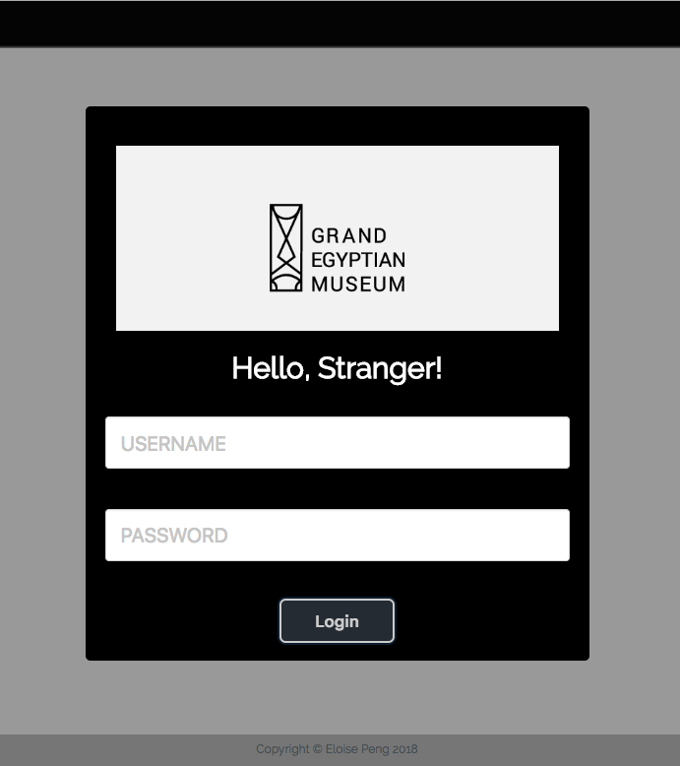
Authorization - Login
Roles:
Admin
Full access & control
Inspector
View collection info
Write Inspection report
Notes:
Pre-determined by manager upon signup

Slide 4

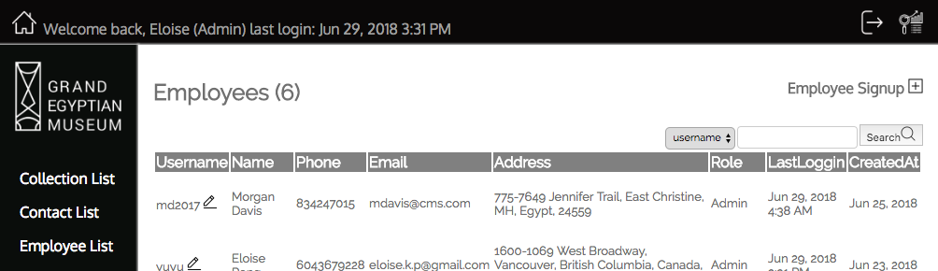




Employee Signup – Admin only

Slide 5
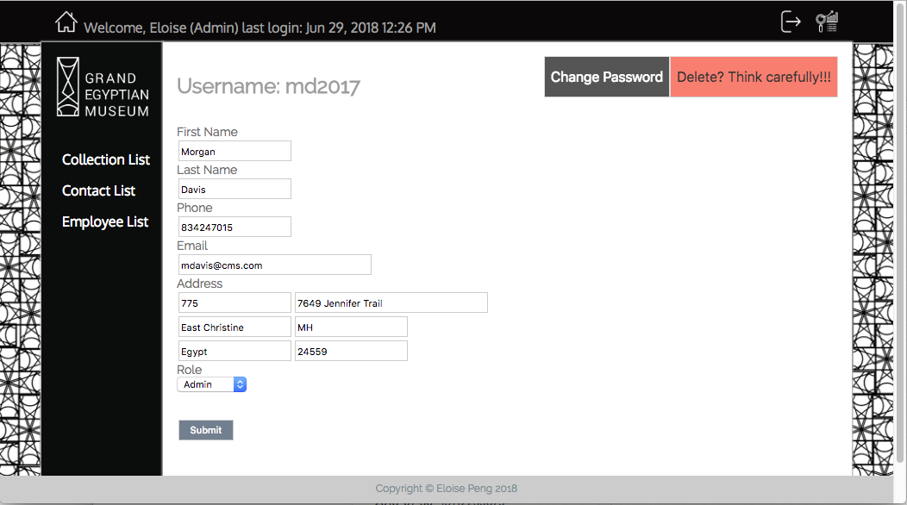
Reset Password – Admin Only
Passport JS
Only overwrite with new password

Slide 6
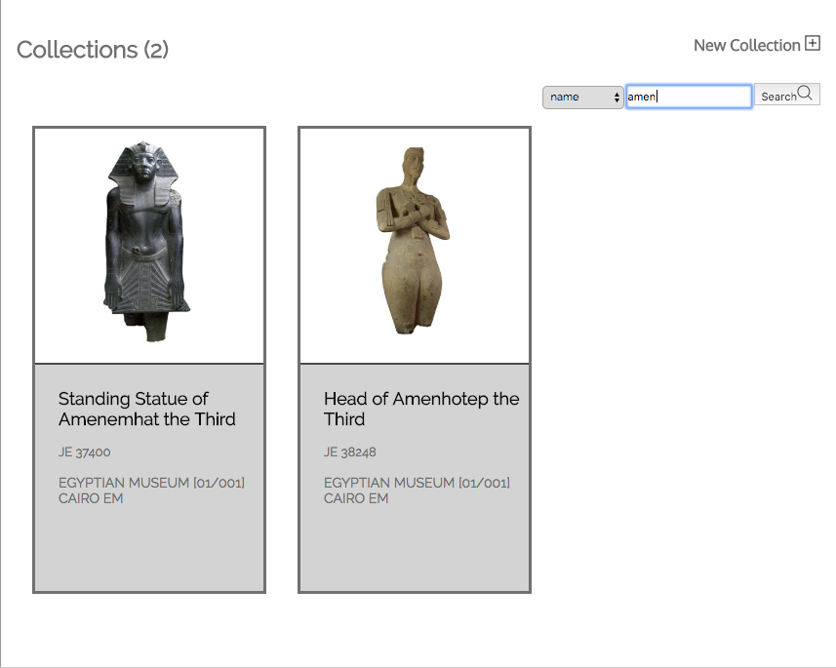
Search result (User friendly)
Match all item names that including ‘amen’ with case insensitivity

Slide 7
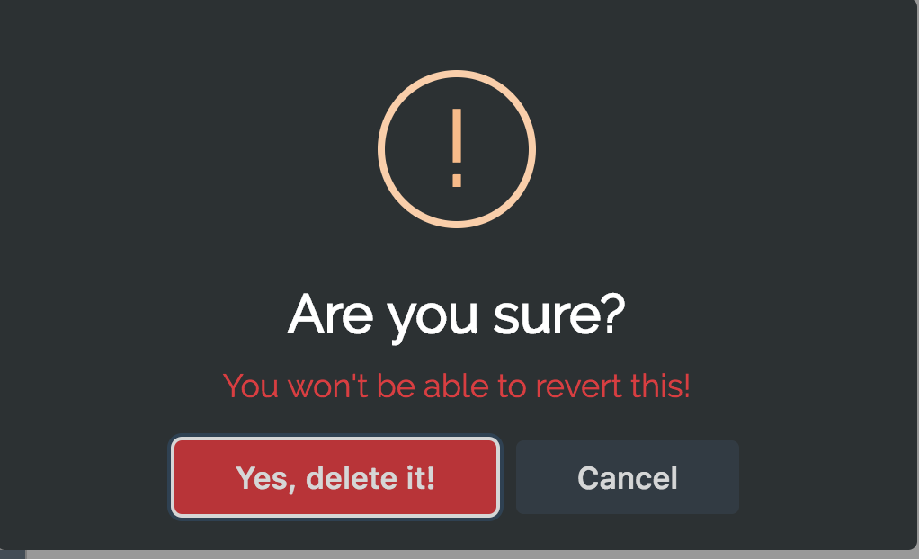
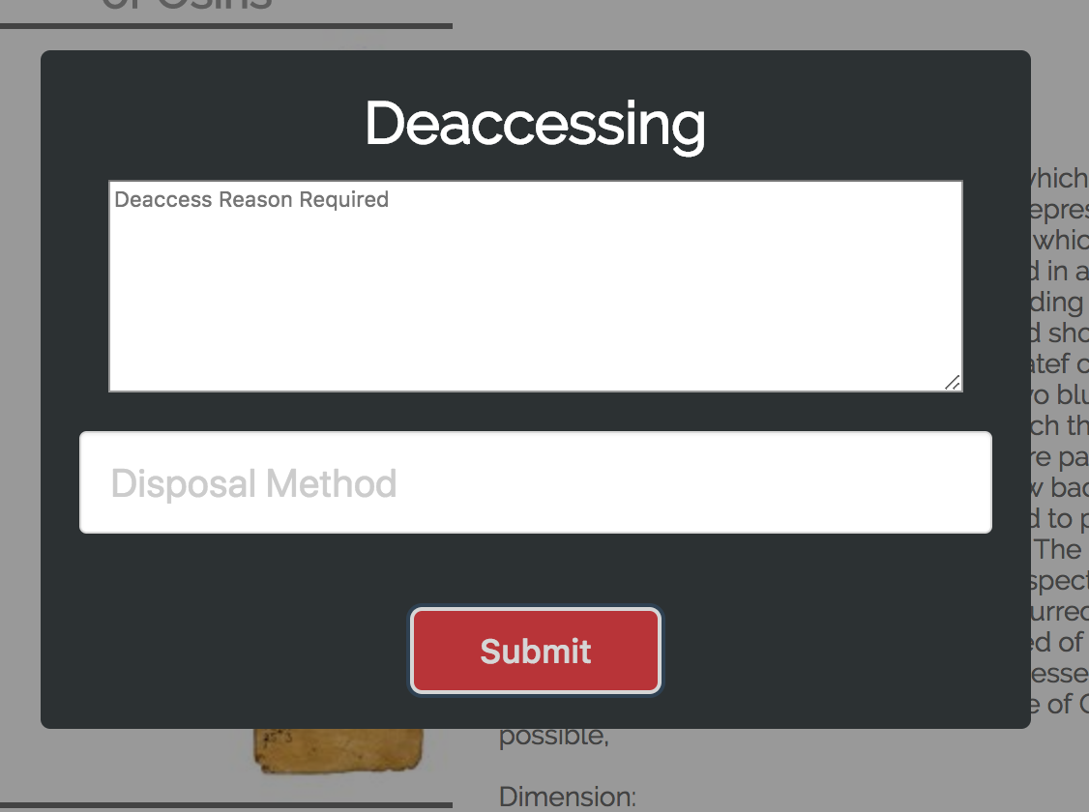
Varies deleting methods
Remove user from database to prevent future access – irreversible
Deactivate Client
No more data modification
Keep track of history
De-access collection
No more data modification
Keep track of history
In case of lost/transfer/disposal

Slide 8
DEMO
museum-cms
- 54.213.249.127

Slide 9
References
##CMS Wiki
- https://en.wikipedia.org/wiki/Collections_management_(museum)
##logo
- https://www.behance.net/gallery/26501779/Branding-The-Grand-Egyptian-Museum
##global egyptian museum database
- http://www.globalegyptianmuseum.org/
##ui design
- http://grelas.com/
##collection api
- https://www.programmableweb.com/category/museums/api

Slide 10
Thank you by Eloise Peng

