Slide 1

Data Lake Value Proposition
Medical Data Processing Company
Eric Lok
Udacity IPS Version 1.0

Slide 2
Agenda
What is a Data Lake
Components of a Data Lake
Data Lake vs Data Warehouse
Business Value of Data Lake Solution
Proposed Data Lake Architecture for Medical Data Processing system
Udacity IPS Ver. 1 2/2020

Slide 3
What is a Data Lake
Executive summary
A data lake is a centralized repository that allows you to store all your structured and unstructured data at any scale.
Data can be stored as-is, without having to first structure the data, and run different types of analytics—from dashboards and visualizations to big data processing, real-time analytics, and machine learning to guide better decisions.
Data Lakes help to identify, and act upon opportunities for business growth faster by attracting and retaining customers, boosting productivity, provide real-time updates, and making informed decisions.

Slide 4
Components of Data Lake
Ingestion – Tools to Ingest Data
Processing – Tools to Process the Data in Data Lake
Storage – Store the Data at Scale in a Data Lake
Serving – Presenting the Data or Results

Slide 5
Data Warehouse
Data Lake
Processed Data
Complicated and costly
Batch reporting, BI, and visualizations
Higher Cost
Raw and Processed Data
Real time. Highly accessible
Machine Learning, Predictive analytics, data discovery, and profiling
Query results getting faster using low-cost storage
Udacity IPS Ver. 1 2/2020

Slide 6
Business Value of Data Lake
Improved Scale and Performance
Improved Customer Interactions
Improve R&D Innovation Choices
Increase Operation Efficiencies

Slide 7
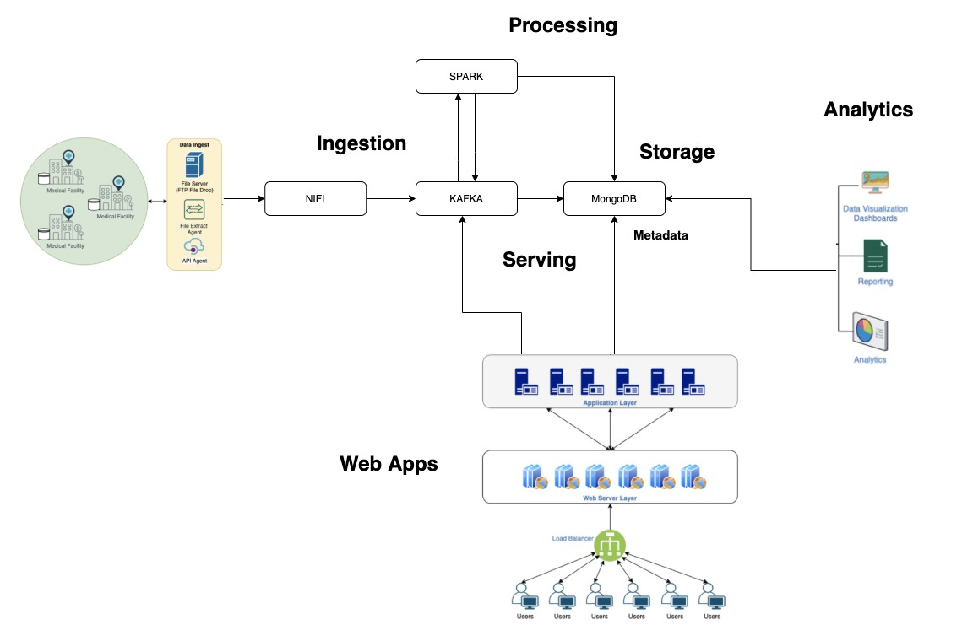
Data Lake Architecture

Slide 8
THANK YOU
Udacity IPS Version 1.0

