Slide 1
Heart Sound

Slide 2

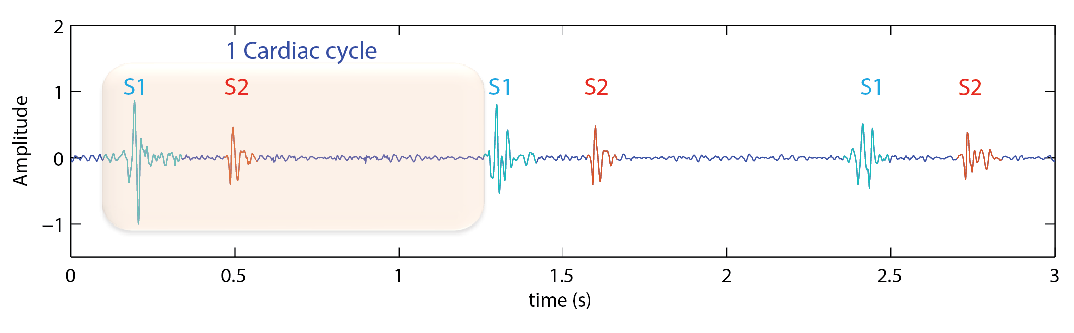
Auscultation of heart sound
Heart sounds - resulted from the snapped shut of atrio-ventricular valves.
Fundamental heart sounds (FHS):
S1 or 'Lub'.
S2 or 'Dub'.
Kumar, D., et al. “Noise detection during heart sound recording.” 2009 AnnualInternational Conference of the IEEE Engineering in Medicine and Biology Society. IEEE, 2009.

Slide 3
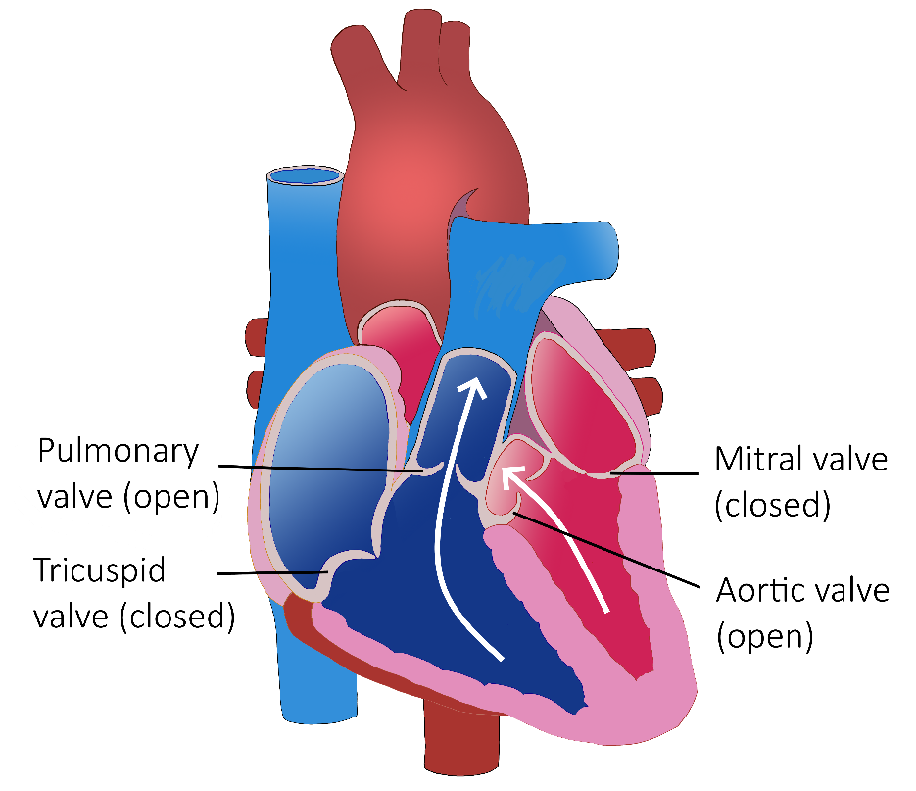
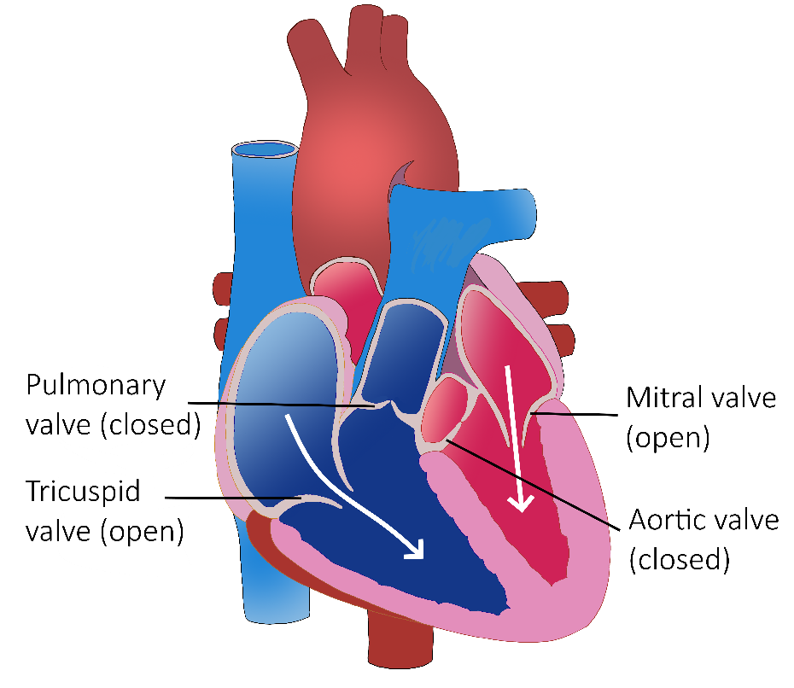
Valvular activities responsible for the production of FHS
Figure: S1 sound is produced due to closure of Mitral and Tricuspid valves [2, 3].
Figure: S2 sound is produced due to closure of Aortic and Pulmonary valves [2, 3].
H. K. Walker, W. D. Hall, and J. W. Hurst, Clinical methods. Butterworths, 1990.
Waugh, Anne, and Allison Grant. Ross & Wilson anatomy and physiology in health and illness. Elsevier Health Sciences, 2014.

Slide 4

Key features of Heart Sounds
Durations
S1 sound: 120 ± 22ms
S2 sound: 92 ± 22ms
Systole and diastole: depends on HCD $∝ \frac{1}{heart rate}$
Heart sound | Frequency ranges (Hz)
S3 and S4 | 15-65
S1 and S2 | 20-200
Mitral stenosis | 40-80
Ejection murmurs | 200-400
Regurgitation | 250-700
Naseri, Hosein, and M. R. Homaeinezhad. "Detection and boundary identification of phonocardiogram sounds using an expert frequency-energy based metric." Annals of biomedical engineering 41.2 (2013): 279-292.

Slide 5

Heart Sounds & Murmurs | Clinical Medicine

Slide 6
References:
George B. Moody PhysioNet Challenge | George B. Moody PhysioNet Challenge
The CirCor DigiScope Dataset: Oliveira, J., Renna, F., Costa, P. D., Nogueira, M., Oliveira, C., Ferreira, C., … & Coimbra, M. T. (2022). The CirCor DigiScope Dataset: From Murmur Detection to Murmur Classification. IEEE Journal of Biomedical and Health Informatics, doi: 10.1109/JBHI.2021.3137048.

Slide 7
Lung Sound

Slide 8
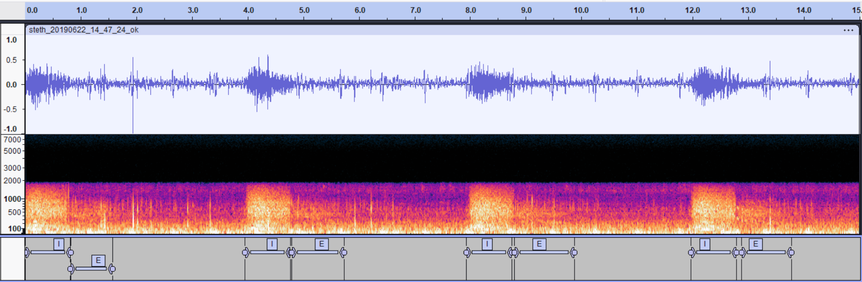
Auscultation of Lung sound
Normal Lung/Breath/Respiratory sounds – turbulent airflow in upper airways and large airways of the lungs (100 – 2000 Hz.
As the sound is transmitted to the lungs, it gets dampened, higher frequencies are lost and softer lower pitched sound is heard (100 - 400 Hz).

Slide 9
Key features of Lung Sounds
Vesicular Breath Sounds:
Characteristics:
Intensity of inspiration (I) more than expiration (E)
Longer duration of inspiration
Lower pitch in expiration
Heart sound | Frequency ranges (Hz)
Normal Breath Sounds | 100 – 2000 Hz
Adventitious Sounds - Wheeze | Anywhere between 400 Hz and 2kH
Adventitious Sounds - Crackles | < 200 Hz
Adventitious Sounds - Ronchi | < 300
Cough Sound | 50-3000 Hz
Approach to Lung sounds | PPT

Slide 10
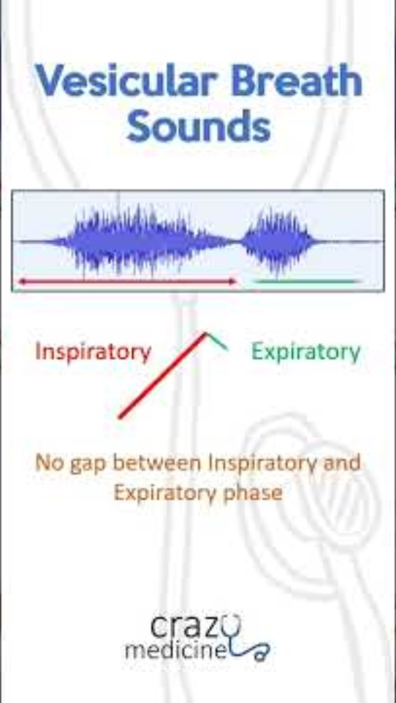
Vesicular Breath Sounds

Slide 11
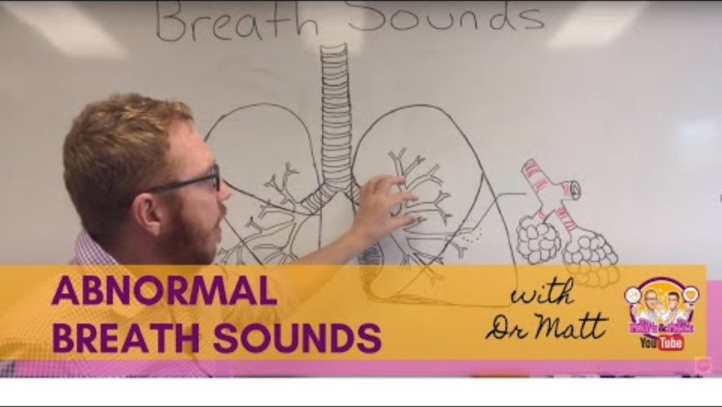
Abnormal Breath Sounds | Respiratory System

Slide 12
References:
Benchmarking of eight recurrent neural network variants for breath phase and adventitious sound detection on a self-developed open-access lung sound database—HF_Lung_V1 | PLOS ONE
Lung and Heart Sounds Analysis: State-of-the-Art and Future Trends - Critical Reviews™ in Biomedical Engineering, Volume 46, 2018, Issue 1 - Begell House Digital Library

