Slide 1
Excess entropy and divalent-ion mobility in multicomponent charged LJ mixtures
HNC screening · replicated MD · thermodynamic integration, pair entropy and 2PT
+0.30 kB
+18–20%
0%
excess entropy gained by HNC-selected solvent designs
divalent-ion self-diffusion, both signs
effect of adding labels without changing interactions
Notes:
Main message: in these model electrolytes, interaction diversity, not the number of components, raises the excess entropy and the mobility of divalent ions. HNC was used to select candidate mixtures; replicated MD with thermodynamic integration (TI) provides the reference entropy and transport. Adding mechanically identical labels raises only the ideal mixing entropy and has exactly zero effect on diffusion.

Slide 2
Design: label count vs interaction diversity
1
HNC screen
Code | Mixture (all with 3% of each ±2 probe) | Role
B3 | 94% LJ solvent | Baseline
B5 | B3 + 5% of each ±1 ion | Salt addition
U4 | 64% solvent + 30% weak solvent, ε = 0.25 | Reference
L5 | U4 with 2 identical weak-solvent labels | Label null
M5 | U4 split into ε = 0.0625 / 0.5625 | Moderate split
H5 | U4 split into ε = 0.01 / 0.81 | Strong split
U6 / H7 | U4 / H5 plus 5% of each ±1 ion | With salt
35 integer-charge, composition and dispersion candidates at T* = 2, ρ* = 0.7; 8 selected
2
Replicated MD
8 mixtures × 3 matched replicas, N = 4000, x(±2) = 0.03; probes matched across mixtures
3
Entropy and transport
TI over 19 densities (fixed LJ cutoff, Debye–Hückel endpoint); MSD in one common COM frame
U4 → M5 → H5 keep charged composition, ionic strength and the mean bare LJ amplitude Σᵢⱼ xᵢxⱼεᵢⱼ = 0.7225 fixed
Notes:
The controls are the core of the design. L5 is mechanically identical to U4 and only adds a label, so it tests whether the number of components matters by itself. M5 and H5 change the distribution of solvent attractions at fixed mean bare amplitude, fixed ionic strength and fixed charged composition. B3/B5 and U6/H7 repeat the comparison with and without monovalent background. Excess entropy is always relative to the ideal mixture of the same composition, so ideal mixing is excluded.

Slide 3
Seven kinds of particles, one size
Solvent A
all mixtures, 54–94%
q = 0, ε = 1
2−
−
Weak solvent B
U4, L5, U6: 30%
q = 0, ε = 0.25
Split solvent B₁ / B₂
M5, H5, H7: 15% each
+
−
−
q = 0, ε = 0.01 / 0.81 (H)
or 0.0625 / 0.5625 (M)
+
2−
2+
2−
Divalent probe ions
all mixtures: 3% each
q = ±2, ε = 1
−
+
2+
+
+
−
Monovalent background
B5, U6, H7: 5% each
2+
2+
q = ±1, ε = 1
2−
All particles: σ = 1, m = 1; εᵢⱼ = √(εᵢεⱼ); Coulomb with Bjerrum length 0.5σ at T* = 2
Cartoon of H7 (2D sketch with roughly its proportions; not simulation data)
Notes:
All species have the same size and mass, so the mixtures differ only in charge and in the strength of the LJ attraction epsilon. The divalent probes are the particles whose mobility we follow. The weak solvent B lowers the average attraction; splitting it into a very weak B1 and a strong B2 keeps the mean amplitude but makes the interactions more diverse. The open dashed circle is the almost non-attractive B1. The picture on the right is a 2D cartoon with roughly H7 proportions, not a simulation snapshot.

Slide 4




HNC for charged mixtures in four steps
1
Pair structure
$$gᵢⱼ\left(r\right),hᵢⱼ=gᵢⱼ−1$$
Probability of finding a j particle at distance r from an i particle, relative to a random mixture
2
Ornstein–Zernike equation
$$hᵢⱼ=cᵢⱼ+Σₖρₖcᵢₖ⊗hₖⱼ$$
Total correlation = direct part + indirect part relayed through every species k (a p × p matrix equation in k space)
3
HNC closure (Morita–Hiroike)
$$gᵢⱼ=exp\left(−βuᵢⱼ+hᵢⱼ−cᵢⱼ\right)$$
Second relation that closes the system; it neglects the bridge diagrams and is accurate for ions
4
Charges (Allnatt; Lomba–Høye)
$$cᵢⱼ→−λBqᵢqⱼ/r$$
Why it is useful here: in HNC the free energy follows in closed form from g and c, so sₑₓ = uₑₓ − aₑₓ costs one solution per mixture, enough to screen dozens of compositions
Coulomb tails decay too slowly to Fourier transform: subtract the screened (Debye) tail analytically and solve for short-ranged parts
Notes:
For students: g(r) is the quantity measured by scattering and computed by simulation. The Ornstein-Zernike equation is exact but introduces a second unknown, the direct correlation function c; a closure relation is needed. The hypernetted-chain closure of Morita and Hiroike sums a large class of diagrams and works well for ionic systems. For charged particles, c behaves like the Coulomb potential at large distances, which cannot be Fourier transformed numerically; following Allnatt, the screened long-range part is treated analytically and only short-ranged functions are discretized, as implemented in the Lomba-Hoye algorithm. The chart is a real HNC result for the B3 mixture: oppositely charged probes form strong contact pairs (peak near 5), like-charged probes avoid each other, and the solvent structure is that of a dense LJ liquid. Finally, HNC gives the excess free energy in closed form, so the excess entropy of each candidate mixture comes from a single solution.

Slide 5
Entropy speeds up ions, less than the solvent
Full designs: Δs_ex ≈ +0.30 kB, probes +18–20%; each sign accelerates separately
Controlled diversity: Δs_ex = +0.103 kB, mean +8–9%, probes +5–6% (resolved by longer runs, next slide)
Labels only (L5/U4): identical diffusion in every replica
Salt only (B5/B3): Δs_ex slightly negative, no resolved speedup
Notes:
Percent changes are exponentiated mean paired log ratios over three matched replicas. The large design changes are robust. The controlled diversification at matched mean amplitude gives a probe response of about 5 percent, roughly half the mean-fluid response. With three replicas its interval was wide and window dependent; the six longer replicas on the next slide resolve it.

Slide 6
Longer runs resolve a +5–6% ion response
−7%
shear viscosity η (Green–Kubo), U4 → H5 and U6 → H7
+1% vs −2 to −3%
D_net·η stays put (Stokes–Einstein); D_probe·η falls: probes only partly carried along
+5.3% / +6.0%
Probe 95% CIs: H5/U4 [+4.0, +6.1]%, H7/U6 [+4.7, +7.1]%. H7/U6 is stable in every MSD window; H5/U4 drops to ≈ +3% beyond 100 τ, so it is quoted as +3 to +5%.
same probe contrasts at N = 8000; D shifts +0.8–1.3%, as Yeh–Hummer predicts
Notes:
Six new matched replicas of B3, U4, H5, U6 and H7, each 5000 tau long, and four replicas at N = 8000. At the primary 20-100 tau window, the probes speed up by 5.1 percent without salt and 5.9 percent with monovalent background, and each sign accelerates separately. The H5/U4 value falls to about 3 percent at long fitting windows because the U4 probes become diffusive slowly, so we quote 3 to 5 percent there; H7/U6 is window independent. The Green-Kubo viscosity explains the difference between mean and probes: diversification lowers eta by about 7 percent and the mean diffusion follows almost exactly, whereas the probe product D eta drops by 2-3 percent, pointing to local solvation. Doubling the box raises all diffusivities by about 1 percent, matching the Yeh-Hummer hydrodynamic correction, and leaves the contrasts unchanged. The old B3 charge-sign asymmetry is not reproduced: -0.0011 [-0.0036, 0.0015].

Slide 7
Tripling the divalent salt leaves the conclusions intact
+0.103 kB
−0.016 kB
Δs_ex(H5−U4) at both concentrations
s_ex shift as HNC predicted
0.73
η −9%
σ_GK / σ_NE in every state (95% CI 0.71–0.75)
Diversification; σ unchanged within ±10%
x(+2)=x(−2)=0.075 (total 0.15), N=4000, 4 matched replicas × 3000τ, ρ*=0.7, T*=2
Notes:
The high-divalent campaign repeats all eight mixtures with four matched replicas of 3000 tau. Its probe diffusion contrasts closely reproduce the lower-concentration results. The controlled entropy increment stays 0.103 kB; absolute excess entropy shifts by about -0.016 kB. The pooled Green-Kubo to Nernst-Einstein conductivity ratio is 0.727 [0.708, 0.746] across 28 replicas. Diversification lowers viscosity by about 9 percent while the conductivity contrast includes zero.

Slide 8
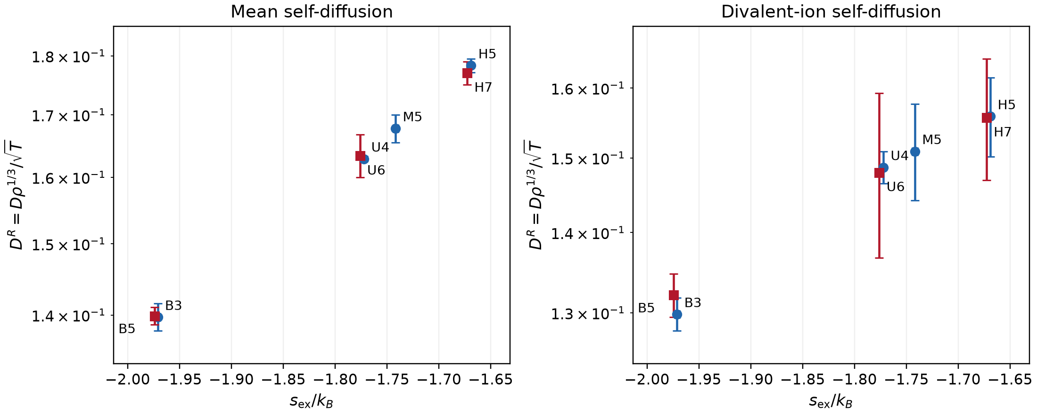
TI entropy tracks mobility; HNC and s₂ follow
≤ 7%
HNC error on the controlled entropy increments
≈ 80%
share of s_ex carried by the MD pair entropy s₂, and of its increments
Descriptive Rosenfeld fits (3–4 mixtures, R² > 0.99): B_net ≈ 0.8, B_probe ≈ 0.6. Controlled local probe slopes ≈ 0.6 × the mean-fluid value. Absolute HNC entropies are 0.06–0.09 kB too low; increments are much better.
−0.33 kB
beyond-pair residual s_ex − s₂: composition dependent, not negligible
Notes:
Excess entropy from thermodynamic integration is the reference coordinate. Both mean and probe diffusion increase with it, but the probe slope is weaker. HNC is an efficient screening tool: it orders the mixtures correctly and predicts the increments within about 7 percent, although absolute values are too negative. The MD pair entropy reproduces the ordering, but leaves a beyond-pair residual of about a third of a kB per particle.

Slide 9
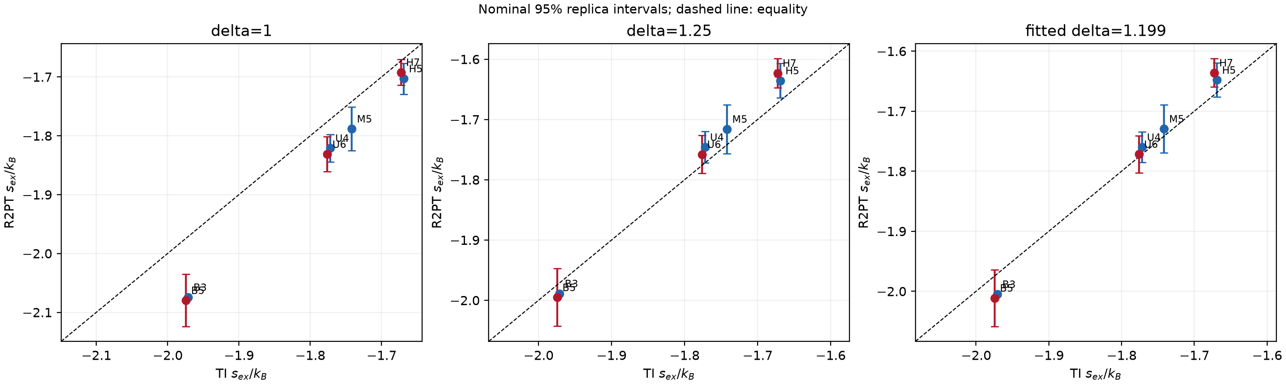
2PT when TI is unfeasible: calibrate, then rank
Calibrate one δ
Good within a family
Limits
Fit over 7 mixtures: δ* = 1.20 [1.17, 1.23]; δ = 1.25 cuts RMS bias 0.067 → 0.029 kB; held-out bias 0.030 kB
M5/U4 and H5/U4 increments reproduced within 0.01 kB; label split exactly zero
H7/U6 +30%, baseline → design +17–23%; D enters the fluidicity, so 2PT cannot test an entropy–diffusion link on its own
Notes:
2PT needs only one short dense trajectory instead of a 19-density isotherm. The partition exponent delta is phenomenological; a single value calibrated over all mixtures fixes the overall level, giving absolute excess entropies within about 0.03 kB. The bias curves are nearly parallel in delta, so the composition-dependent part of the error does not go away: comparisons across solvent families or with salt are overestimated by 17 to 30 percent. Recommended use: calibrate delta on two or three TI anchor states, then rank candidates. Because diffusion enters the fluidicity, a 2PT entropy-diffusion correlation is not independent evidence.

Slide 10
Next: fast entropy estimators for electrolytes
2PT, velocity based
Ready
Voronoi cluster entropy
Open
Calibrated δ ≈ 1.2–1.25 for this model family
One dense trajectory per candidate
Use for ranking; recalibrate on TI anchors
Not independent of diffusion
24 trajectories packaged with TI, s₂ and D references
Must reproduce TI order, the 0.03 and 0.10 kB increments and the label null
Structure based, so independent of transport
1
HNC screen
2
TI anchors
3
2PT / Voronoi
4
Conductivity
candidate mixtures
2–3 states to calibrate and validate
rank many candidates
Green–Kubo current: σ ≈ 0.73 σ_NE at x(±2)=0.075
Next physics test: probe–solvent coordination, association lifetimes and exchange kinetics — does weaker local caging control the ion mobility?
Conclusions hold at x(±2)=0.075; conductivity is set by carrier number and D (σ ≈ 0.73 σ_NE), not by diversification
Notes:
For complex electrolytes, TI over a full isotherm for every candidate is too expensive. A practical route: screen with HNC, compute TI only for a few anchor states, and use a cheaper estimator to rank the rest. 2PT is usable now once delta is calibrated, but it borrows information from diffusion. The Voronoi cluster entropy is open: the data package is ready, and it must reproduce the TI ordering, the controlled increments and the label null. Because it uses structure only, it would give an entropy coordinate independent of transport. Finally, conductivity enhancement must be measured from the charge-current autocorrelation; self-diffusion and Nernst-Einstein estimates miss ion correlations.

