Slide 1
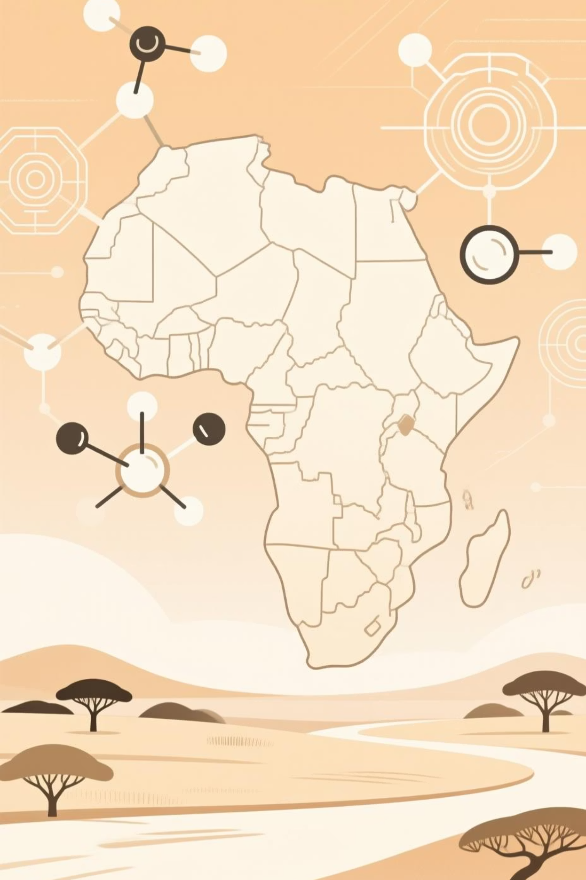
Quantum Drug Discovery for Malaria & TB
Leveraging Variational Quantum Eigensolver and Quantum Machine Learning to accelerate therapeutic development

