Slide 1
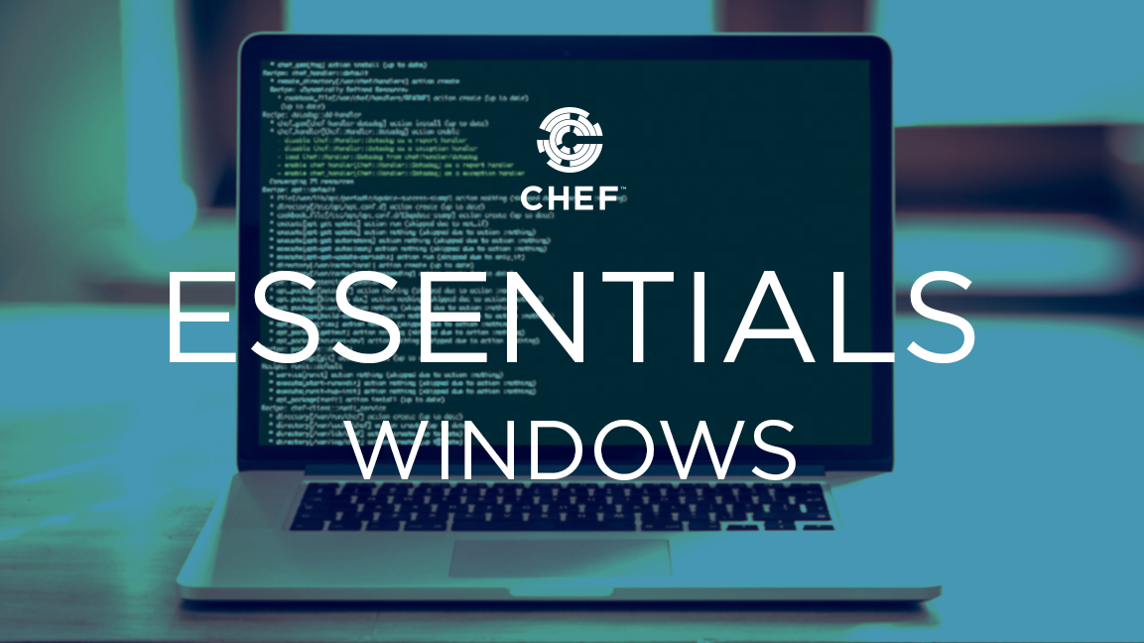
Chef Essentials
Introduction
Notes:
This Chef Essentials course provides a basic understanding of Chef's core components, basic architecture, commonly used tools, and basic troubleshooting methods.
This should provide you with enough knowledge to start using Chef to automate common infrastructure tasks and express solutions to common infrastructure problems.
Instructor Note: Be sure to read Appendix Z for Chef DK version requirements, the training lab set up notes and additional instructor notes.
Also, be sure to read the "About Copy/Paste" section of Appendix Z...The participant and instructor guides don’t lend themselves to copy/paste very well, depending on your PDF viewer. We expect participants to type commands and code rather then relying on copy/paste. (The exceptions are some gist URLs in Day 2 and some other instances where long code has been pasted below some slides in the guides. Such code that is found below slides can be copied.)

Slide 2
Introduce Yourselves
Name
Current job role
Previous job roles/background
Experience with Chef and/or config management
Expectations

Slide 3
Expectations
You will leave this class with a basic understanding of Chef's core components, architecture, commonly used tools, and basic troubleshooting methods.
You bring with you your own domain expertise and problems. Chef is a framework for solving those problems. Our job is to teach you how to express solutions to your problems with Chef.
Notes:
Chef is not, in itself, a solution to your infrastructure problems. Chef is an automation framework. You bring the domain expertise about your own business and its problems. Chef provides a platform for modeling solutions to those problems. Our job in this class is to work together to teach you how to express solutions to your unique problems with Chef.
Together we get unicorns and rainbows, but we can't have one without the other.

Slide 4
Course Objectives
After completing this course, you should be able to:
Use Chef Resources to define the state of your system
Write and use Chef recipes and cookbooks
Manage multiple nodes with Chef Server
Create Organizations
Bootstrap nodes
Apply Integration Testing and Unit Testing

Slide 5
Agenda
Day 1
Day 2
Getting a Workstation
Using Resources
Building Cookbooks
chef-client
Ohai and the Node Object
Roles
Connecting to Chef Server
Community Cookbooks
Chef Search
Why Write Tests?
Writing a Test First
Refactoring Cookbooks with Tests
Faster Feedback with Unit Testing
Testing Resources in Recipes
Refactoring to Attributes

Slide 6
Chef
Chef can automate how you build, deploy, and manage your infrastructure.
Chef can integrate with cloud-based platforms such as Rackspace and Amazon Elastic Compute Cloud to automatically provision and configure new machines.
Notes:
Chef can automate how you build, deploy, and manage your infrastructure. Your infrastructure becomes as versionable, testable, and repeatable as application code enabling you to automate the process of configuring, deploying and scaling servers and applications

Slide 7
Chef
Chef is a large set of tools that are able to be used on multiple platforms and in numerous configurations.
Learning Chef is like learning a language. You will reach fluency very fast but it will take practice until you become comfortable.
A great way to learn Chef is to use Chef
Notes:
Chef is a large set of tools that are able to be used on multiple platforms and in numerous configurations. We will have time to only explore some of its most fundamental pieces.
Learning Chef is like learning a language. You will reach fluency very fast but it will take practice until you become comfortable.

Slide 8
Chef Fundamentals
Ask Me Anything: It is important that we answer your questions and set you on the path to find more.
Break It: If everything works the first time go back and make some changes. Break it!
Notes:
Ask Me Anything: All of us are coming here with unique experiences and from unique teams that are using Chef in unique ways. It is important that we answer your questions and set you on the path to find more.
Break It: If everything works the first time go back and make some changes. Break it! It's rare that you have a safe space like this to explore. Sometimes its more important to know what something looks like when it does not work than when it does work.

Slide 9
Chef Lab System Architecture
In this course you will use two different architectures:
Initially, you'll use a virtual workstation so you can start using Chef right away.
Later, you'll use a common production type of architecture that includes a Chef Server.

Slide 10
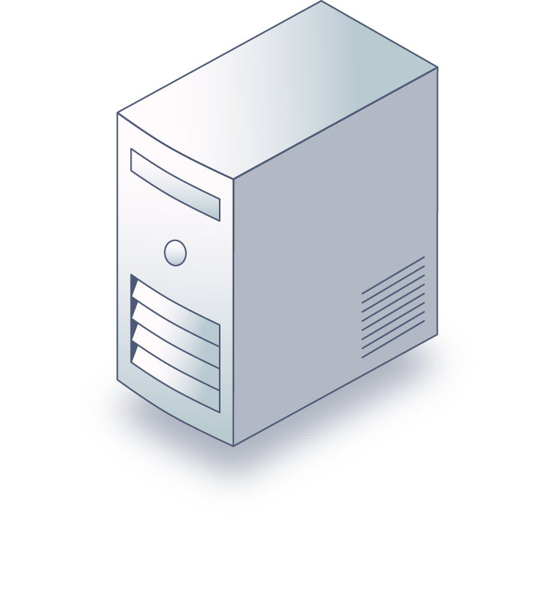
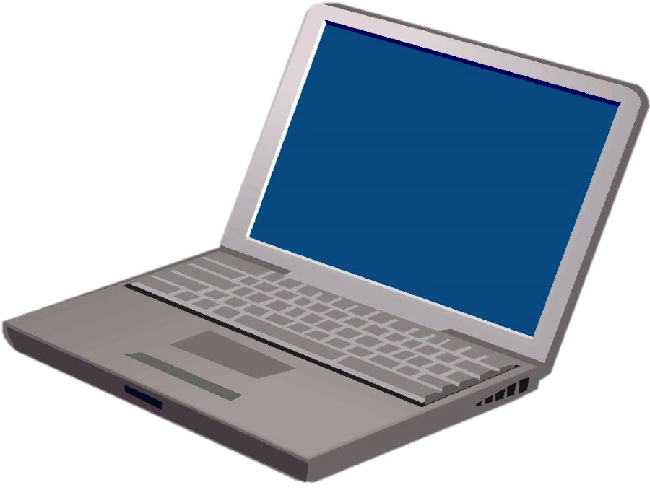
Chef Lab System Architecture
Architecture 1
Virtual Workstation
Preconfigured with Chef tools
Your Laptop
Notes:
This is the architecture you'll start using in a few minutes. To ensure the smoothest setup experience, you'll be using a virtual workstation with all the necessary tools installed so you can start using Chef right away.

Slide 11
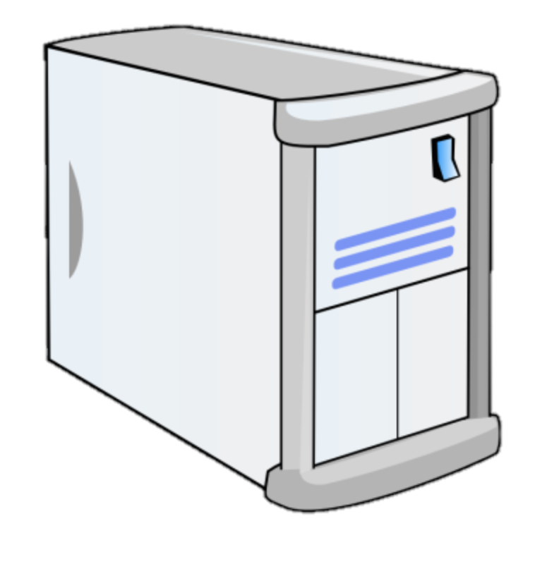
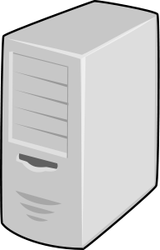
Chef Lab System Architecture
Architecture 2
Chef Server
Your Local Workstation
Nodes
Notes:
This is the architecture you'll be using later in this course. When using this architecture, the Chef tools will be installed on your laptop and you'll perform your configurations locally before pushing them to the Chef server and ultimately to the nodes you will be managing.
In this way, when you complete this course you will have a code repository on your laptop that can be used and modified to solve real business problems.
We'll discuss the items in this architecture in more detail later in this class.

Slide 12
Configuring a Workstation
We need the following:
Chef Development Kit (ChefDK)
Editor (we recommend Atom or Visual Studio Code)
Notes:
Note that Notepad will not be sufficient for an Editor; we recommend using Atom or Visual Studio Code.

Slide 13
Hands-on Legend
GL or Group Lab: All participants and the instructor do this task together with the instructor often leading the way and explaining things as we proceed.
Lab: You perform this task on your own.
Notes:
In this course, various slides and pages will be tagged with either Group Lab (or GL), or Lab. This slide defines those tags.

Slide 14
Group Lab: Pre-built Workstation
We will provide for you a workstation with all the tools installed.
Login to the Remote Workstation
Notes:
As I mentioned there is a lot work planned for the day. To ensure we focus on the concepts we introduce and not on troubleshooting systems we are providing you a workstation with the necessary tools installed to get started right away.
Instructor Note: At the end of the training it is often a good idea to offer your services to help individuals install necessary software or troubleshoot their systems.

Slide 15
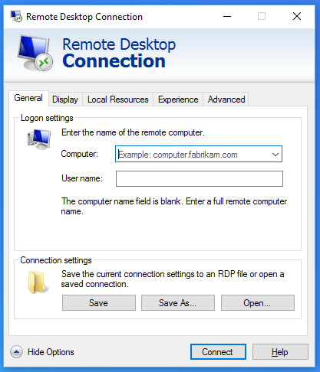
GL: Login to the Remote Workstation
Use the address, user name, and password to connect to the remote workstation.
Notes:
Username: Administrator
Password: Cod3Can!

Slide 16
Group Lab: Pre-built Workstation
We will provide for you a workstation with all the tools installed.
Login to the Remote Workstation
Notes:
Now that you are connected to that workstation we have taken care of all the necessary work to get started with the training.

