Slide 1
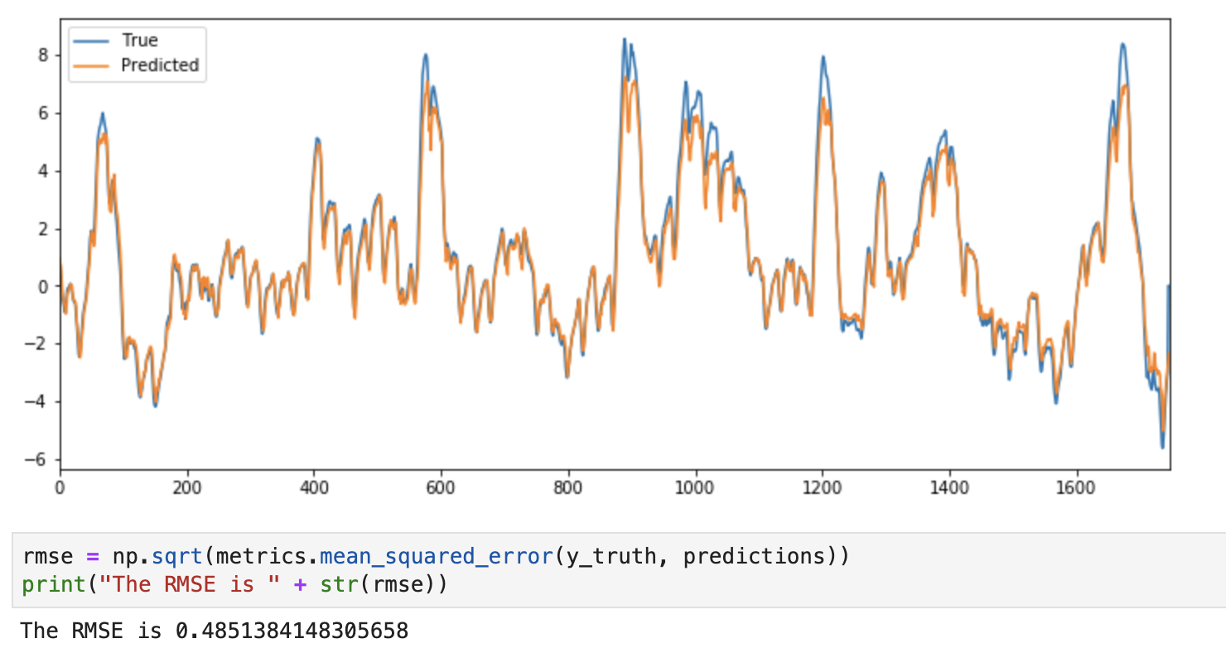
Deep-Voltage
Goal
Predict the difference in temperature inside the rock based on easy measurable KPI for the next coming hour
Motivation: Modulate sampling rate of the instrument based on hourly temperature prediction.
Benefit:
Save the energy by switching off during silent time spans
Reduce the amont of data to be collected and analyzed
Current status: adaptive models RMSE = 0.9
Our model (LSTM) RMSE = 0.48
Inputs
temperature_5cm [°C],
temperature_10cm [°C], temperature_20cm [°C], temperature_30cm [°C], temperature_50cm [°C], temperature_100cm [°C], wind_speed_average [km/h],
net_radiation [Wm^-2], season
Model
LSTM
Target
Delta T (1h)

