Slide 1
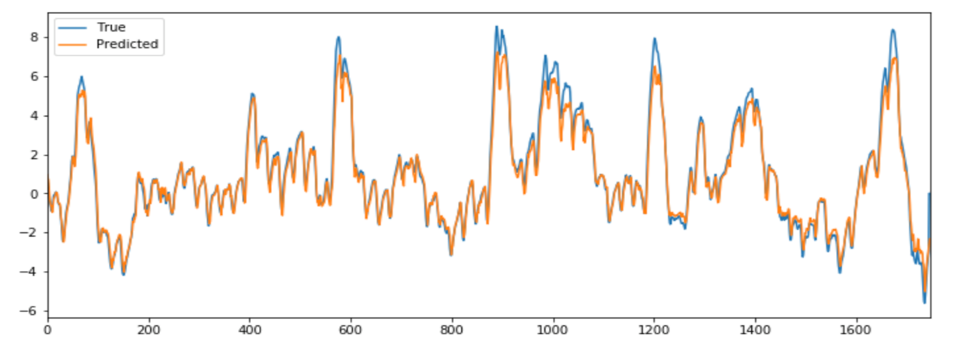
Deep-Voltage
Goal
Predict the difference in temperature inside the rock based on easy measurable KPI for the next 1,4,10, 24 hours.
Motivation: Modulate sampling rate of the instrument based on hourly temperature prediction.
Benefit:
Save the energy by switching off during silent time spans
Reduce the amont of data to be collected and analyzed
Current status: adaptive models RMSE = 5,41
Our model (LSTM) RMSE = 5,36
Inputs
temperature_10cm [°C],
temperature_35cm [°C],
temperature_60cm [°C], temperature_85cm [°C],
wind_speed_average [km/h],
net_radiation [Wm^-2],
season
Model
LSTM
Target
Delta T (10 h)

