Slide 1
Sprint #4 Retrospective
Software engineering II
Politecnico di Torino, a. y. 2019/2020
Group F

Slide 2
1. PROCESS MEASURES

Slide 3
1.1 Macro Statistics
 | Committed | Implemented
Stories | 5 | 5
Points | 29 | 29
 | Planned | Spent
Hours | 71 | 70

Slide 4
1.2 Detailed Statistics (continued)
Story Number | #Tasks | Points | Total Hours Estimation | Total Hours Spent
0 | 20 | / | 29.5 | 30.5
16 | 7 | 13 | 9 | 11
17 | 6 | 5 | 8.5 | 6.5
18 | 6 | 3 | 7 | 7
19 | 7 | 3 | 9 | 5.5
20 | 6 | 5 | 8 | 9.5
TOTAL | 52 | 29 | 71 | 70

Slide 5
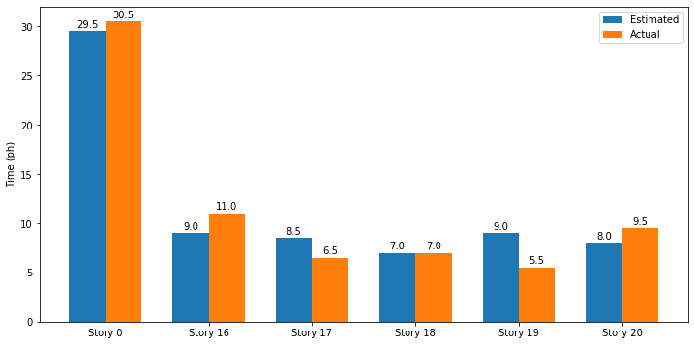
1.2 Detailed Statistics (continued)

Slide 6
Hours per task* | Total task estimation error ratio**
1.23, σ=0.5 | 1.044
* bugs are not considered
** sum of total hours estimation / sum of total hours spent from previous table

Slide 7
2. QUALITY MEASURES

Slide 8
2.1 Story #16 – Quality Measures
Unit testing
Total hours estimated | Total hours spent | Number of automated unit tests | Coverage
1.5 | 1.5 | 4 | N/A
E2E testing
Code review
Total hours estimated | Total hours spent
1.5 | 1.5
Total hours estimated | Total hours spent
1 | 1

Slide 9
2.1 Story #17 – Quality Measures
Unit testing
Total hours estimated | Total hours spent | Number of automated unit tests | Coverage
1.5 | 1 | 1 | N/A
E2E testing
Code review
Total hours estimated | Total hours spent
1.5 | 1
Total hours estimated | Total hours spent
1 | 1

Slide 10
2.1 Story #18 – Quality Measures
Unit testing
Total hours estimated | Total hours spent | Number of automated unit tests | Coverage
1.5 | 1 | 5 | N/A
E2E testing
Code review
Total hours estimated | Total hours spent
1.5 | 1.5
Total hours estimated | Total hours spent
1 | 1

Slide 11
2.1 Story #19 – Quality Measures
Unit testing
Total hours estimated | Total hours spent | Number of automated unit tests | Coverage
1.5 | 0.5 | 3 | N/A
E2E testing
Code review
Total hours estimated | Total hours spent
1.5 | 1
Total hours estimated | Total hours spent
1 | 1

Slide 12
2.1 Story #20 – Quality Measures
Unit testing
Total hours estimated | Total hours spent | Number of automated unit tests | Coverage
1.5 | 2 | 12 | N/A
E2E testing
Code review
Total hours estimated | Total hours spent
1.5 | 1.5
Total hours estimated | Total hours spent
1 | 1

Slide 13
2.2 Technical Debt Management
Using SonarCloud
Total hours estimated | Total hours spent
8 | 10
Number of days | Debt ratio | Rating Reliability | Rating Security | Rating Maintainability
2 | 0.9 | A | A | A

Slide 14
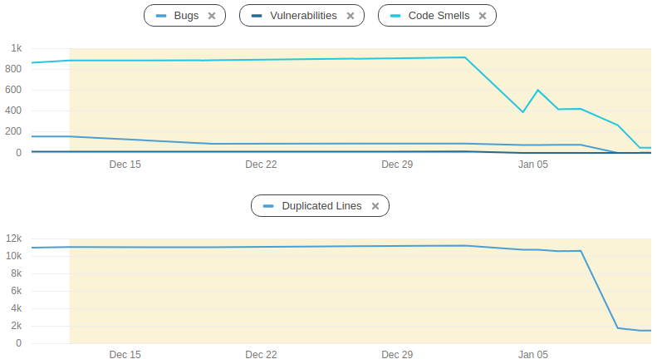
2.2 Technical Debt Management

Slide 15
3. ASSESSMENT

Slide 16
3.1 Errors in estimation
We were good at estimating the time needed for tasks: we exactly predicted around half of them (more than the ones we correctly estimated in last sprint), while for the remaining ones we had some overestimation and underestimation, overall balanced. We also provided a better estimation for tasks that include some technical skill to be learned by us.
In general, our estimations have significantly improved throughout the project, once we got a better understanding of our skills and the technologies used.

Slide 17
3.2 Lessons learned
Positive
Code quality analysis through Sonar is essential to understand the quality of the code produced; scheduling time to improve quality of already written code is necessary
Estimation should include some margin to take into account eventual issues
Importance of docker container to test deployment to target platform and avoid portability errors between different systems
Negative
Having team members partially specialized in some technical contexts causes the team to be less reactive to changes, especially in case that some new code produces/exposes faults in already existing code, that needs to be adapted

Slide 18
3.3 Goal achieved
Well structured team work, with linear progression of task implementation, thanks to internal coordination.
Service correctly deployed in a docker container, use of the latter for demo presentation.
Higher quality software, thanks to useful tools for quality analysis, both on new and already developed code.

Slide 19
3.4 Failed goals
Demo presentation not discussed long enough, although stories were completed days before the sprint end.
It is not only important to develop a good product, but also being able to demonstrate and sell it to the customers!

Slide 20
3.5 Improvements
Being Docker not available for Windows 10 Home, only half of the members were able to test the code on it.
It would have been useful (in a hypothetical future sprint) to provide a simulated target environment (using the cloud or the docker in virtual machines) to every team member, so everyone could have tested directly his modifications on acopy of] the target platform.

Slide 21
3.6 What we are proud of
Improved code quality thanks to SonarCloud suggestions: we learned about better coding style, how to reduce vulnerabilities and write maintainable code.

