Slide 1
Sprint #1 Retrospective
Software engineering II
Politecnico di Torino, a. y. 2019/2020
Group F

Slide 2
Stories and points
 | Committed | Implemented
Stories | 6 | 6
Points | 37 | 37
* not including story 0 (used for project setup)

Slide 3
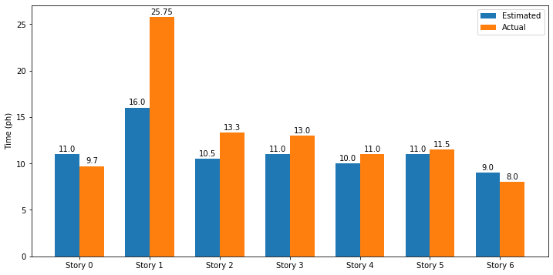
Stories and time

Slide 4
Stories organization
Story Number | #Tasks
0 (setup) | 7
1 | 13
2 | 8
3 | 8
4 | 8
5 | 8
6 | 7
TOTAL | 46

Slide 5
What went wrong
Wrong estimations: mainly test underestimation, because no previous experience with web application testing
Unbalanced work distribution among the sprint: too much effort at the end and not much at the beginning, causing overload and stress in the last days
Not full agreement on programming style: same logic implemented in different ways among different pages, making code review painful and slower

Slide 6
How to improve
Testing problems, hopefully, will not affect next sprint, since we learned the basic concepts and we will be able to apply them more easily
Add an internal deadline a few days before the official deadline, to use the remaining time for demo preparation
Define coding standards, internal conventions and common interfaces to make it easier to read code written by other group members

Slide 7
What was good
Good organization and cooperation between team members
Balanced task division and constructive discussions about implementation details
New technical skills developed (testing tools and PHP frameworks)

