Slide 1
Sprint #2 Retrospective
Software engineering II
Politecnico di Torino, a. y. 2019/2020
Group F

Slide 2
Stories and points
 | Committed | Implemented
Stories | 5 | 4
Points | 18 | 16
* fixes from previous sprint are not included

Slide 3
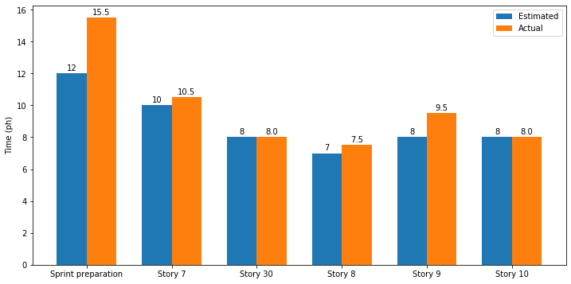
Stories and time

Slide 4
Stories organization
Story Number | #Tasks
sprint preparation* | 16
7 | 7
30 | 7
8 | 6
9 | 7
10 | 7
TOTAL | 50
* fixes from previous sprint​

Slide 5
What went wrong
Task assignments (to each member) were not defined before the sprint, some tasks remained untouched without anyone taking responsibility for them
Internal deadline (proposed in the previous sprint to reduce overload in the last days before demo) was proposed but not respected
Personal issues for one team member slowed down development and affected organization

Slide 6
How to improve
Decide a raw division of tasks among members, to reduce organizational issues and avoid unbalanced task division
"Force" the team to complete the main part of development in the first part of the sprint, to be able to use the remain part for refinement
Be prepared to unplanned events and to deal with them

Slide 7
What was good
Testing was painless, after initial issues in previous sprint
We are getting better with task estimations
Constructive discussions to overcome problems faced during the sprint and agreement on how to proceed next time in same situation
New technologies learned (docker for example) and improved programming skills

