Slide 1
Sprint #3 RETROSPECTIVE
Software engineering II
Politecnico di Torino, a. y. 2019/2020
Group F

Slide 2
1. PROCESS MEASURES

Slide 3
1.1 MACRO STATISTICS
 | Committed | Implemented
Stories | 5 | 5
Points | 28 | 28
 | Planned | Spent
Hours | 54.5 | 58

Slide 4
1.2 DETAILED STATISTICS (CONTINUED)
Story Number | #Tasks | Points | Total Hours Estimation | Total Hours Spent
0 | 7 | / | 14.5 | 14.5
11 | 8 | 2 | 11 | 11.5
12 | 5 | 2 | 7 | 6
13 | 6 | 3 | 7.5 | 8
14 | 6 | 8 | 7.5 | 8.5
15 | 5 | 13 | 7 | 9.5
TOTAL | 37 | 28 | 54.5 | 58

Slide 5
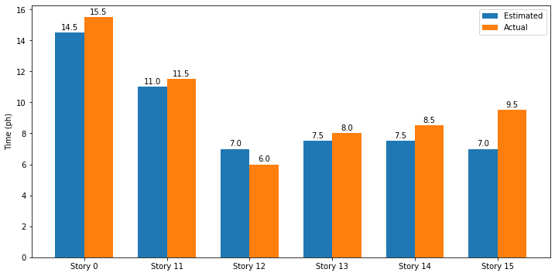
1.2 DETAILED STATISTICS (CONTINUED)

Slide 6
Hours per task* | Total task estimation error ratio**
1.43, σ=0.478 | 0.94
* story #0 is not considered
** sum of total hours estimation / sum of total hours spent from previous table

Slide 7
2. QUALITY MEASURES

Slide 8
2.1 STORY #11 – QUALITY MEASURES
Unit testing
TOTAL HOURS ESTIMATED | TOTAL HOURS SPENT | NUMBER OF AUTOMATED UNIT TESTS | COVERAGE
1.5 | 1.5 | 8 | N/A
E2E testing
Code review
TOTAL HOURS ESTIMATED | TOTAL HOURS SPENT
1.5 | 1.5
TOTAL HOURS ESTIMATED | TOTAL HOURS SPENT
1 | 1

Slide 9
2.1 STORY #12 – QUALITY MEASURES
Unit testing
TOTAL HOURS ESTIMATED | TOTAL HOURS SPENT | NUMBER OF AUTOMATED UNIT TESTS | COVERAGE
1.5 | 1 | 3 | N/A
E2E testing
Code review
TOTAL HOURS ESTIMATED | TOTAL HOURS SPENT
1.5 | 1
TOTAL HOURS ESTIMATED | TOTAL HOURS SPENT
1 | 1

Slide 10
2.1 STORY #13 – QUALITY MEASURES
Unit testing
TOTAL HOURS ESTIMATED | TOTAL HOURS SPENT | NUMBER OF AUTOMATED UNIT TESTS | COVERAGE
1.5 | 2 | 9 | N/A
E2E testing
Code review
TOTAL HOURS ESTIMATED | TOTAL HOURS SPENT
1.5 | 1.5
TOTAL HOURS ESTIMATED | TOTAL HOURS SPENT
1 | 1

Slide 11
2.1 STORY #14 – QUALITY MEASURES
Unit testing
TOTAL HOURS ESTIMATED | TOTAL HOURS SPENT | NUMBER OF AUTOMATED UNIT TESTS | COVERAGE
1.5 | 1.5 | 4 | N/A
E2E testing
Code review
TOTAL HOURS ESTIMATED | TOTAL HOURS SPENT
1.5 | 1
TOTAL HOURS ESTIMATED | TOTAL HOURS SPENT
1 | 1

Slide 12
2.1 STORY #15 – QUALITY MEASURES
Unit testing
TOTAL HOURS ESTIMATED | TOTAL HOURS SPENT | NUMBER OF AUTOMATED UNIT TESTS | COVERAGE
1.5 | 2 | 4 | N/A
E2E testing
Code review
TOTAL HOURS ESTIMATED | TOTAL HOURS SPENT
1.5 | 2
TOTAL HOURS ESTIMATED | TOTAL HOURS SPENT
1 | 1.5

Slide 13
3. ASSESSMENT

Slide 14
3.1 ERRORS IN ESTIMATION
- Our estimations were quite close to the actual time spent: some stories/tasks were overestimated or underestimated, but they compensated, resulting in an overall prediction close to the real time spent.
- Our estimation ability is getting better with the passing of the sprints, as expected, since we are getting used to this kind of approximations and we can relate to our past experience.

Slide 15
3.2 LESSONS LEARNED
Positive
Communication and discussions can speed up decision making and make collaboration easier.
A strict subdivision of the tasks of the stories, letting some common tasks unassigned and chosen during the sprint, seems the best solution for our team
Negative
Lack of professionality of some team members, trying to do the minimum they can and disappearing, reduces the productivity of the team.
There are some code smells and security issues that showed up during SonarCloud code inspection, to be fixed in the next sprint.

Slide 16
3.3 GOAL ACHIEVED
- For the first time we were able to complete the tasks a few days in advance, being able to exploit the last days for visual testing of the whole application and demo preparation.
- This was made possible by the continuous interactions that allowed us to proceed in a synchronized way, getting fast feedback and quick suggestions.

Slide 17
3.4 FAILED GOALS
- Having a functioning application some days before the demo: even if the stories were completed in advance, we did not test the whole system until a few days before the demonstration.
- Stories, even if completed, were not working properly together and the behaviour was not the same on different operating systems.

Slide 18
3.5 IMPROVEMENTS
- Referring to the previous slide, the main solution is to use Docker container to try the application before the demo, as suggested in the course.
- In this way we can be sure that everything is fine and the application behaviour is the one expected in the target operating system.

Slide 19
3.6 WHAT WE ARE PROUD OF
Improved technical abilities in both writing code and reading code written by someone else.
Ability of working together as a team, coordinating the development and helping each other.

