Slide 1
Wahl-Informationssystem

Slide 2


Main Design Goals
Close to reality
Performance
Accessibility

Slide 3
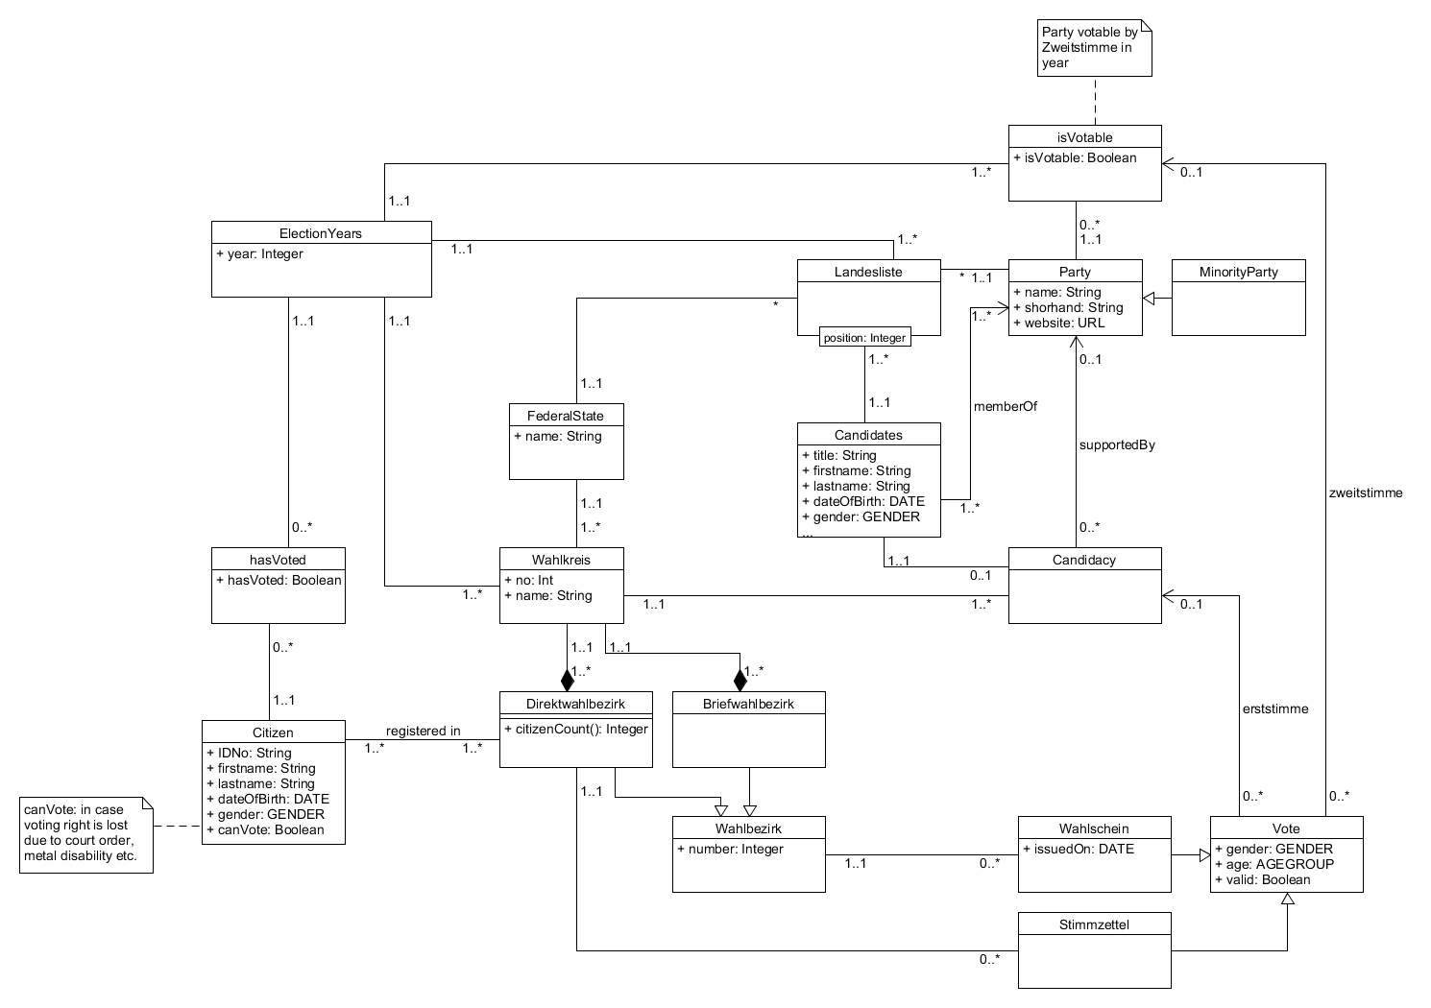
Concept Model
Goal:
detailed modelling
of the real world domain

Slide 4
Concept Model
Wahlkreise divided in
Direktwahlbezirke
(ballout box voting)
Briefwahlbezirke
(absentee voting)

Slide 5
Concept Model
Partys can be minority parties
→ ability to relaize the Sperrklausel

Slide 6
Result Calculation
Results are calculated by pure SQL (stored procedures)
Use of the Höchstzahlverfahren
Can be easily realized with window functions
No procedures needed to find divisor as with the Divisorverfahren
Votes are aggregated on insert by trigger
Wahlbezirk → Wahlkreis → Federalstate

Slide 7
Archiving Completed Elections
No calculation for completed elections
Results_Delegates
Results_Delegates_Current
Results_Delegates_Old
unioned
Copied at end of election

Slide 8
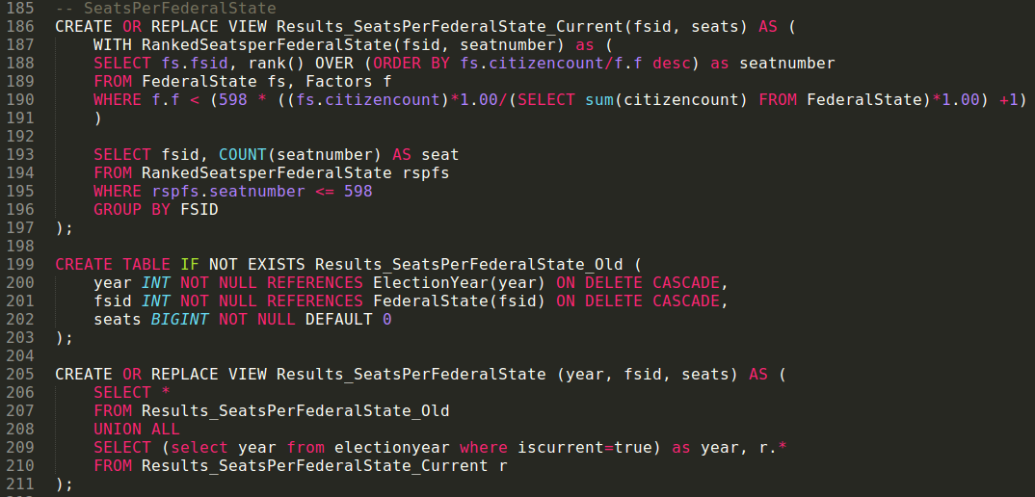
SQL-Code, Höchstzahlverfahren

Slide 9
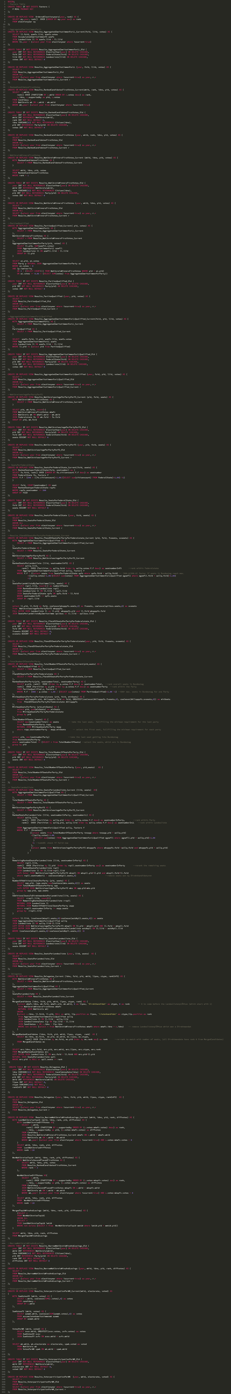

Slide 10
Performance

