Slide 1
Wahl-Informationssystem

Slide 2



Main Design Goals
Modeled close to reality
Performance
Accessibility

Slide 3


Technologies
Notes:
Used technologies: postgres and nodeJS
Both open source
Postgres is a mature database
Node is useful for fast prototype-like development

Slide 4

Modeling

Slide 5
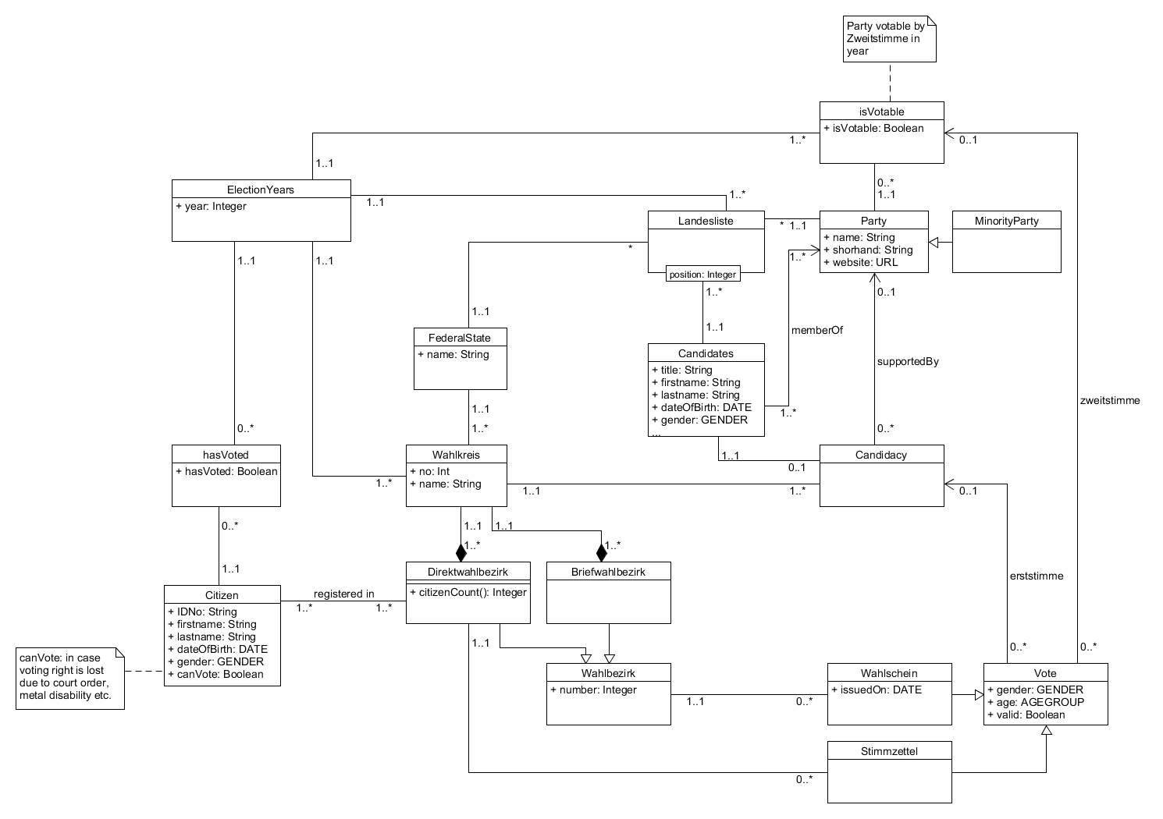
Conceptual Model
Goal:
detailed modelling
of the real world domain

Slide 6
Conceptual Model
Wahlkreise divided in
Direktwahlbezirke
(ballot box voting)
Briefwahlbezirke
(absentee voting)

Slide 7
Conceptual Model
Partys can be minority parties
→ ability to realize the Sperrklausel

Slide 8
Performance

Slide 9
Result Calculation
Results are calculated by pure SQL (no stored procedures)
Use of the Höchstzahlverfahren
Can be easily realized with window functions
No procedures needed to find divisor as with the Divisorverfahren
Votes are aggregated on insert by trigger
Wahlbezirk → Wahlkreis → Federalstate

Slide 10
Archiving Completed Elections
No calculation for completed elections
Results_Delegates_Current

Slide 11
Archiving Completed Elections
No calculation for completed elections
Results_Delegates_Current
Results_Delegates_Old

Slide 12
Archiving Completed Elections
No calculation for completed elections
Results_Delegates
Results_Delegates_Current
Results_Delegates_Old
unioned

Slide 13
Archiving Completed Elections
No calculation for completed elections
Results_Delegates
Results_Delegates_Current
Results_Delegates_Old
unioned
Copied at end of election

Slide 14
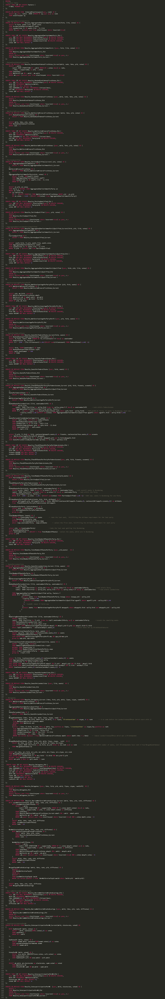

Slide 15
Benchmark
10
Σ | 6503 | According to node
Q1 | 15051ms | 178ms
Q2 | 15354ms | 305ms
Q3 | 15350ms | 172ms
Q4 | 14807ms | 218ms
Q5 | 15261ms | 163ms
Q6 | 15633ms | 166ms
Actor (n)
500
ms delay (t)
10
Min runtime
Notes:
20 requests per second
Benchmark client logs linear increase in response time
Node logs constant response time < 400ms
Node takes very long to start processing the requests
Actual processing, including database queries, are very fast

Slide 16
Pretty safe to say:
node is the limiting factor here
Notes:
Possible way to solve this: Multiple node server with nginx load balancer
Should result in low response times for much longer

Slide 17
Elections are general

Slide 18
Elections are general
i.e. for (almost) everyone
Notes:
Goal: Not exclude people with e.g. disabilities

Slide 19
Accessibility

Slide 20
W3C Web Content Accessibility Guidelines 1.0
Notes:
- Content / presentation separation (HTML / CSS)
- Alternative textual description
- Color independence
- Relative units for scaling
- Screen reader friendlieness
- Device independence
- High contrast
- Legible Fonts
- Etc.

Slide 21
No JavaScript
Notes:
Excludes people with JavaScript disabled
Problems with screen readers

Slide 22
Demo

Slide 23
SQL-Code, Höchstzahlverfahren
-- SeatsPerFederalState
CREATE OR REPLACE VIEW Results_SeatsPerFederalState_Current(fsid, seats) AS (
WITH RankedSeatsperFederalState(fsid, seatnumber) AS (
SELECT fs.fsid, rank() OVER (ORDER BY fs.citizencount/f.f desc) AS seatnumber
FROM FederalState fs, Factors f
WHERE f.f < (598 * ((fs.citizencount)* 1.00 / (SELECT sum(citizencount) FROM FederalState) * 1.00) + 1)
)
SELECT fsid, COUNT(seatnumber) AS seat
FROM RankedSeatsperFederalState rspfs
WHERE rspfs.seatnumber <= 598
GROUP BY fsid
);
CREATE TABLE IF NOT EXISTS Results_SeatsPerFederalState_Old (
year INT NOT NULL REFERENCES ElectionYear(year) ON DELETE CASCADE,
fsid INT NOT NULL REFERENCES FederalState(fsid) ON DELETE CASCADE,
seats INT NOT NULL DEFAULT 0
);
CREATE OR REPLACE VIEW Results_SeatsPerFederalState(year, fsid, seats) AS (
SELECT *
FROM Results_SeatsPerFederalState_Old
UNION ALL
SELECT (SELECT year FROM electionyear WHERE iscurrent=true) AS year, r.*
FROM Results_SeatsPerFederalState_Current r
);

