Slide 1

Golden Girls Fund: ESG Investment Strategy in the Food Manufacturing Industry
Portfolio Strategy, Impact, and Performance
FINA 4920: ESG Investing
Erik Loualiche
By: Christy Hoang, Emerson Oliver, Isabelle Erhart, Rhylee Haensel, Ellie Berglin, Megan Smith, Julia Urban
Notes:
Today, we will present our ESG investment strategy in the Food Manufacturing Industry, highlighting our portfolio's impact, strategy, and performance. Our team has analyzed how ESG factors influence investment decisions in this sector and how we can drive sustainable growth while maximizing returns.

Slide 2
Food Manufacturing Industry
Packaged and Processed Foods
Heinz H.J. Co.
Conagra Inc.
Hormel Foods Corp
Agricultural Products
Compass Minerals Intl Inc.
Archer Daniels Midland Co.
Beverages
Green Mountain
Coffee Roasters
Ingredients & Additives
Compass Minerals
Intl Inc
Confectionary
Hershey Co.
General Mills Inc
Kellogg Co.
Notes:
The food manufacturing industry consists of several key sectors including packaged and processed foods, beverages, confectionary, Ingredients and additives, and agricultural products. It plays a crucial role in global food supply but faces significant ESG challenges. Therefore, it is crucial that companies in this industry continue to improve ESG initiatives.
Iz

Slide 3
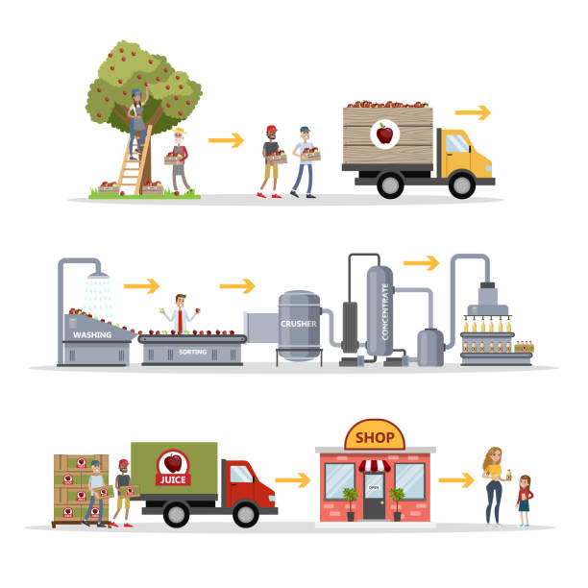
The ESG Case for Food Manufacturing
Massive environmental impact 🡪 26% of global emissions from food systems
Supply chain complexity 🡪 ESG risks in labor, water use, and deforestation
Consumer-driven ESG transformation 🡪 Demand for organic, ethical sourcing
Regulatory factors 🡪 Government pressure
Notes:
Iz:
One of the biggest sectors driving environmental and social impact is food manufacturing.
This is why our team chose this industry, because it directly affects global sustainability, consumer behavior, and regulatory frameworks.
food manufacturing is an important sector for ESG investing—not just for our fund, but for global sustainability efforts.
Food manufacturing has a massive environmental impact: 26% of global greenhouse gas emissions come from food production, making it one of the most polluting industries. Key concerns include deforestation, methane from livestock, and water pollution.
Consumer-Driven ESG Transformation – Demand for organic, fair-trade, and plant-based products is growing.
Supply Chain Complexity & ESG Risks – The industry faces labor exploitation, water scarcity, and biodiversity loss
Regulatory Pressure – Governments are enforcing carbon reduction targets, stricter emissions reporting, and sustainable sourcing mandates (EU Green Deal, SEC Climate Disclosure)
ESG investing in food manufacturing isn’t just about ethics. It’s also about risk management and long-term profitability. The food industry is a strategic ESG investment opportunity.
Sources: Ritchie, H. (2019). Food Production is Responsible for One-Quarter of the World’s Greenhouse Gas Emissions. Our World in Data.FAO (2021). The State of Food and Agriculture. Food and Agriculture Organization of the United Nations.
European Commission (2020). The European Green Deal.

Slide 4


Our ESG Investment Approach
Key ESG Factors Considered:
Fund Objective: Start with ESG targets, then maximize financial returns
Governance: Board diversity, executive compensation, business ethics
Environmental: Carbon footprint, water use, waste reduction
Investment Thesis: Food manufacturing is a critical sector for sustainability and consumer impact
Social:
Ethical labor practices, supply chain transparency
Notes:
Our investment approach balances ESG principles with financial performance. We started by prioritizing ESG compliance and later shifted to maximizing returns.
Fund Objective → We initially focused on meeting ESG targets but adjusted our strategy to prioritize risk-adjusted returns once those targets were met.
Investment Thesis → Food manufacturing has a major sustainability impact, affecting climate change, resource use, and ethical labor practices. Investing in this sector allows us to drive positive change while maintaining strong financial returns.
Key ESG Factors Considered:
Environmental – We looked at carbon emissions, water use, and waste reduction to assess sustainability efforts.
Social – Focused on fair labor practices and supply chain transparency, especially in sourcing raw materials.
Governance – Evaluated board diversity, executive pay, and corporate accountability to ensure ethical leadership.
By integrating ESG into our selection process, we identified companies that align with both financial growth and long-term sustainability goals to deliver value for investors and society
Emerson

Slide 5
Investment Strategy
Diversification
Selecting a diverse portfolio of stocks to spread risk and optimize performance.
Balance
Striking a balance between positive social/environmental impact and strong financial performance.
Positive Screening
Focus on industry leaders driving the shift toward sustainable practices, ensuring our investments aligned with both profitability and long-term environmental impact.
High Impact
Focusing on high-impact, sustainable companies that align with long-term growth.
Notes:
Our investment strategy ensures that we not only drive positive ESG impact but also maintain strong financial performance. Here’s how we structured our approach:
Diversification → We built a portfolio with multiple food manufacturing companies to spread risk and optimize returns while ensuring ESG alignment. A diverse portfolio helps protect against sector-specific downturns.
Balance → Our goal was to blend financial performance with ESG impact—selecting companies that are both profitable and making meaningful environmental and social contributions.
Positive Screening → Instead of avoiding certain industries, we actively sought out leaders in sustainability—companies that are driving waste reduction, ethical sourcing, and responsible production practices.
High Impact → We prioritized companies that could deliver long-term ESG value and financial stability, ensuring that our investments contribute to both market returns and global sustainability efforts.
This strategic approach allowed us to invest in companies that are financially resilient while also leading the way in ESG transformation
Emerson

Slide 6
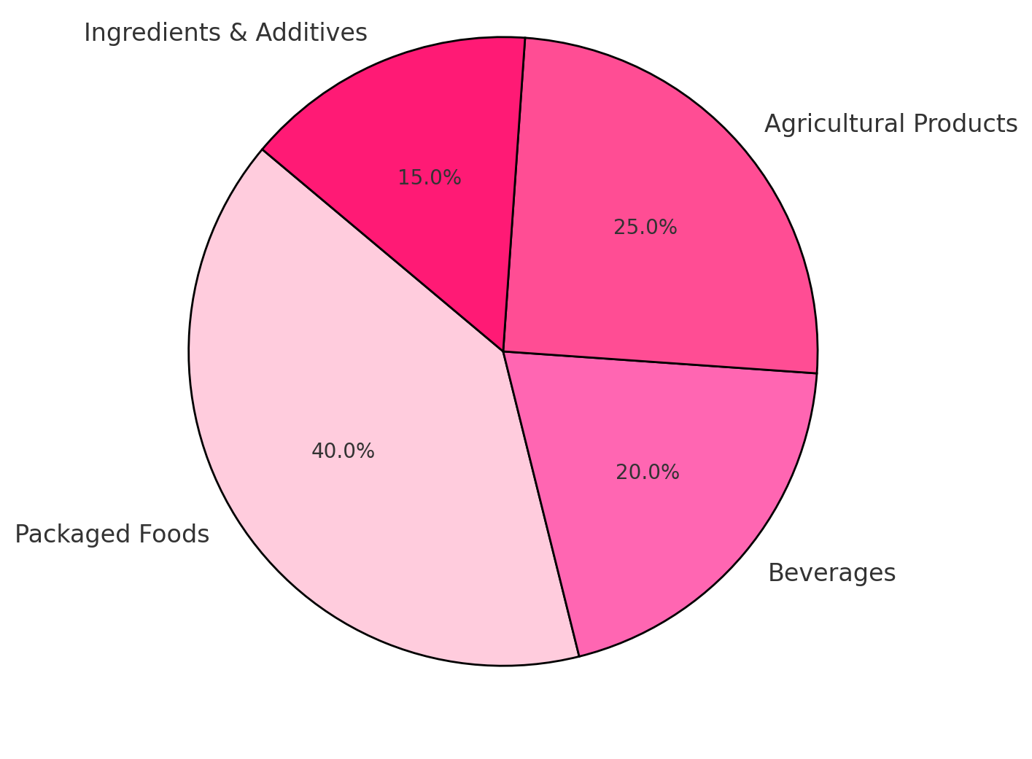
Portfolio Diversification: Food Industry Subsectors
Notes:
We diversified across various food manufacturing subsectors to reduce risk and enhance impact. This approach allows us to capture growth opportunities while mitigating ESG-related challenges, which ensures a well-balanced portfolio.
CH

Slide 7

Clients
Client Profile:
Institutional Investors
Wealthy Investors
Pension Funds
Endowments
&
Foundations
Institutional Investors
Notes:
Before building our portfolio, we identified the types of investors who would benefit most from an ESG-driven fund. Here’s who we targeted:
Pension Funds → These investors need long-term stability and risk mitigation, making ESG investing attractive as it promotes sustainable business practices that reduce financial volatility.
Wealthy Investors → Many high-net-worth individuals and family offices are looking for investments that align with ethical and sustainable values without sacrificing returns. ESG investing provides a way to achieve both.
Endowments & Foundations → Organizations with a mission-driven focus, such as universities and charities, seek investments that reflect their values, particularly in sustainability and social impact.
CH

Slide 8
Initial Stock Selection Overview
General Mills
Hershey
Compass Minerals
Hormel
Green Mountain Coffee Roasters
Packaged Food
Packaged Food
Ingredients and Additives
Packaged Food
Beverages
Global food company. Focus on nutrition, sustainability, and innovative long-term impact initiatives.
Global confectionary company. Prioritize responsible sourcing, and environmental sustainability.
Focused on sustainability, safety, and responsible resource management.
Global branded food company committed to sustainability, social responsibility, and strong governance.
Commitment to environmental sustainability and social responsibility.
Notes:
Our initial stock selection in year 1 included the following stocks that we identified as having strong commitments and alignment with ESG initiatives within the food manufacturing industry. These selections were weighted equally in order to diversify the portfolio and provide a benchmark for future investments. To further diversify out stocks within the food manufacturing industry we sorted the stocks into subcategories like packaged food, and ingredient additivies. Also included in our slide is some short descriptions of the initiatives each company is working towards.
Julia

Slide 9
Portfolio Construction Strategy
Stock Selection Criteria:
ESG Strength in One or More Pillars
Industry Relevance & Financial Performance
Potential for ESG Engagement & Improvement
Companies must demonstrate strong Environmental, Social, or Governance performance.
Selected food manufacturing leaders with sustainable practices and strong market positioning
Considered historical performance, revenue growth, and risk-adjusted returns
Chose companies where active engagement could drive ESG progress
Focused on businesses with room to enhance governance transparency or reduce environmental impact
Notes:
The portfolio reflects a balance between financial performance and ESG compliance.
Portfolio Construction Overview:
Our approach was to balance ESG responsibility with strong financial performance. We didn’t just pick the highest ESG-scoring companies. Instead, we looked for food manufacturing firms with at least one strong ESG pillar and room for improvement through engagement. The goal was to invest in companies already making progress while encouraging further ESG adoption. This allowed us to be proactive in ESG investing, not just reactive
When picking stocks, we followed three key criteria:
1. Strong ESG Scores in One Pillar – Companies had to be leaders in at least one area.
If a company had weaknesses in certain ESG areas, it was considered for engagement-driven improvement rather than outright exclusion
2. Industry Fit & Financial Performance – We focused on major food manufacturers that had proven financial stability and growth potential. We needed companies that could deliver strong financial performance while also being sustainable.
3. Potential for ESG Engagement – Instead of just screening out low-scoring companies, we wanted firms that could improve with active engagement. This means choosing companies where we, as could push for more transparency, better governance, or stronger sustainability commitments
Julia

Slide 10
Portfolio Weight Allocation Strategy
Year 1 (2012):
Subsequent Years (2013-2017):
Adjustments were driven by:
Equal allocation of 20% per stock to ensure diversification
Upgraded or maintained allocation for stocks with strong financial & ESG performance.
Sharpe Ratio (Risk-Adjusted Return)
ESG Score Progression
Downgraded weight for underperforming stocks or those with stagnating ESG metrics.
Industry Trends & Macroeconomic Factors
Notes:
When choosing our portfolio weights, we started with an even 20% allocation per stock in year 1. This gave us a diversified portfolio and allowed us to see how each company performed without bias.
In following years, we made strategic adjustments based on:
Financial Performance: If a stock had strong returns and a high Sharpe Ratio we increased its weight
ESG Score Trends: Companies that improved their ESG scores or continued strong ESG performance were maintained or upgraded in allocation.
Underperforming Stocks: If a company had weak financials or stagnant ESG progress, we reduced its weight
By adjusting based on both ESG and financial performance, we rewarded high-performing, responsible companies while phasing out weaker ones. This allowed us to stay profitable while keeping our ESG commitments to our clients
Rhylee

Slide 11
Investment Strategy: Engagement
Divestment Decisions
Heinz divested after acquisition → M&A can disrupt ESG strategy
Green Mountain dropped due to volatility despite ESG improvements
Engagement Over Shorting
No shorting → Instead, actively adjusted allocations to favor improving ESG scores
Dynamic Engagement Approach
Reallocated capital to companies showing stronger long-term ESG progress
Notes:
Our investment strategy wasn’t just about picking high ESG-scoring companies. It was about actively managing the portfolio to support sustainable growth while optimizing returns. Here’s how we approached engagement:
1. Divestment Decisions – Managing ESG & Market Risks
Heinz Divestment → After Heinz was acquired, we exited our position because (M&A) can disrupt ESG strategy. Acquisitions often lead to corporate restructuring, changes in governance, and ESG uncertainty,
Green Mountain Coffee Roasters Dropped → Despite some ESG improvements, the stock had high volatility, making it an unstable investment. Since our strategy balanced ESG with financial performance, we reallocated funds to more stable ESG leaders.
2. Engagement Over Shorting – Prioritizing Positive Change
Instead of shorting companies with poor ESG performance, we took a proactive engagement approach:
Increased allocation to companies improving their ESG scores rather than betting against poor performers.
3. Dynamic Engagement – Rewarding ESG Progress
Actively rebalanced the portfolio to favor companies making genuine ESG improvements.
Instead of maintaining a static allocation, we redirected capital toward businesses demonstrating long-term ESG commitment.
This allowed us to maximize both impact and returns—ensuring financial growth while supporting sustainable business practices.
By actively adjusting allocations rather than simply screening companies in or out, we ensured that our investments were aligned with real ESG progress and financial stability.
Rhylee

Slide 12


Measurement
Quantitative
Qualitative
Performance is measured by analyzing financial metrics.
Sharpe Ratio: Analyzed ratios for individual companies, as well as the overall Sharpe ratio of our portfolio.
Expected Returns: Calculated year over year to evaluate company performance.
ESG scores are determined by performance across three different categories: Environmental, Social, and Governance.
These categories are broad, and often subject to interpretation
To standardize, we used ESG scores provided from MSCI to evaluate our fund
Notes:
To evaluate our fund’s success, we used both quantitative financial metrics and qualitative ESG performance scores.
Quantitative Metrics:
Sharpe Ratio → We analyzed individual stock Sharpe ratios and the portfolio-wide ratio to measure risk-adjusted returns.
Expected Returns → Year-over-year calculations helped us track financial performance and portfolio growth trends.
Qualitative Metrics:
ESG Scores → We used MSCI ESG ratings to assess companies based on Environmental, Social, and Governance factors.
Standardization Challenges → ESG metrics are broad and subjective, so using MSCI scores ensured consistency in evaluation.
By combining these financial and ESG measurements, we ensured a data-driven approach to impact investing.
Megan

Slide 13
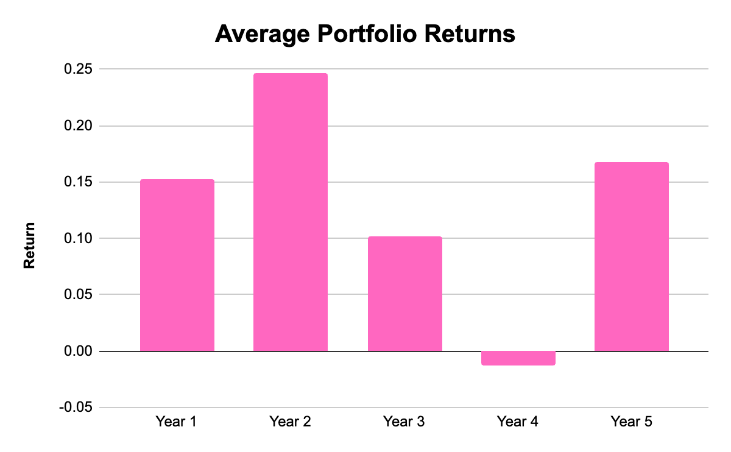
Overall Financial Performance
Financial Returns
Generated strong fiscal results over the 5 years with an overall return of 0.82
Notes:
Overall financial performance of our fund stayed relatively strong throughout the investment period, with the exception of a dip in returns in year 4, most likely as a result of Archer Daniels Midlands volatility. However, in year 4 ADM had a positive swing and our investment generated strong results over the 5 years with an overall return of 82%.
Megan

Slide 14
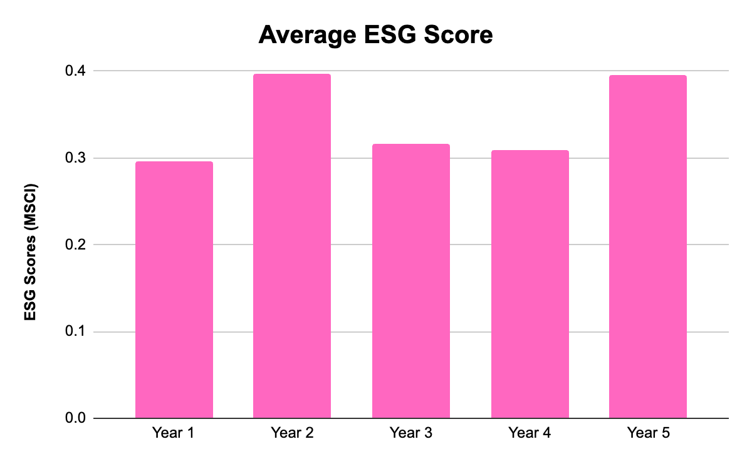
Overall ESG Performance (MSCI)
MSCI Metrics
Selected stocks maintained stable ESG scores, showing alignment with ESG targets
Notes:
Overall ESG performance of our fund stayed relatively strong and stable throughout the entire investment period.
Megan

Slide 15
Impact
How Did We Create Impact?
Positive ESG Change
Maximized Client Value
Opportunities for Sustainable Growth
Fostered positive ESG impact within the industry by targeting stocks aligned with sustainability, reducing waste, and promoting responsible sourcing.
Created value for our clients by maximizing financial returns while contributing to positive investments.
Created by investing in companies with strong ESG practices, aligning profitability with purpose and promoting long-term, responsible business practices.
Notes:
Beyond financial returns, we ensured our investments made a positive ESG impact
Positive ESG Change → We focused on companies actively reducing waste, improving sustainability, and promoting responsible sourcing. Our portfolio encouraged better corporate ESG behavior by prioritizing these factors.
2. Maximized Client Value → We didn’t just aim for sustainability; we ensured our clients benefited from strong risk-adjusted returns while investing in companies with long-term ESG commitments.
3. Opportunities for Sustainable Growth → By investing in companies that prioritize ESG innovation, we contributed to long-term industry improvements, showing that sustainable businesses can be highly profitable
Our strategy proved that financial growth and ESG impact don’t have to be separate or mutually exclusive. they can work together for long-term success.
Ellie

Slide 16
Final Stock Selection Overview
General Mills
Hershey
Conagra
Kellogg
Archer Daniels Midland
Return: 10.35%
Return 18.82%
Return: 24.17%
Return: 4.78%
Return: 28.15%
Weight: 20%
Weight: 15%
Weight: 25%
Weight: 25%
Weight: 15%
Notes:
Here is an overview of our final year stock selections for the fund.
General Mills – We gave this stock a 20% allocation. It had a solid return of 10.35% and is strong in sustainable sourcing.
Hershey – We allocated 15% here. Hershey had a nice return of 18.82% and stands out for ethical cocoa sourcing.
Conagra – This was one of our larger allocations at 25% because of its strong governance. It brought in a 24.17% return.
Kellogg – We also gave 25% to Kellogg, but its return was lower at 4.78%. However, Kellogg is strong in supply chain sustainability.
Archer Daniels Midland – This stock had the highest return at 28.15%, with a 15% allocation. It focuses on agricultural sustainability, which was a priority for us.
Overall, we balanced our allocations based on both ESG strengths and financial performance, and as you can see, our top returns came from Archer Daniels Midland and Conagra.
Ellie
Why These Stocks?
General Mills – Sustainability leadership in food processing
Hershey – Ethical sourcing and fair-trade initiatives
Kellogg – Sustainable agriculture and supply chain responsibility
Conagra – Strong governance policies
Archer Daniels Midland (ADM) – Agri-business sustainability

Slide 17
Overall Fund Performance
Fund Growth Overtime:
ESG & Portfolio Adjustments
Key Takeaways
Sharpe Ratio Increased from 0.70 → 1.27
Avg. Return Per Year: 16.5%
Increased weight for high-performing & ESG-improving stocks
ESG Investing Can Be Profitable
Final Balance (Year 5): $182.44M
Starting Balance (Year 1): $100M
Reduced exposure to underperformers or stagnating ESG stocks.
Dynamic Allocation Worked
Balanced ESG responsibility with strong financial performance.
Impact + Engagement; helped companies improve sustainability.
Notes:
Iz:
Our portfolio started with $100 million and grew to $182.44 million, an overall return of +82.44%. We saw steady improvements in our Sharpe Ratio, meaning we weren’t just making money—we were optimizing our risk-adjusted returns.”
How ESG Impacted Our Performance We followed a dynamic strategy—increasing exposure to companies excelling in ESG and financials, while phasing out underperformers. This approach balanced ethics with profitability and showed that sustainable companies can also be strong investments.
Key Takeaways from Our Strategy
We Proved ESG Investing Works – Our Sharpe Ratio and returns improved while keeping sustainability in focus.
We Used Engagement, Not Just Exclusion – Instead of just avoiding low ESG scores, we chose companies with improvement potential.
Our Strategy Was Adaptable – By adjusting weights annually, we kept aligning ESG principles with financial goals.
Our fund demonstrated that you don’t have to sacrifice returns for ESG principles. When done right, ESG investing can be both ethical and profitable.

Slide 18
Thank you! Questions?

