Slide 1
Technical Task

Slide 2
Business Specification
Develop a system, which would enable a grain broker to determine the best supplier to deliver against the client’s order requirements.

Slide 3
Current Business Solution
All identification requests are handled in an excel spreadsheet and operate on a first placed, first fulfilled system.

Slide 4
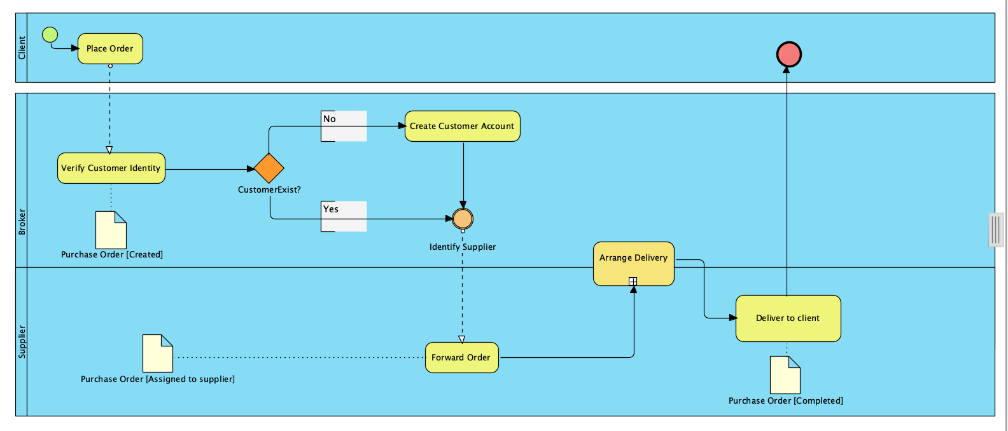
Business Process Diagram

Slide 5
Business Limitation
Costly and time-consuming, identification is not significant. In some instances, clients’ order requirements are handled by supplier’s who do not have sufficient stocks, thus resulting in poor customer experience and loss of revenue.

Slide 6
Business Motivation
Develop a system, which provides faster process, interactive, responsive and user-friendly interface.
Simplify the process of identifying suppliers and minimize the amount of human factored errors.
Repetitive task reduction within a workplace. The system would aid in reducing repetitive, and time-consuming work.

Slide 7
Business Need: | Classify customer’s order requirement to the best supplier based on customer’s location
Solution: | Using Order dataset,
Objective and Goals: | CSV to Database. CSV Data Analysis Build Machine Learning Algorithm Evaluate Model

Slide 8
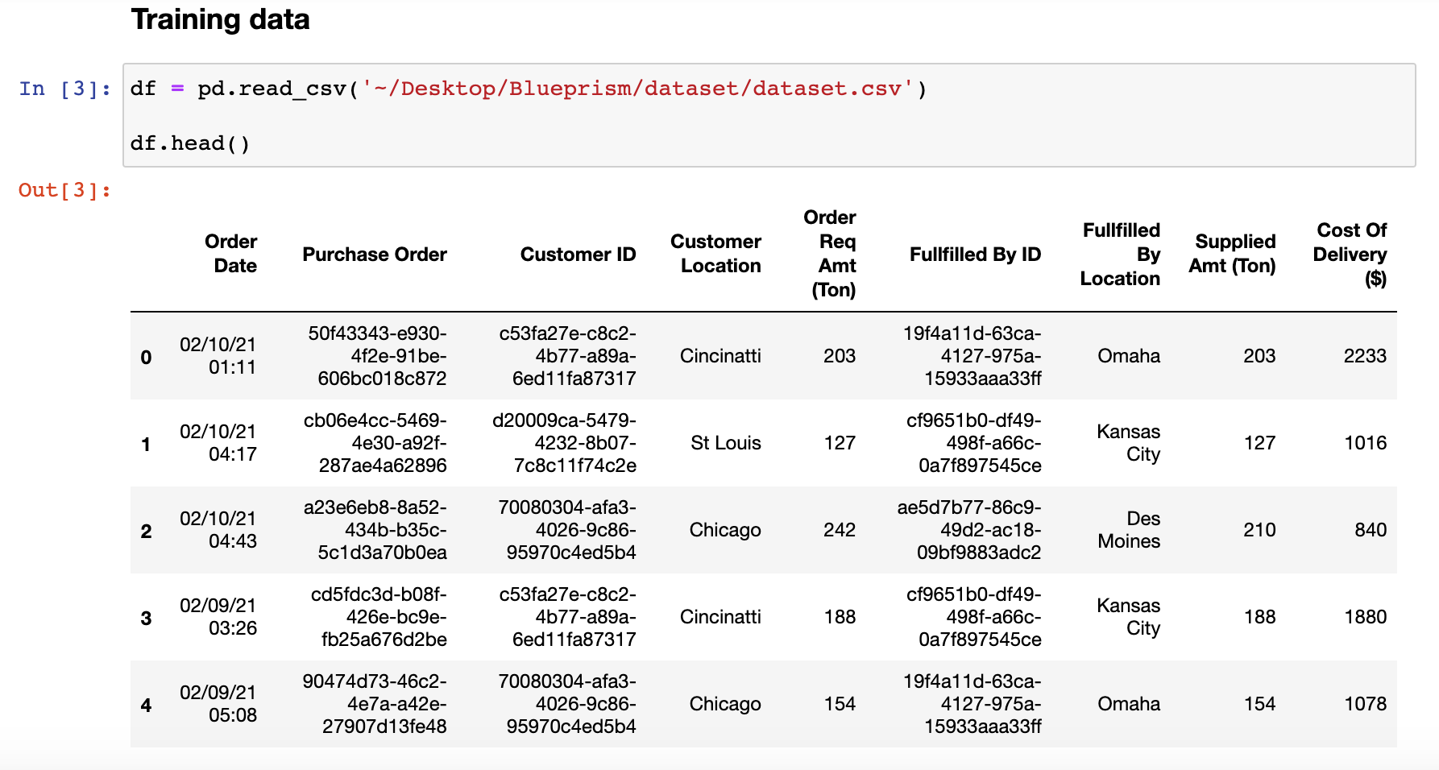
Exploratory Data Analysis
Data Structure

Slide 9
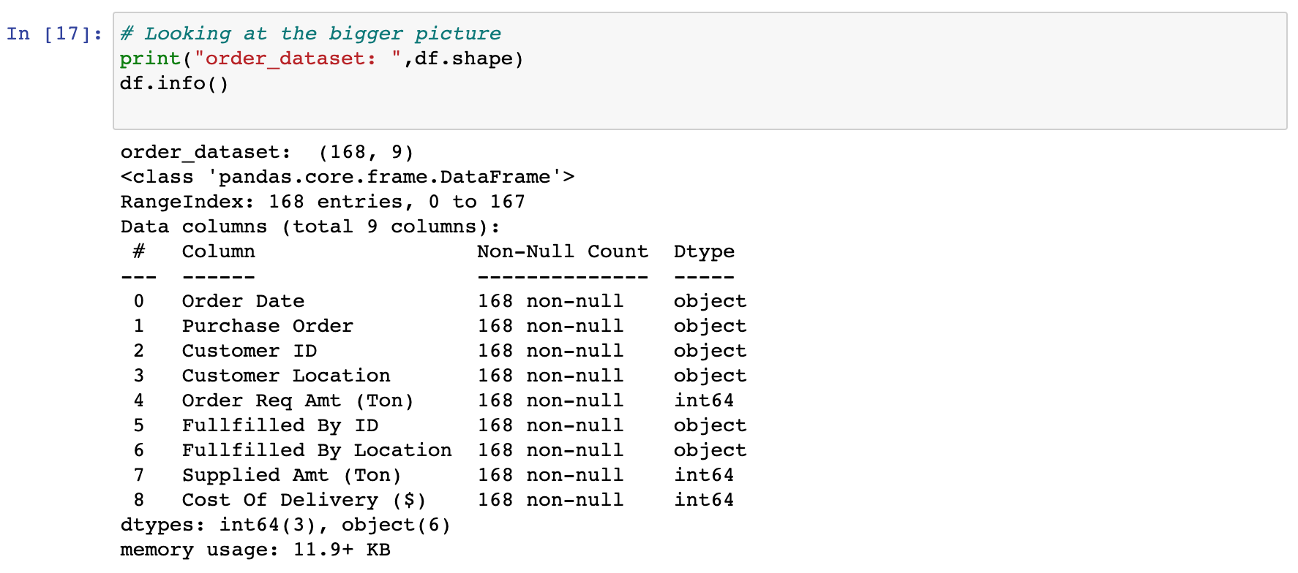
The info() method provide us with insightful description of the data, particularly the total number of rows, each attributes type and the number if non null values.

Slide 10
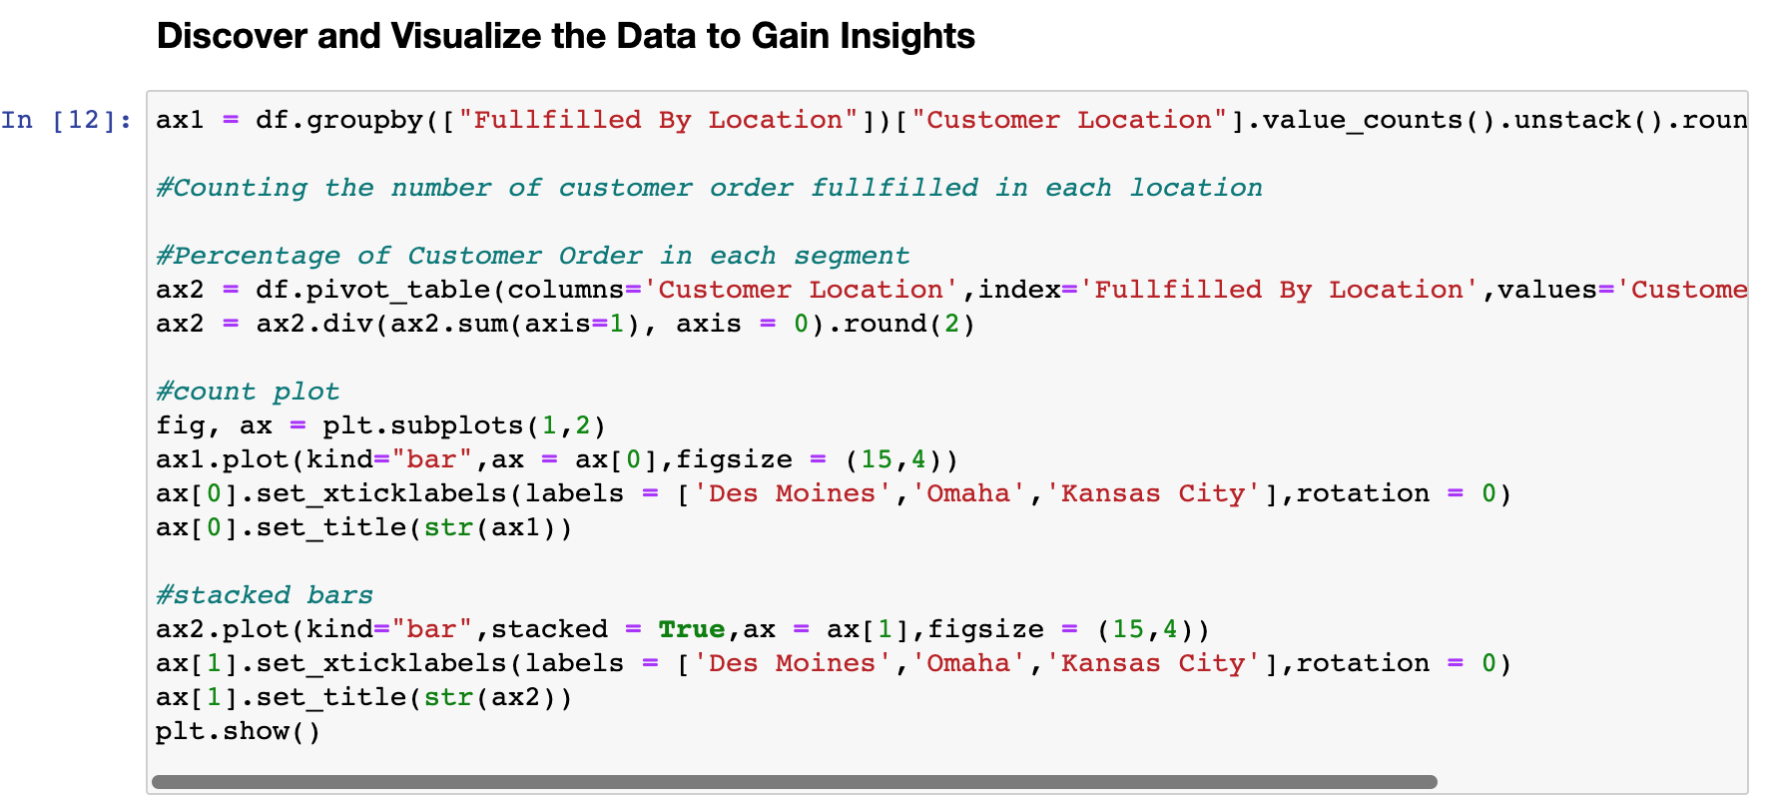

Slide 11
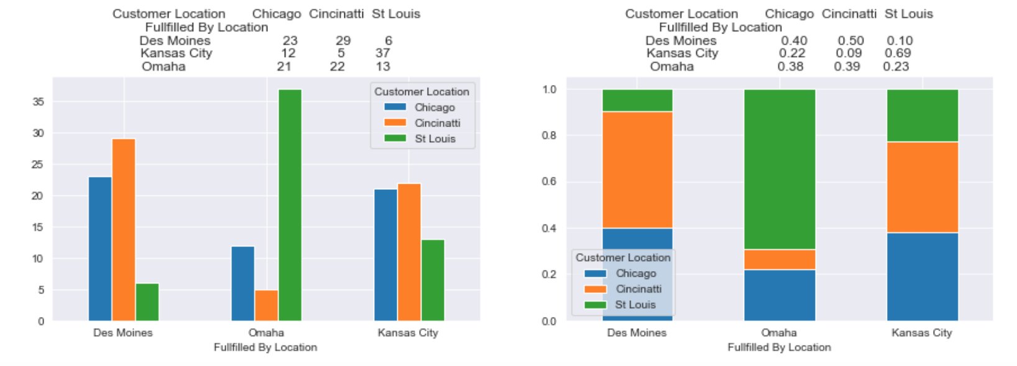

Slide 12
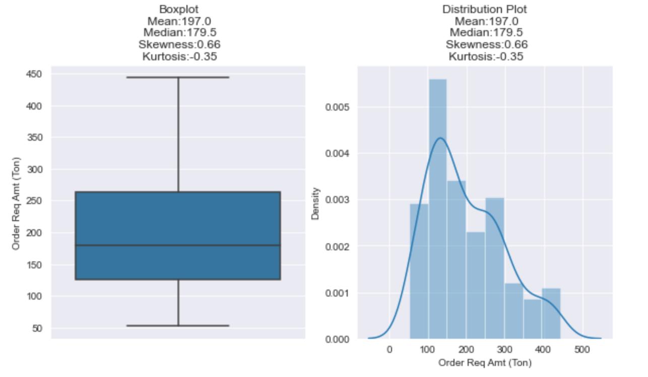
Distribution of Order Req Amt (Ton) column

Slide 13
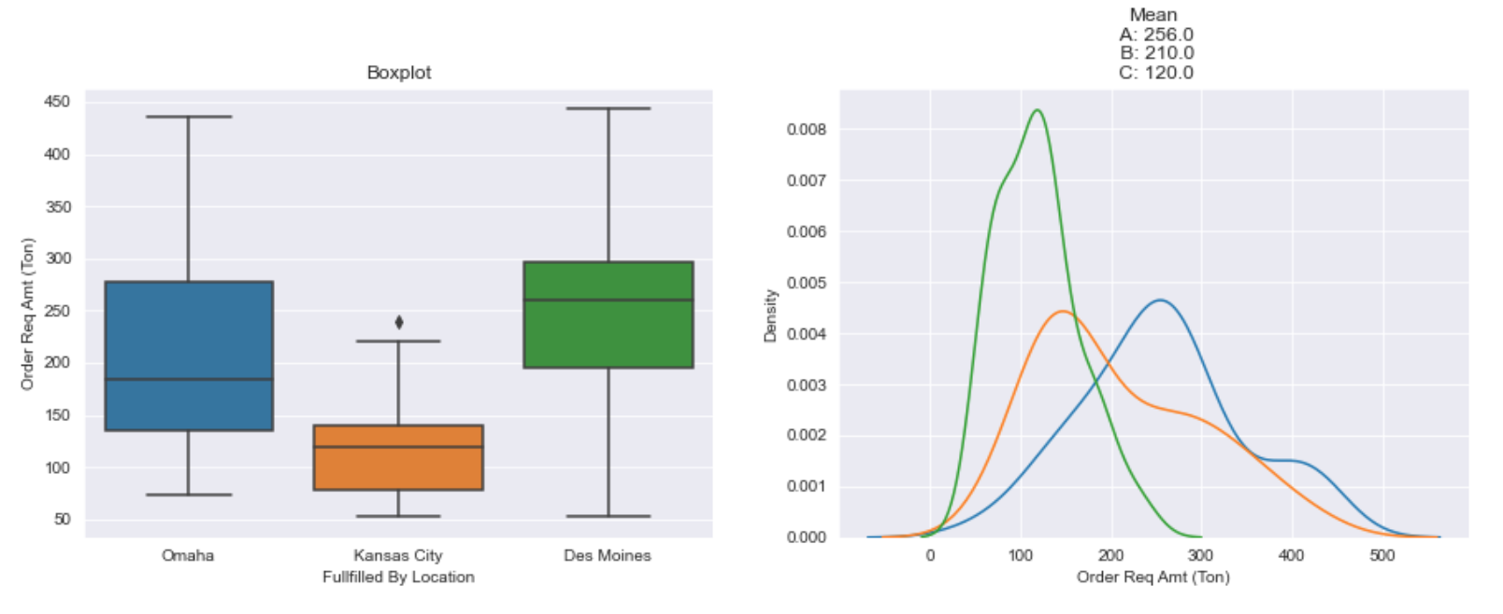
The distribution of column Fullfilled By Location
w.r.t to each segment

Slide 14
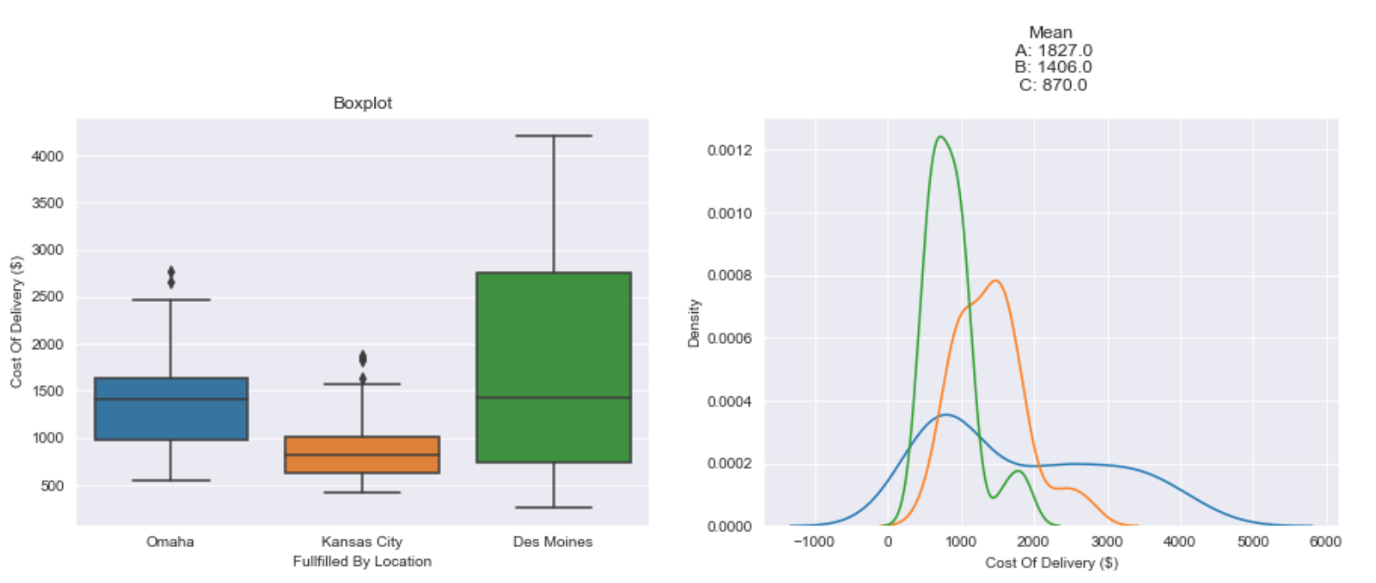

Slide 15
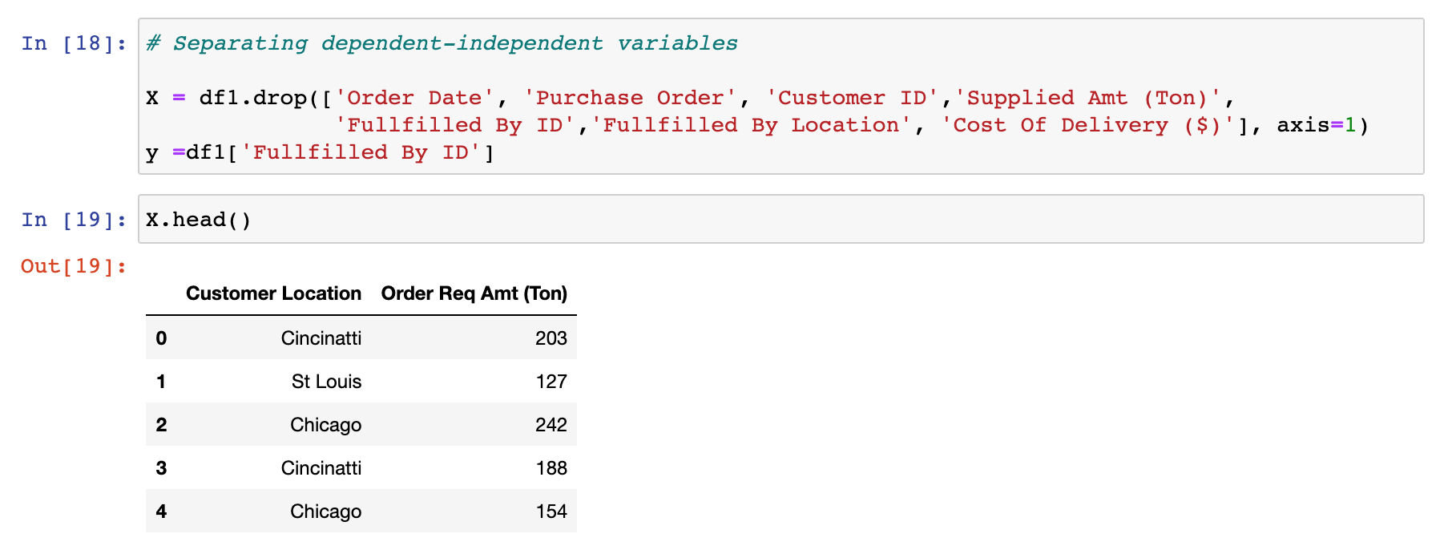
Separating dependent-independent variables

Slide 16
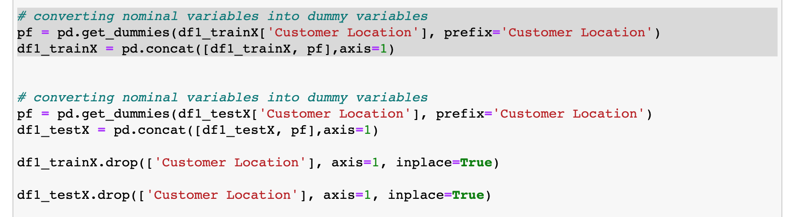
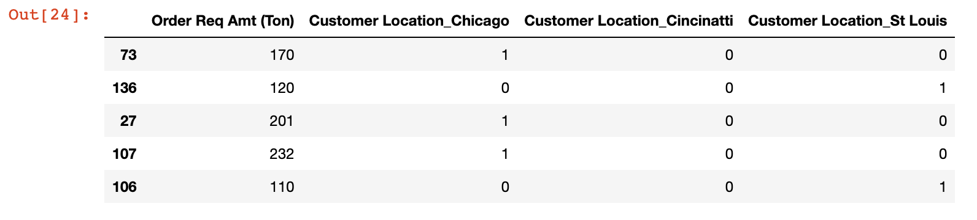
Nominal Variable to Dummy Variable

Slide 17
Model Evaluation
Algorithms Covered:
Used Decision Tree and Random Forest algorithms to solve problem.
Used K-NN and Naive Bayes algorithms to solve problem.

Slide 18
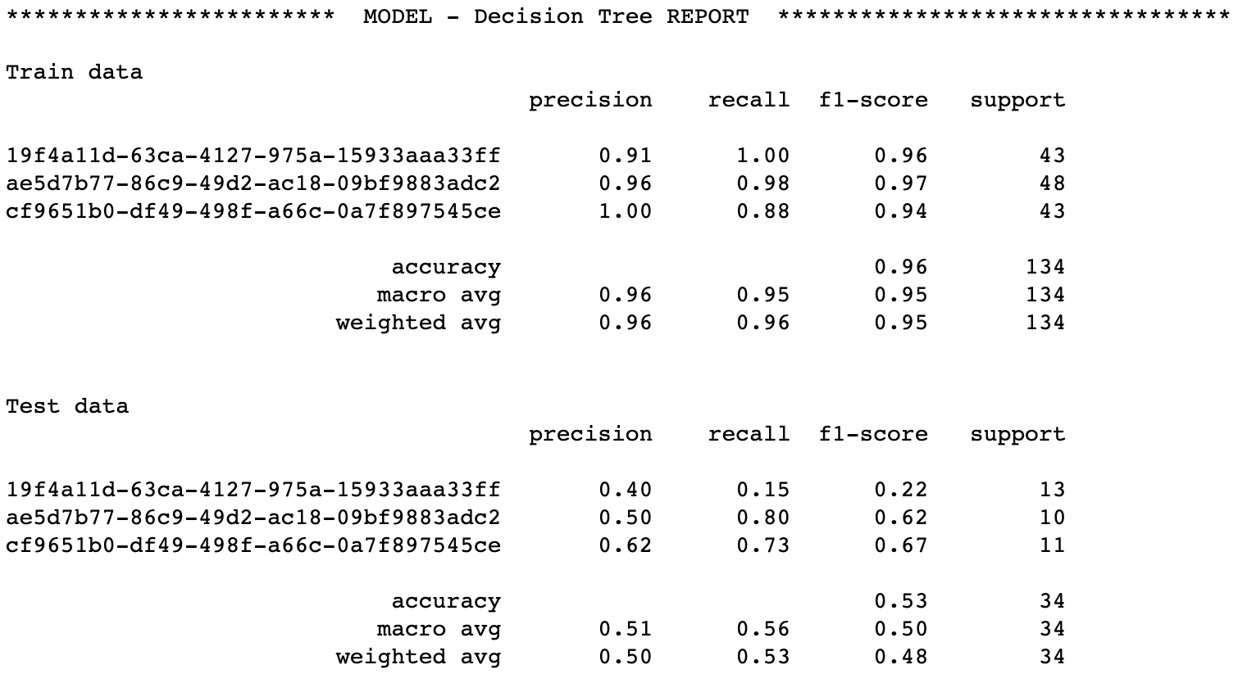
Decision Tree Evaluation

Slide 19
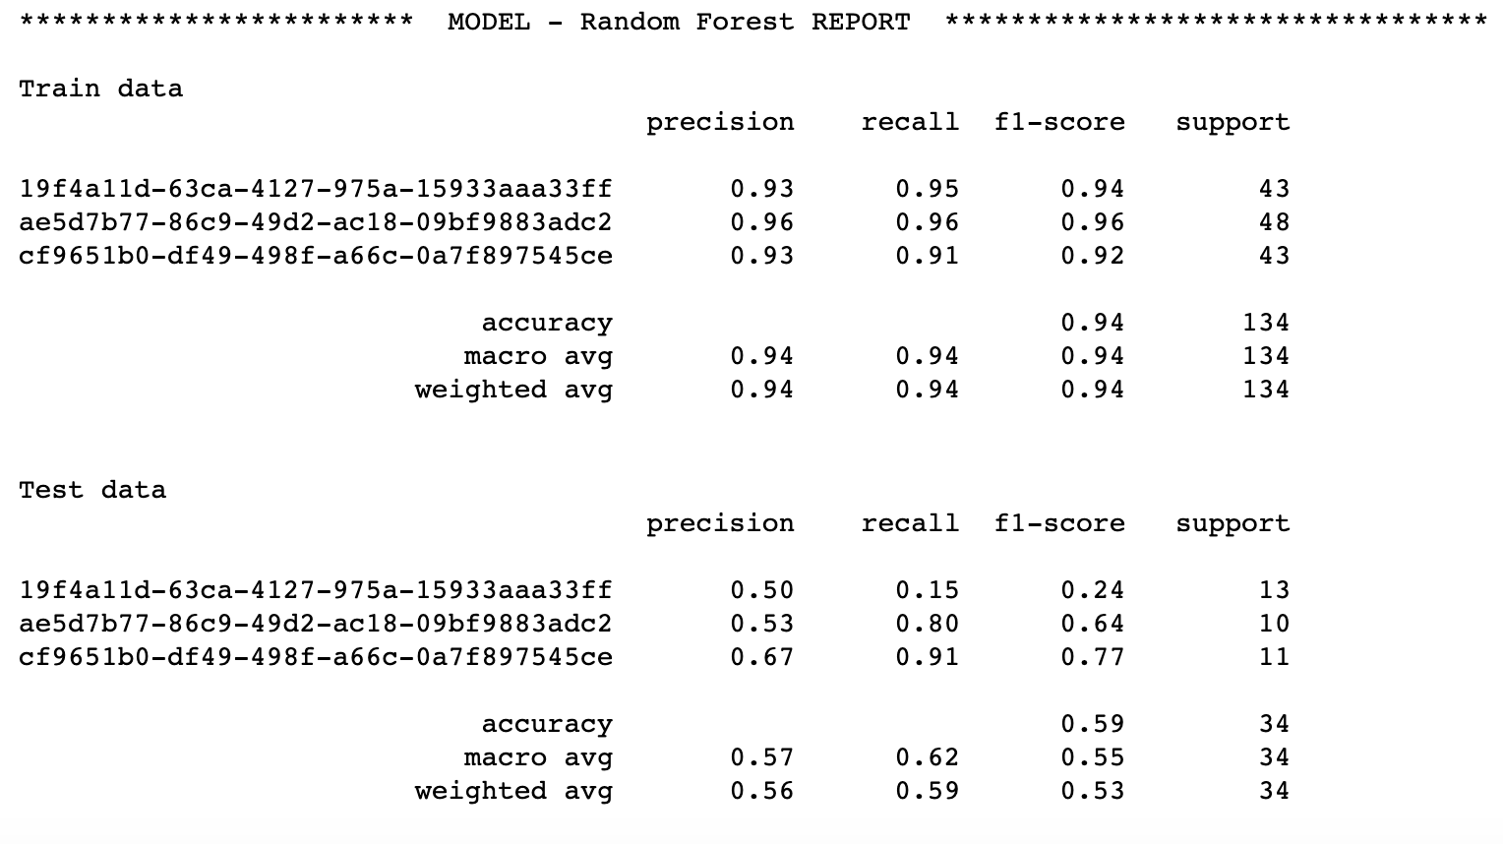
Random Forest Evaluation

Slide 20
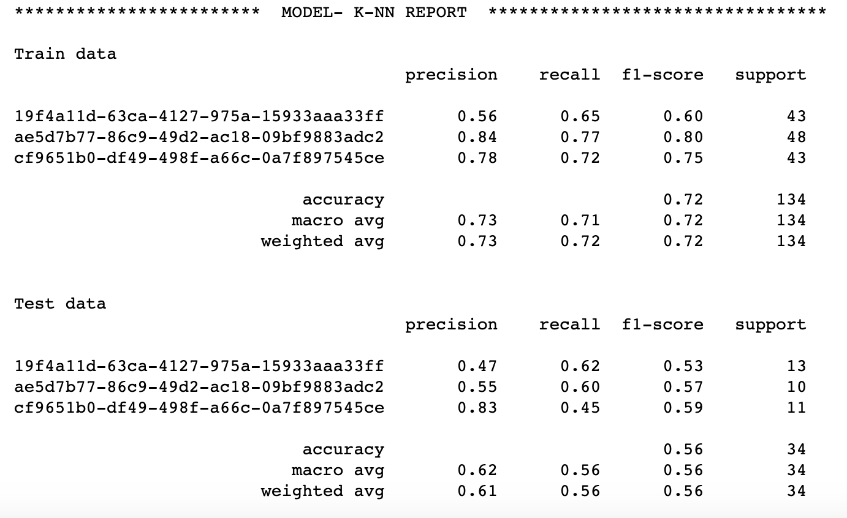
K-NN Model Evaluation

Slide 21
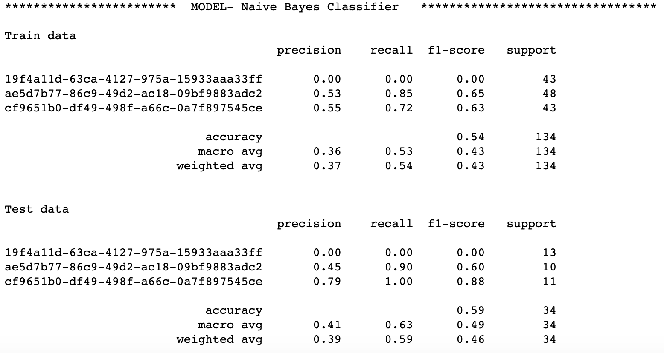
Naives Bayes Model Evaluation

Slide 22
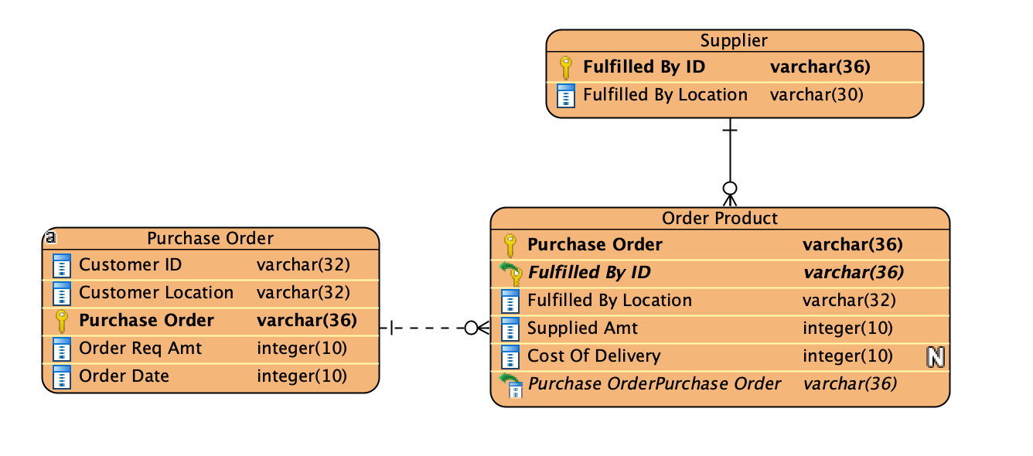
ENTITY RELATIONS DIAGRAM

Slide 23
System Requirement
Design a front end user interface, which would enable interaction with the model.
Design and implement an API as communication pipeline.
Design and implement a 'database/storage layer'

Slide 24
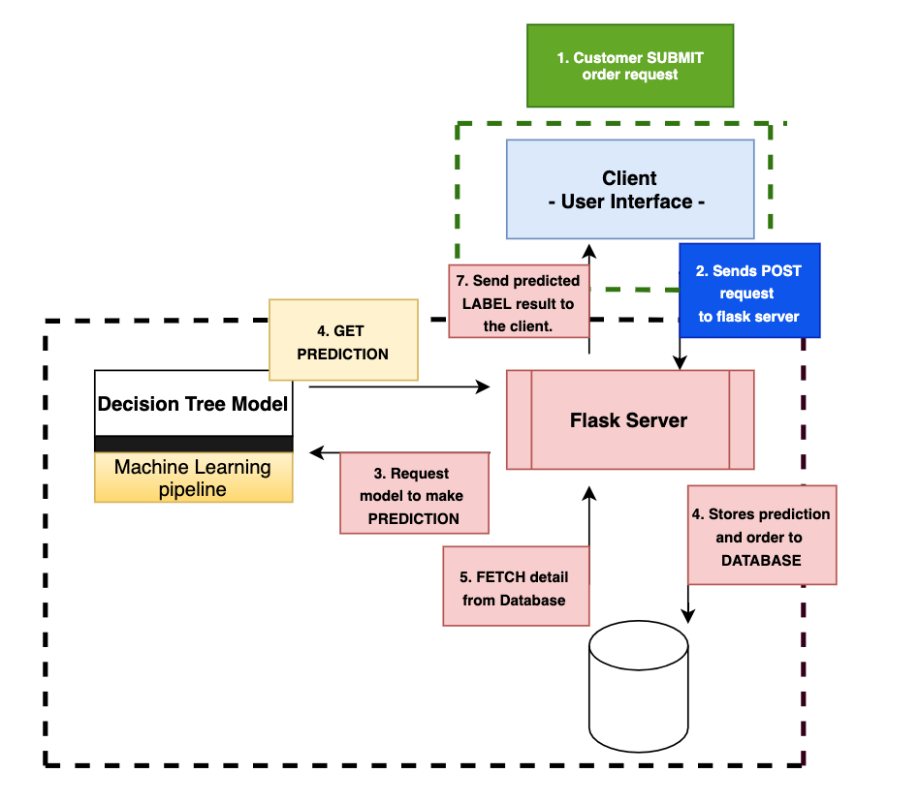
System Architecture
---- Frontend
---- Backend

