Slide 1


EnerR C
CONNECTING PEOPLE
Aitor Murgui, Eloy LLoveras
Notes:
EneRIC , Eneric mas que un proyecto es una oportunidad de ayudar para los países subdesarrollados, Eneric usa 5G y un análisis dinámico de inteligencia artificial , permitiendo interconectar un país entero con una ventada de bajo coste económico y de bajos recursos .
Today, I am here to present Eneric.
What is Eneric?
Eneric is more than just a project; it is an opportunity to help underdeveloped countries.
Eneric uses 5G and dynamic artificial intelligence analysis, allowing an entire country to be interconnected at a low economic cost and with minimal resources.

Slide 2
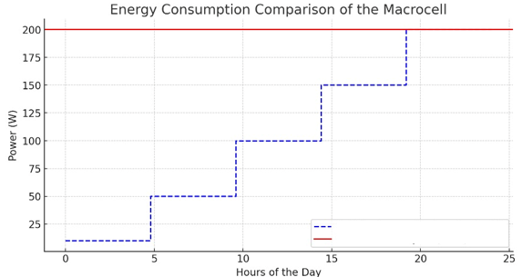
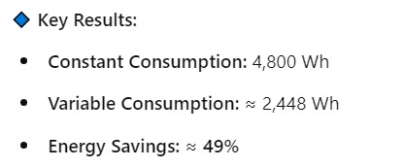
EneRIC Comparative
FLEXIBLE service delivery, an QoE enchanced by AI model to adapt dynamically the network
EneRIC
Actually Infrastructures
Notes:
Looking at the graphs on the screen, we can get a real idea of the impact Eneric can have, reducing economic and energy costs by 60%.
QUE COMPARAMOS, €, POWER , AND WHAT MOER
! 1 INFRAESTRUCURA R.A.N
4KW * 24H = 14,4€
Dia
Mes 432 €
PRECIO BASADO EN ESPAÑA 0,1705 €/kWh

Slide 3
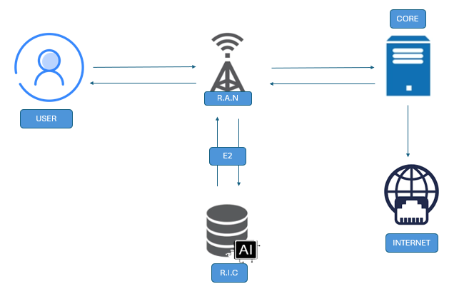




EneRIC Architecture

Slide 4



Notes:
EneRIC , Eneric mas que un proyecto es una oportunidad de ayudar para los países subdesarrollados, Eneric usa 5G y un análisis dinámico de inteligencia artificial , permitiendo interconectar un país entero con una ventada de bajo coste económico y de bajos recursos .
Today, I am here to present Eneric.
What is Eneric?
Eneric is more than just a project; it is an opportunity to help underdeveloped countries.
Eneric uses 5G and dynamic artificial intelligence analysis, allowing an entire country to be interconnected at a low economic cost and with minimal resources.

Slide 5






PESTEL
POLITICAL
ECONOMIC
SOCIAL FACTORS
TECHNOLOGICAL

Slide 6


PESTEL
ENVIRONMENTAL
FACTORS
LEGAL FACTORS

Slide 7


EnerR C
CONNECTING PEOPLE
https://www.linkedin.com/in/eloylloverasgil/
https://www.linkedin.com/in/aitor-murgui-gonz%C3%A1lez-a744b1227/
Notes:
EneRIC , Eneric mas que un proyecto es una oportunidad de ayudar para los países subdesarrollados, Eneric usa 5G y un análisis dinámico de inteligencia artificial , permitiendo interconectar un país entero con una ventada de bajo coste económico y de bajos recursos .
Today, I am here to present Eneric.
What is Eneric?
Eneric is more than just a project; it is an opportunity to help underdeveloped countries.
Eneric uses 5G and dynamic artificial intelligence analysis, allowing an entire country to be interconnected at a low economic cost and with minimal resources.

