Slide 1
Model-Based-Design workflow using the Inverted Pendulum Problem
Mr. Sebastien Dupertuis
Applications Engineer
Wednesday, March 11, 2015
Notes:
Feel free to adapt the table of contents and hide slides based on what you are going to show or not.
The Readme.docx file gives a good overview of what should be shown and what is optional.

Slide 2
Three Key Takeaways
From one model to many targets using MATLAB and Simulink
Automatic code generation out of an executable specification
Bi-directional traceability between requirements, models and generated code

Slide 3
Topics
Introduction
Problem formulation
Base model and project overview
Plant modelling
Introduction to SimMechanics
Modelling the inverted pendulum
Control logic modelling
Introduction to Stateflow
Controller modelling and analysis
Control design
PID tuning
System identification
Code generation and verification
Automatic code generation
In-the-Loop verification methodologies

Slide 4
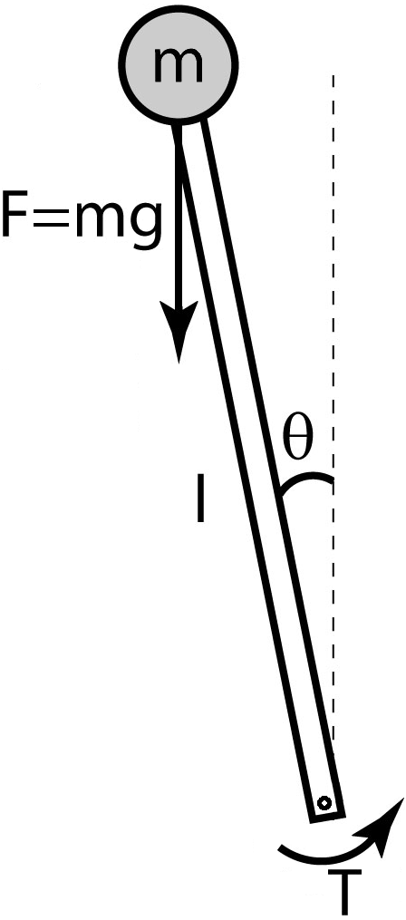
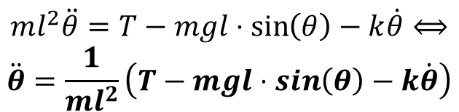
Problem Formulation Inverted pendulum
Plant Differential Equation:
$$ml^{2}\ddot{θ}=T−mgl⋅\sin\left(θ\right)−k\dot{θ}⟺$$
$$\ddot{θ}=\frac{1}{ml^{2}}\left(T−mgl⋅\sin\left(θ\right)−k\dot{θ}\right)$$

Slide 5
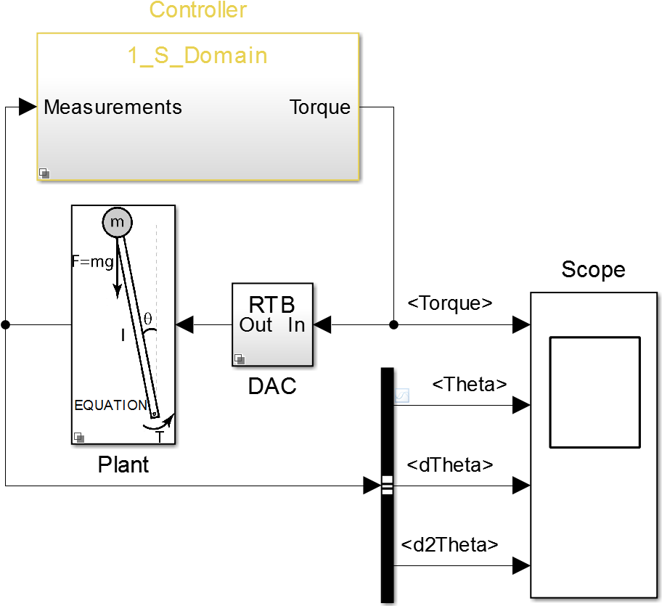
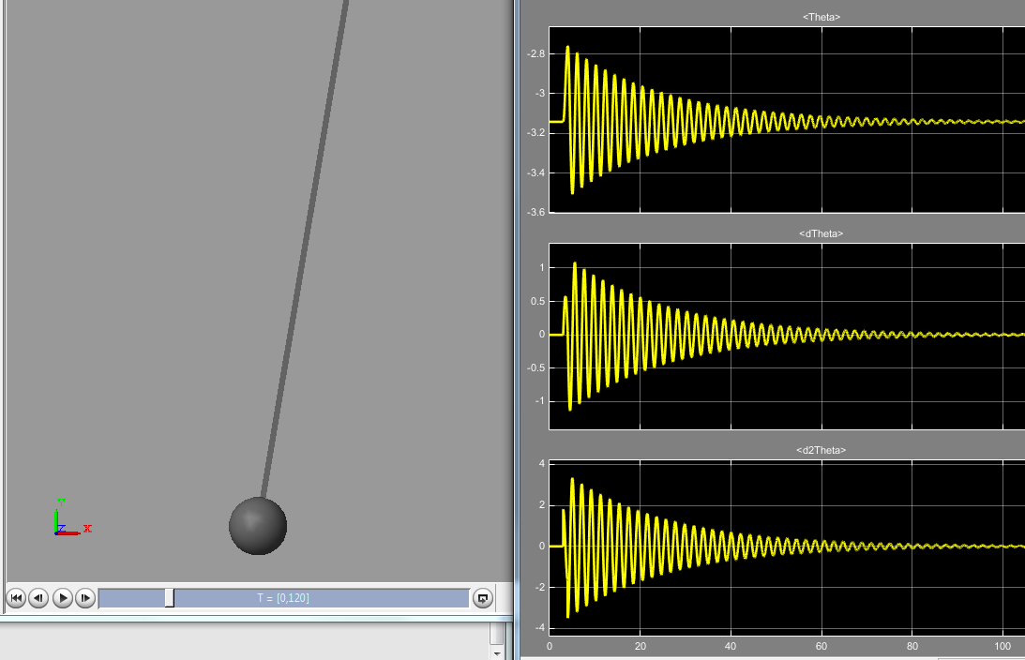
Base Model Overview
Notes:
Demo: open the final model, run it, show SM 3D visualization as well as scope; explain shortly the blocks on the top-level

Slide 6
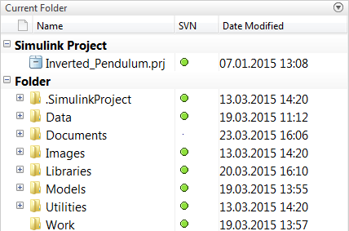
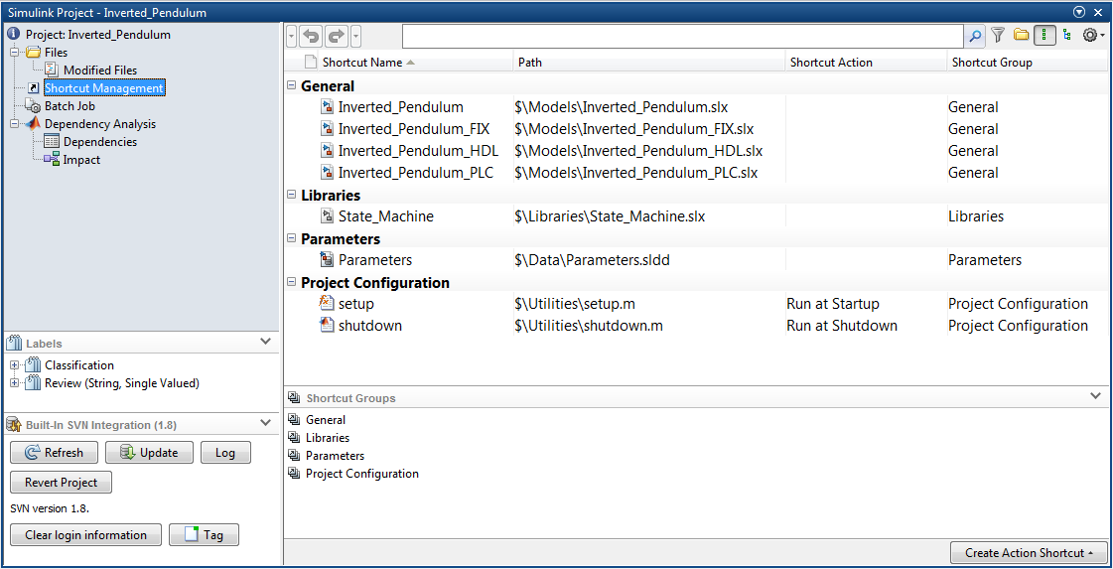
Integrated Development Environment Simulink Project

Slide 7
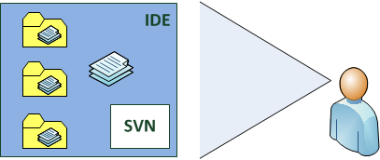
Use of Simulink Projects
Organize the structure of project’s folders and files
Put all source files and models under version control
Have an overview of files relationship
Share project’s data among the team
Do automation of tasks
Notes:
Simulink Projects is an interactive tool in Simulink for managing your project files and connecting to source
control software. It promotes effective collaboration across teams.
Using Simulink Projects gives the possibility to the team to get benefits of standard IDEs with integrated
version control system and allows team members to get a good overview of the entire projects.

Slide 8
Simulink Projects: main advantages
Support team work
Design reuse
Parallel workflows
Source control integration
Knowledge transfer across projects
Setup guidelines
Team members work the same way
Teams leaders get accurate projects overview
Projects integrity is stable and under control at any time

Slide 9


Configuration Management
Simulink Projects supports:
Subversion (SVN) integration by default
Git
Use of the Source Control Adapter SDK to link to another Source Control System
Notes:
Simulink Projects do integrate Source Control System. By default, SVN is defined as the standard Version
Control System for Simulink Projects. However, the Version Control System “Git” is also supported by
Simulink Projects. If another Source Control System is commonly used in the company, it can be linked to
Simulink by using the Source Control Adapter SDK.

Slide 10
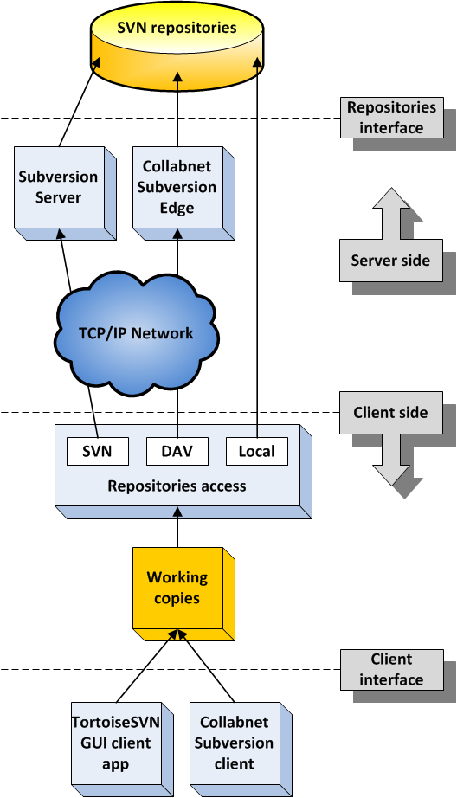
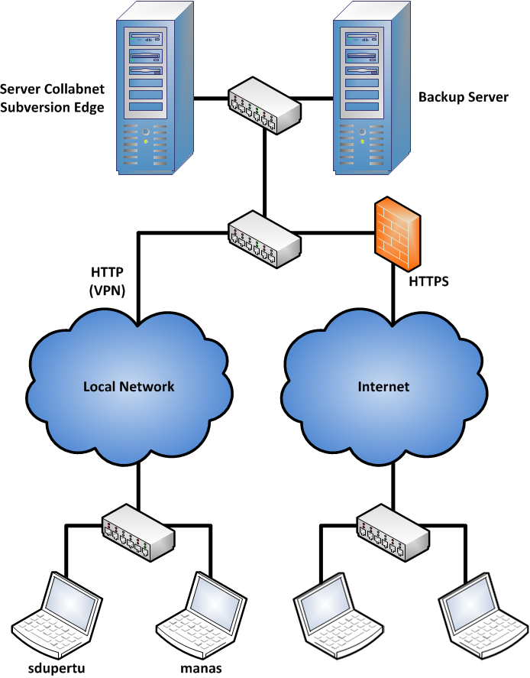
Configuration Management: Subversion
Notes:
Here is the representation of the SVN Architecture:
On the server side, there are the SVN repositories related to different projects inside the company that are interfaced with either the Subversion Server or the CollabNet Subversion Server. Subversion Server: it runs the simple svn protocol which is not WebDAV compliant. WebDAV stands for Web Distributed Authoring and Versioning. It is an extension of the Hypertext Transfer Protocol (HTTP) that facilitates collaboration between users in editing and managing documents and files stored on World Wide Web servers. CollabNet Subversion Edge: it runs the HTTP/HTTPS protocols which are WebDAV compliant. This also allows users to get access to the Web Viewer Interface for Subversion repositories. This gives the possibility to team leaders to get an overview of a specific project by navigating through its different files directly online without having to create locally a working copy of the project.
On the client side, there are the working copies related to the different projects located on the SVN repositories. They are directly controlled by the SVN command line client which can be driven by a graphical interface like TortoiseSVN. The exchange of data between the clients and the server can be done via the svn or http/https protocols, or locally if the Subversion Server is installed on the same computer.
For the setup of the Hardware on the network, their are:
The server running CollabNet Subversion Edge plus its Backup Server which can process nightly builds of every repositories in order to check the integrity of them. The Server can be setup so that it serves data over either an HTTP or HTTPS connections depending on the network that is used by the team members

Slide 11
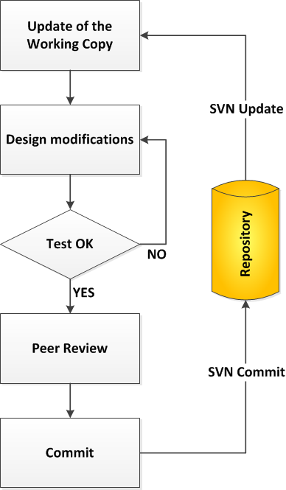
Configuration Management: Typical Workflow

Slide 12
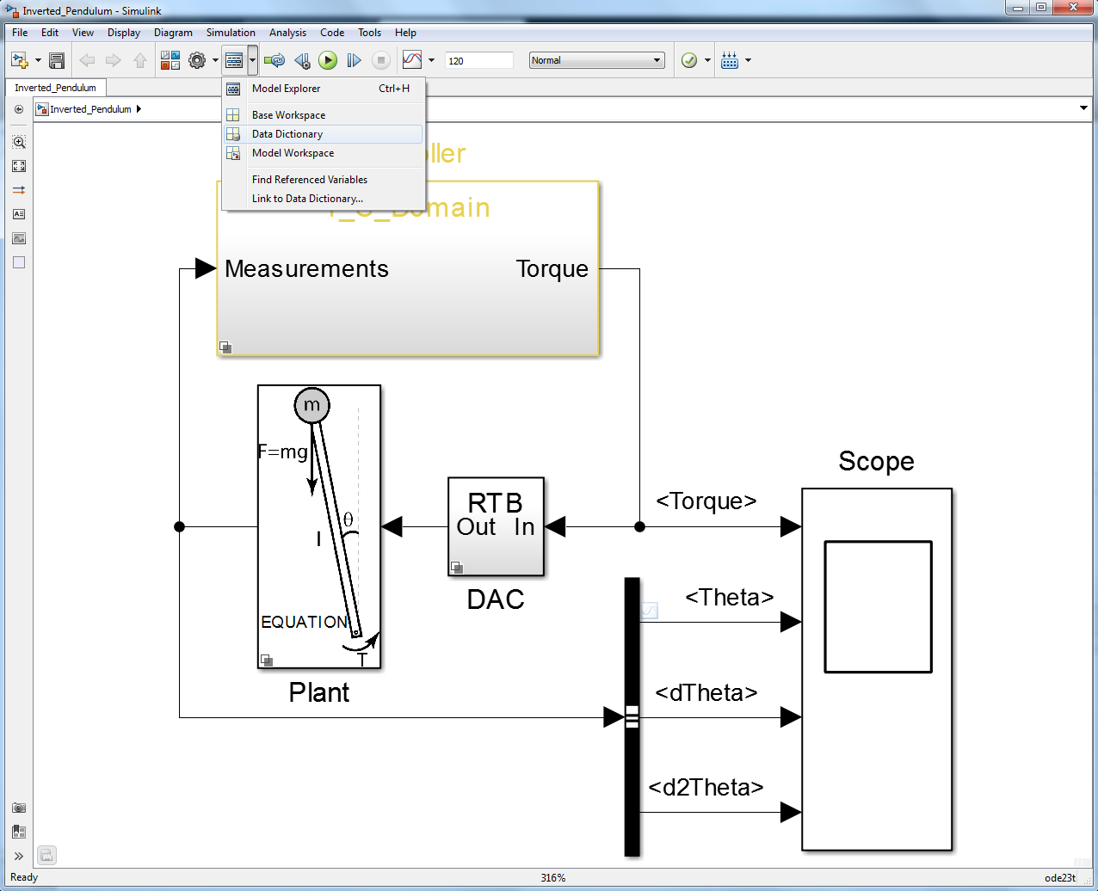
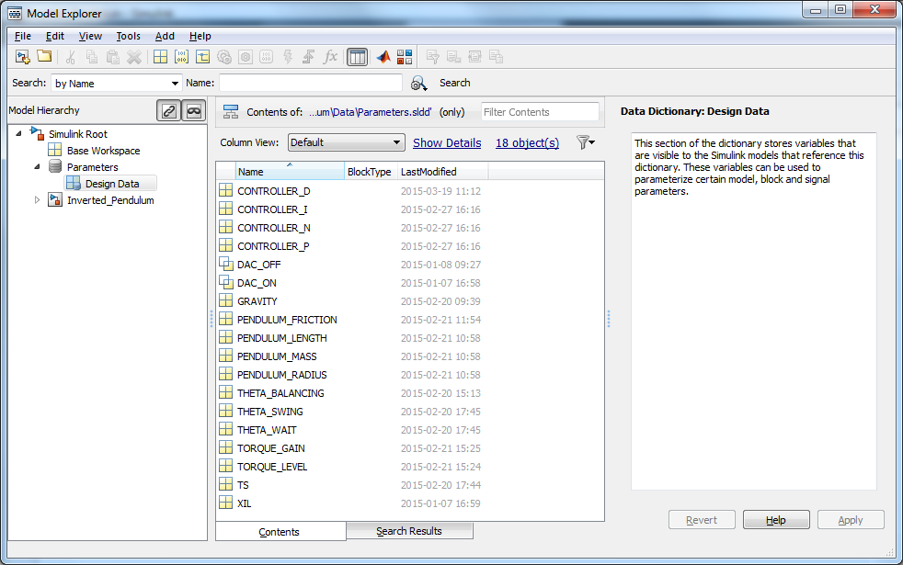
Integrated Development Environment Simulink Data Dictionary

Slide 13
Data Management Capabilities
Provides management for global design data:
Simulink
SLX
File
Model 1
SLX
File
SLX
File
Model 2
Change tracking and differencing
Defined relationship with SLDD file
Componentization
Scalability and performance
Integration with Simulink Projects
Model 3
SLDD
File
SLDD
File
Global Data
SLDD
File

Slide 14
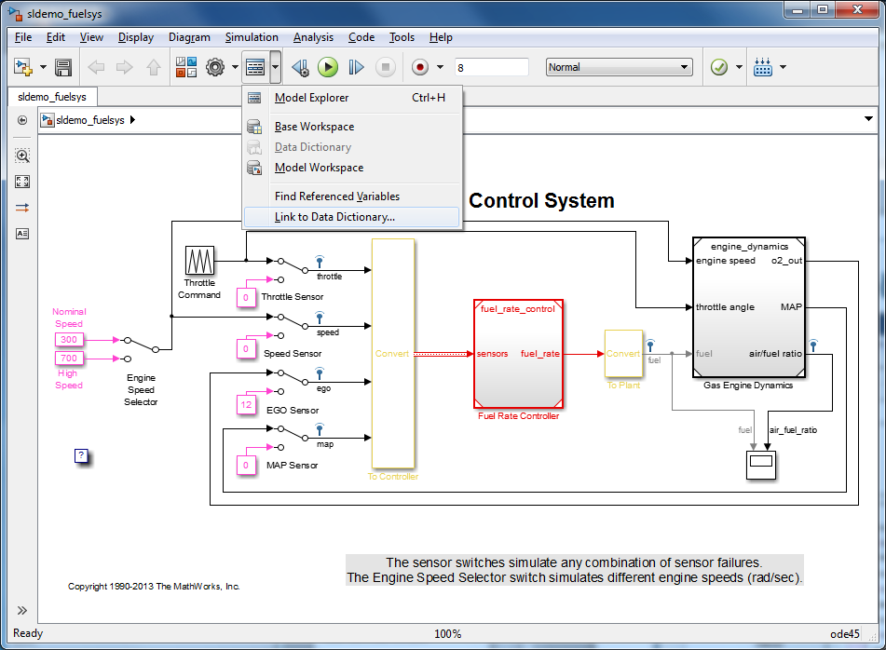
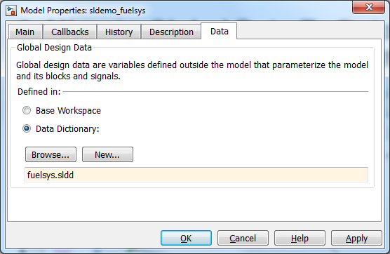
Data Management: Migration

Slide 15
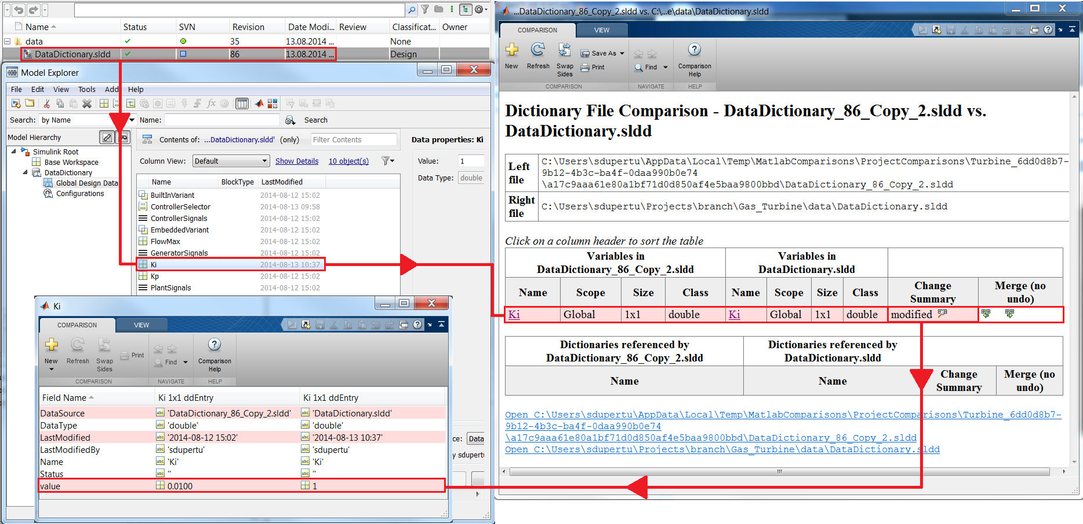
Data Management: Change Tracking

Slide 16
Topics
Introduction
Problem formulation
Base model and project overview
Plant modelling
Introduction to SimMechanics
Modelling the inverted pendulum
Control logic modelling
Introduction to Stateflow
Controller modelling and analysis
Control design
PID tuning
System identification
Code generation and verification
Automatic code generation
In-the-Loop verification methodologies

Slide 17
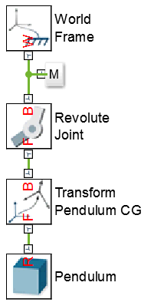
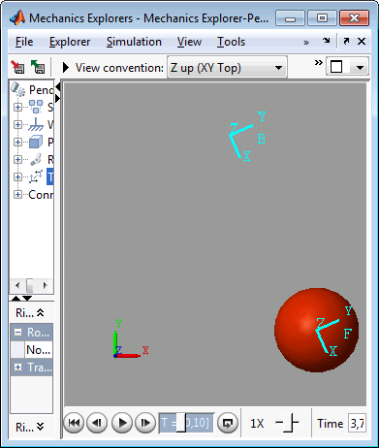
Introduction to SimMechanics
SimPowerSystems
SimMechanics
SimHydraulics
SimDriveline
SimElectronics
Simulate and visualize 3D multibody mechanical systems
Construct model using rigid bodies, joints, and forces
Model matches structure of system
No need to derive and program equations
Primary uses
System-level dynamics analysis
Control development in Simulink
Simscape
MATLAB, Simulink

Slide 18
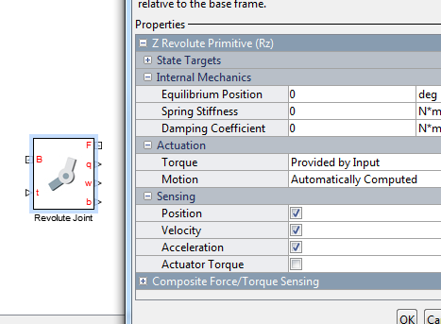
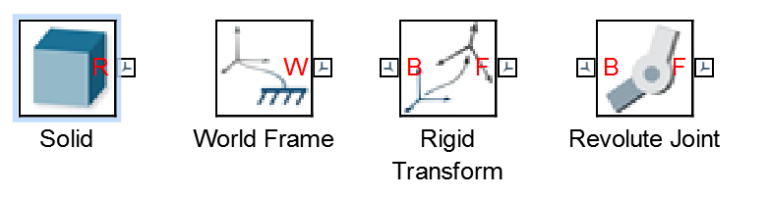
Modelling Concepts
Simscape: Multi-Domain Modelling → Energy flow dynamics
SimMechanics: Multibody mechanical model → What is relevant?
Mechanical dynamics – location, movement
Block ports represent coordinate systems
Blocks are bodies or coordinate transforms
Forces/torques are applied to joints

Slide 19

Building the Pendulum in SimMechanics

Slide 20
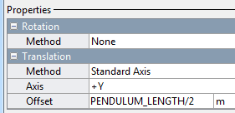
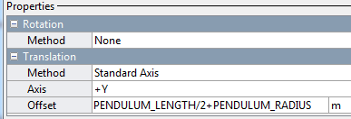
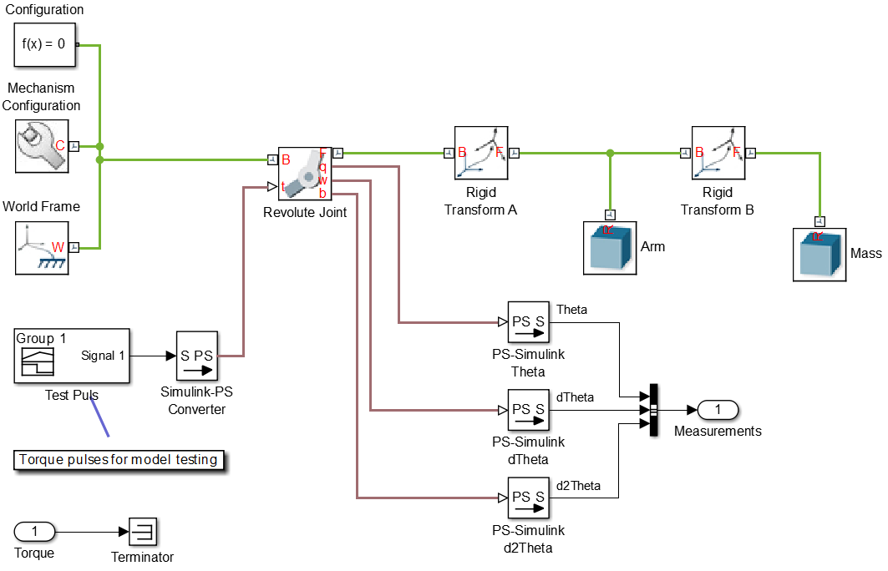
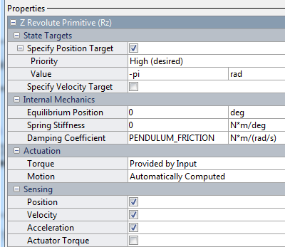
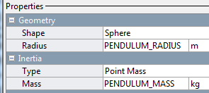
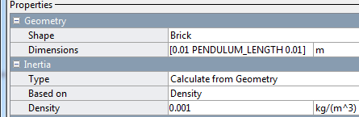
Pendulum

Slide 21
Topics
Introduction
Problem formulation
Base model and project overview
Plant modelling
Introduction to SimMechanics
Modelling the inverted pendulum
Control logic modelling
Introduction to Stateflow
Controller modelling and analysis
Control design
PID tuning
System identification
Code generation and verification
Automatic code generation
In-the-Loop verification methodologies

Slide 22
Introduction to Stateflow: Terms
Chart: A Stateflow chart that contains either
State diagrams: A chart that contains State(s)
Flow charts: A chart that does not use State(s), only transitions and conditional logic. NOTES: most Stateflow charts use a mixture of State diagrams and Flow Charts
Stateflow Functions: discrete functions that can be called from within the Stateflow diagram
Graphical functions
Simulink functions
MATLAB functions

Slide 23
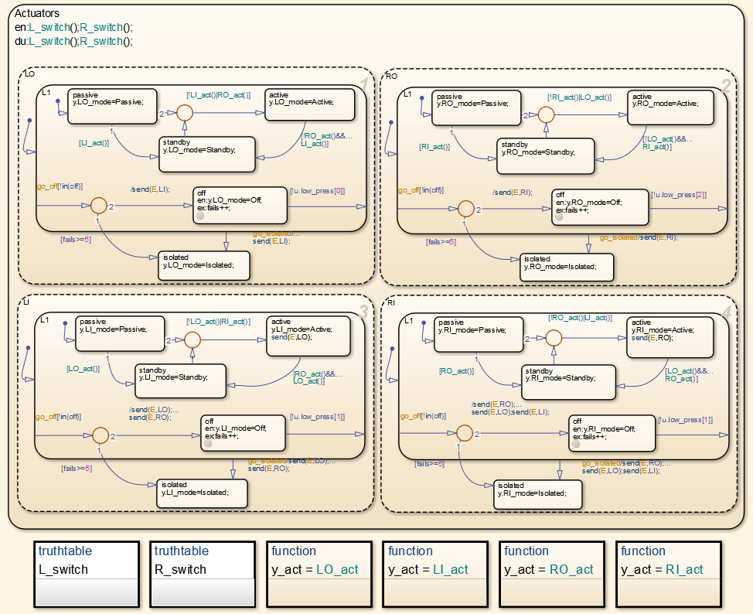
Introduction to Stateflow: Terms
Level: a level is a grouping of Stateflow charts that is visible at one time. It can include nested Stateflow charts
Subcharted states form a new level

Slide 24
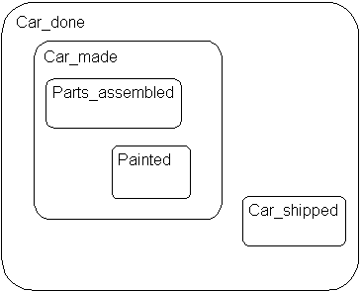
Introduction to Stateflow: States
In the following example, drawing one state within the boundaries of another
state indicates that the inner state is a substate (or child) of the outer state (or
superstate). The outer state is the parent of the inner state:
Stateflow hierarchy can also be represented textually, in which the Stateflow chart is represented by the slash (/) character and each level in the hierarchy of states is separated by the period (.) character
/Car_done
/Car_done.Car_made
/Car_done.Car_shipped
/Car_done.Car_made.Parts_assembled
/Car_done.Car_made.Painted

Slide 25
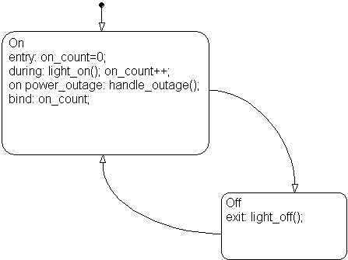
Introduction to Stateflow: States
State Actions: After the name, you enter optional action statements for the
state with a keyword label that identifies the type of action. You can specify
none, some, or all of them. The colon after each keyword is required. The
slash following the state name is optional as long as it is followed by a
carriage return.
Entry Action. Preceded by the prefix entry or en for short. In the preceding example, state On has entry action on_count=0. This means that the value of on_count is reset to 0 whenever state On becomes active (entered).
During Action. Preceded by the prefix during or du for short. In the preceding label example, state On has two during actions, light_on() and on_count++. These actions are executed whenever state On is already active and any event occurs.
Exit Action. Preceded by the prefix exit or ex for short. In the preceding label example, state Off has the exit action light_off(). If the state Off is active, but becomes inactive (exited), this action is executed.
On Event_Name Action. Preceded by the prefix on event_name, where event_name is a unique event. In the preceding label example, state On has an on power_outage action. If state On is active and the event power_outage occurs, the action handle_outage() is executed.
Bind Action. Preceded by the prefix bind. In the preceding label example, the data on_count is bound to the state On. This means that only the state On or a child of On can change the value of on_count. Other states, such as the state Off, can use on_count in its actions, but it cannot change its value in doing so.

Slide 26
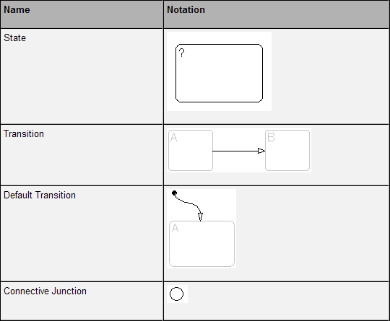
Introduction to Stateflow
entry:
during:
exit:
Condition: []
Initialization: {}

Slide 27
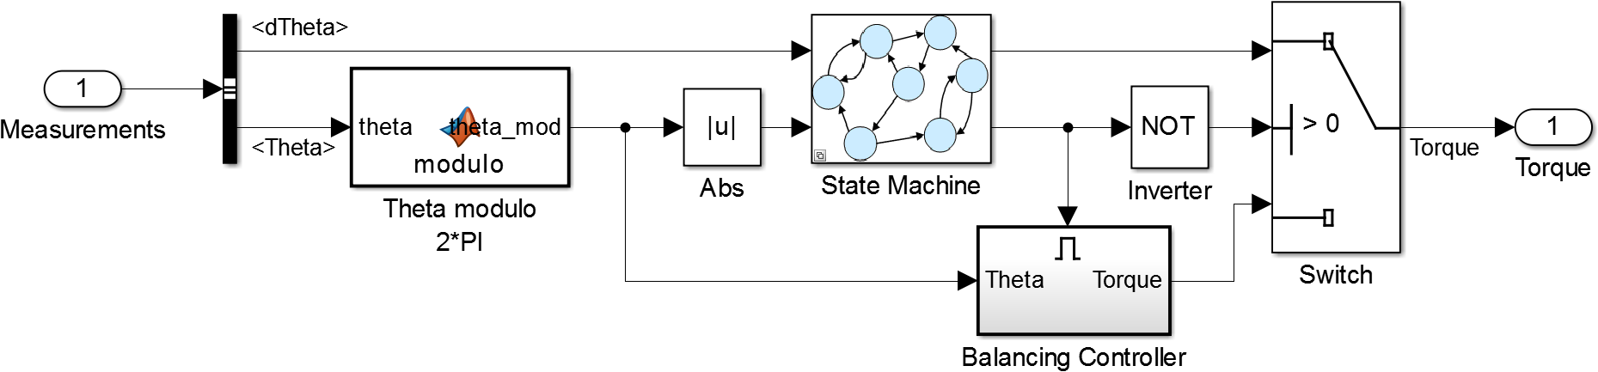
Controller
Logic
PID

Slide 28
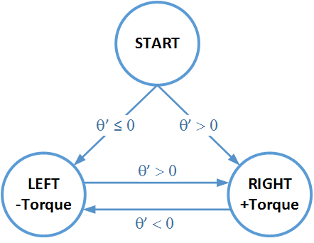
Controller Simple state machine
Variables correspondence
In this diagram | In Stateflow
θ’ | dTheta
Torque | Torque
Values correspondence
In this diagram | In Stateflow
±Torque | ±TORQUE_LEVEL
Variables initialization
In this diagram | In Stateflow
No Torque | Torque = 0

Slide 29
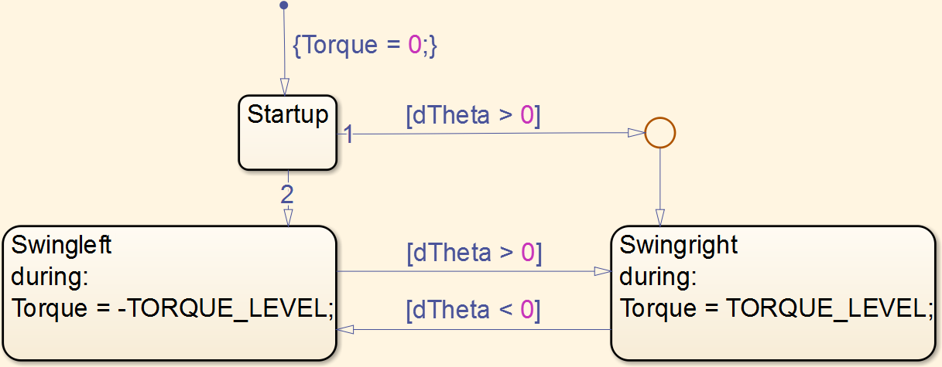
Controller Simple state machine

Slide 30
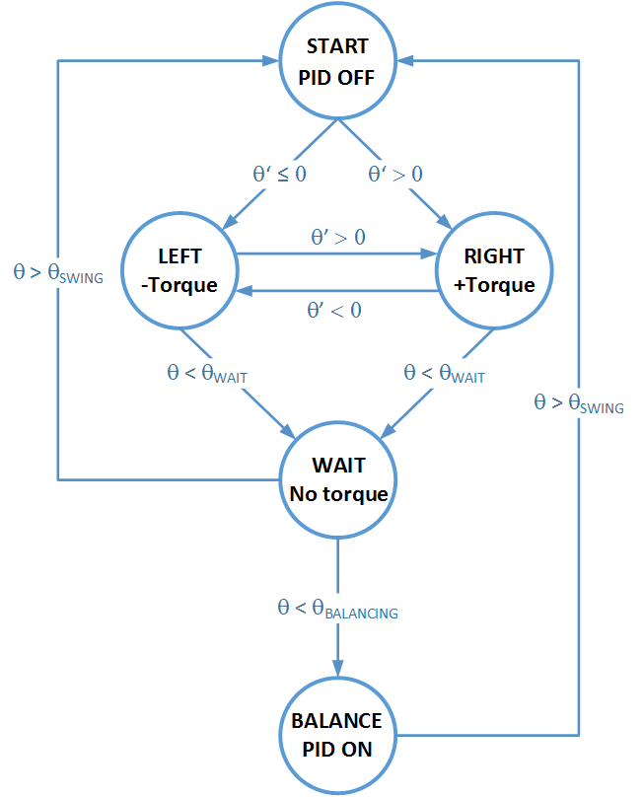

Controller Full state machine
Variables correspondence
In this diagram | In Stateflow
θ’ | dTheta
θ | Theta
Torque | Torque
PID ON/OFF | Enable_Controller
Values correspondence
In this diagram | In Stateflow
±Torque | ±TORQUE_LEVEL
θ_{WAIT} | THETA_WAIT
θ_{SWING} | THETA_SWING
θ_{BALANCING} | THETA_BALANCING
Variables initialization
In this diagram | In Stateflow
No Torque | Torque = 0
PID OFF | Enable_Controller = 0
Trigger signal generation

Slide 31
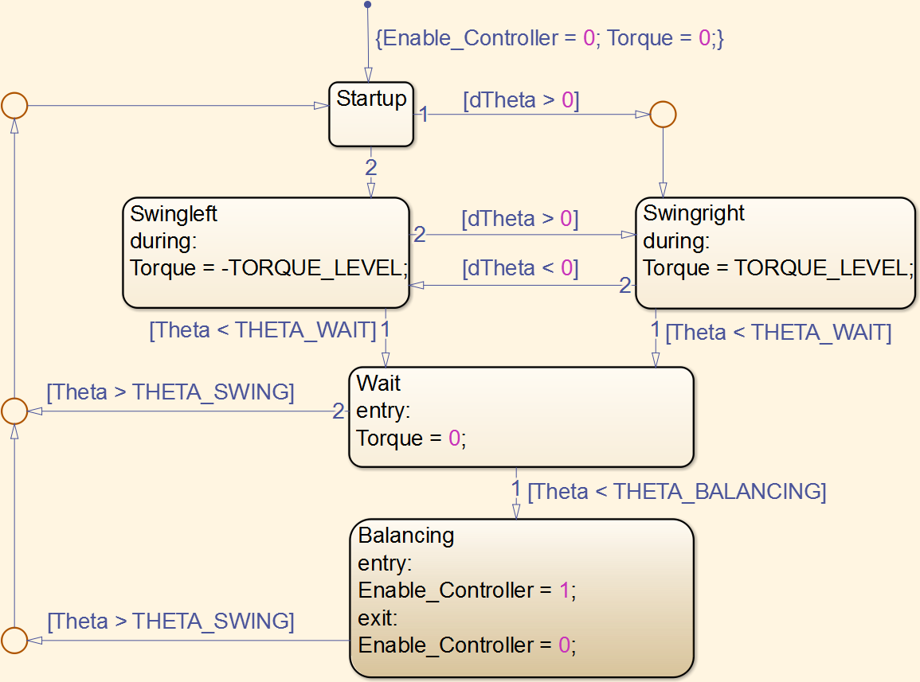
Controller Full state machine

Slide 32
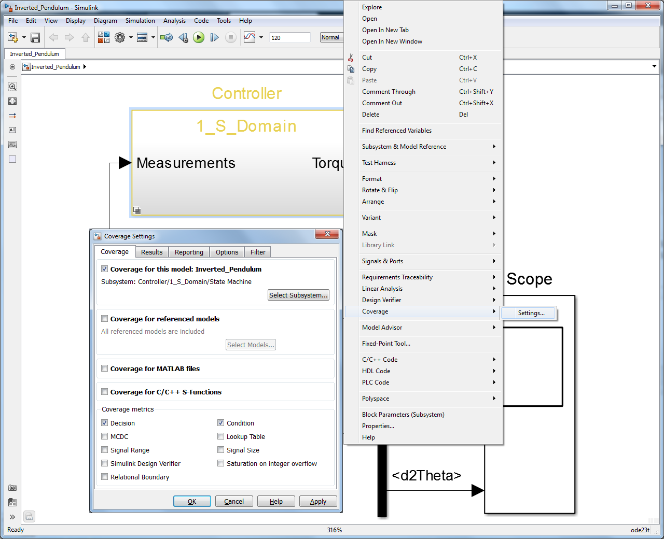
Controller Coverage Analysis

Slide 33
Topics
Introduction
Problem formulation
Base model and project overview
Plant modelling
Introduction to SimMechanics
Modelling the inverted pendulum
Control logic modelling
Introduction to Stateflow
Controller modelling and analysis
Control design
PID tuning
System identification
Code generation and verification
Automatic code generation
In-the-Loop verification methodologies

Slide 34
Inverted pendulum: PID Tuning
TUNE

Slide 35
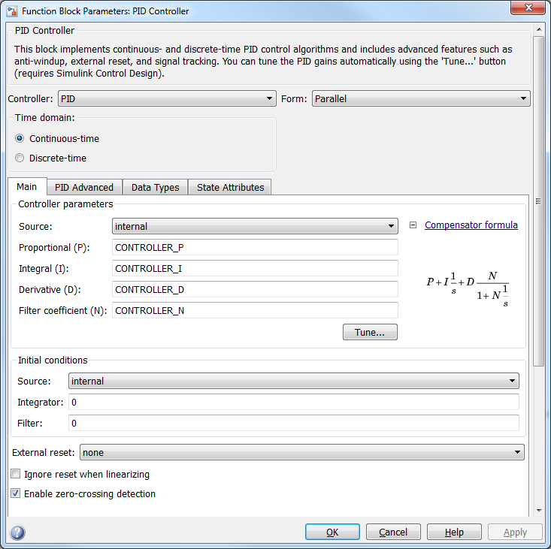
PID Tuning

Slide 36
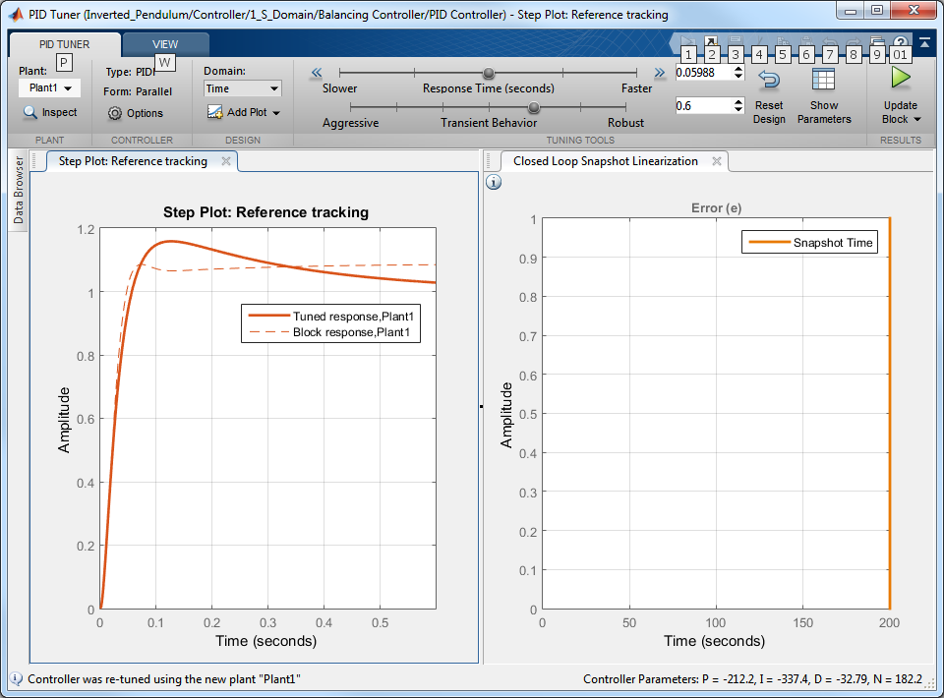
PID Tuning
Set enough time:
SIM time = 200s
LIN time = 200s

Slide 37
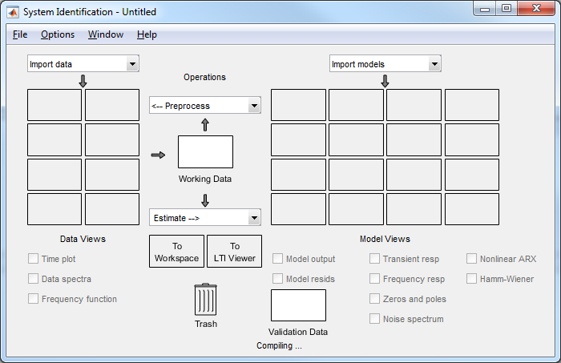
System identification App
>> ident

Slide 38
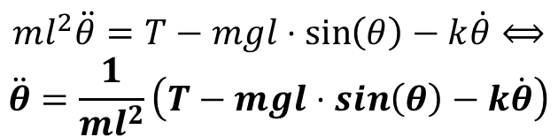

System identification: Inverted Pendulum Non linear fit
Plant Differential Equation:
State space representation:
$$ml^{2}\ddot{θ}=T−mgl⋅\sin\left(θ\right)−k\dot{θ}⟺$$
$$\ddot{θ}=\frac{1}{ml^{2}}\left(T−mgl⋅\sin\left(θ\right)−k\dot{θ}\right)$$
$$\left[\begin{matrix}\dot{θ} \\ \ddot{θ}\end{matrix}\right]=\frac{1}{ml^{2}}\left(\begin{matrix}\dot{θ} \\ T−mgl⋅\sin\left(θ\right)−k\dot{θ}\end{matrix}\right)⟺$$
$$\left[\begin{matrix}\dot{θ} \\ \ddot{θ}\end{matrix}\right]=\left(\begin{matrix}\dot{θ} \\ T−\frac{g}{l}⋅\sin\left(θ\right)−\frac{k}{ml^{2}}\dot{θ}\end{matrix}\right), g<0$$
$$\frac{d\vec{x}}{dt}=\left(\begin{matrix}\dot{θ} \\ T+\frac{g}{l}⋅\sin\left(θ\right)−\frac{k}{ml^{2}}\dot{θ}\end{matrix}\right) g>0$$

Slide 39
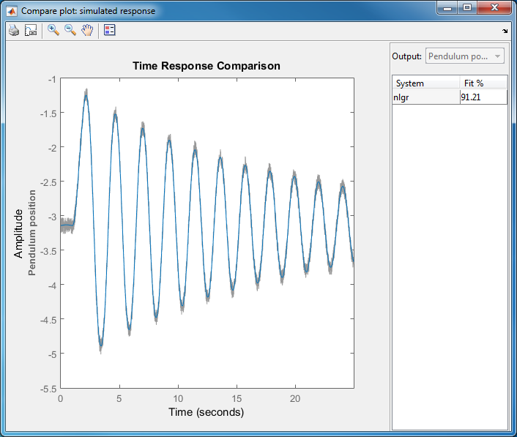
Non linear fit of measurements data

Slide 40
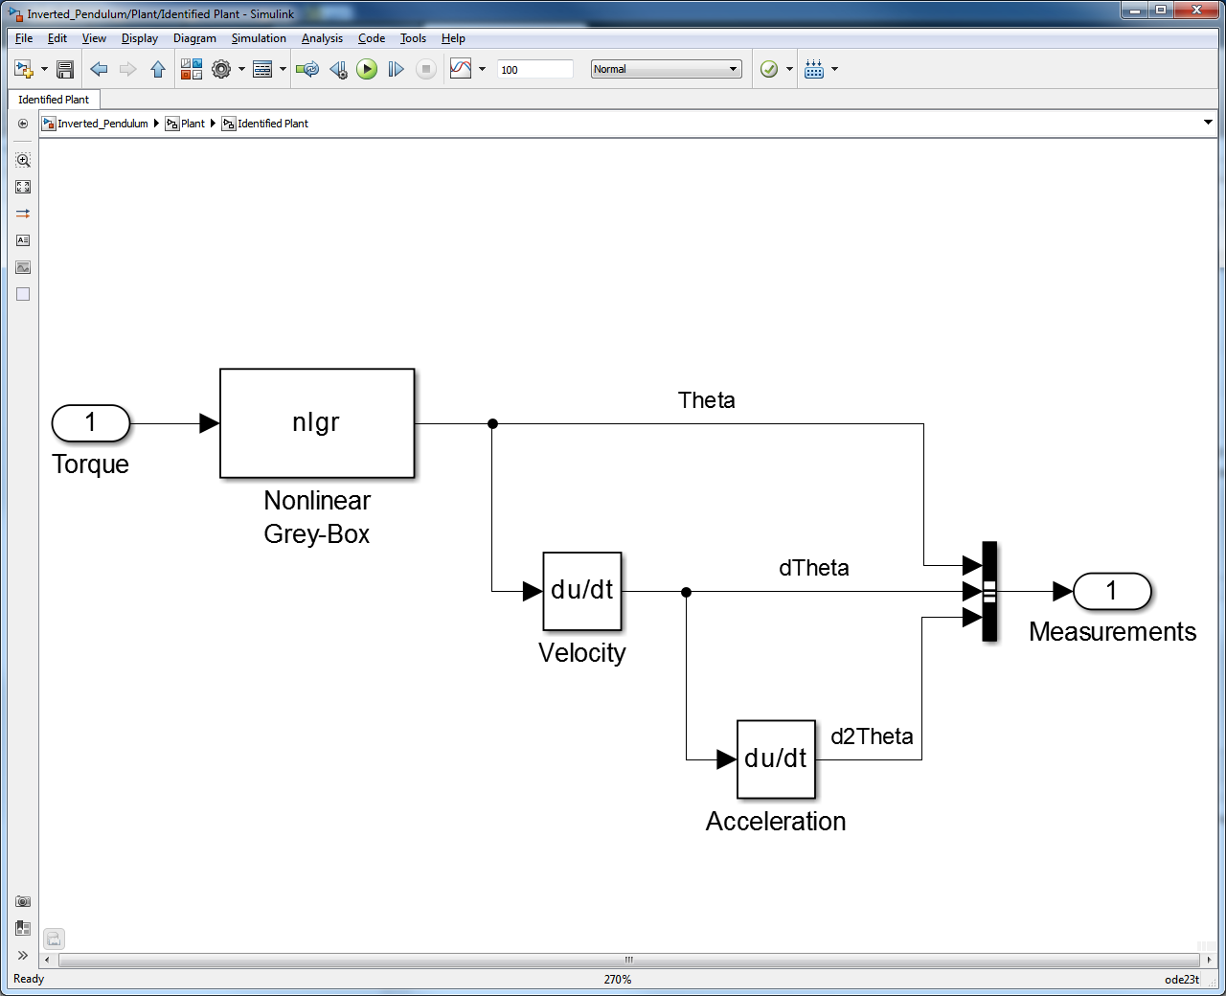
Grey box implementation of a non linear fit

Slide 41
Topics
Introduction
Problem formulation
Base model and project overview
Plant modelling
Introduction to SimMechanics
Modelling the inverted pendulum
Control logic modelling
Introduction to Stateflow
Controller modelling and analysis
Control design
PID tuning
System identification
Code generation and verification
Automatic code generation
In-the-Loop verification methodologies

Slide 42
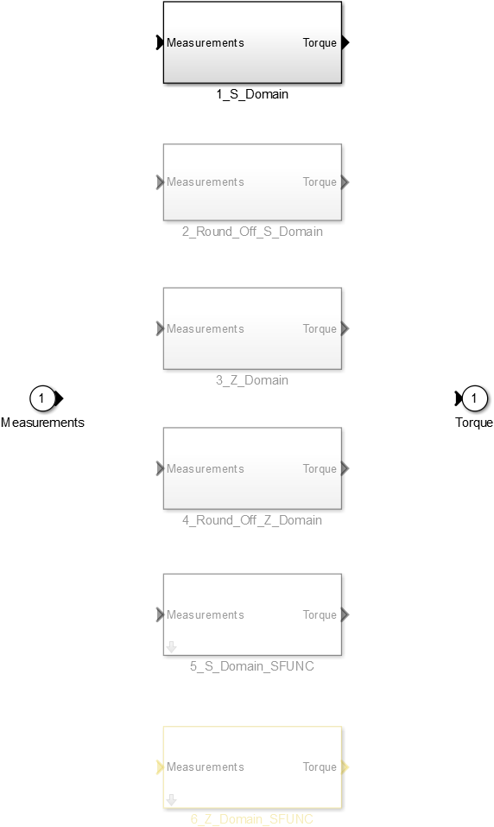
Code Generation and Verification Variant Subsystems

Slide 43
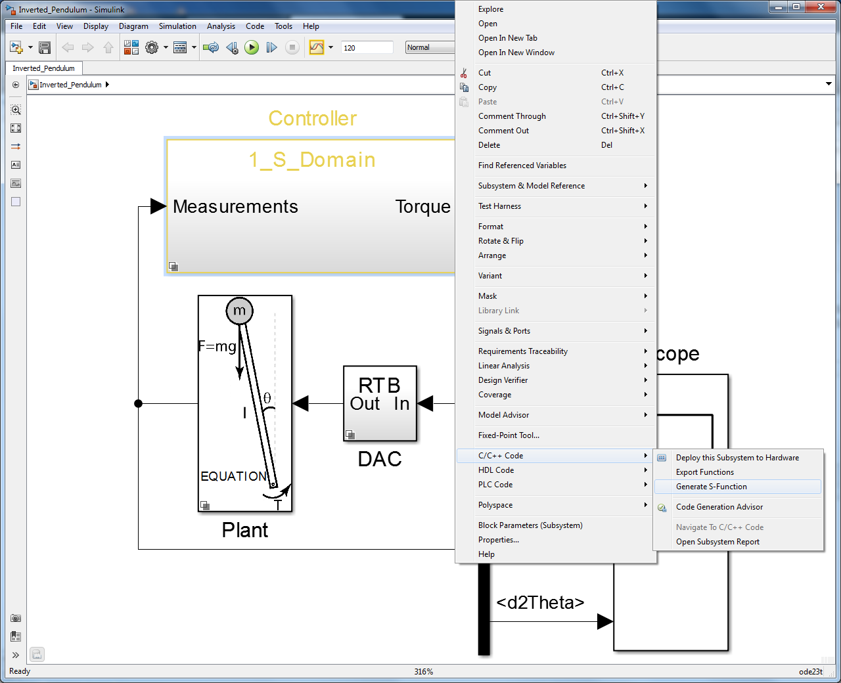
Code Generation and Verification S-Function, SIL/PIL

Slide 44
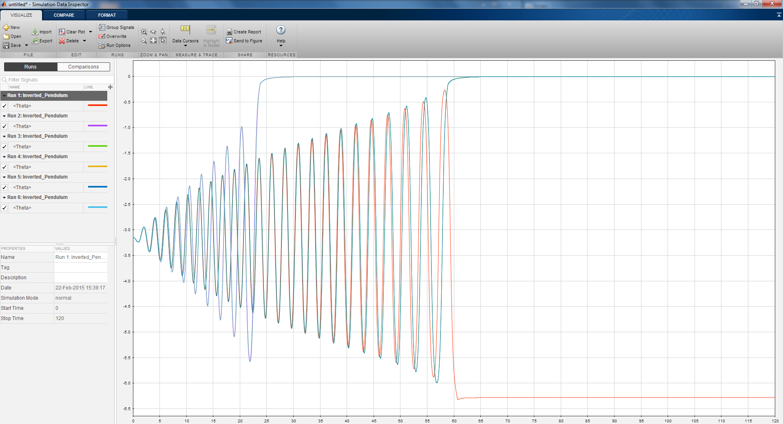
Code Generation and Verification Simulation Data Inspector

Slide 45
Three Key Takeaways
From one model to many targets using MATLAB and Simulink
Automatic code generation out of an executable specification
Bi-directional traceability between requirements, models and generated code

