Slide 1

Meet Sam

Slide 2
Autism Pocket Book
To provide one location for families with children on the autism spectrum a place to document interventions with the ability to enter multiple data points and provide scales suited to assess behavior.

Slide 3
Goals
Easy to use
Customizable
Allow Note taking
Allow end parents to input multiple data points.
Have the capability to summarize totals, averages, and ranges in behavior over a period of time.

Slide 4
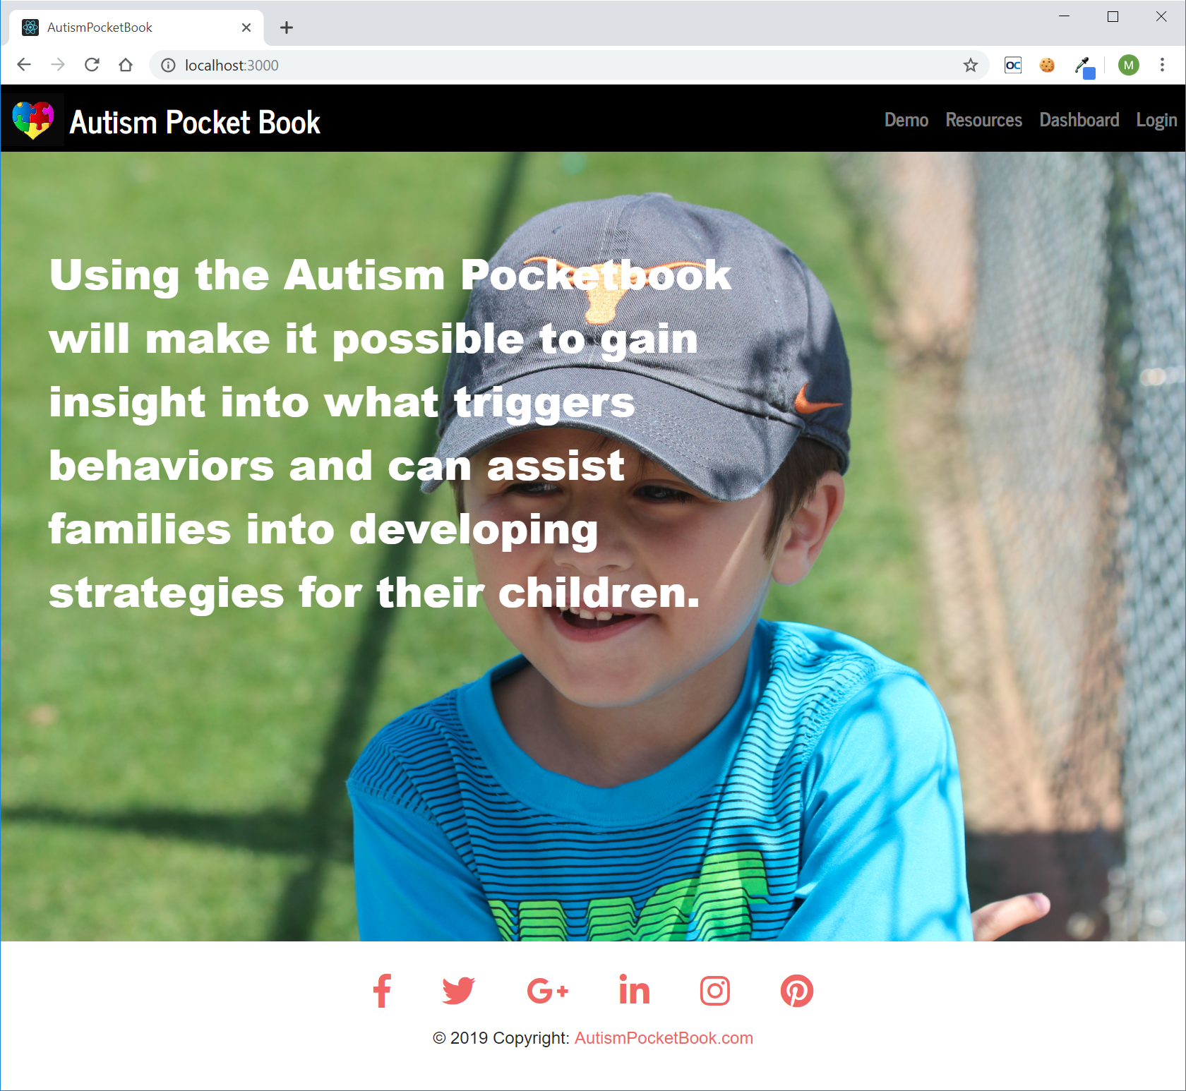
Demo Time

Slide 5
Under The Hood : Front-End
Twitter-Bootstrap
React
Formik
Axios
FullCalendar
React-Export-Excel
Chart

Slide 6
Under The Hood : Back-End
Node.js Server
Express
Axios
MongoDB/Mongoose
JsonWebToken
Bcrypt
WordDefinition

Slide 7
The Future
Ability to edit the parent and child’s profiles
Ability to edit child’s note data
Ability to import a parent and child’s picture
Ability to add multiple children
Ability to reset a parents password
Ability to add date ranges for reports and charts
Add summary data to Excel reports
Send daily email reminders to parents to enter notes
Add a Forum for parents to exchange ideas/ask questions

