Slide 1
Deep Fake Detection
Project Results
Group Members:
Michael Cortez
Francisco Tejeda-Villarreal
Xavier Cristan
Raphael Pangilinan

Slide 2
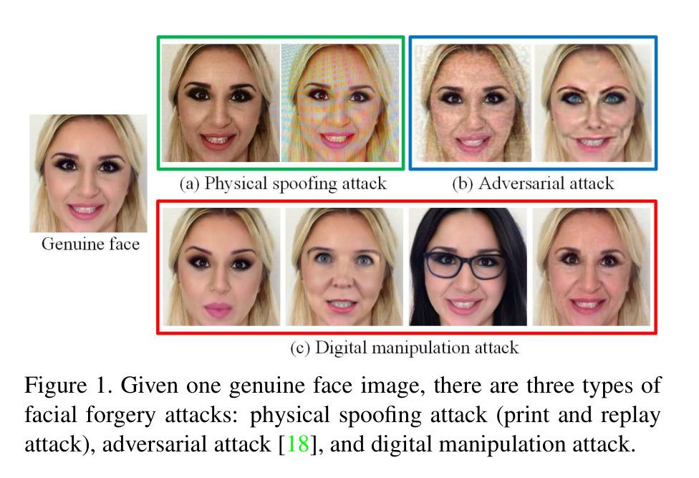
Problem and Motivation
Deepfakes raise major ethical and societal concerns:
  Privacy invasion
  Identity misuse
  Spread of manipulated content
Goal: train a model that labels a face as real or fake

Slide 3
Dataset - OpenForensics
OpenForensics (Le et al., ICCV 2021, CC BY 4.0)
Faces in the wild with real/fake labels and face boxes
We used the Val set (about 3 GB)
Split by image, so no photo is in two splits
Each annotated face is cropped and used as one sample
Split | Faces | Fake
Train | 10,752 | 69%
Validation | 2,302 | 70%
Test | 2,280 | 69%
About 7 in 10 faces are fake, so we weight the loss by class.

Slide 4
Methodology
Crop each face from its box, with 20% extra margin
Resize to 128 x 128 pixels
ResNet-18 pretrained on ImageNet
  Final layer replaced with 2 outputs: real / fake
Fine-tuned with class-weighted cross-entropy
Face crop
128 x 128
ResNet-18
(pretrained)
Real / Fake
score

Slide 5
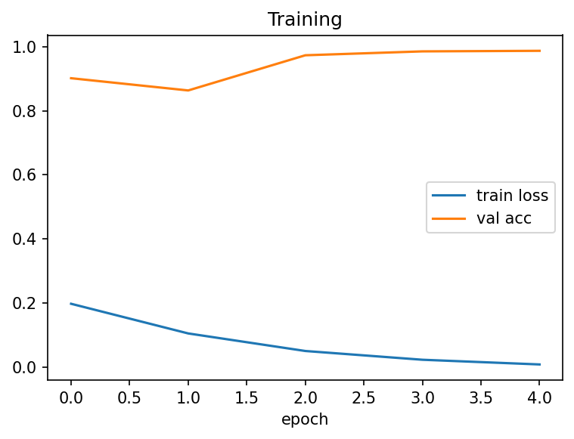
Training Setup
5 epochs, batch size 64
AdamW optimizer, one-cycle learning rate (peak 1e-3)
Random horizontal flip as augmentation
Mixed precision on a Colab GPU
Kept the checkpoint with the best validation accuracy
Training loss falls; validation accuracy reaches about 0.99.

Slide 6
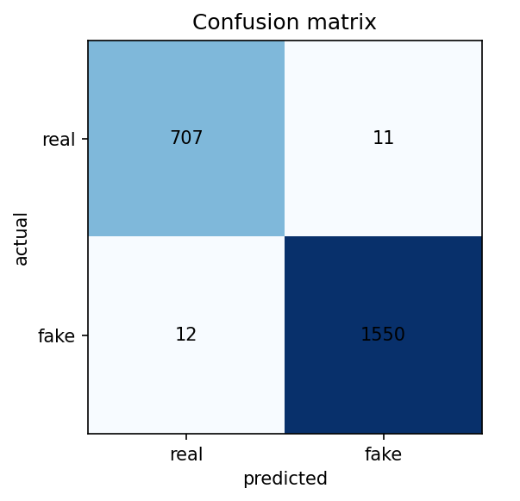
Results on the Test Set
2,280 held-out faces (718 real, 1,562 fake)
98.99%
0.9994
Accuracy
ROC AUC
Class | Precision | Recall | F1
Real | 0.98 | 0.98 | 0.98
Fake | 0.99 | 0.99 | 0.99
Only 23 of 2,280 faces misclassified (11 real called fake, 12 fake called real).

Slide 7
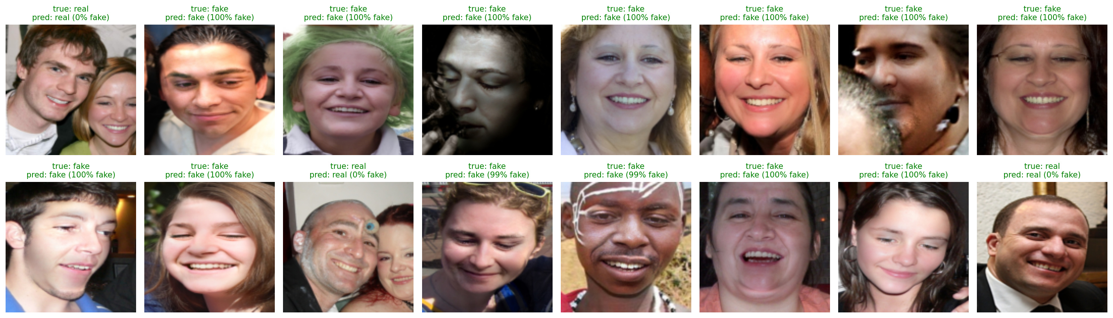
Example Predictions
16 random faces from the test set. True label and predicted label with the model's fake probability; green means correct. All 16 are correct here.

Slide 8
Limitations and Next Steps
Train, validation and test all come from the same dataset (Val set)
  Results show in-dataset performance only
Next steps:
  Test on OpenForensics Test-Dev and on other deepfake datasets
  Train on more data (Train parts)
  Compare against other architectures from the proposal
  Video detection if time allows

Slide 9
References
T.-N. Le, H. H. Nguyen, J. Yamagishi, and I. Echizen, “OpenForensics: Large-Scale Challenging Dataset for Multi-Face Forgery Detection and Segmentation In-the-Wild,” in Proc. IEEE/CVF Int. Conf. Computer Vision (ICCV), 2021.
K. He, X. Zhang, S. Ren, and J. Sun, “Deep Residual Learning for Image Recognition,” in Proc. IEEE Conf. Computer Vision and Pattern Recognition (CVPR), 2016.
G. Pei et al., “Deepfake Generation and Detection: A Benchmark and Survey,” ACM Comput. Surv., vol. 58, no. 11, pp. 1–41, Aug. 2026, doi: 10.1145/3801962.

