Slide 1


QAMP 2025
Reinforcement learning based selection of error mitigation parameters for Zero Noise Extrapolation #56
Speaker name: Abdullah K
Team member: Deenathayalan A
Mentors: Dr. Ritajit Majumdar, Dr. Anupama Roy

Slide 2
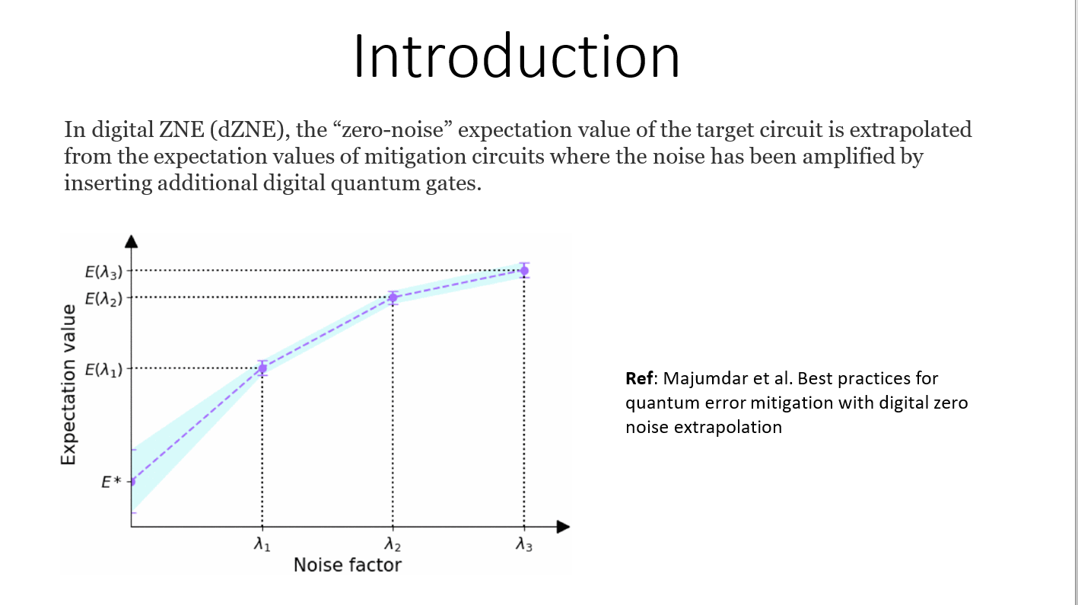

Slide 3
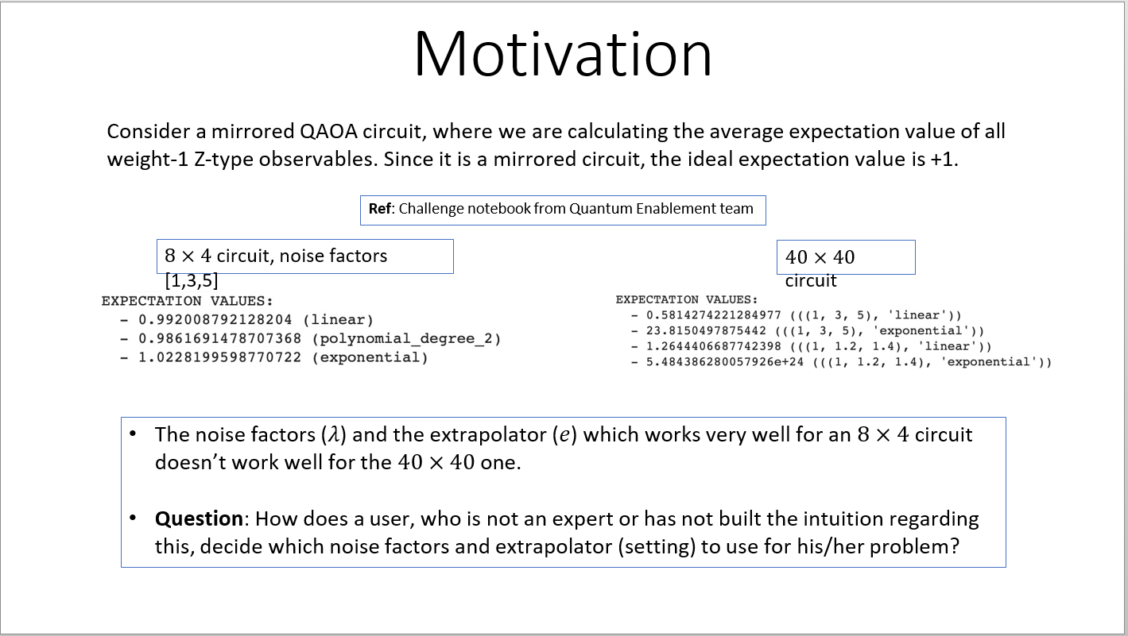

Slide 4
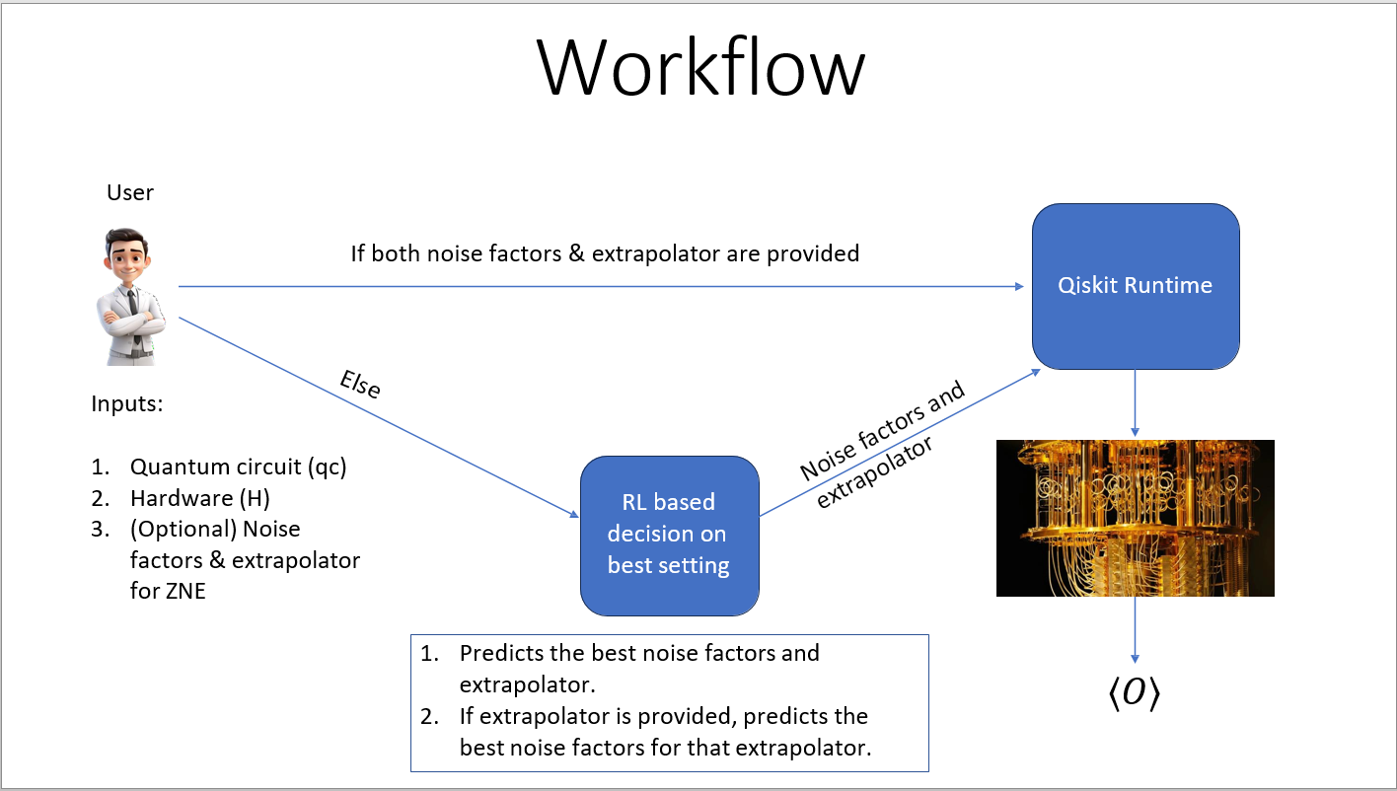

Slide 5
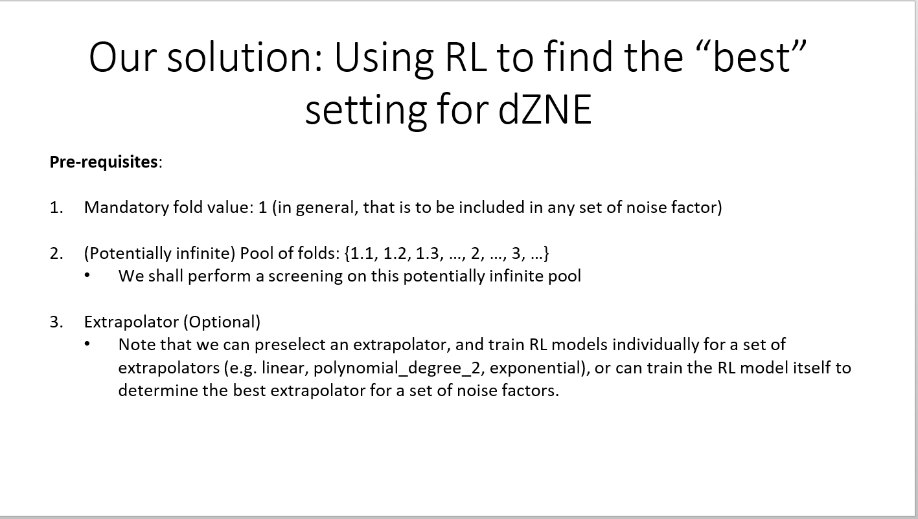

Slide 6
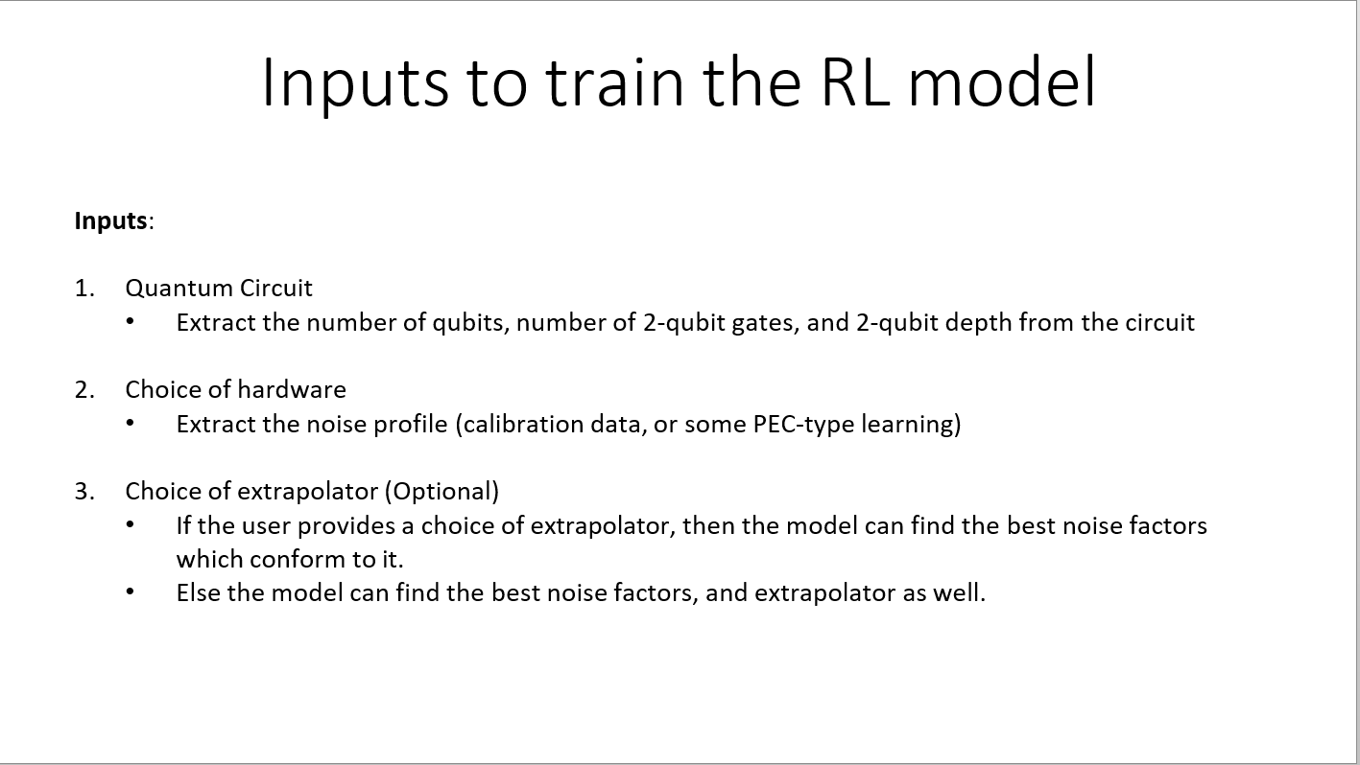

Slide 7
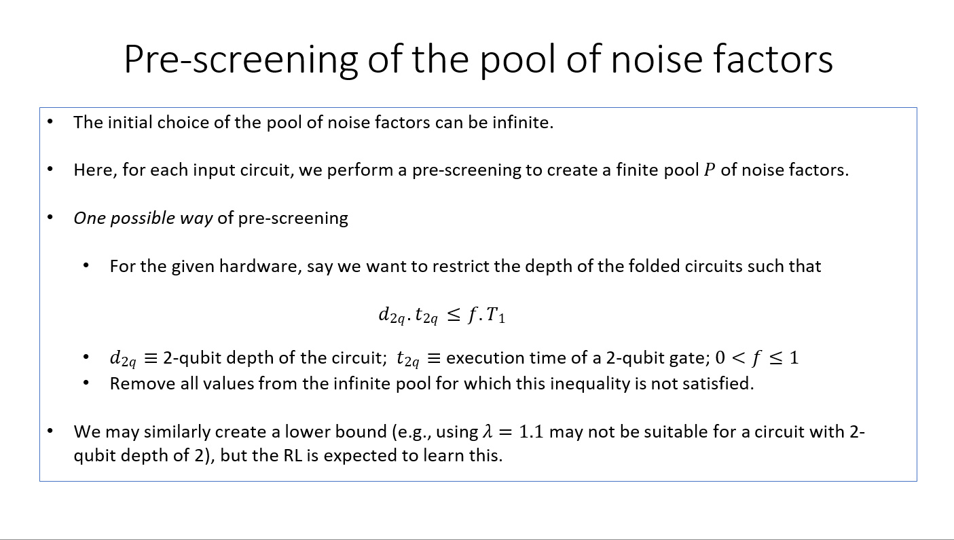

Slide 8
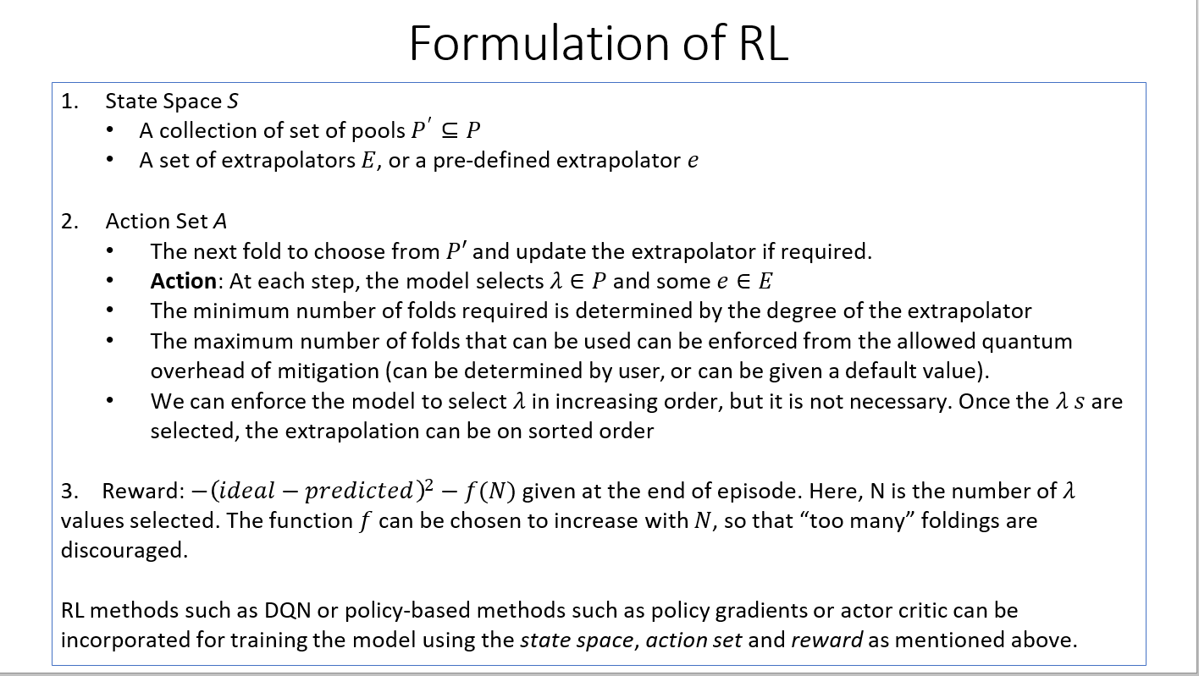

Slide 9
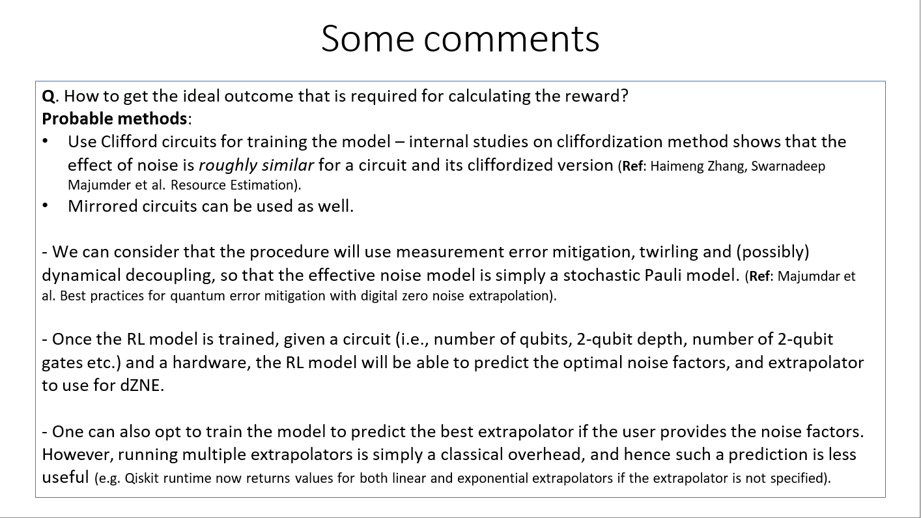

Slide 10
THANK YOU

