Slide 1
Appliance Energy Prediction
DATS6313 – Time Series Modeling
Erika Pham

Slide 2
Content
INTRODUCTION
Overview of the data
EXPLORATORY DATA ANALYSIS
Overview of data preprocessing and EDA
MODELING
Base models, Regressions, Holt-Winters, ARMA/ARIMA/SARIMA/Multiplicative
SUMMARY
Summary of model performance

Slide 3
INTRODUCTION- DATASET
Appliance Energy Prediction from UCI Machine Learning library
19735 entries, 27 variables
The forecast variable is "Appliances” – which is energy use in Wh.
Experimental data of appliances energy use in a low energy building. The data set is sampled every 10 min for about 4.5 months.
Weather from the nearest airport weather station (Chievres Airport, Belgium) was downloaded from a public data set merged together with the experimental data sets using the date and time column
Two random variables have been included in the data set for testing the regression models and to filter out non predictive attributes (parameters)

Slide 4
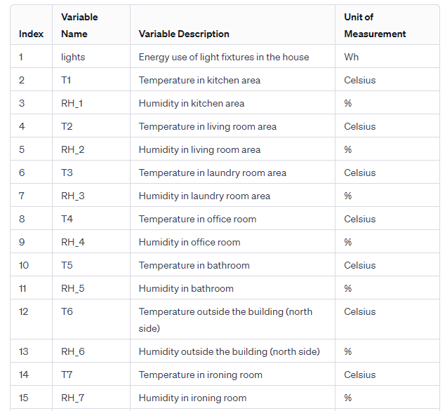
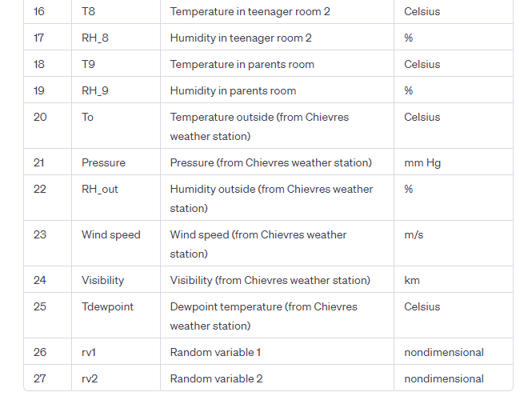
Introduction – DATAset

Slide 5
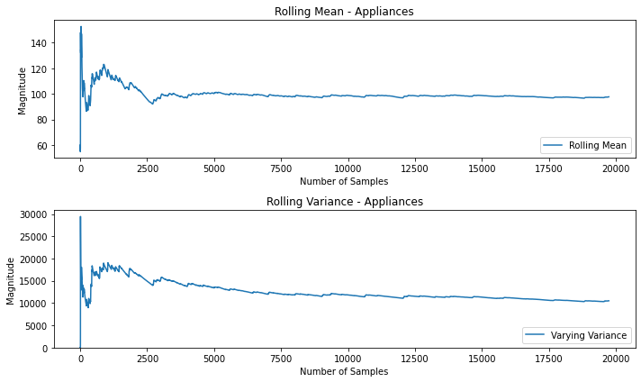
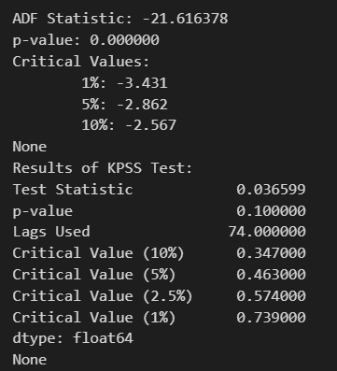
EDA – STATIONARITY CHECK
Rolling mean/variance stable
P-values for ADF and KPSS both show stationarity
-> data is stationary

Slide 6
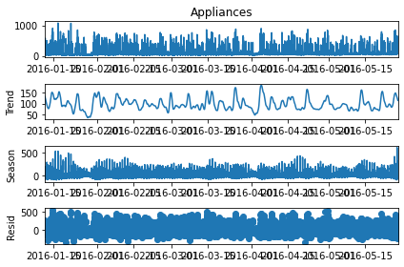
EDA – DECOMPOSITION
Strength of trend for the raw data is 17.526%
Strength of seasonality for the raw data is 49.983%
-> no strong trend or seasonality

Slide 7
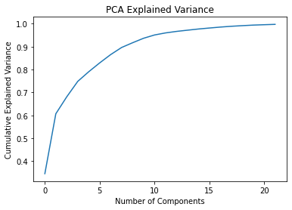
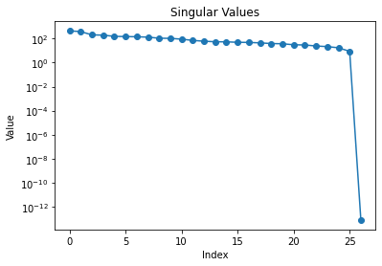
EDA – Dimensionality REDUCTION
Condition number is extremely large (5076777717078298), meaning there is a strong case of multicollinearity
From correlation matrix, we see high correlation between the humidity between some rooms, as well as some indoors and outdoors temperatures. The random variables have no discernable correlations. VIFs are high for these variables.
Both PCA and SVD results show that we can reduce the features and still explain a lot of variance in the data. PCA for example, show that ~20 features can explain almost all of the variance.

Slide 8
EDA – Dimensionality reduction
Using backwards stepwise selection
Alpha = 0.05
Retaining 19 features, removing: temperature in bathroom, humidity in office room, temperature in kitchen area, pressure, temperature in ironing room, humidity in bathroom, and the 2 random variables 'rv2', 'rv1’.

Slide 9
TIME SERIES MODELING
Base Models
Holt-Winters Method
Naïve, Average, Drift, SES, Exponential Smoothing
Regressions
ARMA
OLS model
ARMA(1, 0) model

Slide 10
TS Modeling – Base models
Naïve, Average, Drift, Simple Smoothing, Exponential Smoothing
h-step prediction, h = len(test set)
Average performed the best, and Exponential Smoothing performed the worst (which signals that the Holt-Winters Method might also not do very well)
Model | RMSE
Naïve | 223.05
Average | 91.05
Drift | 250.96
Simple Smoothing | 104.14
Exponential Smoothing | 262.90

Slide 11
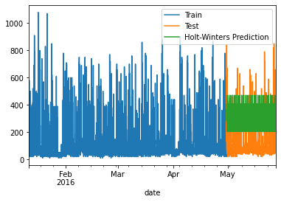
TS Modeling – Holt-Winters Method
Using additive methods
Seasonal period = 144, as there are 144 10-minute intervals per day
RMSE = 204.71, which is ~8% better than Naïve but not as good as other models
Data shows no strong trend or seasonality, so poorer performance is understandable

Slide 12
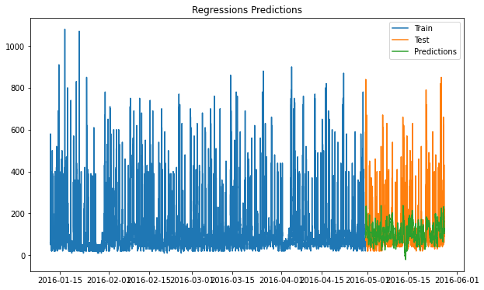
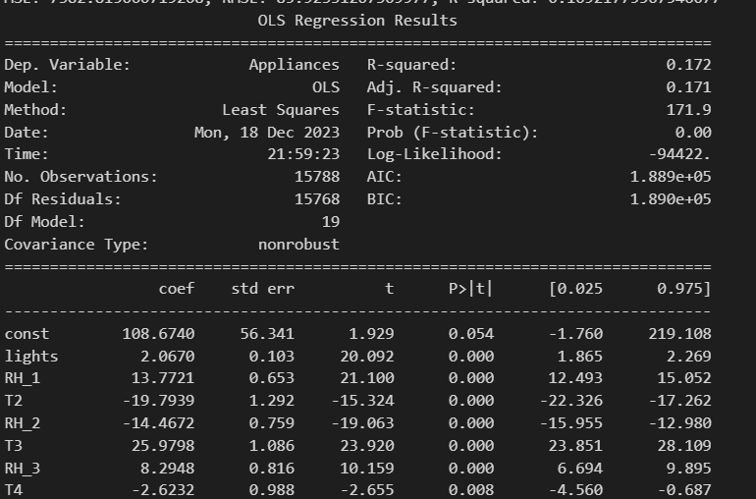
TS Modeling – Multiple Linear REGRESSIONS
Without cross validation, R-squared is 0.17. After cross-validation (5-fold), average R-squared is 0.07. Does not explain much variance in the data. Average RMSE = 94.37.
F-test is significant with p-value = 0.00, suggests that at least some of the predictors significantly contribute to predicting the independent variable
Most features are significant, except dewpoint temperature and outside humidity (t-prob > 0.1)

Slide 13
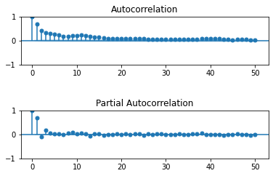
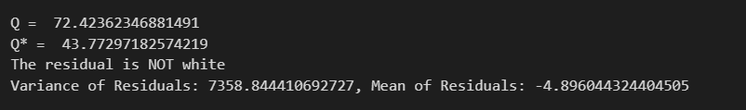
TS Modeling – Multiple Linear REGRESSIONS
ACF/PACF for residuals do not look like white noise
Q value also supports that residual is not white

Slide 14
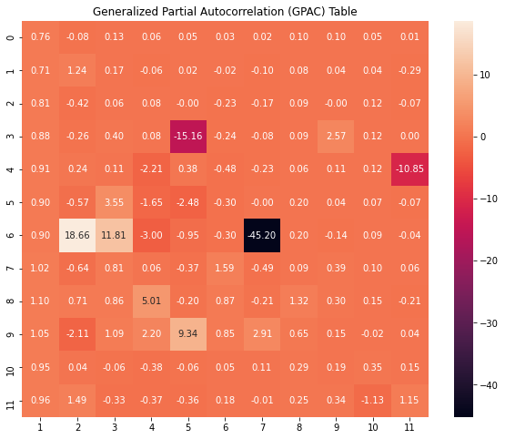
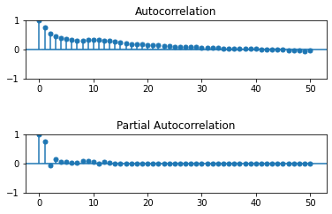
TS Modeling – ARMA/ARIMA/SARIMA
Order selection: GPAC shows a column of constant at k=1 and j=0. Other less clear patterns include k=8 and/or j =10
ACF/PACF shows tails-off/cuts-off (lag 1) pattern, meaning this is potentially an AR(1) model

Slide 15
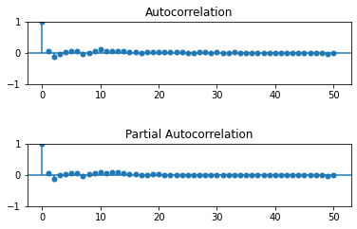
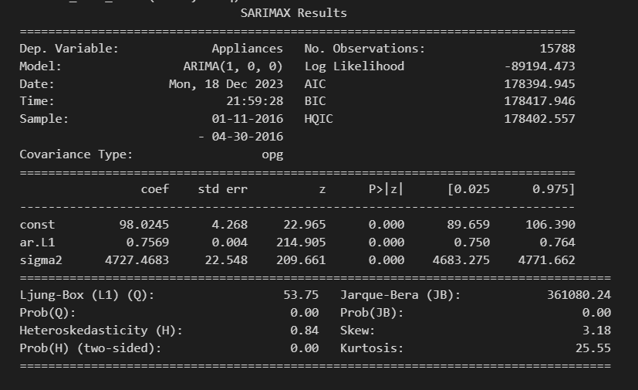
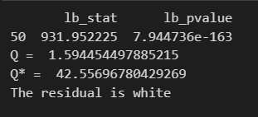
TS Modeling – ARMA/ARIMA/SARIMA
Plugging ARIMA (1, 0, 0) into forecast function
ACF/PACF and Q-values show that residual is white
RMSE is 131.51, which is worse than Average and Regressions
The model after estimation is ARIMA(1,0,0): y(t) = 98.0245 + 0.7569y(t-1) + e(t).

Slide 16
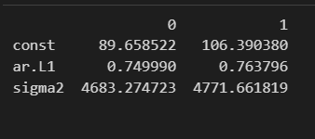
TS Modeling – ARMA/ARIMA/SARIMA
Variance of errors is 4727.56 and variance of the forecast errors is 8104.44. This suggests that the model does not generalize well as it performs much worse on unseen data.
Residual mean is 0.0096, which suggests that the model is unbiased
Root analysis shows that the final coefficient matches the current one, 0.7569
Confidence interval suggests all parameters are significant (no 0 between)

Slide 17
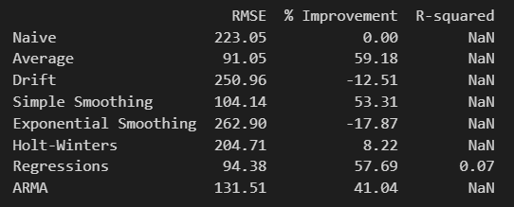
SUMMARY
Average model performed the best, Regressions came 2nd
No other model performed better than the base Average model
Suggests problems with data processing. Need to try different feature selection criteria

Slide 18
Thank you

