Slide 1


Slide 2
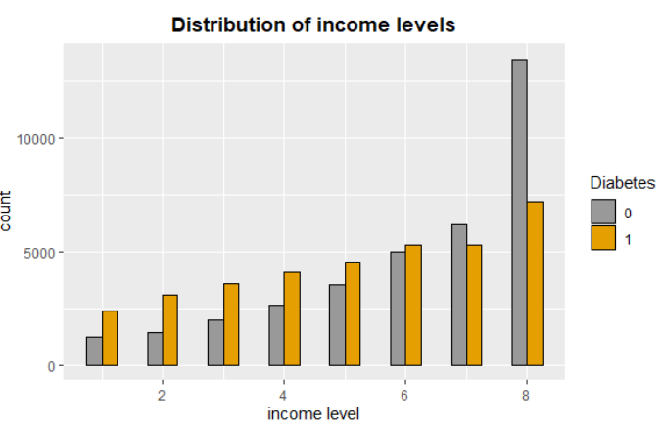
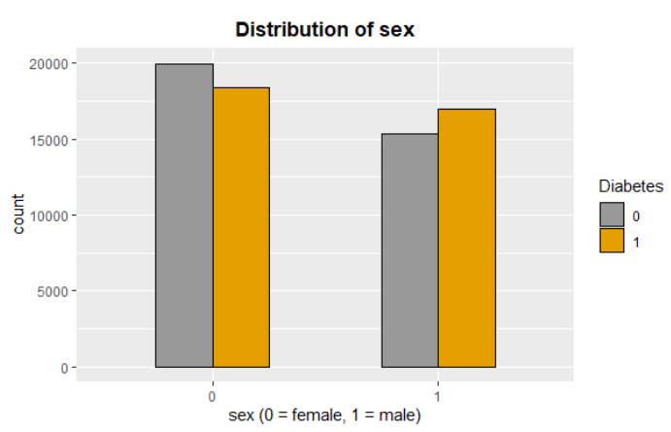
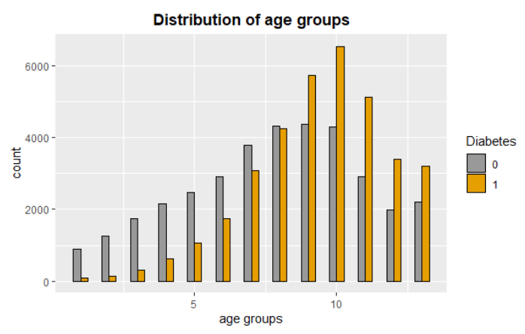
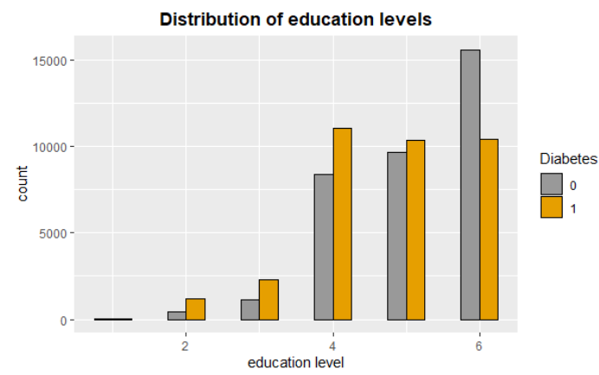
BIODEMOGRAPHIC VARIABLES
More women are prediabetic/diabetic than men
At lower income levels, more people with pre/diabetes
Older age groups have more diabetic participants (from 55 years onwards)
Most diabetic participants have finished high school or later. For participants who have finished college, there are more people who do not have pre/diabetes.

Slide 3
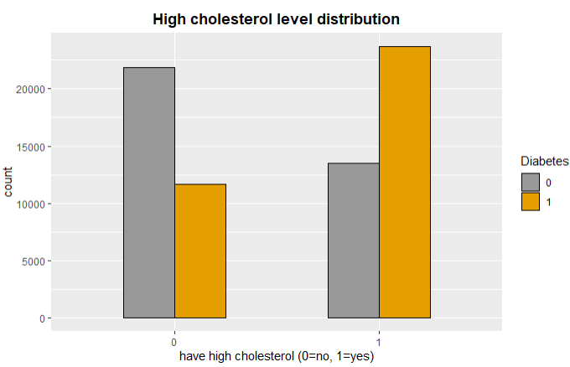
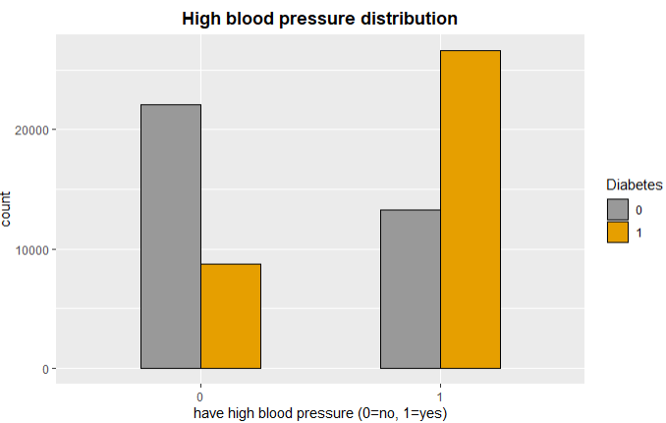
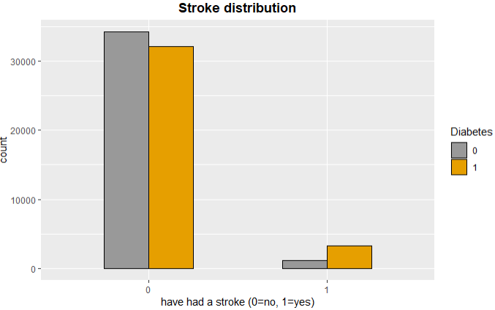
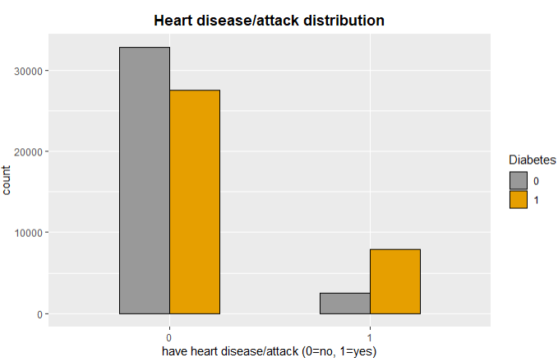
HEALTH INDICATORS
For people who have high blood pressure and high cholesterol, more have diabetes that not
For people who have had a stroke, more have diabetes than not

Slide 4
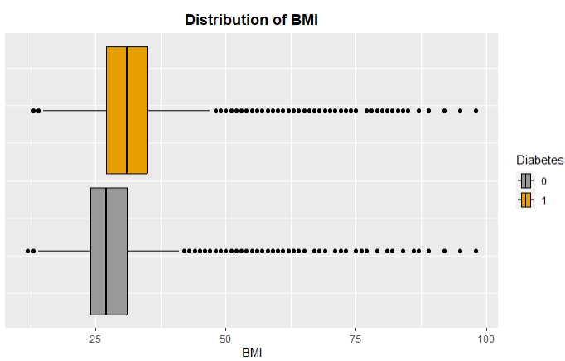
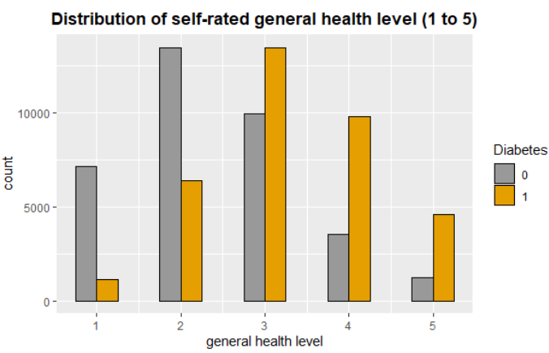
HEALTH INDICATORS
Participants with pre/diabetes have higher BMI overall (25 – 29.9 is overweight, 30+ is obese)
A good number of people have BMI 30 and above in both groups
From scale of 1 – 5 (1 being excellent, 5 being poor) more people with diabetes rated their health level lower compared to people without diabetes

Slide 5
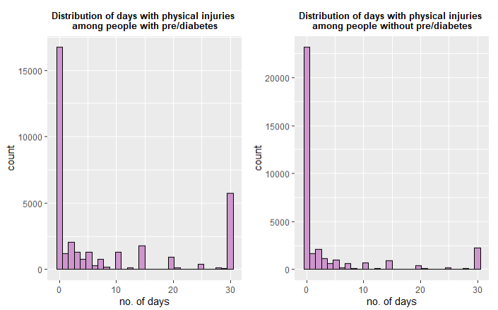
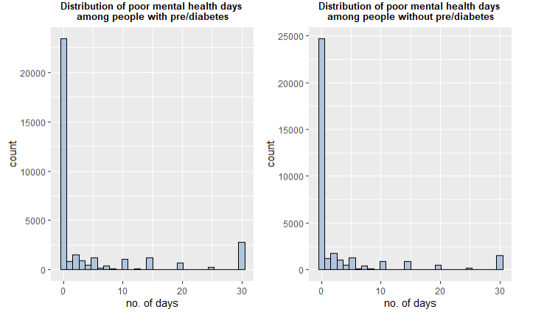
HEALTH INDICATORS
People with diabetes reported more days with injury than people without
Similarly, people with diabetes reported more days with bad mental health than people without diabetes

Slide 6
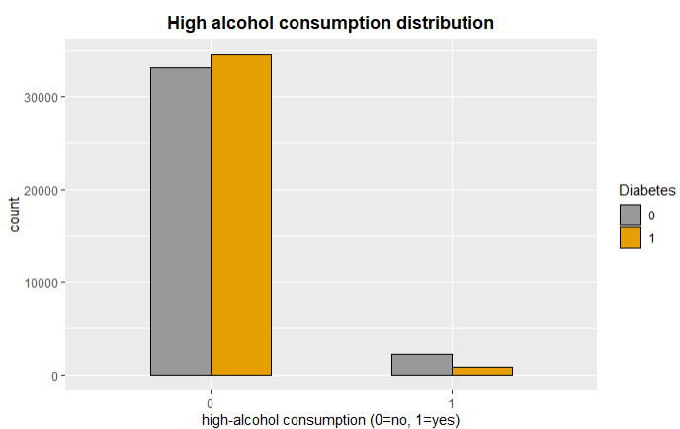
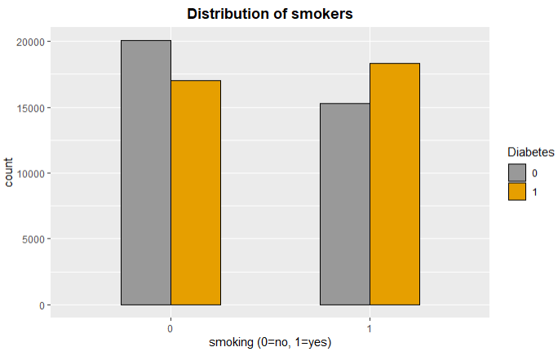
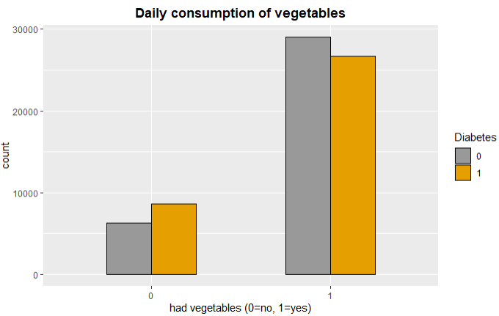
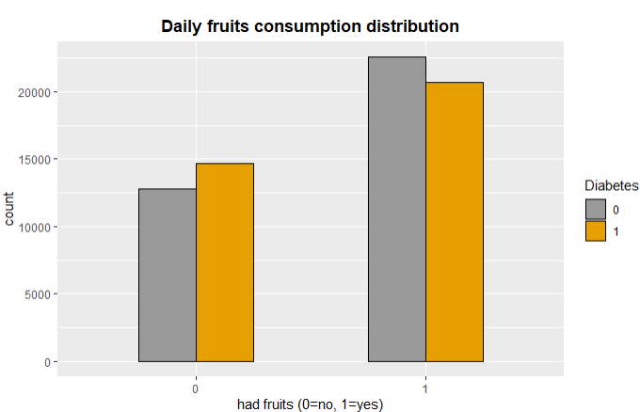
BEHAVIORAL & OTHER INDICATORS
Among those who smoked, more have diabetes than not
Among those who did not consume fruits and vegetables daily, more have diabetes than not
Among those who do include fruits and vegetables daily, more participants did not have diabetes
More participants without diabetes have high alcohol consumption

Slide 7
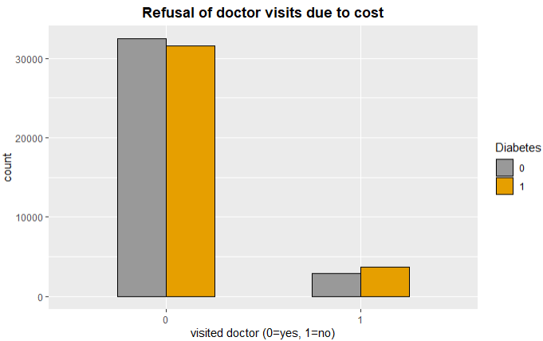
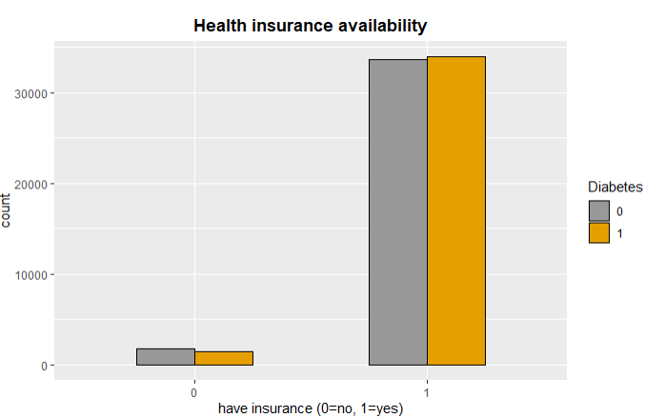
BEHAVIORAL & OTHER INDICATORS
More people with diabetes could not visit a doctor due to high cost
Most participants had health insurance. Among those who did have insurance, more people have diabetes than not.

Slide 8
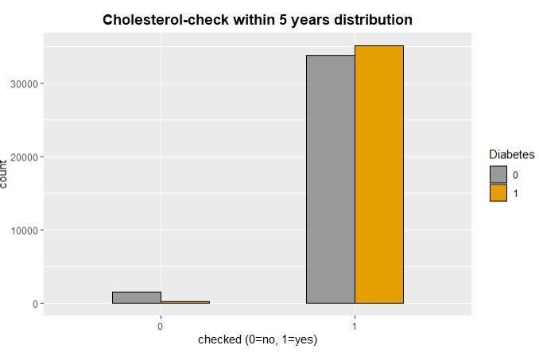
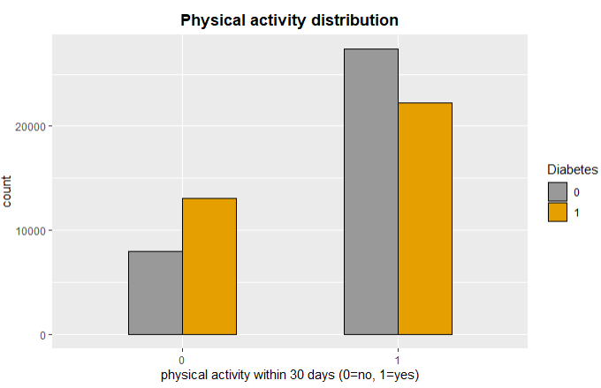
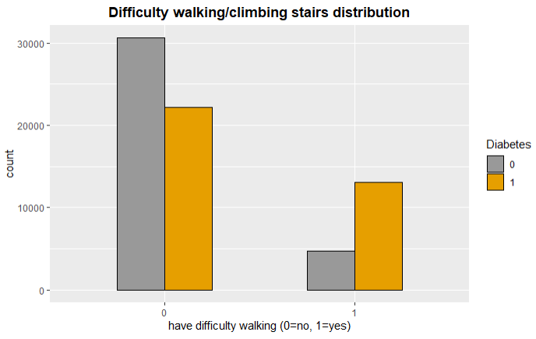
BEHAVIORAL & OTHER INDICATORS
Among those who have checked their cholesterol level, more people have diabetes than not.
More people with diabetes reported not having physical activity outside of their job in the past 30 days.
For those with difficulty walking/climbing stairs, more also reported having pre/diabetes

