Slide 1
Black Box
Hidden Layer
Inputs
Outputs
Tone
Gender
………..
Answer
Accent
Age

Slide 2
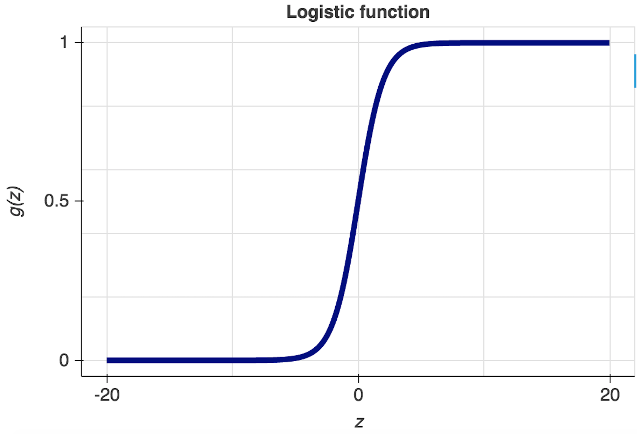
Inputs
Correlated to the Output
Logistic regression
Outputs
Tone
w1
Gender
w2
Answer
w3
Accent
w4
Age

