Slide 1
References
BY PRAPHUL KOLTE

Slide 2
References
Reference is alias for variable
How to declare and define reference
  int a=10;
  int &r =a;
  Here r is reference to a( alias)
Reference has to be initialized where it is declared but cannot be initialized with NULL
Reference is internally a constant pointer hence needs to be initialized where it is declared

Slide 3
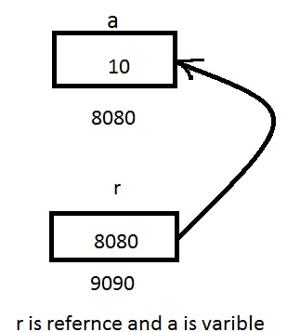
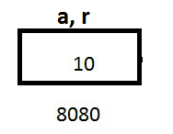
References
Conceptual representation
Internal representation

Slide 4
References
References are auto dereferenced
Change in reference will change original variable value.
    int a=10;
    int &r =a;
    r = r+1;
    cout<<"\n"<<r<<" "<<a; // will print 11 11
Reference to const is also possible. It is also known as const reference.
    const int &r = 12;
    int k =10;
    const int &r1=k;

Slide 5
References
We can not access dynamically allocated memory using reference.
We can change value of variable/constant using reference if reference is const reference.
  const int &r = 12;
  r = r+1; // Will generate error
Pointer and reference declaration difference
  int a=10;
  int *p = &a;
  int &r =a ; // only LHS * is replaced by RHS &

Slide 6
References
Address of reference variable and variable is same.
  int a=10; //Lets us assume address of a is 8080
  int &r =a; // Lets us assume address of r is 9090
  cout<<&a; // Will print 8080
  cout<<&r; // Will print 8080
  // As reference is constant ptr internally and it is auto dereferenced (&r) turns out to &(*r)
  (*r) ==> a and hence (&r) becomes &a

Slide 7
References
Passing reference to function (pass by ref)
  void swap( int &ra , int &rb)
  { int k = ra;
  ra = rb;
  rb =k; }
  int main()
  { int a= 10; int b =20;
  swap(a,b);
  cout<<"\n"<<a<<"\n"<<b;
  return 0;
  }

Slide 8
References
Returning reference from function
  Returning reference of local variable from function will result in dangling pointer problem.
  int& sum(int a, int b)
  { int s = a+b;
  return s;}
  int main(){
  int c = sum(10,20);
  cout<< c;
  return 0;
  } // This program will result in compilation error &segmentation fault

Slide 9
References
Advantages of reference
  Reference has clear and clean syntax
  Reference is auto dereferenced
  Minimize use of pointers

Slide 10
Thank You
Be happy, I minimize use of pointers!!!!
………. Reference

