Slide 1
AVL TREES

Slide 2
AVL TREE IS…
named after Adelson-Velskii and Landis
the first dynamically balanced trees to be propose
Binary search tree with balance condition in which the sub-trees of each node can differ by at most 1 in their height

Slide 3
DEFINITION OF A BALANCED TREE
Ensure the depth = O(log N)
Take O(log N) time for searching, insertion, and deletion
Every node must have left & right sub-trees of the same height

Slide 4
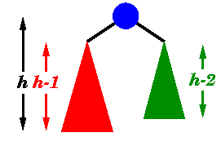
AN AVL TREE HAS THE FOLLOWING PROPERTIES:
Sub-trees of each node can differ by at most 1 in their height
Every sub-trees is an AVL tree

Slide 5
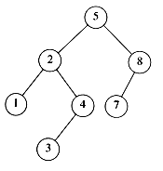
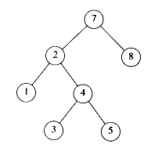
AVL TREE?
YES
Each left sub-tree has height 1 greater than each right sub-tree
NO
Left sub-tree has height 3, but right sub-tree has height 1

Slide 6
INSERTION AND DELETIONS
It is performed as in binary search trees
If the balance is destroyed, rotation(s) is performed to correct balance
For insertions, one rotation is sufficient
For deletions, O(log n) rotations at most are needed

Slide 7
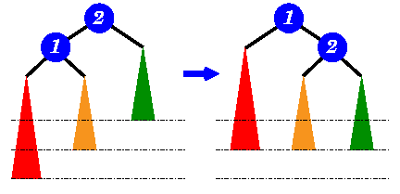
Single Rotation
left sub-tree is two level
deeper than the right sub-tree
move ① up a level and
② down a level

Slide 8
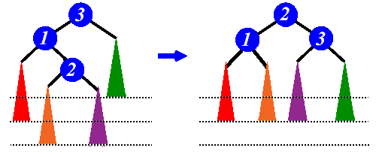
Double Rotation
Left sub-tree is two level
deeper than the right sub-tree
Move ② up two levels and
③ down a level

Slide 9
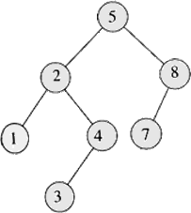
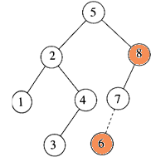
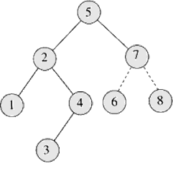
Insertion
Insert 6
Imbalance at 8
Perform rotation with 7

Slide 10
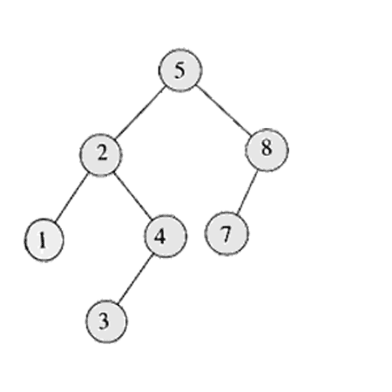

Slide 11
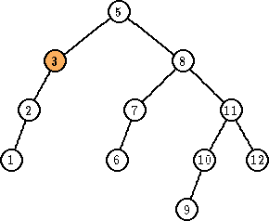
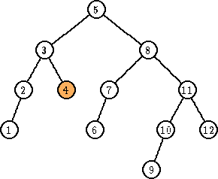
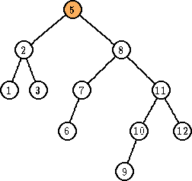
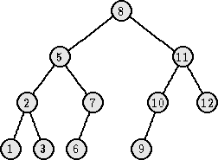
Deletion
Delete 4
Imbalance at 3
Perform rotation with 2
Imbalance at 5
Perform rotation with 8

Slide 12
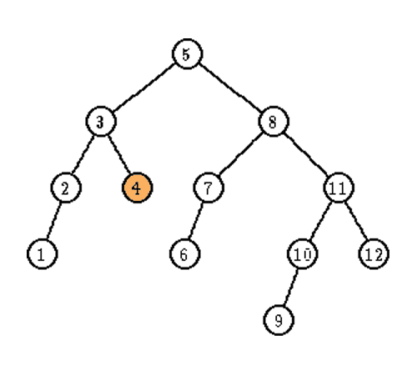

Slide 13
KEY POINTS
AVL tree remain balanced by applying rotations, therefore it guarantees O(log N) search time in a dynamic environment
Tree can be re-balanced in at most O(log N) time

