Slide 1


SOLACE INFOTECH PVT. LTD.
MeraClass
Solace Infotech Pvt. Ltd. All Rights Reserved

Slide 2
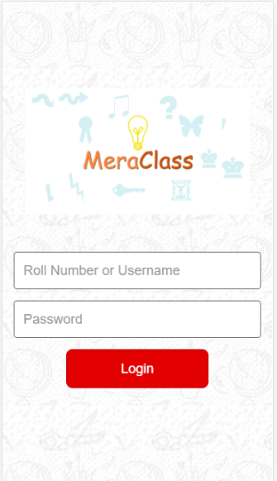
Application
Login Form
Solace Infotech Pvt. Ltd. All Rights Reserved

Slide 3
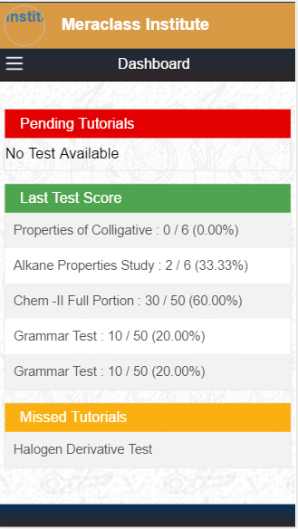
Dashboard
Solace Infotech Pvt. Ltd. All Rights Reserved

Slide 4
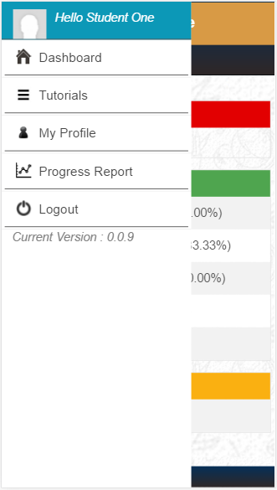
Menu

Slide 5
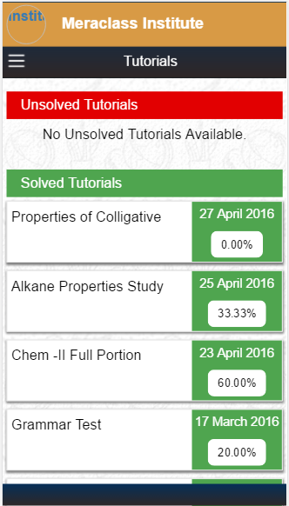
My Tutorials

Slide 6
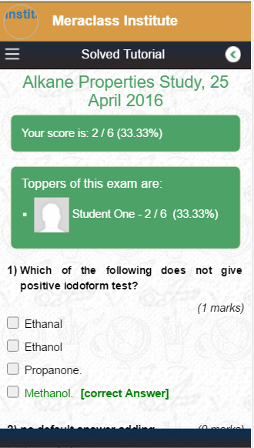
Tutorial

Slide 7
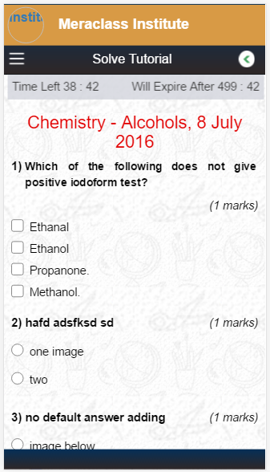
Solve Tutorial

Slide 8
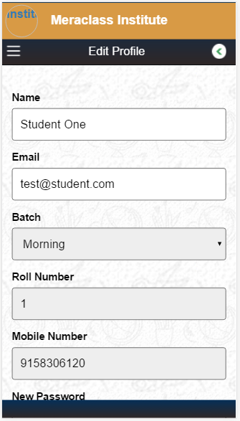
Edit Profile

Slide 9
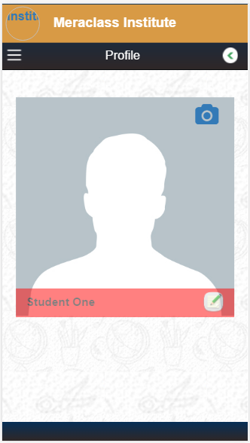
Profile Picture

Slide 10
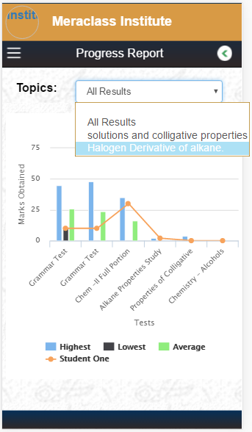
Progress Report

Slide 11
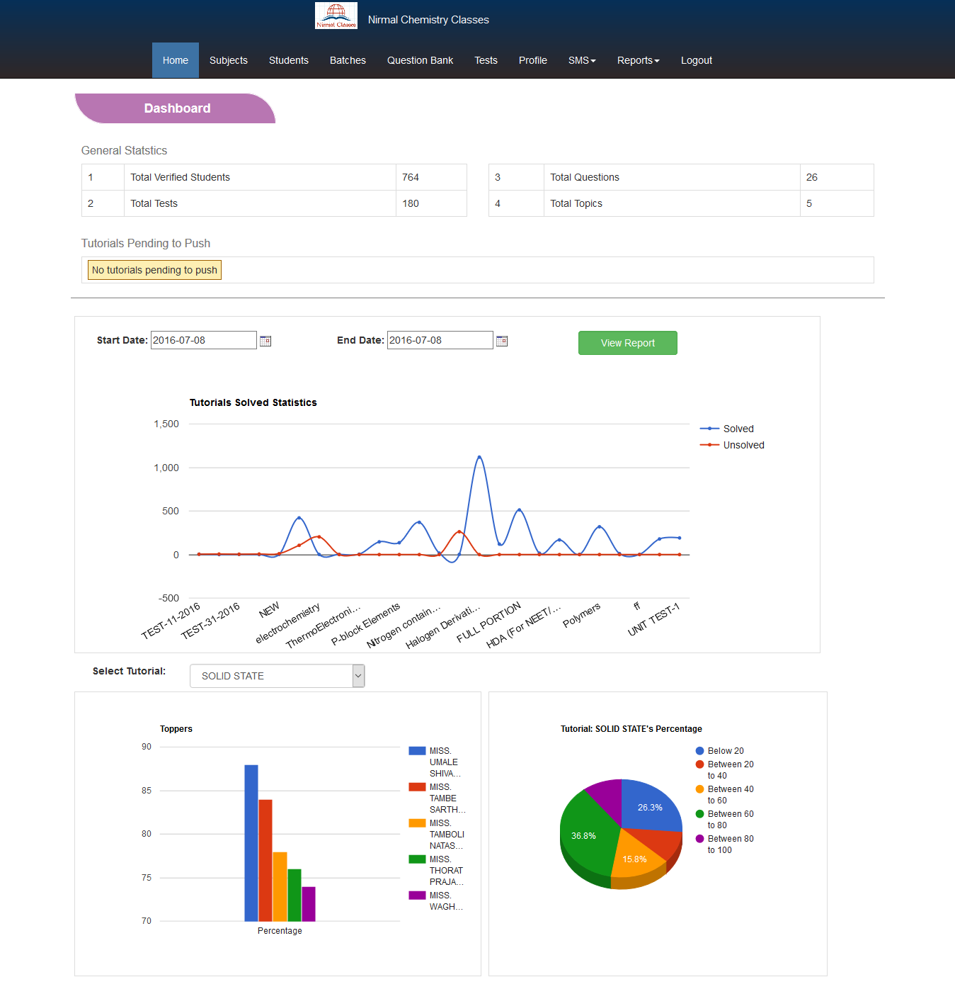
Administrator

Slide 12
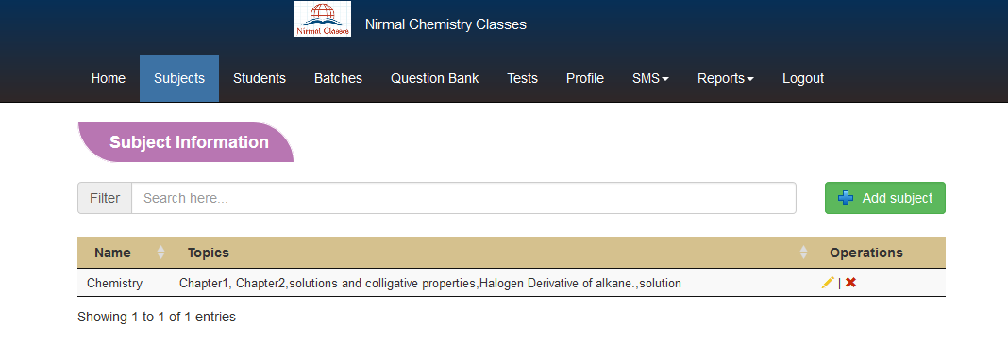
Subjects List

Slide 13
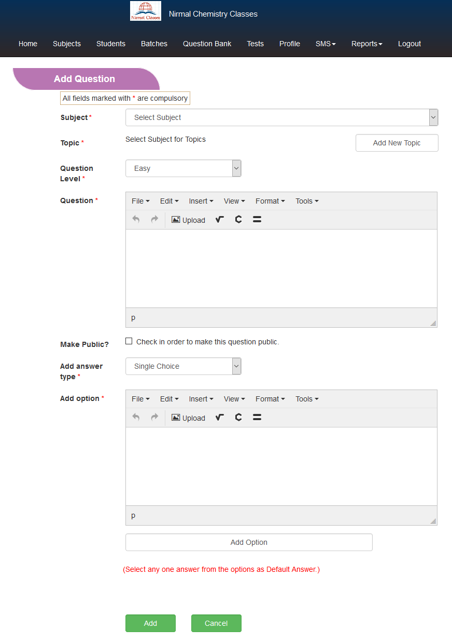

Slide 14
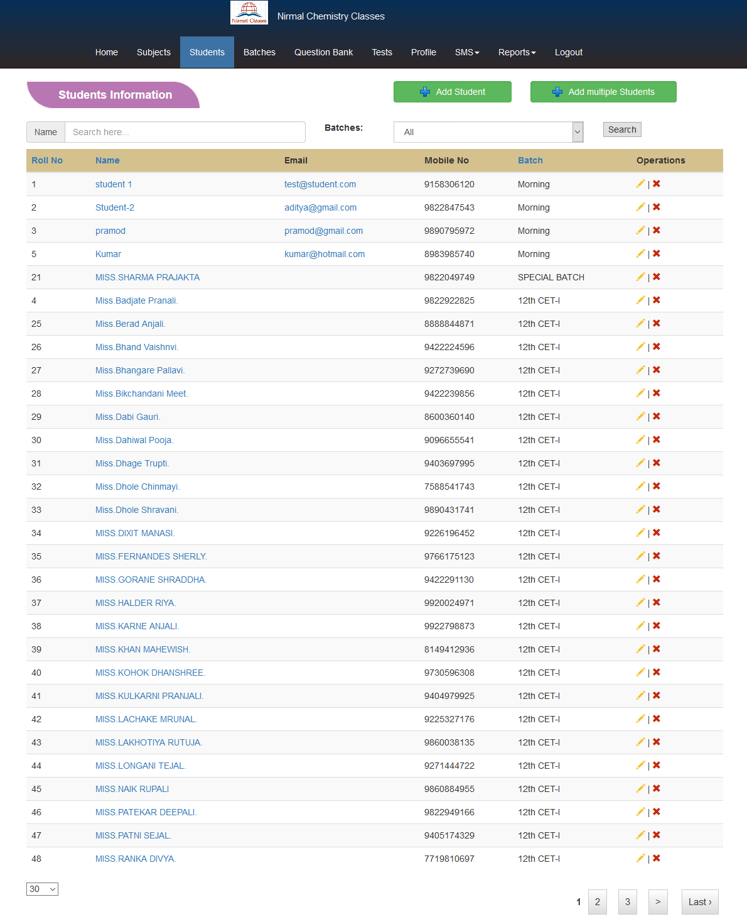

Slide 15
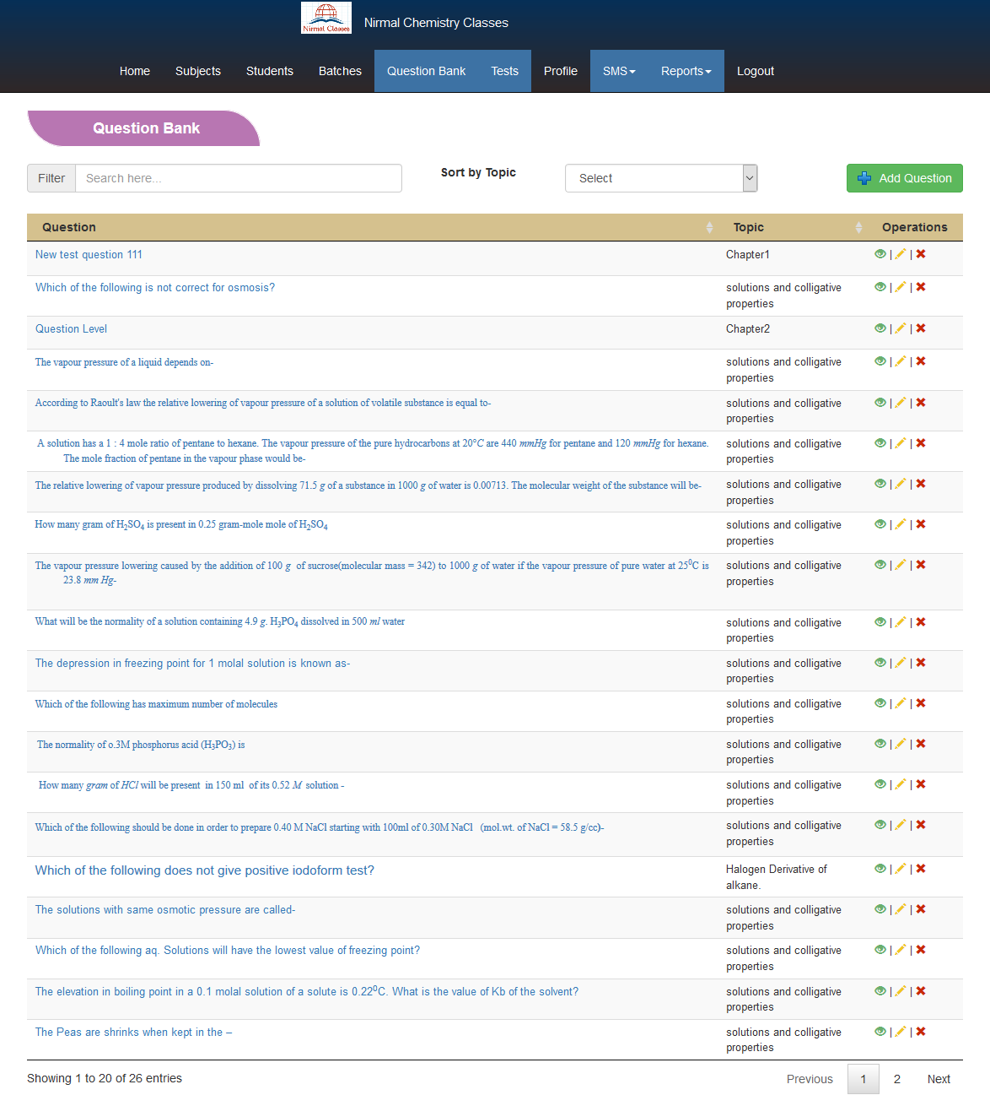

Slide 16
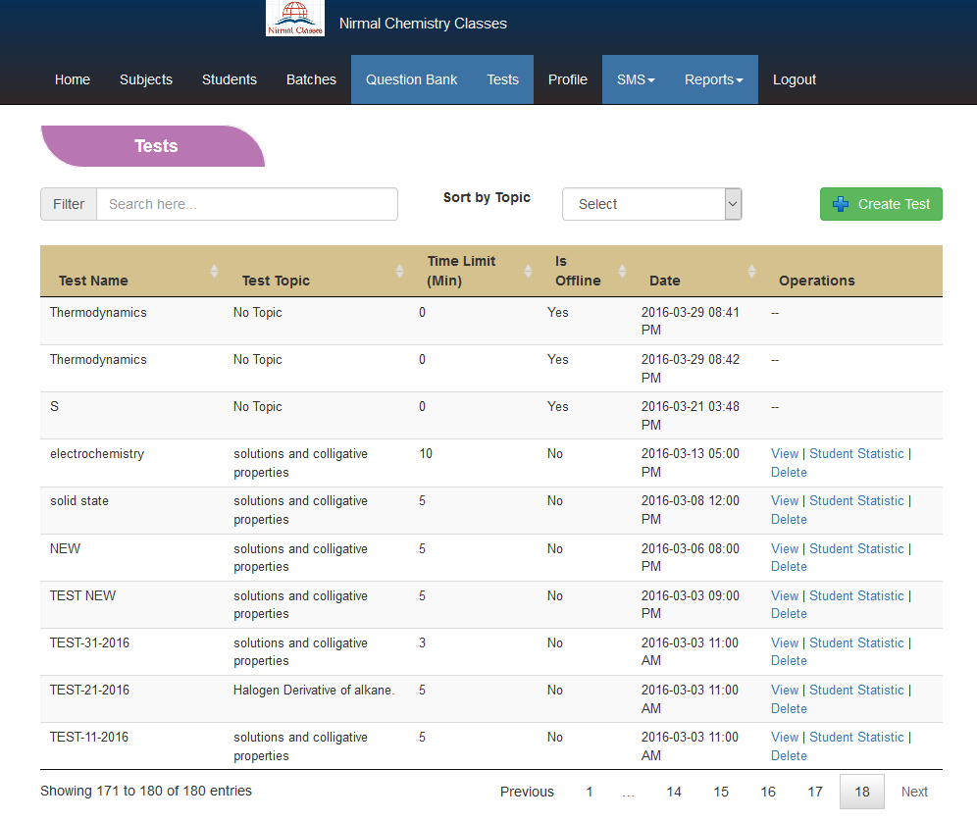

Slide 17
Thanks

