Slide 1
Gokhale Education Society’s R.H.Sapat College of Engineering, Management Studies & Research, Nashik .
A
Project on
Mera Class
Presented By,
Kasar Yogita H.
Joshi Kaustubh.
Nikam Pooja G.
Mahajan Mayuri V.
Guided By,
Prof. G. J. Solanke
Sponsered By ,
Solace Infotech Pvt.Ltd.

Slide 2
Contents
Introduction
Problem Statement
Objectives and scope
System Architecture
Front End & Back End
Application
Conclusion
References

Slide 3
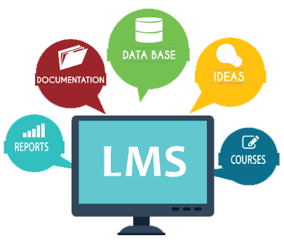
Introduction
Learning Management System :
The backbone of most e-learning activities.

Slide 4
Problem Statement
The purpose of our project is to design and implement Educational Application which is intended to supports Learning Management System . The application is being designed to provide learning environment to students by giving various tests based on various subjects and assessment of students progress .

Slide 5
Objective and Scope
To allow students to enroll online and keep track of their details, course progress and test results.
To manage every aspect of a course, from the registration of students to the storing of test results
To enable Teacher to keep track of students progress by providing tests based on various subjects
To provide Test results in graphical format .

Slide 6
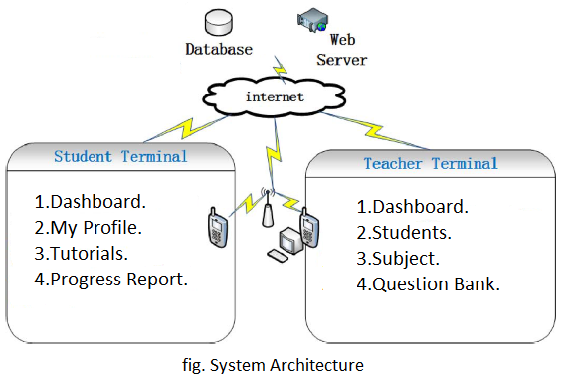
System Architecture

Slide 7
Features
Student Profile
Tutorials : Solved /Missed /Pending Tutorials
Progress Report for individual test and overall teats
Admin / Guide will prepare tests , add subjects, add students.
Admin will display list of toppers in tests

Slide 8
Front End-
Android Native Code
PHP Codeigniter Framework
JavaScript
TinyMce Editor
Google Charts to show statistics
Back End -
MySQL Database
Datatable plugin of jQuery

Slide 9
Applications
This system used in :
Any Educational institute

Slide 10
Conclusion
Mobile Learning is developed for the mobile devices to be accessible at anytime as long as the users brings the mobile devices and help learners in learning process . Tutorials provided by guide will help to increase the overall performance of learner.

Slide 11
References
“Mobile-Based Learning Design with Android Development Tools” 2014 1st International Conference on Information Technology, Computer and Electrical Engineering (ICITACEE)
M. L. Crescente and D. Lee, “Critical issues of m-learning: Design models, adoption processes, and future trends,” J. Chinese Inst. Ind. Eng., vol. 28, no. 2, pp. 111–123, 2011.
X. Zhao, X. Wan, and T. Okamoto, “Adaptive content delivery in ubiquitous learning environment,” in Proc. 6th IEEE WMUTE, 2010, pp. 19–26.
“Design of a Microlecture Mobile Learning System Based on Smartphone and Web Platforms” ,IEEE TRANSACTIONS ON EDUCATION, VOL. 58, NO. 3, AUGUST 2015

Slide 12



