Slide 1
Gokhale Education Society’s R.H.Sapat College of Engineering, Management Studies & Research, Nashik
A
Project on
Android Based E-Learning Application
Sponserd By
Solace Infotech Pvt. Ltd.
Presented By,
Kasar Yogita H.
Joshi Kaustubh A.
Nikam Pooja G.
Mahajan Mayuri V.
Guided By,
Prof. C. R. Barde

Slide 2

Agenda
Introduction
Problem Statement
Objective And Scope
System Architecture
Application
Front End And Back End
Conclusion
References

Slide 3
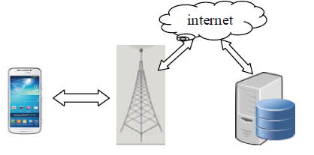
Introduction
M-Learning/Ubiquitous Learning.
Fig .Architecture Of M-Learning

Slide 4
Problem Statement
The Purpose Of Our Project Is To Design And Implement Android Application Which Supports Mobile Based Learning , Which Intend To Change Traditional Method Of Giving & Taking Tests To Digital One.

Slide 5
Objective And Scope
Ability To Assimilate Learning Any Were At Any Time.
Ability To Assessment Overall Progress Of Study.

Slide 6
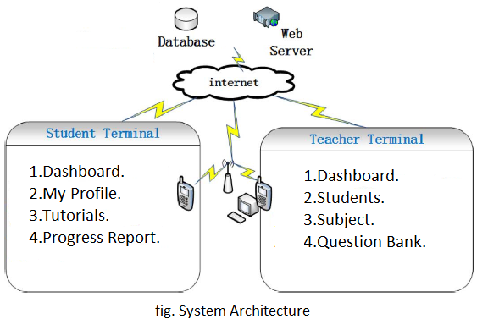
System Architecture

Slide 7
Front End-
Android Native Code
PHP
Codeigniter Framework
Bootstrap
JavaScript
jQuery
Back End-
Database

Slide 8
Application

Slide 9
Conclusion
Thus we Studied New Idea Of Combiining M-learning in a

Slide 10
References
“Design of a Microlecture Mobile Learning System Based on Smartphone and Web Platforms” ,IEEE TRANSACTIONS ON EDUCATION, VOL. 58, NO. 3, AUGUST 2015
“Mobile-Based Learning Design with Android Development Tools” 2014 1st International Conference on Information Technology, Computer and Electrical Engineering (ICITACEE)
M. L. Crescente and D. Lee, “Critical issues of m-learning: Design models, adoption processes, and future trends,” J. Chinese Inst. Ind. Eng., vol. 28, no. 2, pp. 111–123, 2011.
X. Zhao, X. Wan, and T. Okamoto, “Adaptive content delivery in ubiquitous learning environment,” in Proc. 6th IEEE WMUTE, 2010, pp. 19–26.

Slide 11


