Slide 1

A Project On
Android Based E-Learning Application
Class-E
Group No : 1
-BY
Joshi Kaustubh A. (B120694223)
Kasar Yogita H. (B120694227)
Mahajan Mayuri V. (B120694232)
Nikam Pooja G. (B120694237)
Guided By :
Prof. N. V. Alone
Sponsored By :
Solace Infotech Pvt.Ltd.

Slide 2
Contents
Introduction
Literature Survey
Existing System Architecture
Problem Statement
Objectives and scope
System Architecture
Use Case Diagram
Modules of the System
Mathematical Model
Requirements
Front End and Back End
References
Conclusion

Slide 3
Introduction
What is E-Learning ?
What is Ubiquitous Learning ?
What is Class-E ?

Slide 4
Literature survey
 | APPLICATION | YEAR | TECHNIQUE USED | LIMITATION
1. | Dulingo | 2009 | DynomoDB,AWS, twitter Bootstrap | A Language Learning Application
2. | Project Euler | 2011 | AWS,Mysql,Jquery | Does Not Track User Progress.
3. | CETIQ | 2011 | Mysql,Cloud | No Dynamicity for Solving Test.

Slide 5
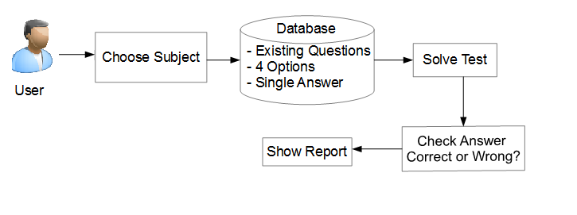
EXISTING SYSTEM ARCHITECTURE

Slide 6
DRAWBACK OF EXISTING SYSTEM
Unidirectional System
Outdated GUI and API level
Static Model
Less User Friendly

Slide 7
Problem Statement
The purpose of our system is to design and implement Educational Application which is intended to support E-Learning Platform. The application is being designed to provide learning environment to User by giving various tests based on various Topics and assessment of Users progress .

Slide 8
Objective and Scope
To allow students to enroll online and keep track of their details, course progress and test results.
To manage every aspect of a course, from the registration of students to the storing of test results
To enable Teacher to keep track of students progress by providing tests based on various subjects
To provide Test results in graphical format .

Slide 9
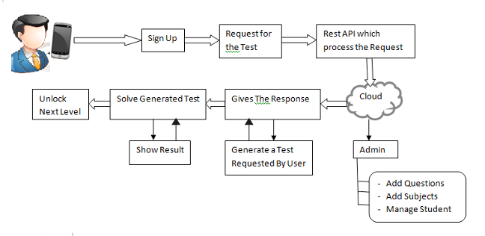
System Architecture

Slide 10
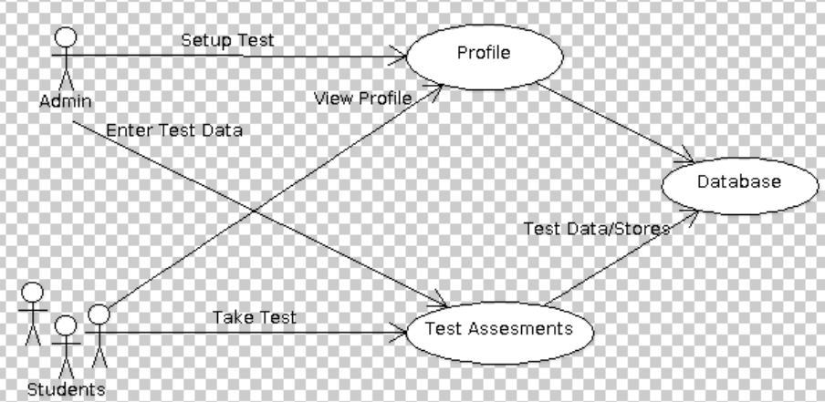
USE-CASE DIAGRAM

Slide 11
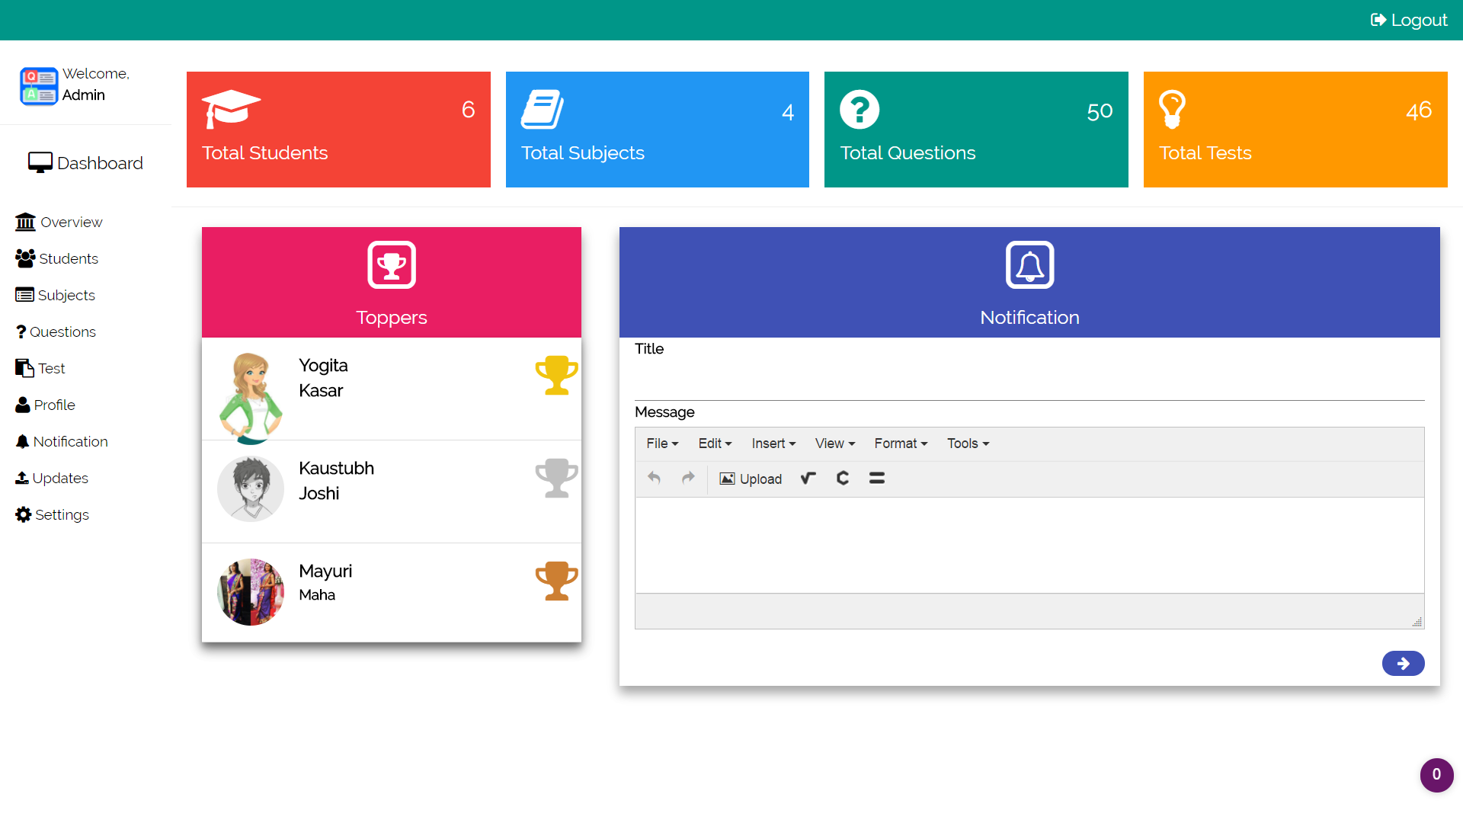
OUTPUT OF SYSTEM
Web APPLICATION

Slide 12
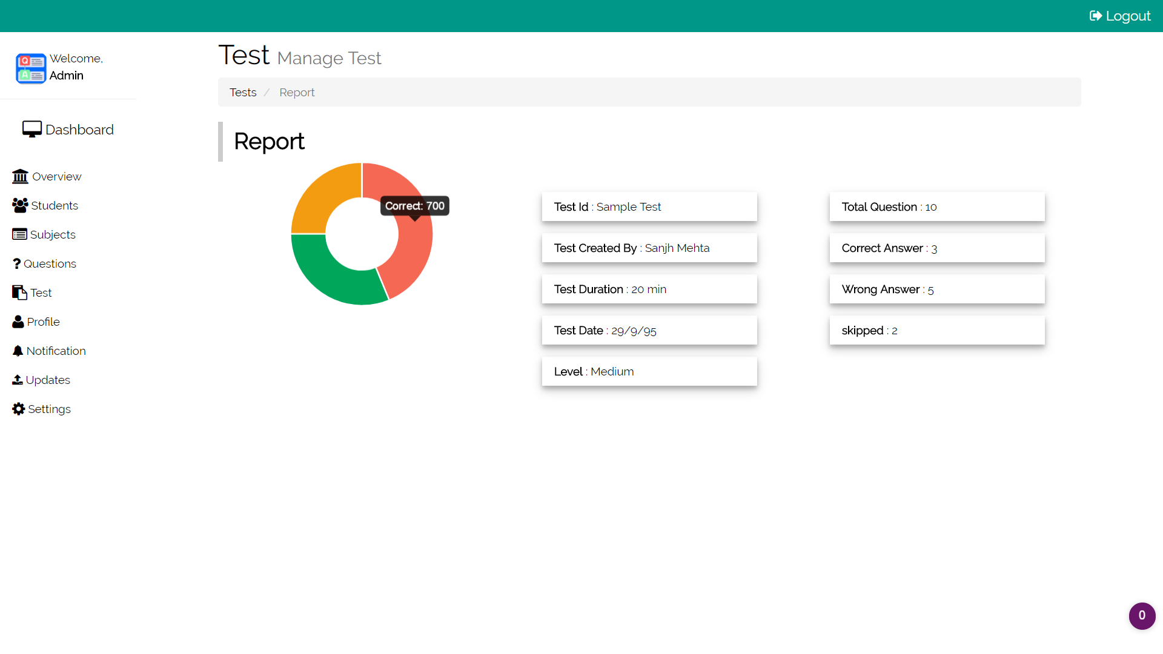
Web APPLICATION

Slide 13
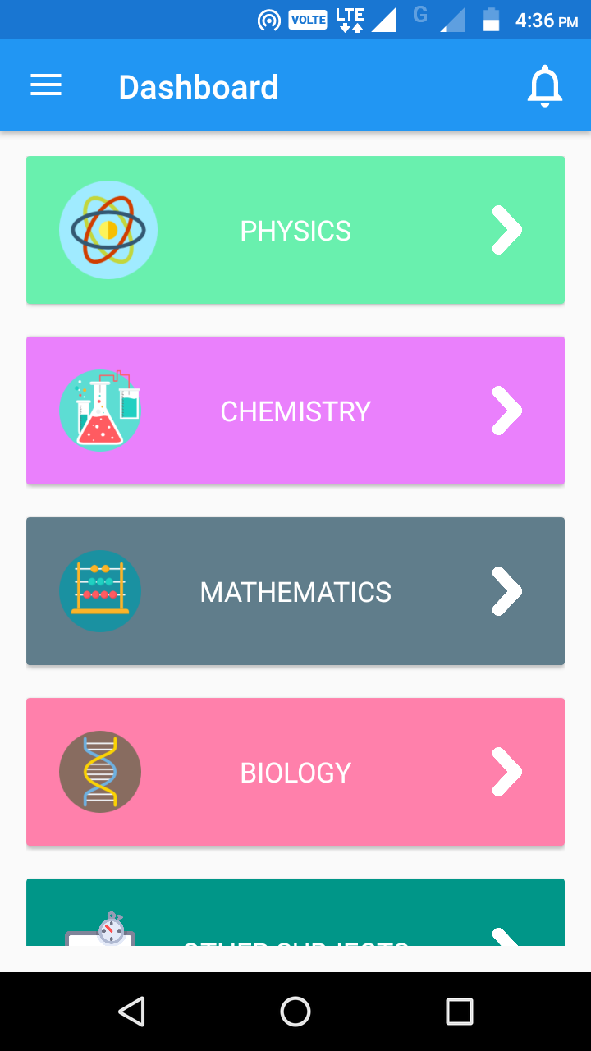
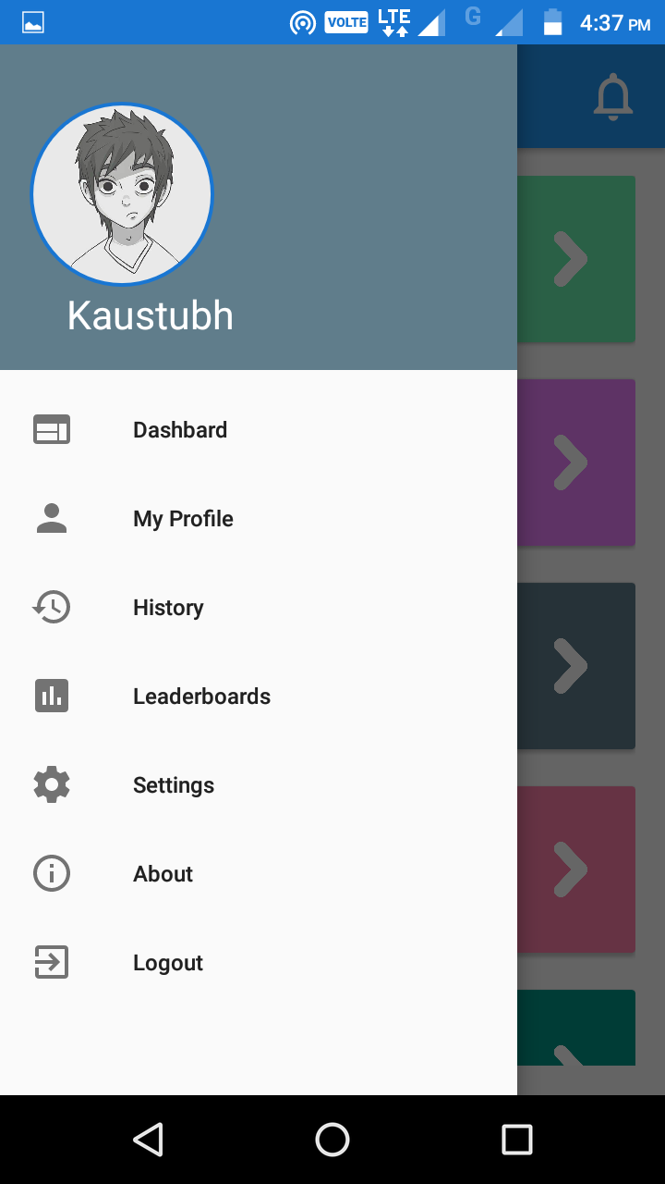
Android APPLICATION

Slide 14
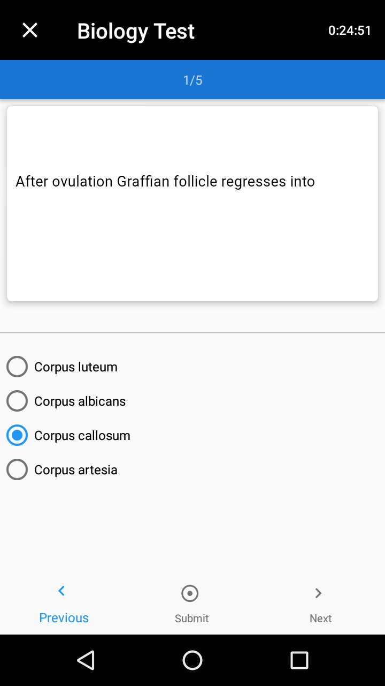
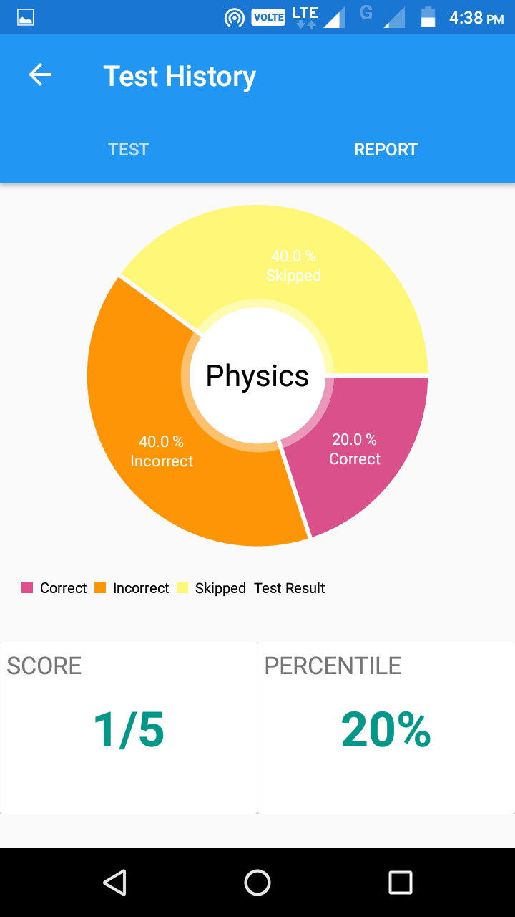
Android APPLICATION

Slide 15
Mathematical Model
S is a system for implementing a Android Based E-Learning Application. S = { s, e, x, y, DD, NDD, success, failure, CPUcore count} s = Start state e = End state x = input : Request for Tutorials y = output : Test with given parameters DD = Deterministic Data : Subject for Tutorial. NDD = Non-Deterministic Data : Questions of Requested Subject. Success case : All modules working without crash. Failure case : No internet connection. CPU core count = No. of cores required to execute the application : 1

Slide 16
REQUIREMENTS
HARDWARE :
Android Smart phone
System with working internet connectivity
SOFTWARE :
Android Application
Compatible Browser

Slide 17
Front End
Android
Middleware
Volley
CodeIgniter REST API
Postman REST Client
Back End
CodeIgniter
MySQL Database

Slide 18
References
“Mobile-Based Learning Design with Android Development Tools” 2014 1st International Conference on Information Technology, Computer and Electrical Engineering (ICITACEE)
M. L. Crescente and D. Lee, “Critical issues of m-learning: Design models, adoption processes, and futur00e trends,” J. Chinese Inst. Ind. Eng., vol. 28, no. 2, pp. 111–123, 2011.
X. Zhao, X. Wan, and T. Okamoto, “Adaptive content delivery in ubiquitous learning environment,” in Proc. 6th IEEE WMUTE, 2010, pp. 19–26.
“Design of a Microlecture Mobile Learning System Based on Smartphone and Web Platforms” ,IEEE TRANSACTIONS ON EDUCATION, VOL. 58, NO. 3, AUGUST 2015

Slide 19
Conclusion
Thus we propose an E-Learning Application Which overcomes drawback of previous systems and is Ubiquitous.

