Slide 1
Pattern Recognition Karapepera Elpida

Slide 2
Project analysis slide 2
ANN
Best accuracy 83.01%
FLATTEN
DROPOUT
Preprocessing:
[rotation 10’,
0.1 width/height shift & shear range,
0.2 zoom range]
10,899,722 params
Batch size: 150
Early stopping
Checkpoint
NORMALIZATION
DENSE (1024, 512, 256) with RELU
RESCALING
DENSE (10) with SOFTMAX

Slide 3
Project analysis slide 2
CNN
Best accuracy 98.54%
BATCH NORMALIZATION
CONV2D [256 (1,1) ] with RELU
BATCH NORMALIZATION
Preprocessing:
None needed
15,109,806 params
Batch size: 150
Early stopping
Checkpoint
CONV2D [64 (1,1), 128 (3,3) ] with RELU
CONV2D [512 (1,1), 1024 (3,3) ] with RELU
BATCH NORMALIZATION
MAXPOOLING (6x6)
MAXPOOLING (4x4) BATCH NORMALIZATION .
FLATTEN

Slide 4
Project analysis slide 3
CNN Fully Connected
DENSE 1024
with RELU
BATCH NORMALIZATION
DENSE 512
with RELU
BATCH NORMALIZATION
DENSE 256
with RELU
BATCH NORMALIZATION
DENSE 128
with RELU
BATCH NORMALIZATION
DENSE 64
with RELU
BATCH NORMALIZATION
DENSE 32
with RELU
BATCH NORMALIZATION
DENSE 10
with RELU
BATCH NORMALIZATION

Slide 5
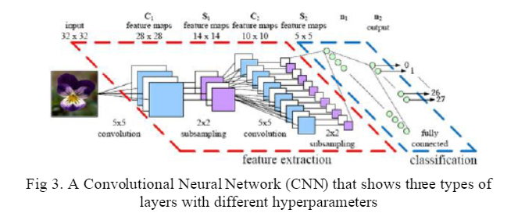
Project analysis slide 8
CNN vs. ANN
CNN has better accuracy
ANN has less parameters
Convolutional layer (only in CNN)
Fully connected layer (common in CNN and ANN)
CNN can work without fully connected layer however outcome is disappointing

Slide 6
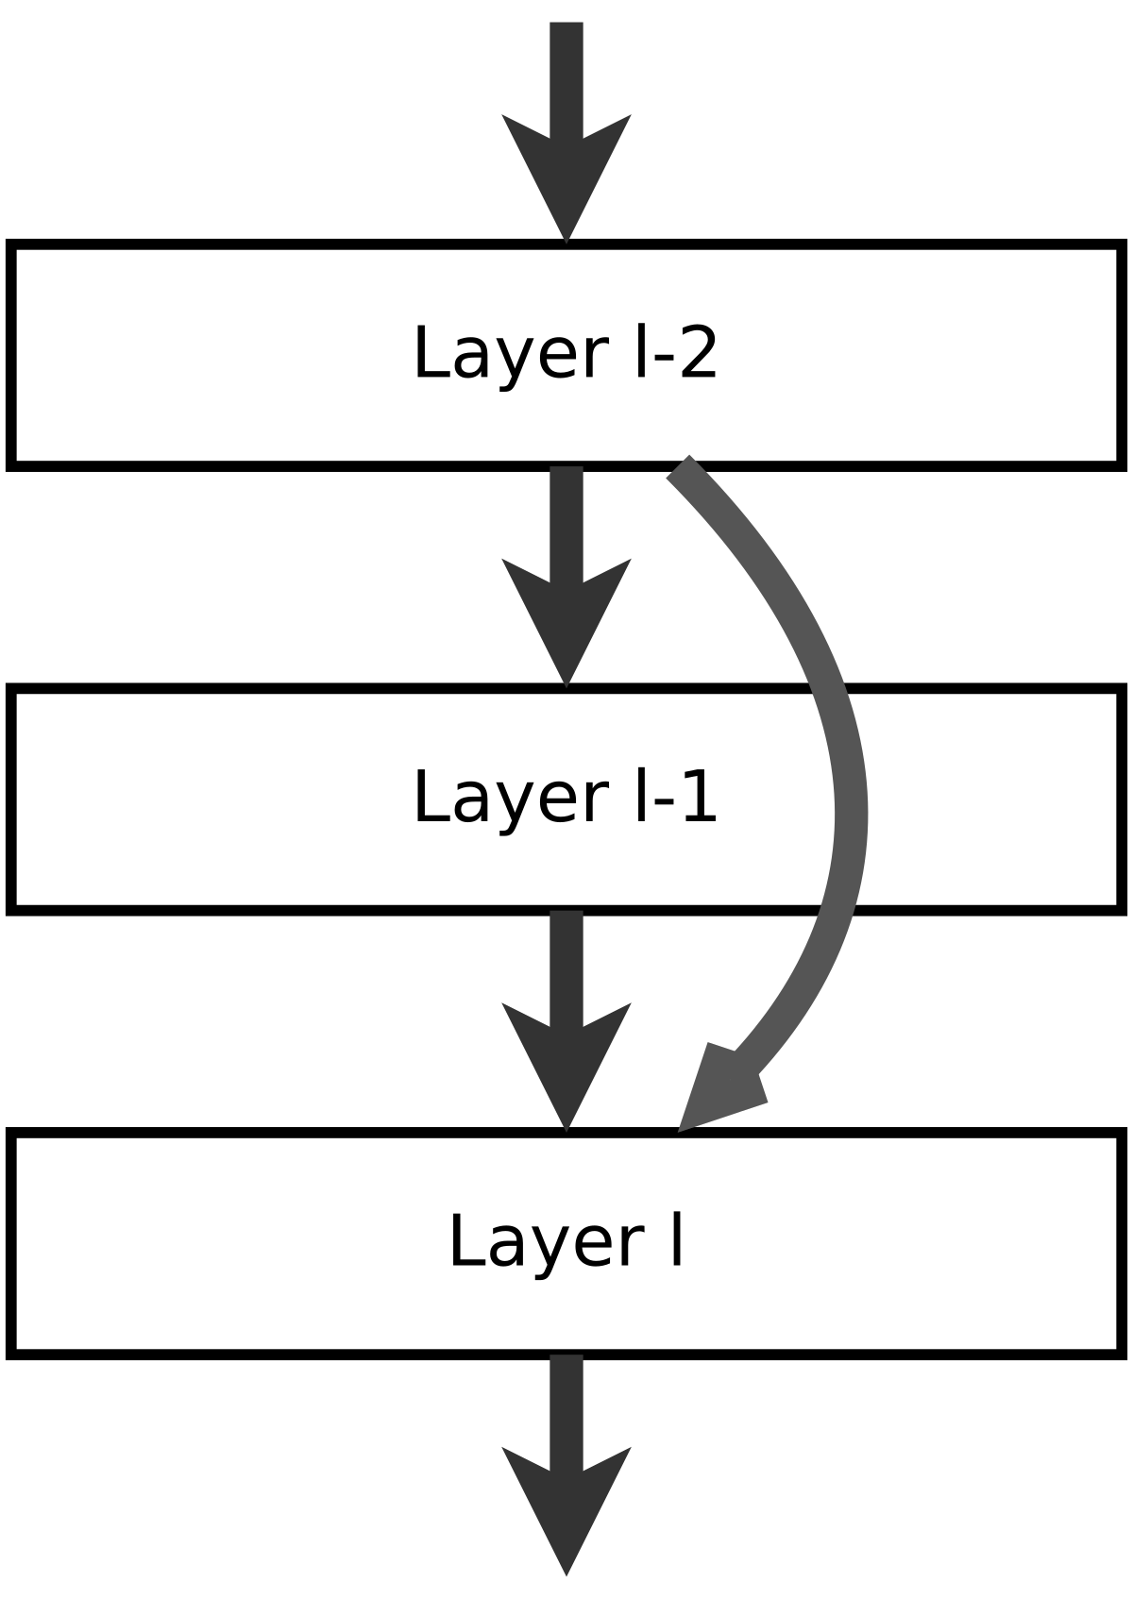
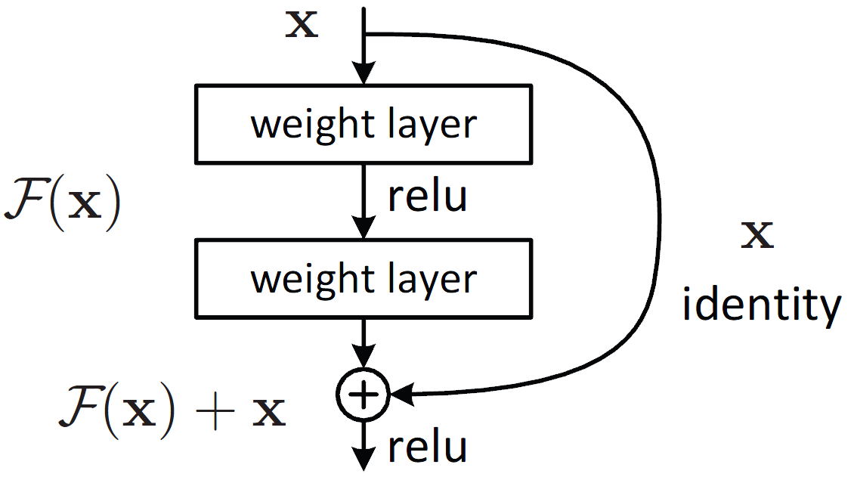
Project analysis slide 8
ResNet vs. CNN
ResNet contains skip connections
ResNet50 (50-filter ResNet) gave a much better accuracy to the bonus dataset than the original CNN did

Slide 7
Thank You

