Slide 1
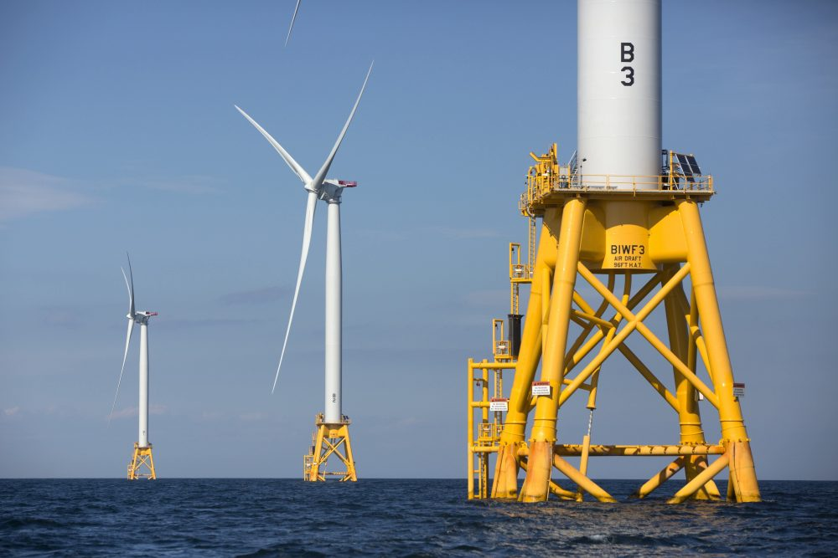
2016 Deepwater Wind' s Turbines at Block Island, R.I. (by M. Dwyer)

Slide 2


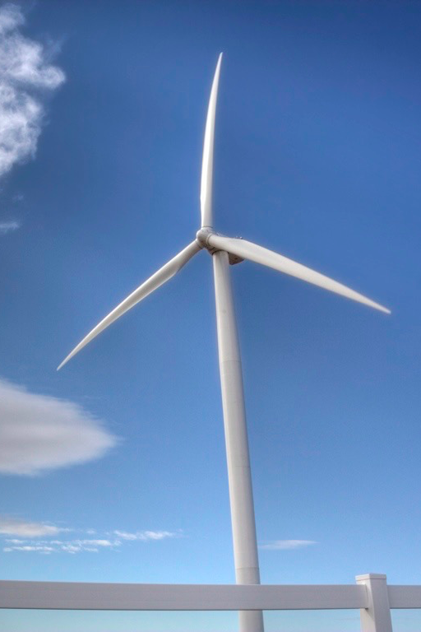
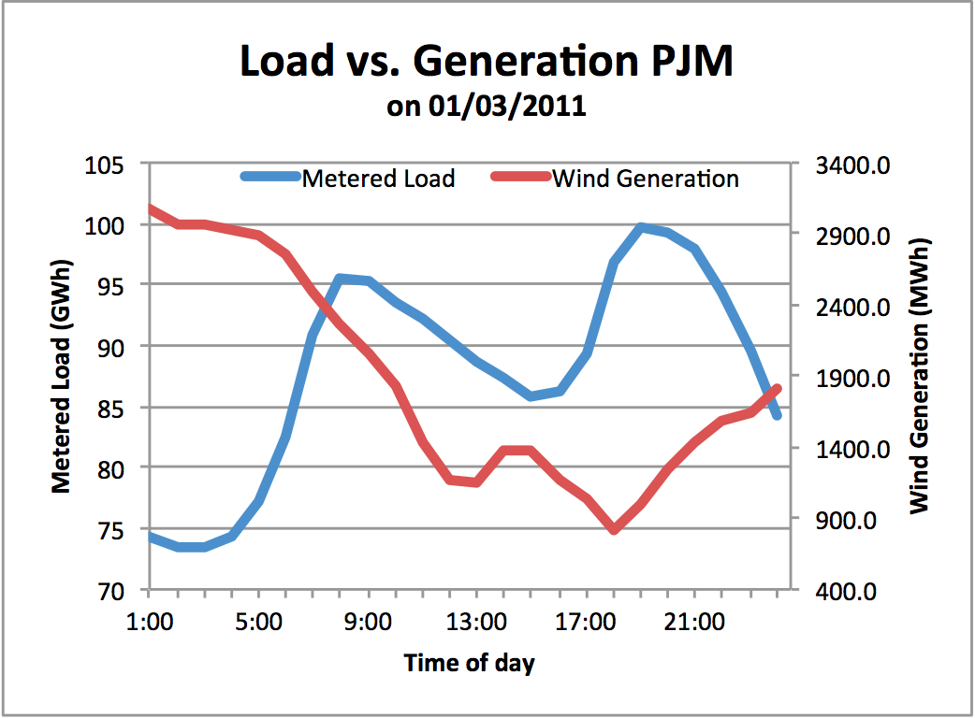
Wind Energy
Source: regional transmission organization (RTO) PJM

Slide 3







The grid balancing problem
The Electric Power Scale

Slide 4
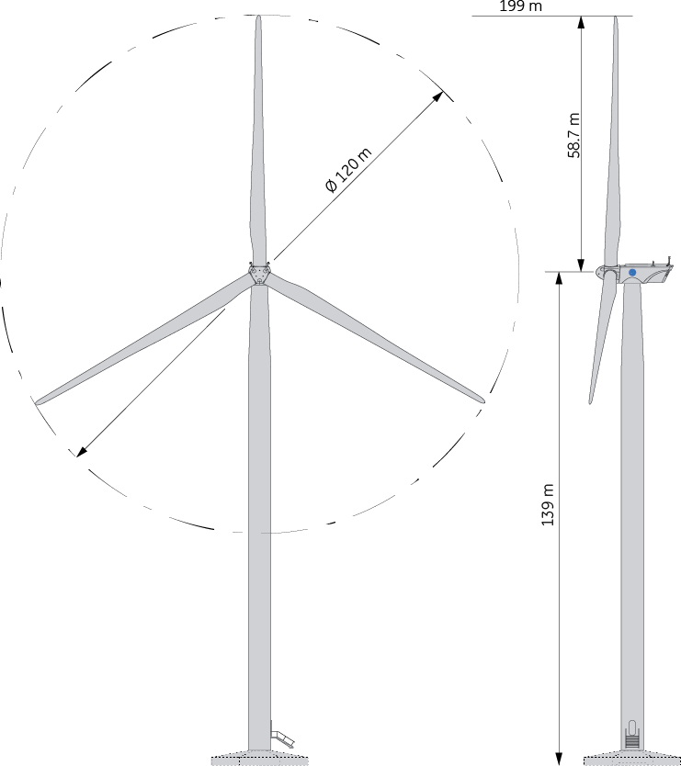
Wind Turbine Theory
Wind turbine power output is a strong function with wind speed.
Blades sweep through rotor disk.
The power output is a function of the kinetic energy flux through the rotor disk and the efficiency of the design.
Technical Drawing of GE 2.75-120 wind turbine
Source: https://www.ge.com/renewableenergy/wind-energy/turbines/275-120

Slide 5
Wind Turbine Theory
Power = ½ CpAV³, where:
p = air density, C = coefficient of performance, A = rotor area, V = wind speed
Real wind turbine performance is a function of aerodynamics.
Power output is limited at generator rated power after the rated wind speed.
Wind turbine manufacturers measure their turbine’s power curve.

Slide 6
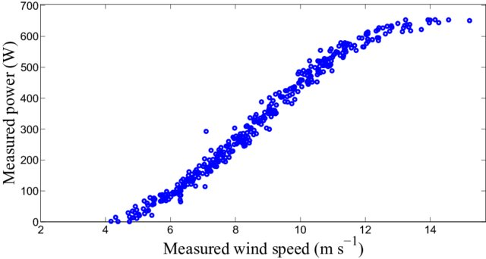
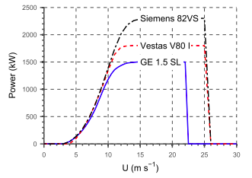
Wind Turbine Performance
Measured power curve for a wind turbine
Source: 10.1016/j.renene.2015.10.014
(Men et. al. 2016)
Power curves for different turbines
Source: Idaho National Laboratory (Seifert 2007)

Slide 7
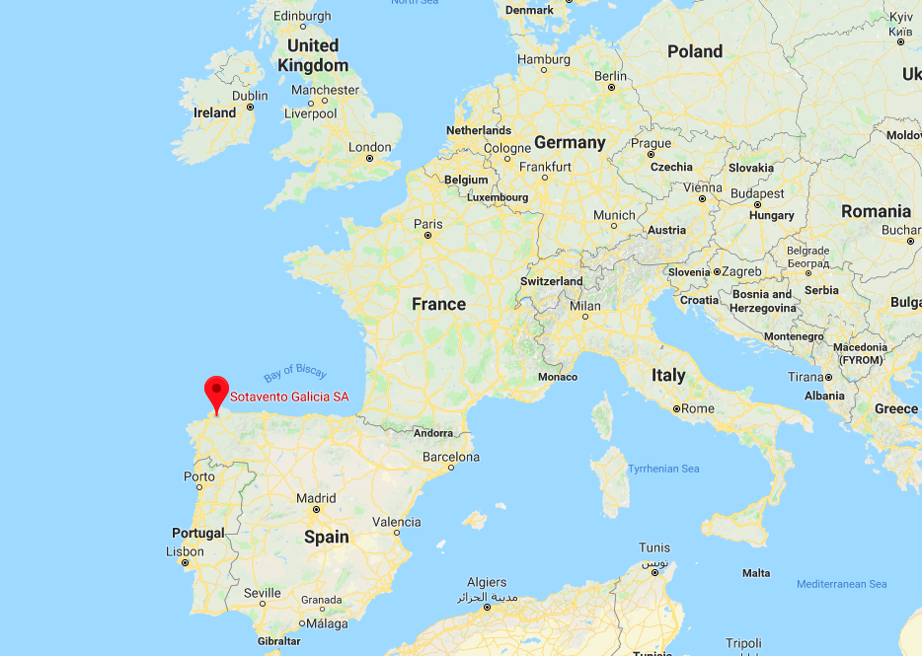
Wind Data
Source: http://www.sotaventogalicia.com/en/real-time-data/historical

Slide 8
Wind Data
Galician Wind Farm for information, training and research.
Technical information:
Number of wind turbines: 24
Different models: 9
Power rating of the wind farm: 17.56 MW
Average annual generation: 33,364 MWh
Prevailing winds: on the east-west axis
Average wind speed at the site: 6.41 m/s

Slide 9
Overview
Wind power forecasting through Machine Learning
Training
Test Set & Validation
Power Generation (20% of data)
Power Generation (80% of data)
Model
Wind Speed (20% of data)
Model
Wind Speed (80% of data)
Output
Predicted Power Generation (20% of data)
Validation

