Slide 1
UCM SERVICES
360-Degree Digital Business Audit
& Growth Strategy
BRUTALLY HONEST
COMMERCIALLY FOCUSED
ACTIONABLE
Website, market, customer journey, operations, marketing, AI opportunities and implementation roadmap.
Prepared July 2026

Slide 2
EXECUTIVE VERDICT
The business is credible. The digital engine is underpowered.
UCM appears to have real service breadth, history and operational capability. But the website currently behaves like a polished brochure, not a lead-generation and contract-acquisition system.
Bottom line
UCM does not need a nicer website.
It needs a revenue system.
The site looks professional, but does not prove enough fast enough.
The technical SEO setup likely leaves high-intent local demand on the table.
The offer is too broad: cleaning, maintenance and renovation need sharper packaging.
The upside is not cosmetic. It is more qualified leads, larger retainers and stronger trust.
UCM SERVICES | DIGITAL BUSINESS AUDIT
02

Slide 3
CURRENT POSITION
UCM has useful breadth - but breadth is not positioning.
1994
11-50
3
Strategic interpretation
Breadth is commercially useful only when packaged into buyer-specific offers. Otherwise it reads as generic capability.
heritage claimed on UCM content and LinkedIn
LinkedIn company-size range
core revenue arenas: cleaning, maintenance, renovation
Best angle: cleaning plus responsive maintenance for London property and workplace buyers.
UCM SERVICES | DIGITAL BUSINESS AUDIT
03

Slide 4
MARKET REALITY
Demand exists. Attention is expensive. Trust decides.
1.51m
78,915
$81bn
people employed in UK cleaning, hygiene and waste sector
businesses operating in the sector in 2025
estimated UK facility management market size in 2025
What this means for UCM
Cleaning is commoditised at the bottom; procurement trust matters at the top.
The best growth lane is recurring B2B contracts, not one-off jobs alone.
Sustainability, compliance, reporting and proof are now sales assets.
Sources: British Cleaning Council, IBISWorld, Mordor Intelligence.
UCM SERVICES | DIGITAL BUSINESS AUDIT
04

Slide 5
WEBSITE AUDIT
The front end looks decent. The crawlable foundation is weak.
Observed technical issues
Commercial consequence
React/Vite app shell returned across tested URLs.
For a London service business, SEO is not decoration. It is distribution.
If Google cannot easily understand every service, sector and location page, UCM is asking paid ads and referrals to do too much work.
No sitemap found at /sitemap.xml.
No obvious LocalBusiness, Organization or FAQ schema in raw HTML.
Repeated generic page title across key service pages.
UCM SERVICES | DIGITAL BUSINESS AUDIT
05

Slide 6
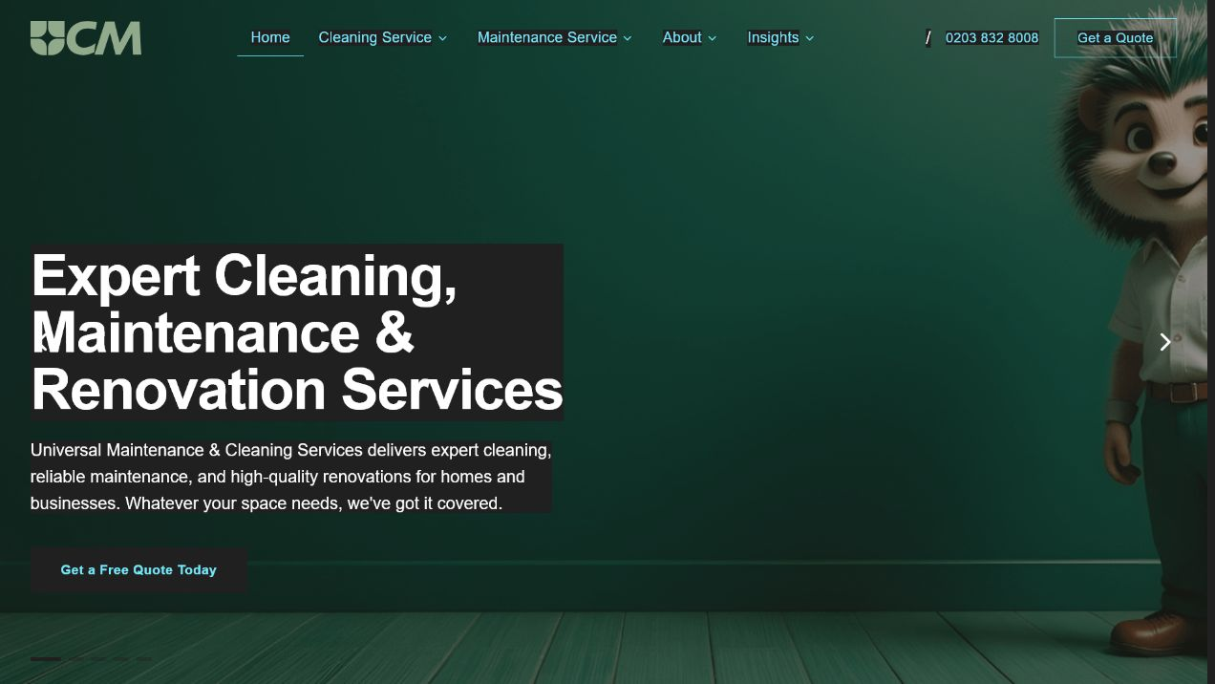

CUSTOMER JOURNEY
The first impression is polished - but not yet persuasive.
Buyer friction
No immediate proof stack.
No sector-specific promise.
No response-time claim.
No visible review source.
Mobile hero feels cramped.
UCM SERVICES | DIGITAL BUSINESS AUDIT
06

Slide 7
COMPETITOR LANDSCAPE
Competitors are clearer about who they serve and why to trust them.
Cleanology
Office/commercial cleaning, city pages, sustainability and sector depth.
Regular Cleaning
Commercial/property-management credibility, 45-year message, policies, certifications.
Perfect Cleaning
Direct response, quote flow, domestic/commercial coverage and testimonials.
UCM opportunity
Own the combined lane: cleaning plus maintenance for London property/workplace buyers.
UCM SERVICES | DIGITAL BUSINESS AUDIT
07

Slide 8
REVENUE DIAGNOSIS
The biggest commercial unlock is recurring B2B revenue.
One-off work is useful. Retainers build enterprise value.
Commercial cleaning retainer
Property manager care plan
End-of-tenancy fast turnaround
Daily/weekly office, washrooms, consumables, periodic deep clean.
Communal cleaning, minor maintenance, inspections, monthly reporting.
Clean, waste removal, minor repairs, deposit-ready handover.
Data centre and IT cleaning
Responsive maintenance SLA
Anti-static process, trained staff, method statements, risk controls.
Repairs, carpentry, decoration, plumbing triage and documented response.
UCM SERVICES | DIGITAL BUSINESS AUDIT
08

Slide 9
GROWTH STRATEGY
Four pillars should carry the next phase.
1
2
3
4
Fix findability
Prove trust
Package offers
Systemise response
Crawlable service, sector and location pages with schema and tracking.
Reviews, case studies, accreditations, policies, photos and guarantees.
Retainers, SLAs and buyer-specific bundles instead of a loose menu.
CRM, quote workflow, follow-up automation and job reporting.
UCM SERVICES | DIGITAL BUSINESS AUDIT
09

Slide 10
SEO & CONTENT
Build pages around how buyers actually search.
Core page architecture
Every money page needs
Office Cleaning London
Unique title and meta description.
Commercial Cleaning London
Sector-specific proof and FAQs.
Property Management Cleaning London
LocalBusiness or Service schema.
Data Centre Cleaning London
Quote CTA above and below fold.
End of Tenancy Cleaning London
Photos, reviews, accreditations and process.
Responsive Property Maintenance London
UCM SERVICES | DIGITAL BUSINESS AUDIT
10

Slide 11
TRUST INFRASTRUCTURE
The site must answer procurement objections before sales speaks.
Proof
Client logos, case studies, before/after photos, named outcomes.
Compliance
Insurance, RAMS, COSHH, ISO/SSIP evidence where applicable.
People
Cleaner vetting, training, supervision, escalation path.
Reporting
Monthly service reports, photo proof, issue logs, SLA performance.
UCM SERVICES | DIGITAL BUSINESS AUDIT
11

Slide 12
OPERATIONS
Marketing will only scale if quoting and delivery are systemised.
Lead intake
Quote engine
Delivery proof
Service type
Scope template
Checklists
Postcode
Site visit trigger
Photo evidence
Urgency
Margin guardrails
Issue log
Property type
Photos/docs
Monthly report
Budget range
Proposal follow-up
Renewal prompts
UCM SERVICES | DIGITAL BUSINESS AUDIT
12

Slide 13
AI OPPORTUNITIES
Use AI to respond faster, quote better and document quality.
Lead triage
Quote support
Call summaries
Classify enquiry, urgency, location, contract potential and next action.
Turn form inputs/photos into a draft scope for human review.
Transcribe calls and push requirements into CRM.
Job reporting
Proposal engine
Route planning
Cleaner photo uploads, checklist summaries and exception flags.
Draft follow-ups, tender answers and sector-specific proposals.
Cluster jobs by postcode, crew skill, equipment and urgency.
UCM SERVICES | DIGITAL BUSINESS AUDIT
13

Slide 14
RISK REGISTER
The largest risks are fixable, but ignoring them costs revenue.
SEO invisibility
High
Crawlable pages, sitemap, schema, internal linking.
Generic positioning
High
Sector offers and clear buyer promises.
Weak proof
High
Reviews, case studies, policies, accreditations.
Lead leakage
Medium
Quote forms, call tracking, CRM follow-up.
Operational strain
Medium
SLA design, capacity planning, job reporting.
UCM SERVICES | DIGITAL BUSINESS AUDIT
14

Slide 15
PRIORITIES
Do these first. Everything else is secondary.
01
Fix technical SEO: sitemap, schema, unique metadata and indexable service content.
02
Rebuild commercial, office, property-manager, data-centre, end-of-tenancy and maintenance pages.
03
Add proof blocks: reviews, case studies, accreditations, policies, images and guarantees.
04
Set up analytics, call tracking, form events, CRM stages and lead-source attribution.
05
Productise retainers and SLAs so UCM sells recurring outcomes, not loose tasks.
UCM SERVICES | DIGITAL BUSINESS AUDIT
15

Slide 16
ROADMAP
First 90 days: fix the machine, then put fuel in it.
Days 1-30
Days 31-60
Days 61-90
Technical SEO, analytics, Search Console, GBP, mobile hero, contact form, tracking.
Six money pages, FAQs, proof blocks, reviews, case studies and sales PDFs.
Paid search, LinkedIn targeting, CRM pipeline, proposals and automated follow-up.
UCM SERVICES | DIGITAL BUSINESS AUDIT
16

Slide 17
SCALE PLAN
Months 4-12: move from lead capture to market authority.
Publish sector and location pages for property managers, offices, landlords, education and hospitality.
Deploy AI-assisted quote workflow, call summaries and job reporting.
Launch recurring-contract upsell campaigns across cleaning and maintenance clients.
Build partner channels with estate agents, landlords, block managers and fit-out firms.
Create a tender library and quarterly sustainability/quality report.
Target operating model: fewer cold leads, more retained clients, clearer proof, faster response.
UCM SERVICES | DIGITAL BUSINESS AUDIT
17

Slide 18
Final thought
The money is in proof, packaging and recurring contracts.
UCM has enough substance to grow. The next step is to make the digital experience prove it faster than competitors can.
Sources used: UCM website, UCM LinkedIn, British Cleaning Council, IBISWorld, Mordor Intelligence, Cleanology, Regular Cleaning, Perfect Cleaning.

