Slide 1
Face-detector
Chaitanya
Vamsi
Srija

Slide 2
Problem Statement
Detecting Faces in Images.In this we have to select particular dataset of images which consists of specific characteristcs like light conditions, face sizes, face orientations, background and skin colors.We will Implement various non standard methods for face detection.

Slide 3
Face detection using Histogram of Oriented gradients
Histograms of Oriented Gradients are an effective descriptor for object recognition and detection. These descriptors are powerful to detect faces with occlusions, pose and illumination changes because they are extracted in a regular grid. We calculate and vector quantizes into different codewords each descriptor and then we construct histograms of this codeword distribution that represent the face image. Finally, a set of experiments are presented to analyze the performance of this method.We try to implement and tested face detection method by various classifiers like svm,knn and compare the results between them.

Slide 4
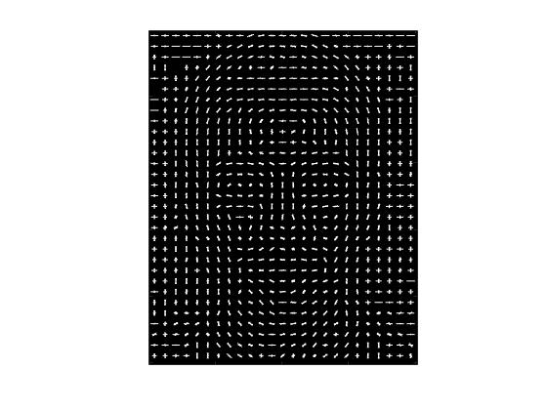
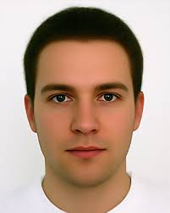
HOG Visualisation

Slide 5
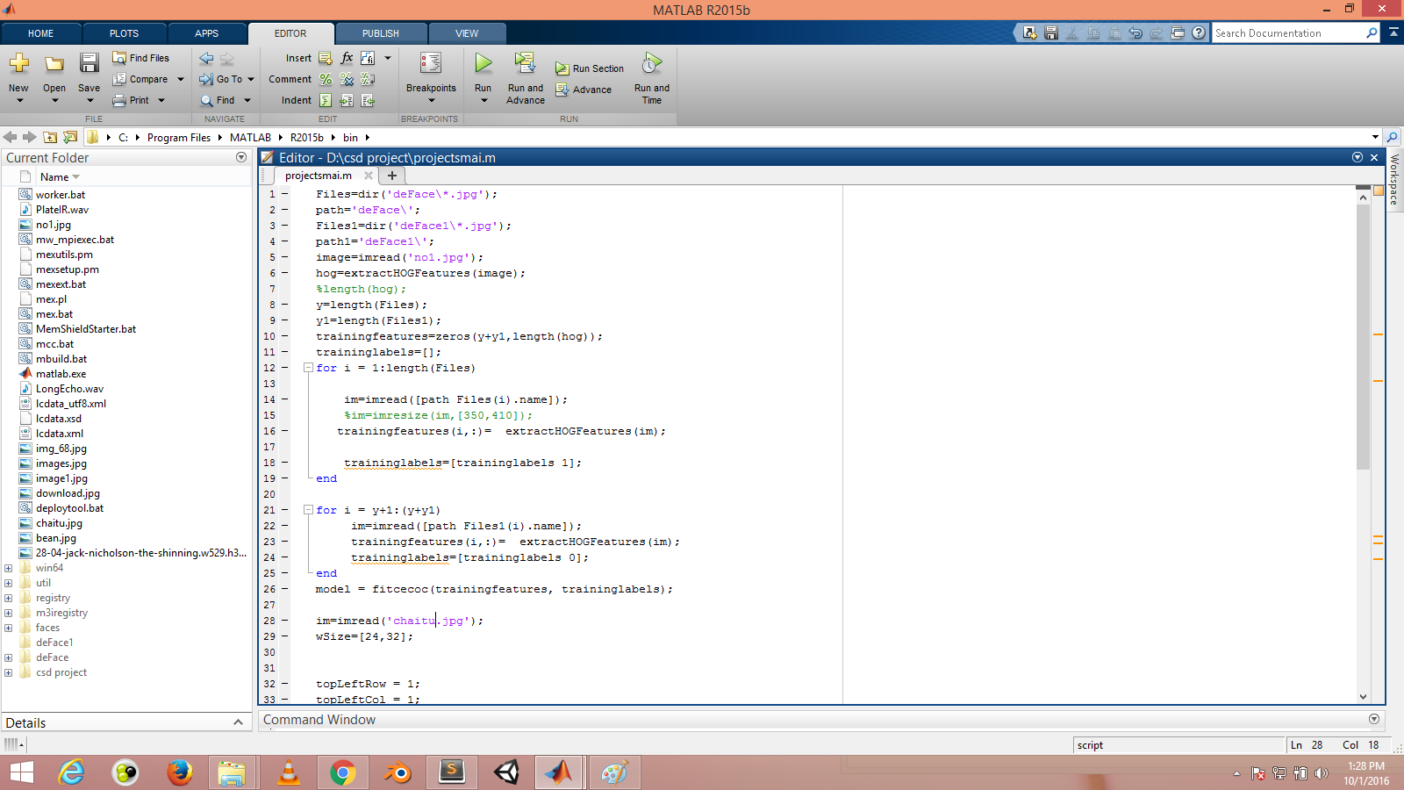

Slide 6
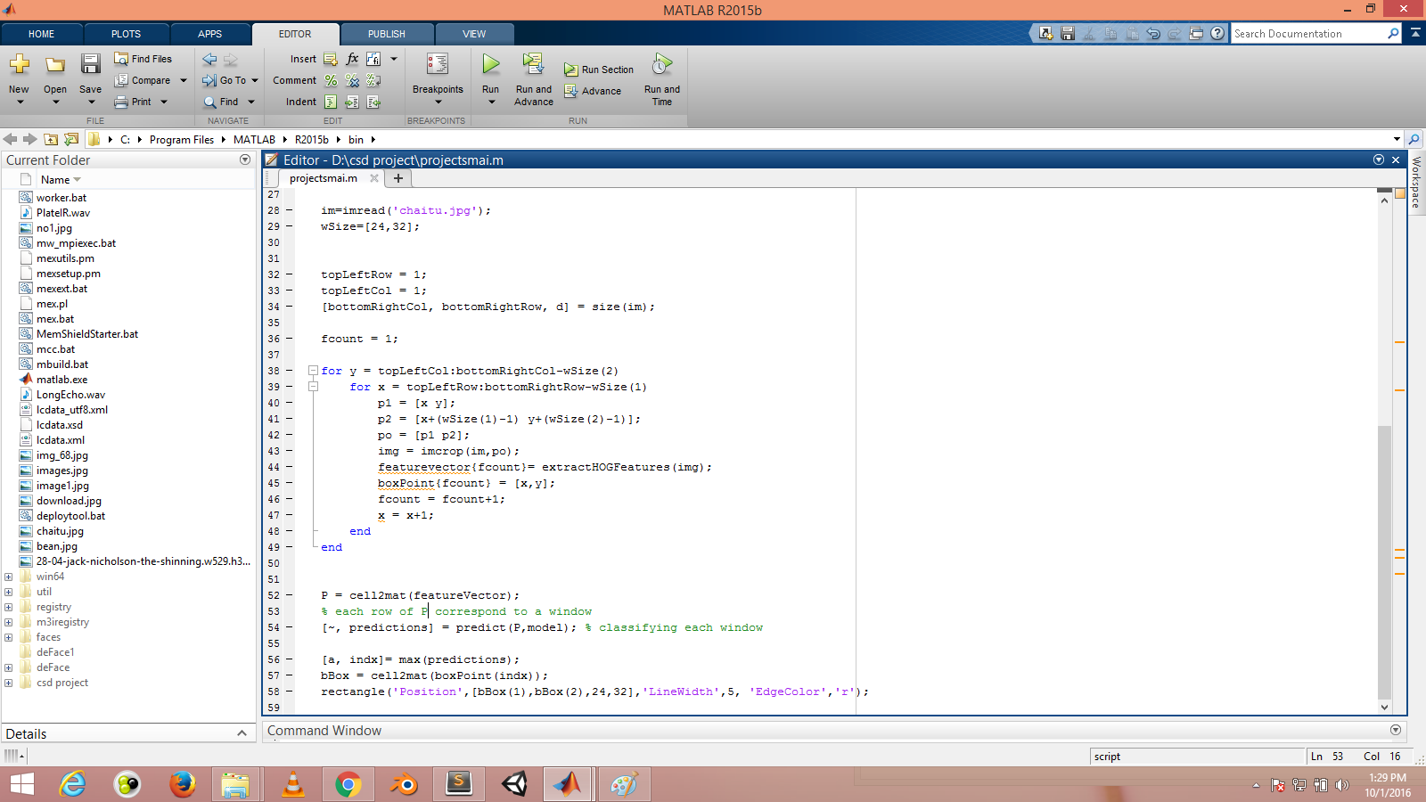

Slide 7
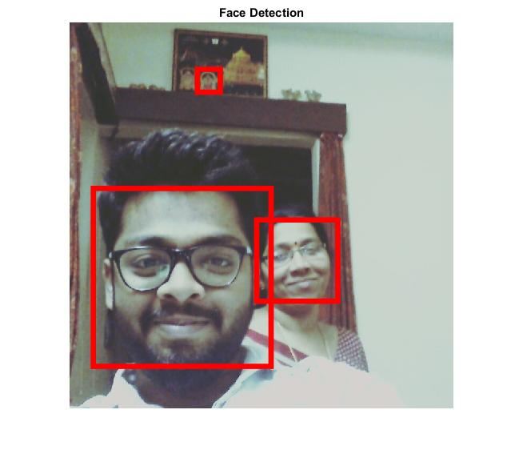


Slide 8
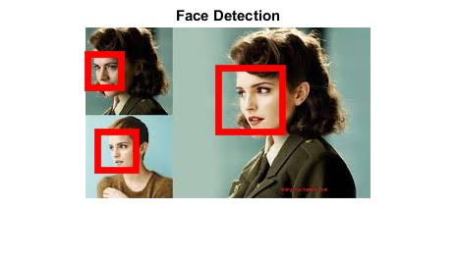
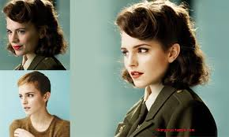

Slide 9
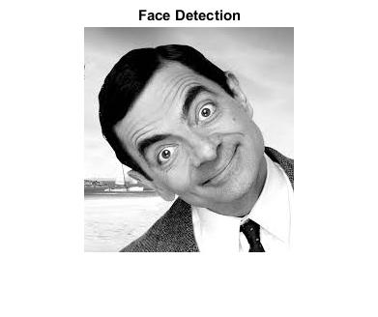


Slide 10
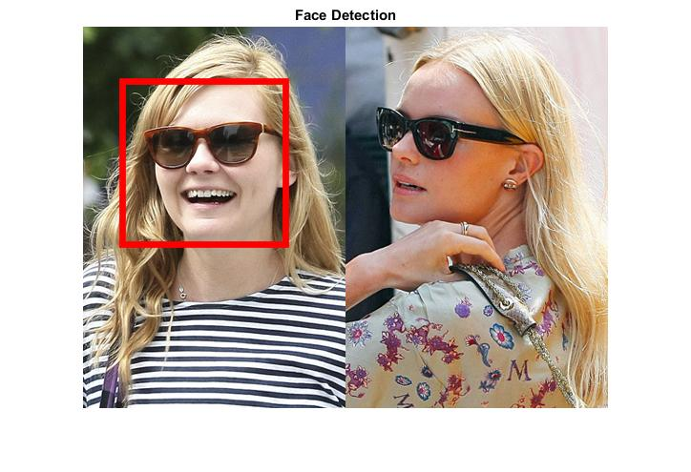
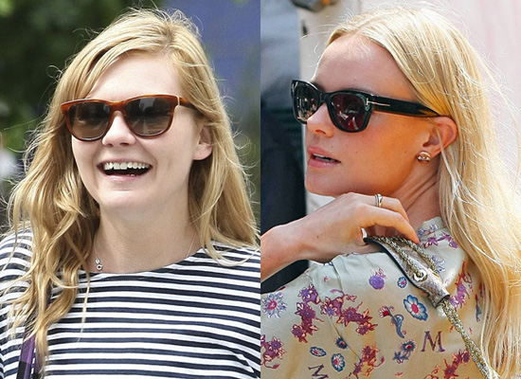

Slide 11
Results
Out of the 20 face images and 4 non-face images we tested.
 | Face | Non-Face
Face | 18 | 2
Non-Face | 1 | 3

Slide 12
Future Goals
Implement this method using various classifiers like knn,nearest neighbour classifier(NN),linear regression e.t.c
We will compare the results between them and decide which is the best classifier for face detection.

