Slide 1
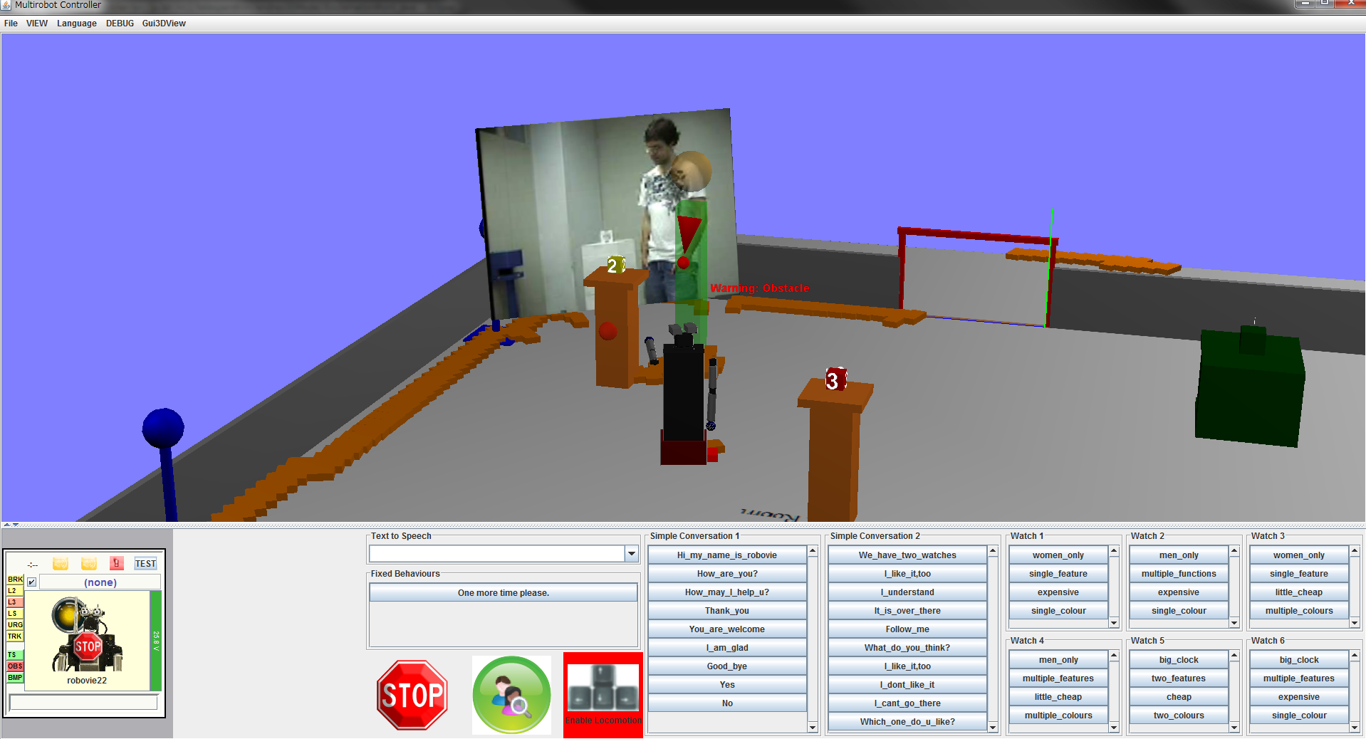
Video feed
Raw Laser Range Data
Visualization Area
3D Robot
Model
Actuation Area
Robot Status
Automatic Gaze Control
Locomotion Control
General Utterances
Feature-specific Utterances

