Slide 1
Identifying Events using SRL, BERT
& Tensorboard Embeddings Projector for Events Analysis
Data Science Project
by Lou Pemberton-Roberts
Intern - Machine Learning
Project & Insights
August 2022

Slide 2

Overview of Project Demo
Included in this presentation …
Semantic Role Labelling (SRL)
Project overview
Tensorboard Embeddings Projector
Use cases & Analysis
Summary
2

Slide 3
Problem
Problem
We want to be able to identify events as quickly as possible when they happen.
3

Slide 4

Problem
We want to be able to identify events as quickly as possible when they happen.
But, what is an event?
An event is an Interesting Commercial Action (ICA)
In language, ICA’s often include the use of variations of root verbs such as “acquire”, “invest”, “hire”, and “merge”
How can we exploit this to better understand what is happening in the real world, and to help us learn faster about emerging takeovers, products and markets?
4

Slide 5
Solution
If we can isolate these verbs and capture their context in a sentence, it is possible to identify ICA’s when a certain entity is repeated through analysis.
5

Slide 6
Solution
If we can isolate these verbs and capture their context in a sentence, it is possible to identify ICA’s when a certain entity is repeated throughout analysis.
6

Slide 7
Solution
If we can isolated these verbs and capture their context in a sentence, it is possible to identify ICA’s when a certain entity is repeated throughout analysis.
The soldiers
the rebels after
so they could
the men and prevent it being
ever again.
7

Slide 8
Solution
If we can isolated these verbs and capture their context in a sentence, it is possible to identify ICA’s when a certain entity is repeated throughout analysis.
The soldiers
the rebels after
so they could
the men and prevent it being
ever again.
We can then learn the different contexts in which these verbs are used in different sentences and which tokens accompany them either side in a triple most frequently.
8

Slide 9
Solution
If we can isolated these verbs and capture their context in a sentence, it is possible to identify ICA’s when a certain entity is repeated throughout analysis.
The soldiers
the rebels after
so they could
the men and prevent it being
ever again.
We can then learn the different contexts in which these verbs are used in different sentences and which tokens accompany them either side, in any order, most frequently.
9

Slide 10
Semantic Role Labelling (SRL)
SRL aims to helps to model the predicate-argument structure of a sentence, and helps to understand “who did what to whom” 1
10
Sources: 1. Ruder, Sebastian. 2019. "Semantic role labeling." NLP-progress

Slide 11

Semantic Role Labelling (SRL)
SRL aims to helps to model the predicate-argument structure of a sentence, and helps to understand “who did what to whom” 1
11
Sources: 1. Ruder, Sebastian. 2019. "Semantic role labeling." NLP-progress
2. Yih, Scott Wen-tau and Kristina Toutanova. 2006. "Automatic Semantic Role Labeling." HLT-NAACL-06 Tutorial

Slide 12
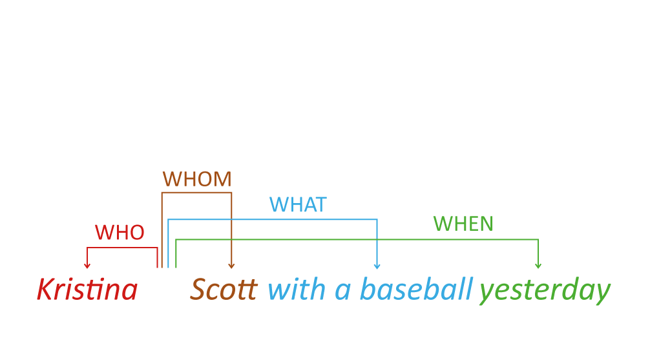
Semantic Role Labelling (SRL)
SRL aims to helps to model the predicate-argument structure of a sentence, and helps to understand “who did what to whom” 1
12
Sources: 1. Ruder, Sebastian. 2019. "Semantic role labeling." NLP-progress
2. Yih, Scott Wen-tau and Kristina Toutanova. 2006. "Automatic Semantic Role Labeling." HLT-NAACL-06 Tutorial

Slide 13

Semantic Role Labelling (SRL)
SRL aims to helps to model the predicate-argument structure of a sentence, and helps to understand “who did what to whom” 1
13
Sources: 1. Ruder, Sebastian. 2019. "Semantic role labeling." NLP-progress
2. Yih, Scott Wen-tau and Kristina Toutanova. 2006. "Automatic Semantic Role Labeling." HLT-NAACL-06 Tutorial

Slide 14
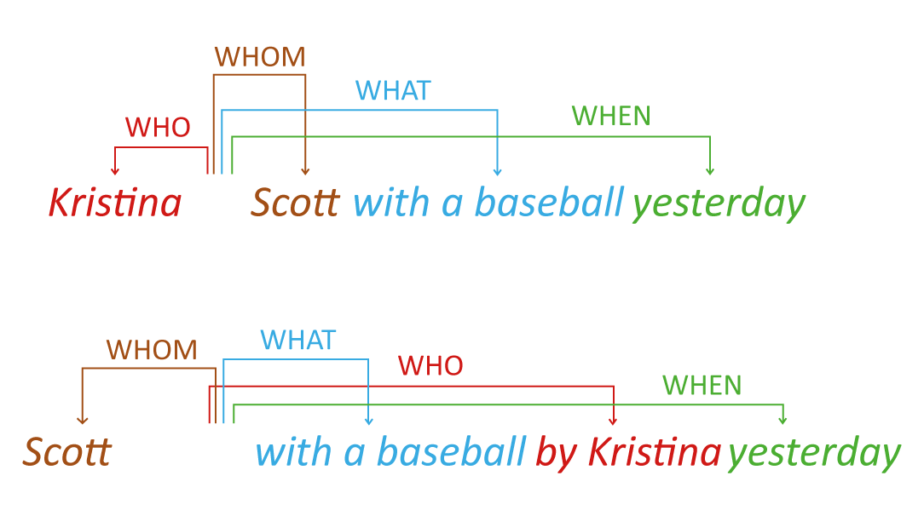
Semantic Role Labelling (SRL)
SRL helps to understand the meaning of a sentence, regardless of the order of the words
14
Sources: 2. Yih, Scott Wen-tau and Kristina Toutanova. 2006. "Automatic Semantic Role Labeling." HLT-NAACL-06 Tutorial

Slide 15
Semantic Role Labelling (SRL)
Off-the-shelf SRL model 3,4,5 that uses the PropBank predicate-argument structure for sentences 6
15
Sources: 3. AllenNLP SRL-BERT: https://docs.allennlp.org/models/main/models/structured_prediction/predictors/srl/ 4. Shi, P. Lin, J. 2019, ‘Simple BERT Models for Relation Extraction and Semantic Role Labelling’ Available at: https://arxiv.org/abs/1904.05255
5. CoNLL-2004 and CoNLL-2005 Shared Tasks: https://www.cs.upc.edu/~srlconll/home.html 6. PropBank: https://verbs.colorado.edu/~mpalmer/projects/ace.html

Slide 16
Semantic Role Labelling (SRL)
Off-the-shelf SRL model 3,4,5 that uses the PropBank predicate-argument structure for sentences 6
16
Sources: 3. AllenNLP SRL-BERT: https://docs.allennlp.org/models/main/models/structured_prediction/predictors/srl/ 4. Shi, P. Lin, J. 2019, ‘Simple BERT Models for Relation Extraction and Semantic Role Labelling’ Available at: https://arxiv.org/abs/1904.05255
5. CoNLL-2004 and CoNLL-2005 Shared Tasks: https://www.cs.upc.edu/~srlconll/home.html 6. PropBank: https://verbs.colorado.edu/~mpalmer/projects/ace.html

Slide 17
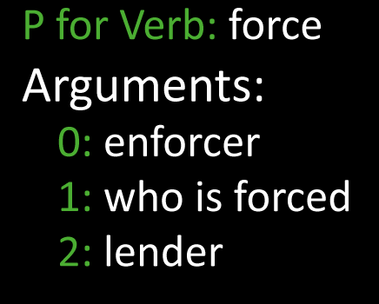
Semantic Role Labelling (SRL)
Off-the-shelf SRL model 3,4,5 that uses the PropBank predicate-argument structure for sentences 6
17
Sources: 3. AllenNLP SRL-BERT: https://docs.allennlp.org/models/main/models/structured_prediction/predictors/srl/ 4. Shi, P. Lin, J. 2019, ‘Simple BERT Models for Relation Extraction and Semantic Role Labelling’ Available at: https://arxiv.org/abs/1904.05255
5. CoNLL-2004 and CoNLL-2005 Shared Tasks: https://www.cs.upc.edu/~srlconll/home.html 6. PropBank: https://verbs.colorado.edu/~mpalmer/projects/ace.html

Slide 18
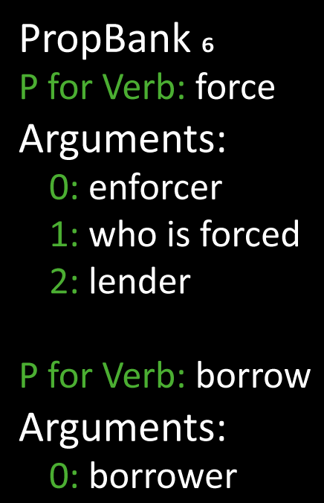
Semantic Role Labelling (SRL)
Off-the-shelf SRL model 3,4,5 that uses the PropBank predicate-argument structure for sentences 6
18
Sources: 3. AllenNLP SRL-BERT: https://docs.allennlp.org/models/main/models/structured_prediction/predictors/srl/ 4. Shi, P. Lin, J. 2019, ‘Simple BERT Models for Relation Extraction and Semantic Role Labelling’ Available at: https://arxiv.org/abs/1904.05255
5. CoNLL-2004 and CoNLL-2005 Shared Tasks: https://www.cs.upc.edu/~srlconll/home.html 6. PropBank: https://verbs.colorado.edu/~mpalmer/projects/ace.html

Slide 19
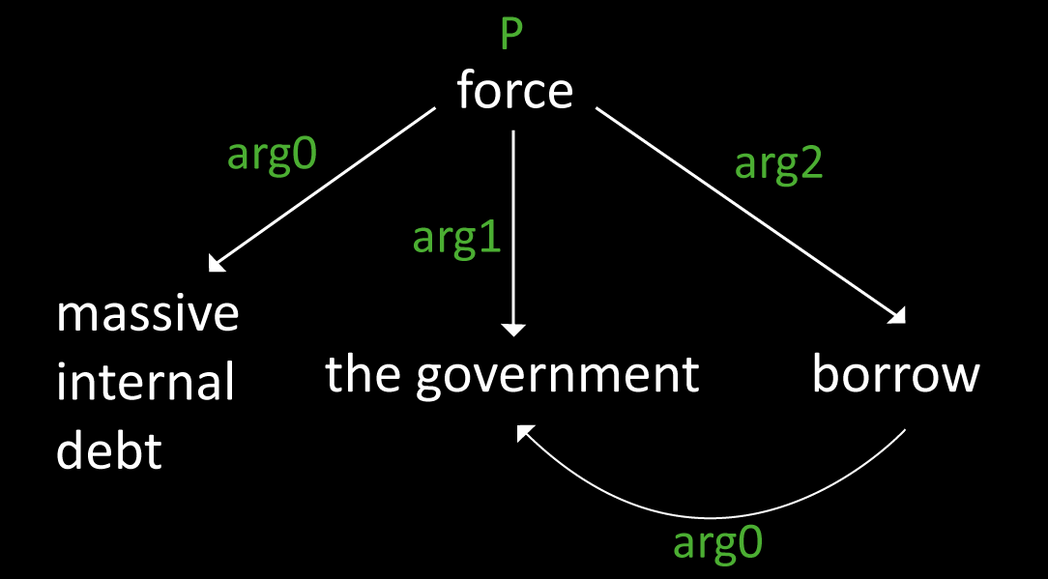
Semantic Role Labelling (SRL)
Off-the-shelf SRL model 3,4,5 that uses the PropBank predicate-argument structure for sentences 6
19
7
Sources: 3. AllenNLP SRL-BERT: https://docs.allennlp.org/models/main/models/structured_prediction/predictors/srl/ 4. Shi, P. Lin, J. 2019, ‘Simple BERT Models for Relation Extraction and Semantic Role Labelling’ Available at: https://arxiv.org/abs/1904.05255
5. CoNLL-2004 and CoNLL-2005 Shared Tasks: https://www.cs.upc.edu/~srlconll/home.html 6. PropBank: https://verbs.colorado.edu/~mpalmer/projects/ace.html 7. Kingsbury, Paul R. and Martha Palmer. (2003) “PropBank: the Next Level of TreeBank.”.

Slide 20
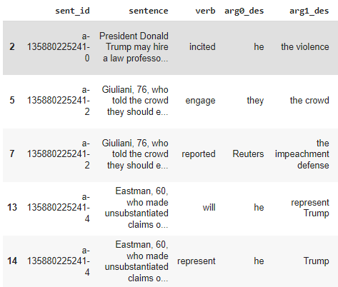
Extract SRL Annotations
20
Sources: n/a

Slide 21
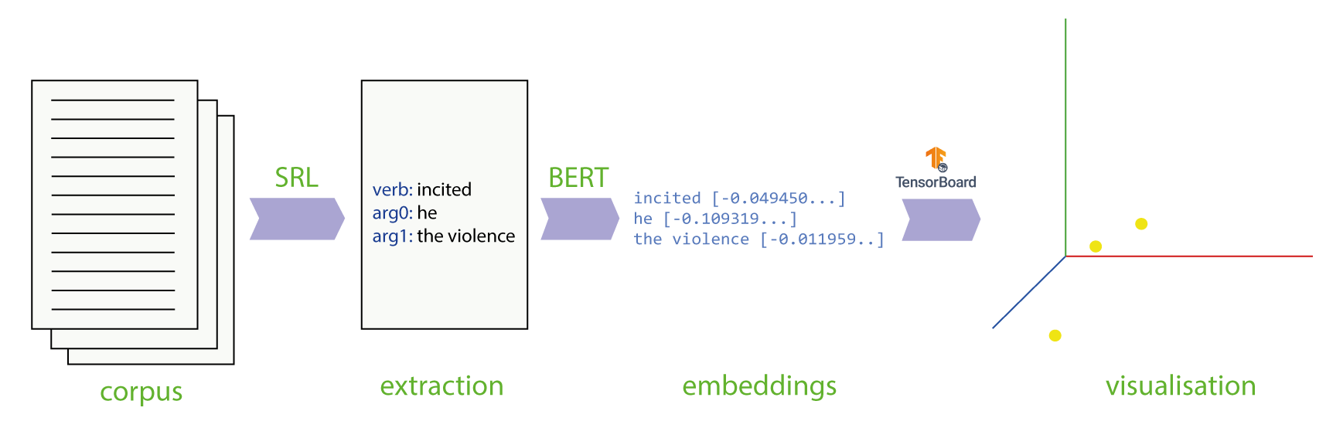
From corpus to visualisation
21
Sources:

Slide 22

Tensorboard Embedding Projector
Powerful tool used in data analysis for interpreting and visualising low-dimensional embeddings.
22
Sources:

Slide 23
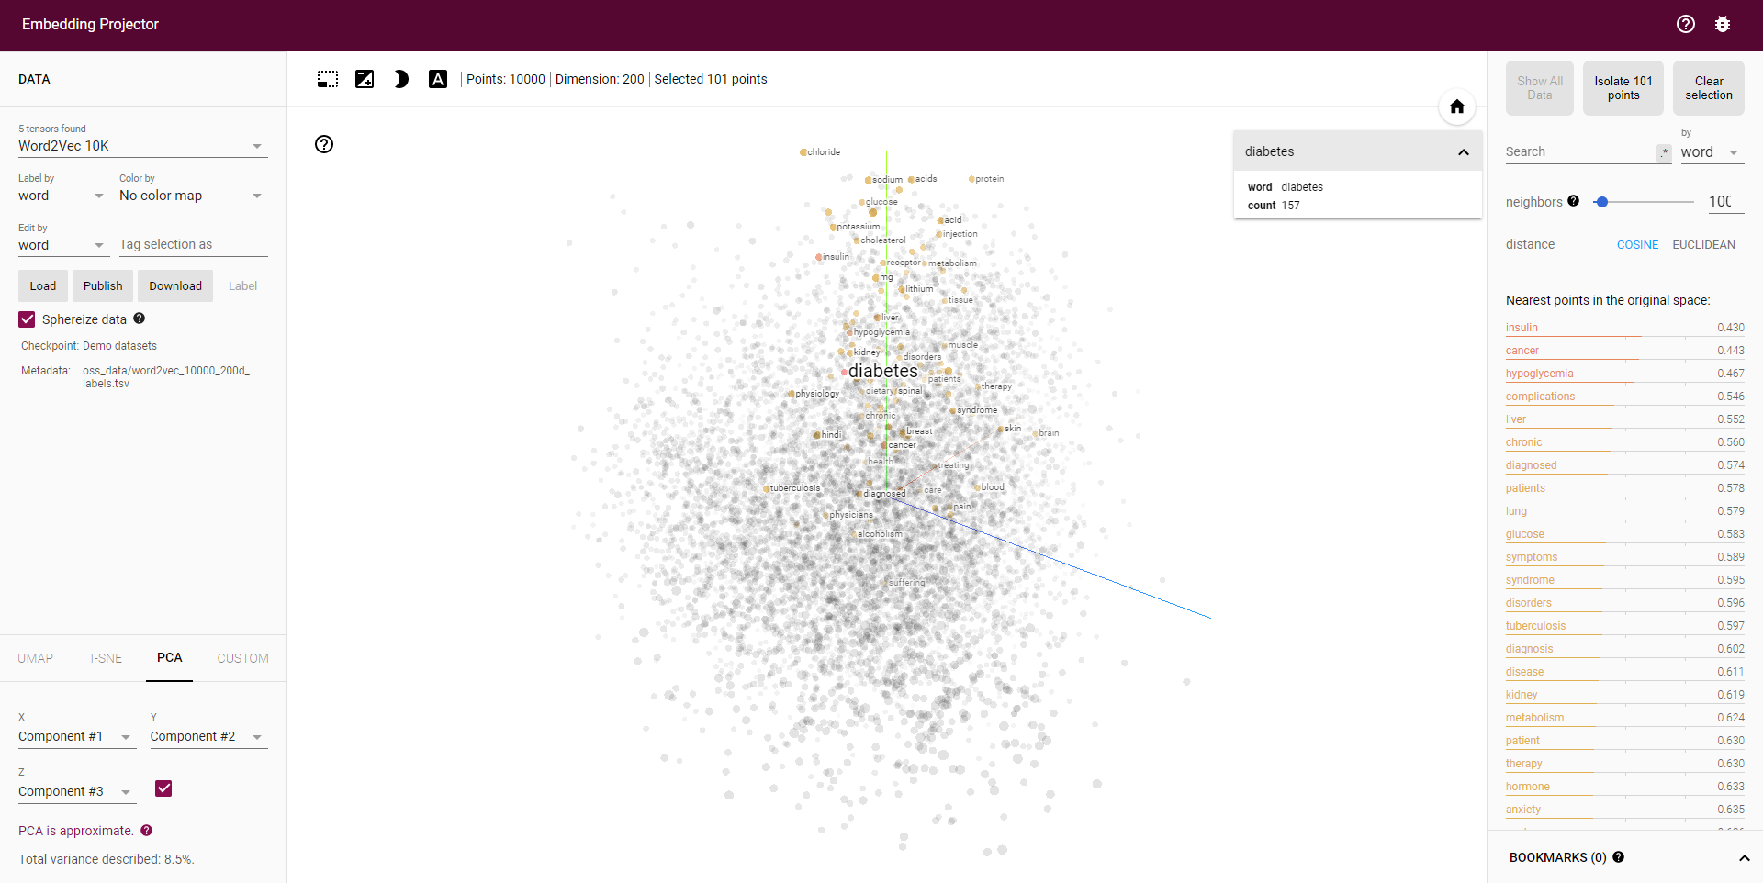
Tensorboard Embedding Projector
Powerful tool used in data analysis for interpreting and visualising low-dimensional embeddings.
Data
Analysis
Visualisation
Algorithms
23
Sources: 9. Tensorboard Embeddings Projector. Available from: https://projector.tensorflow.org/

Slide 24
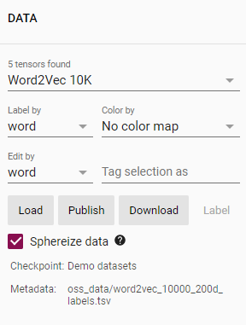
Tensorboard Embedding Projector
The Data Panel
Data
Analysis
Visualisation
Algorithms
Algorithms
24
Sources: 9. Tensorboard Embeddings Projector. Available from: https://projector.tensorflow.org/

Slide 25
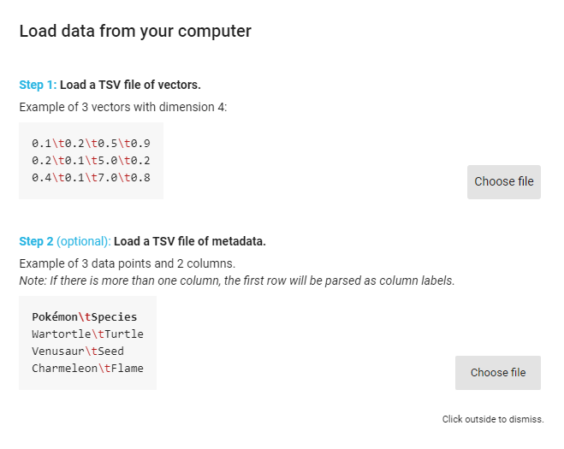
Tensorboard Embedding Projector
The Data Panel
25
Sources: 9. Tensorboard Embeddings Projector. Available from: https://projector.tensorflow.org/

Slide 26
Tensorboard Embedding Projector
The Data Panel
Data
Analysis
Visualisation
Algorithms
Algorithms
26
Sources: 9. Tensorboard Embeddings Projector. Available from: https://projector.tensorflow.org/

Slide 27
Tensorboard Embedding Projector
The Data Panel
Data
Analysis
Visualisation
Algorithms
Algorithms
27
Sources: 9. Tensorboard Embeddings Projector. Available from: https://projector.tensorflow.org/

Slide 28
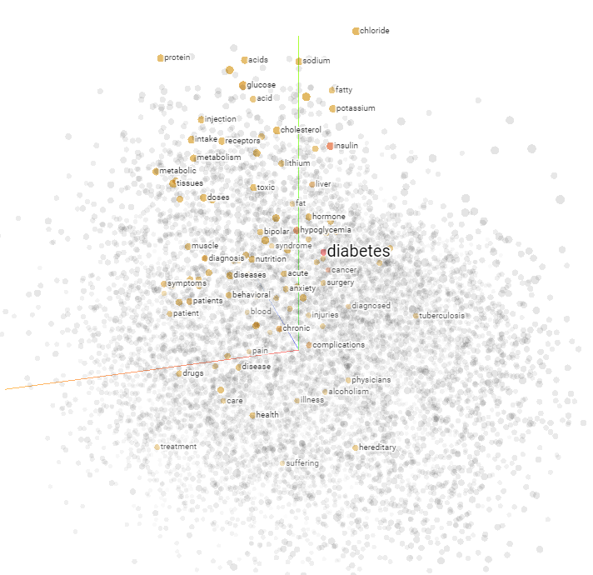
Tensorboard Embedding Projector
The Visualisation Panel
Data
Analysis
Visualisation
Algorithms
Algorithms
28
Sources: 9. Tensorboard Embeddings Projector. Available from: https://projector.tensorflow.org/

Slide 29
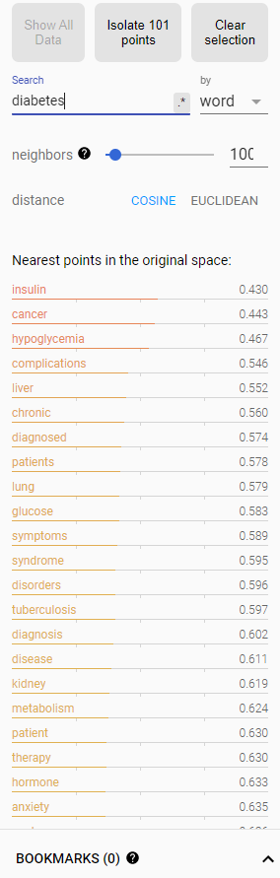
Tensorboard Embedding Projector
The Analysis Panel
Data
Analysis
Visualisation
Algorithms
Algorithms
29
Sources: 9. Tensorboard Embeddings Projector. Available from: https://projector.tensorflow.org/

Slide 30
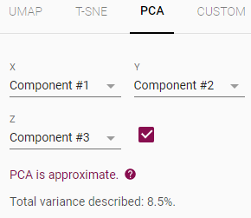
Tensorboard Embedding Projector
The Algorithm Panel
Data
Analysis
Visualisation
Algorithms
30
Sources: 9. Tensorboard Embeddings Projector. Available from: https://projector.tensorflow.org/

Slide 31
Use Case Analysis
Finding company connections (and other ICA’s)
31
Sources:

Slide 32
Use Case Analysis
Finding company connections (and other ICA’s)
We have a client who wants to know which companies are active in biotechnology, and if they are connected …
32
Sources:

Slide 33
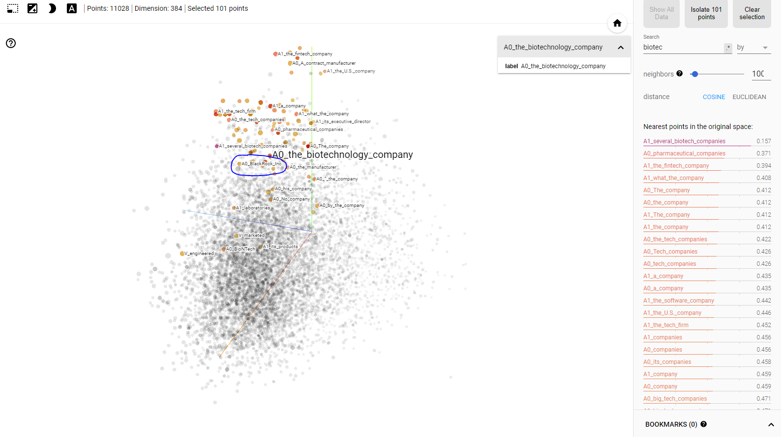
Use Case Analysis
Finding company connections (and other ICA’s)
33
Sources: Tensorboard Embeddings Projector. Available from: https://projector.tensorflow.org/

Slide 34
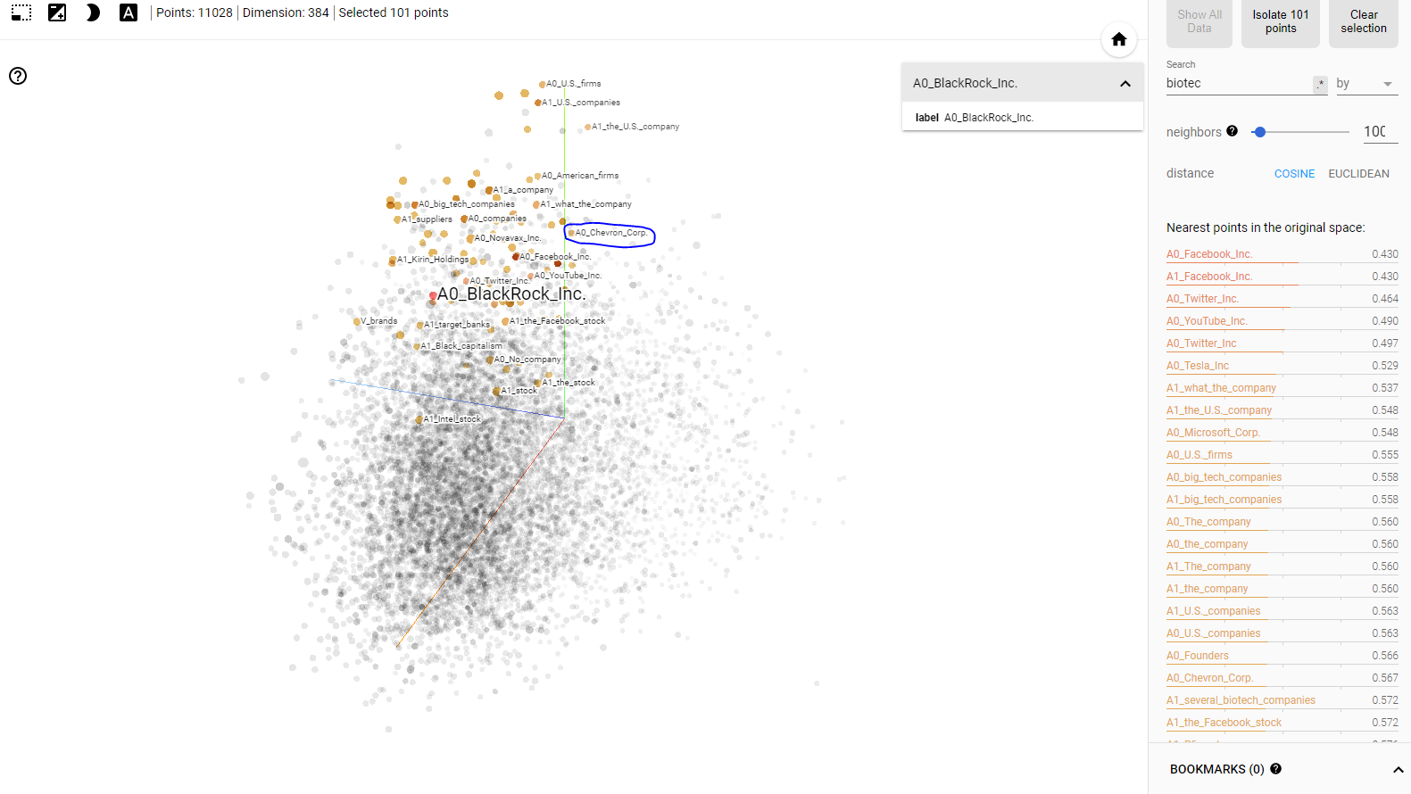
Use Case Analysis
Finding company connections (and other ICA’s)
34
Sources: Tensorboard Embeddings Projector. Available from: https://projector.tensorflow.org/

Slide 35
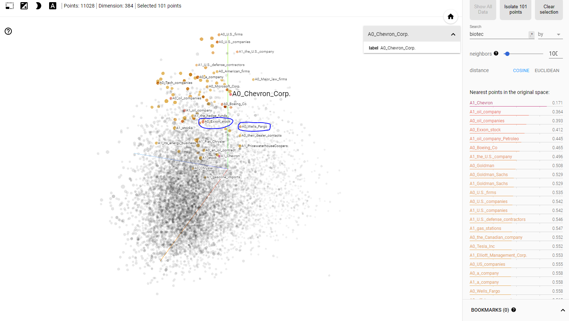
Use Case Analysis
Finding company connections (and other ICA’s)
35
Sources: Tensorboard Embeddings Projector. Available from: https://projector.tensorflow.org/

Slide 36
Use Case Analysis
Finding company connections (and other ICA’s)
Blackrock Inc.
Invested
Chevron Corps
Advisor to
Goldman Sachs,
Wells Fargo
owns
Discuss merger 2021
Noble Energy,
Texaco,
Renewable Energy Group (REN)
Exxon Stock
Merger 1998
Tried to purchase
Noble Energy ahead of
Chevron Corps
Mobil
Elliott Management Corps
36
Sources:

Slide 37
Use Case Analysis
Finding company connections (and other ICA’s)
Blackrock Inc.
Invested
Chevron Corps
Advisor to
Goldman Sachs,
Wells Fargo
owns
Discuss merger 2021
Noble Energy,
Texaco,
Renewable Energy Group (REN)
Exxon Stock
Merger 1998
Reliance Industries
Tried to purchase
Noble Energy ahead of
Chevron Corps
Mobil
Own
Elliott Management Corps
Reliance Life Sciences
37
Sources:

Slide 38
Use Case Analysis
Finding company connections (and other ICA’s)
Blackrock Inc.
Invested
Chevron Corps
Advisor to
Goldman Sachs,
Wells Fargo
owns
Discuss merger 2021
Takeover 2012
Noble Energy,
Texaco,
Renewable Energy Group (REN)
Exxon Stock
Merger 1998
Reliance Industries
Tried to purchase
Noble Energy ahead of
Chevron Corps
Mobil
Own
Elliott Management Corps
Reliance Life Sciences
38
Sources:

Slide 39
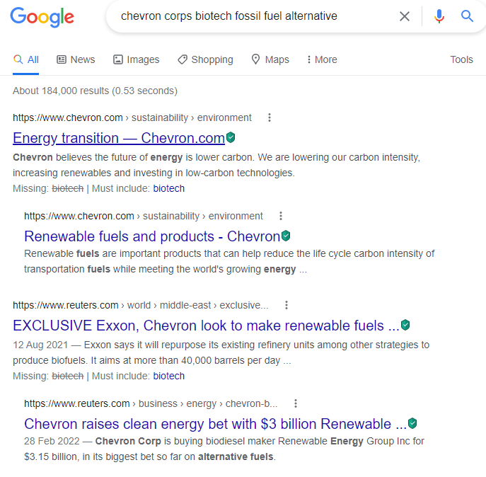
Use Case Analysis
Finding company connections (and other ICA’s)
39
10
Sources: 10. Google 12.08.22

Slide 40
Use Case Analysis
Finding company connections (and other ICA’s)
40
10
Sources: 10. Google 12.08.22

Slide 41
Use Case Analysis
Finding company connections (and other ICA’s)
41
10
Sources: 10. Google 12.08.22

Slide 42

Conclusion
By using SRL and the Embeddings Projector to analyse the nearest neighbours of annotations, it is possible to find:
Company connections & relationships
Frequent ICA-active company’s
Deep insights quickly
Recorded states for simple reporting
42

Slide 43
The End
Thank you to Luis for his guidance and supervision throughout this project.
Thank you to everyone else for your help.
Thank you for listening.
43

Slide 44



Lou Pemberton-Roberts
Intern - Machine Learning
lou.pemberton@amplyfi.com
AMPLYFI.COM

