Slide 1
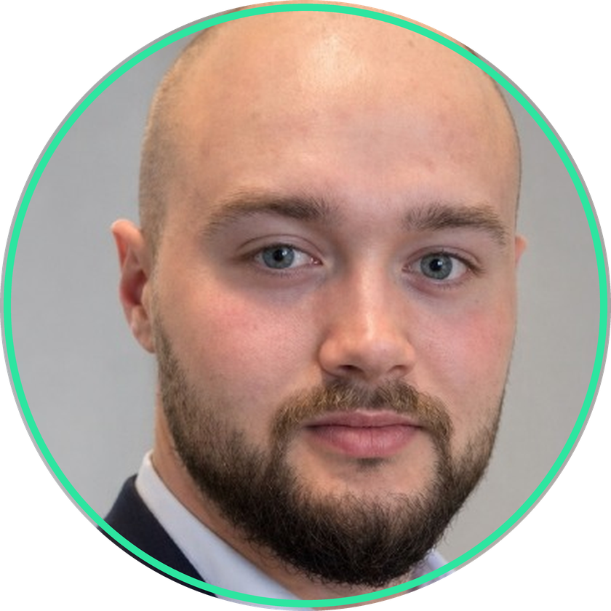
FOSS4G NL 2026
netweevil
Prototyping a Reproducible Network Analysis Engine in the Age of AI Agents
Years of answering other people's routing questions with duct tape. Then agents got good, and the tool I always wanted became a few days of work.
Rust engine
HTTP API
QGIS plugin
Reproducible runs
Elmeri Niemi
Geo Consultant · Geodienst
elmeri.niemi@gmail.com · o.e.niem@rug.nl · me@elmeriniemi.com
Standing on OpenStreetMap, GTFS, twenty years of routing research, and the QGIS community.
Notes:
Hi, I am Elmeri. For a good part of my career I was the person researchers and public agencies came to with routing questions. This talk is in three parts. First the questions I could never answer properly. Then the instrument I built to answer them. And then the part the title gives away: most of that instrument was written by AI coding agents, and I want to be honest about what that was like.

Slide 2
ACT ONE · THE PROBLEM
The questions that kept landing on my desk
A big part of my work used to be helping researchers and public agencies with network analysis. Different projects, same shape of question:
"How much time do ambulances spend on motorways, now that the national speed limit changed?"
THE UNCOMFORTABLE PART
Every one of these is a fair question.
Almost every answer was a one-off script, a hand-patched cost function, and a result I could not fully reconstruct six months later.
This talk is about closing that gap, and about who actually wrote the code.
"What would the Lelylijn do to accessibility in the north of the Netherlands?"
"Which road types do trips actually use, and how does that shift between policies?"
"Can you route vehicles along deliberately suboptimal paths, and tell me what that costs?"
"Can you run the whole thing again next year and get exactly the same numbers?"
netweevil · FOSS4G NL 2026
02 / 19
Notes:
Act one, the problem. These are real questions, lightly anonymised. The ambulance one is real. The Lelylijn comes up constantly here in the Netherlands. And the last one is the quiet killer: reproducibility. For most of my career the honest answer to that one was no. Not because we were sloppy, but because the answers lived in one-off scripts glued around whatever tool was closest.

Slide 3
ACT ONE · THE PROBLEM
Great tools, none of them shaped for this
OSRM
Valhalla
pgRouting
QNEAT3
The gap
Fastest car routing at continental scale. The reference for raw throughput.
Production multimodal routing, tiled and mature. Runs real services today.
Routing inside PostGIS. Arbitrary graph queries in SQL, deep database integration.
Zero-setup network analysis inside QGIS. Open the plugin and go.
Custom cost models meant Lua, C++ or SQL per question, plus re-preprocessing. And nothing recorded how a result was produced.
I used pgRouting and Valhalla for years, and they are excellent at their jobs. But every research question became a fight with someone else's schema. So last spring I did the unreasonable thing and built my own. Let me show you around first.
netweevil · FOSS4G NL 2026
03 / 19
Notes:
To be clear, I used these tools for years and they are excellent. OSRM is absurdly fast. Valhalla runs real products. pgRouting gives you the whole database. QNEAT3 is right there in QGIS. But a custom cost model meant editing Lua or C++ and re-preprocessing, or writing SQL per question. And none of them wrote down how a result was produced in a way I could hand to a reviewer a year later. So last spring I did the unreasonable thing and built my own engine. Before I tell you how, let me show you around, because the tool has to earn your attention on its own.

Slide 4
ACT TWO · THE INSTRUMENT
An analysis engine, not a production backend
A Rust workspace, 11 crates, one binary for import, profile compilation, analysis, simulation and reporting.
CLI
HTTP API
QGIS plugin
Reports
Scriptable, deterministic, CI friendly. Import, compile, analyze, simulate, report.
Axum service, datasets and profiles held in memory. JSON or GeoJSON, ready for the plugin or a notebook.
QGIS 3.28 to 4.99, Qt 5 and Qt 6. Route, OD, matrix, service area, transit and live simulation as grouped layers.
Run manifests plus GeoJSON, CSV, GPKG, Parquet and GeoParquet you can defend later.
It reads OSM extracts and Overture Maps GeoParquet, imports GTFS, and keeps every derived artifact in one local directory. No database, no tile server, no services to babysit before you can ask a question.
netweevil · FOSS4G NL 2026
04 / 19
Notes:
Act two, the instrument. Netweevil is a Rust workspace, eleven crates, one binary. The CLI does import, profile compilation, analysis, simulation and reporting. The same engine serves an HTTP API that a QGIS plugin talks to. Everything lands in one local dot-netweevil directory. No database, no tile server, nothing to operate before you can ask a question.

Slide 5
ACT TWO · COST MODELS
The ambulance question is a YAML file now
Speeds, surface factors, turn penalties, ferries, tolls: the whole cost model is a plain YAML profile. Edit, recompile in seconds, route again.
ambulance_emergency_call_v1.yml
speed_rules:
- match: { highway: motorway }
speed_kph: 150
factors:
- match: { surface: sand }
speed_factor: 0.25
- match: { smoothness: impassable }
speed_factor: 0.08
turns:
uturn_penalty_s: 12
preferences:
use_tolls: 1.0
returns:
explain_cost_derivation: true
A speed limit study becomes a diff. Two profiles, old and new motorway speeds, the same request batch, and a road-type breakdown on every route.
Any mode you can describe. Car, bicycle, pedestrian, ambulance, or something that exists only in one study.
Readable by reviewers. The complete cost model fits in a paper appendix, version controlled next to the results.
netweevil · FOSS4G NL 2026
05 / 19
Notes:
The ambulance question from act one. In netweevil, a cost model is a YAML file. Speeds by tag, surface factors, turn penalties, tolls, and how posted speed limits are treated. The national speed limit study becomes two profiles and a diff: same requests, compare the time spent per road class before and after. Compilation takes seconds, and the profile is version controlled next to the results, so the cost model can literally go in the paper's appendix.

Slide 6
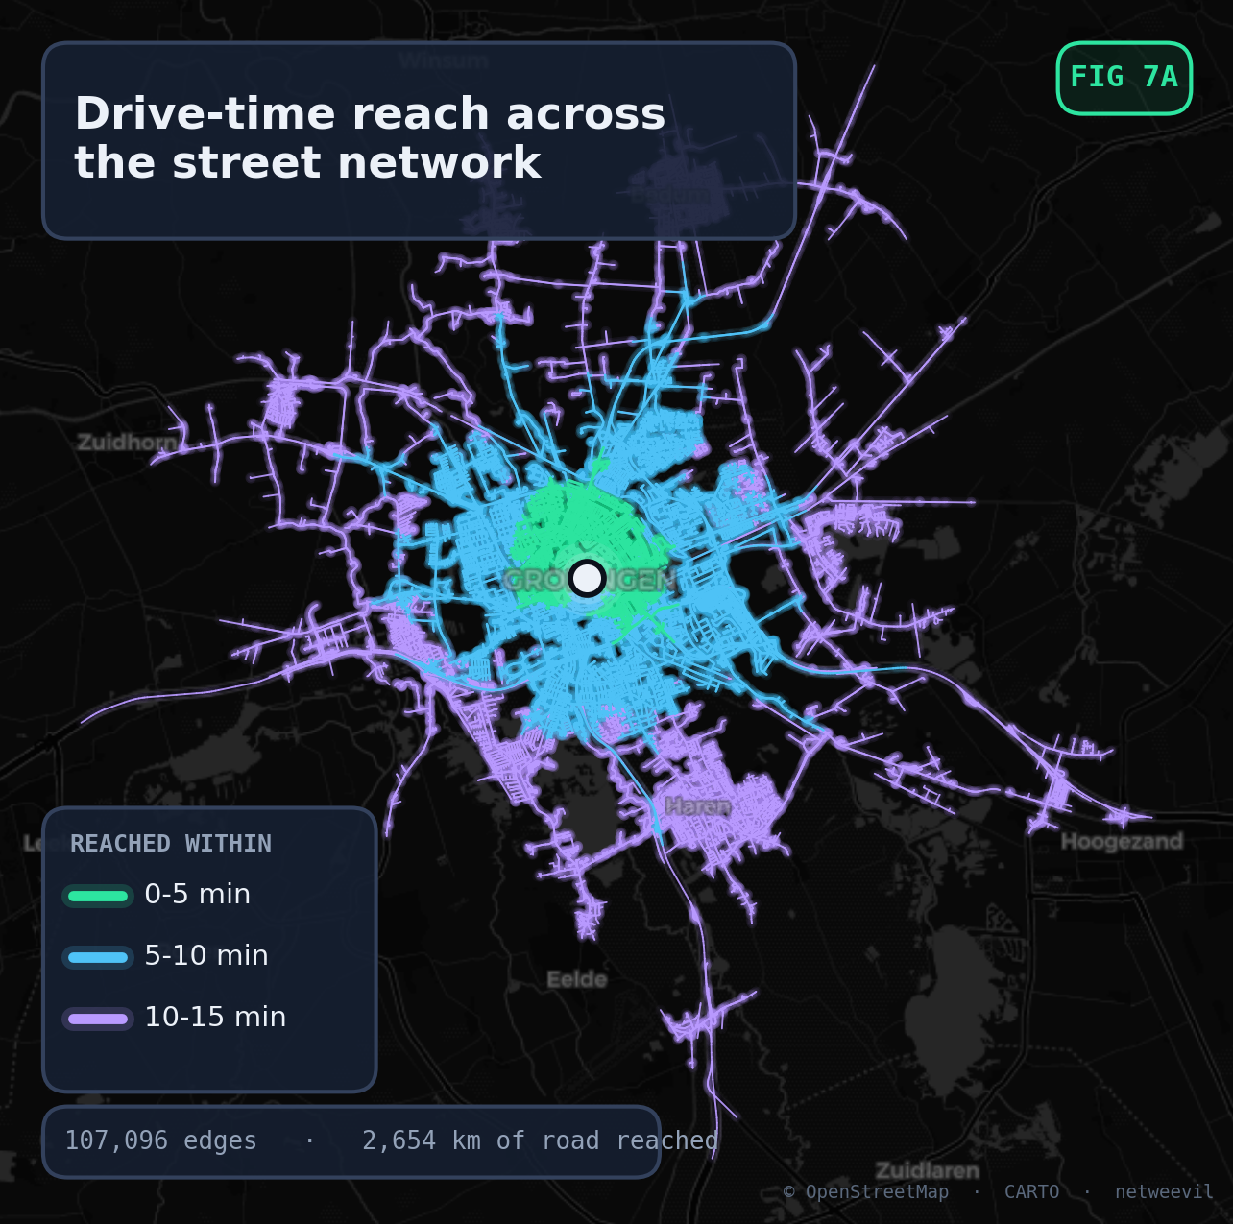
ACT TWO · THE TOOLBOX
The standard answers, one engine
The everyday request types are native, with no glue code between them:
Route single path, ranked alternatives, full geometry.
Route batch thousands of routes in one deterministic run.
OD pairs origins to destinations from CSV or JSON.
Matrix many-to-many time and distance.
Service area isochrones and the reachable network itself.
Accessibility who can reach what, scored across the network.
netweevil · FOSS4G NL 2026
06 / 19
Notes:
The everyday requests are all native. Single routes with full geometry, batches of thousands in one deterministic run, origin-destination pairs, time and distance matrices, service areas, accessibility scoring. The map is a drive-time service area from the centre of Groningen, computed on the reachable network itself, not as a smoothed hull: about 107 thousand edges and 2,650 kilometres of road within fifteen minutes. This is the bread and butter behind every accessibility question.

Slide 7
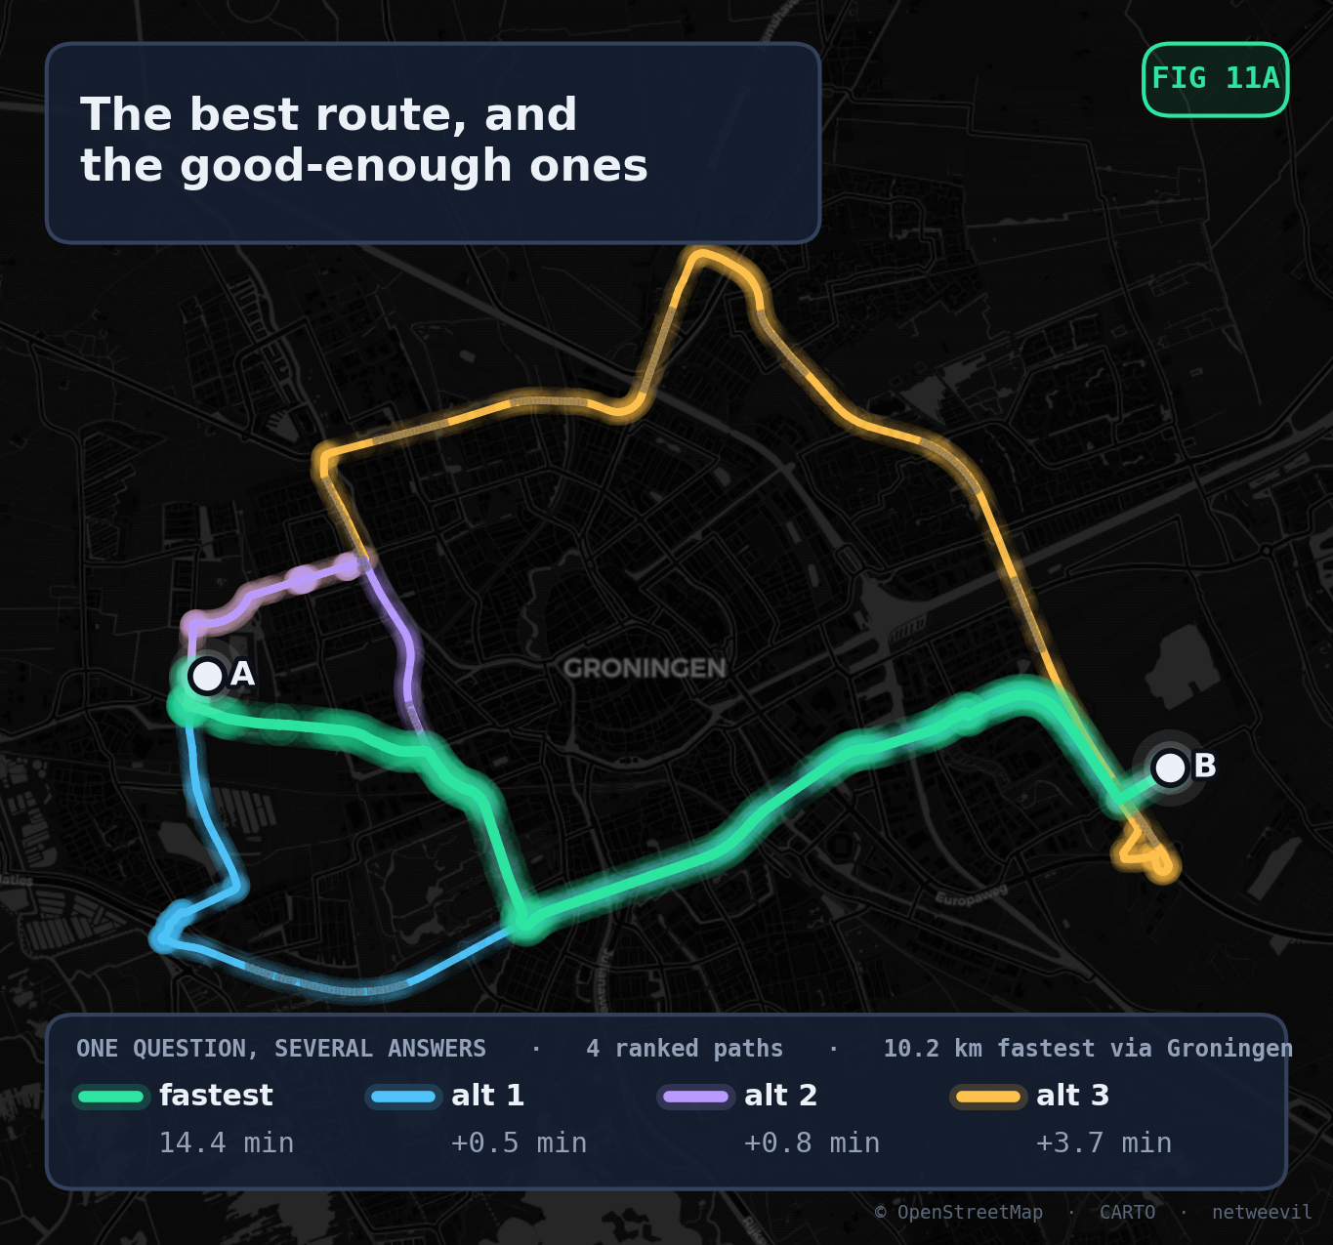
ACT TWO · SUBOPTIMAL PATHS
What does the second-best route cost?
What happens when vehicles do not take the optimal path? That question came up more often than almost any other.
Ranked alternatives with price tags. Each alternative reports its extra minutes and metres against the optimum, so suboptimality is measurable, not vague.
Useful far beyond navigation. Exposure studies, fleet dispersion, believable simulated traffic, sensitivity checks on a corridor before roadworks.
Same guarantees as the main route. Alternatives respect the same profile, restrictions and breakdowns as the optimal path.
netweevil · FOSS4G NL 2026
07 / 19
Notes:
One of my favourite recurring questions: what happens when vehicles do not take the optimal path? People want this for exposure studies, for spreading fleets over corridors, for making simulated traffic believable, or just to know how expensive the second-best option is. Most routers treat alternatives as a UI feature. Here they are a first-class result: every alternative reports its extra minutes and metres against the optimum, so suboptimality has a price tag. On this map the fastest crossing of Groningen takes 14.4 minutes, two alternatives cost less than a minute extra, and the wide northern ring costs 3.7 minutes more. That is the whole analysis, as one request.

Slide 8
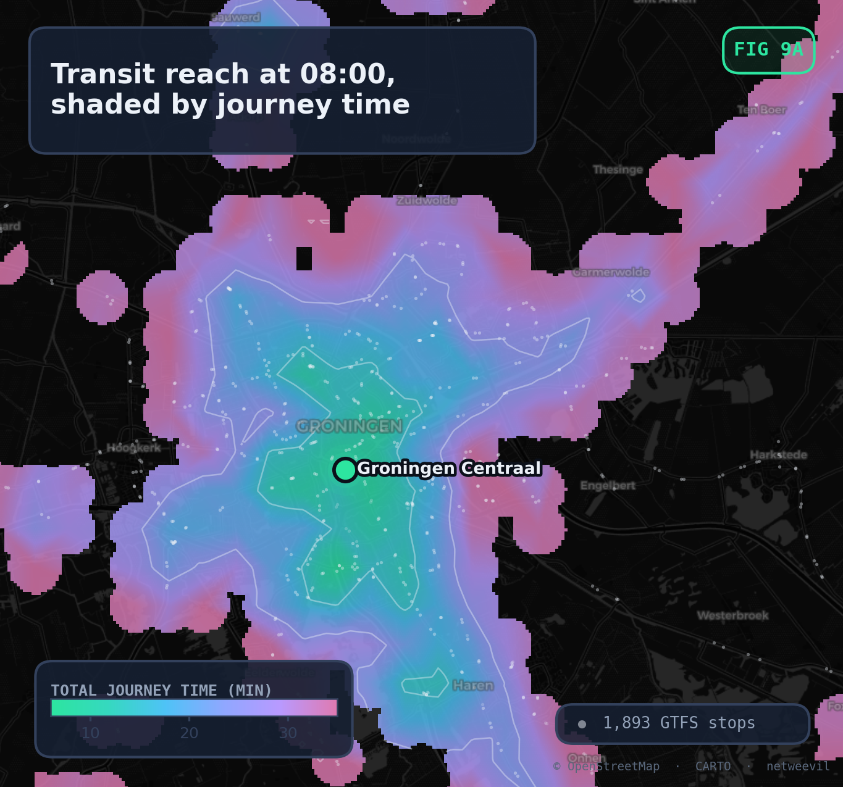
ACT TWO · MULTIMODAL
What would the Lelylijn actually change?
GTFS feeds import next to the road network, and journeys stitch walking and scheduled services together.
Accessibility, before and after. Run transit reach on today's feed. Add the hypothetical line as ordinary GTFS rows, run it again, difference the surfaces.
Real schedules, real transfers. Service dates, transfer times and access walks are part of the query, not an afterthought.
Time of day matters. Reach at 08:00 is not reach at 22:00. The query takes a clock time.
netweevil · FOSS4G NL 2026
08 / 19
Notes:
And the Lelylijn. GTFS feeds import next to the road network, and a journey stitches walking and scheduled services together. The map shows transit reach from Groningen central station at eight in the morning, on the real national feed, about nineteen hundred stops in this extract. The trick for a line that does not exist yet: describe it as ordinary GTFS rows, import the synthetic feed, run the same accessibility query, and difference the two surfaces. The before and after map is the answer to the question.

Slide 9
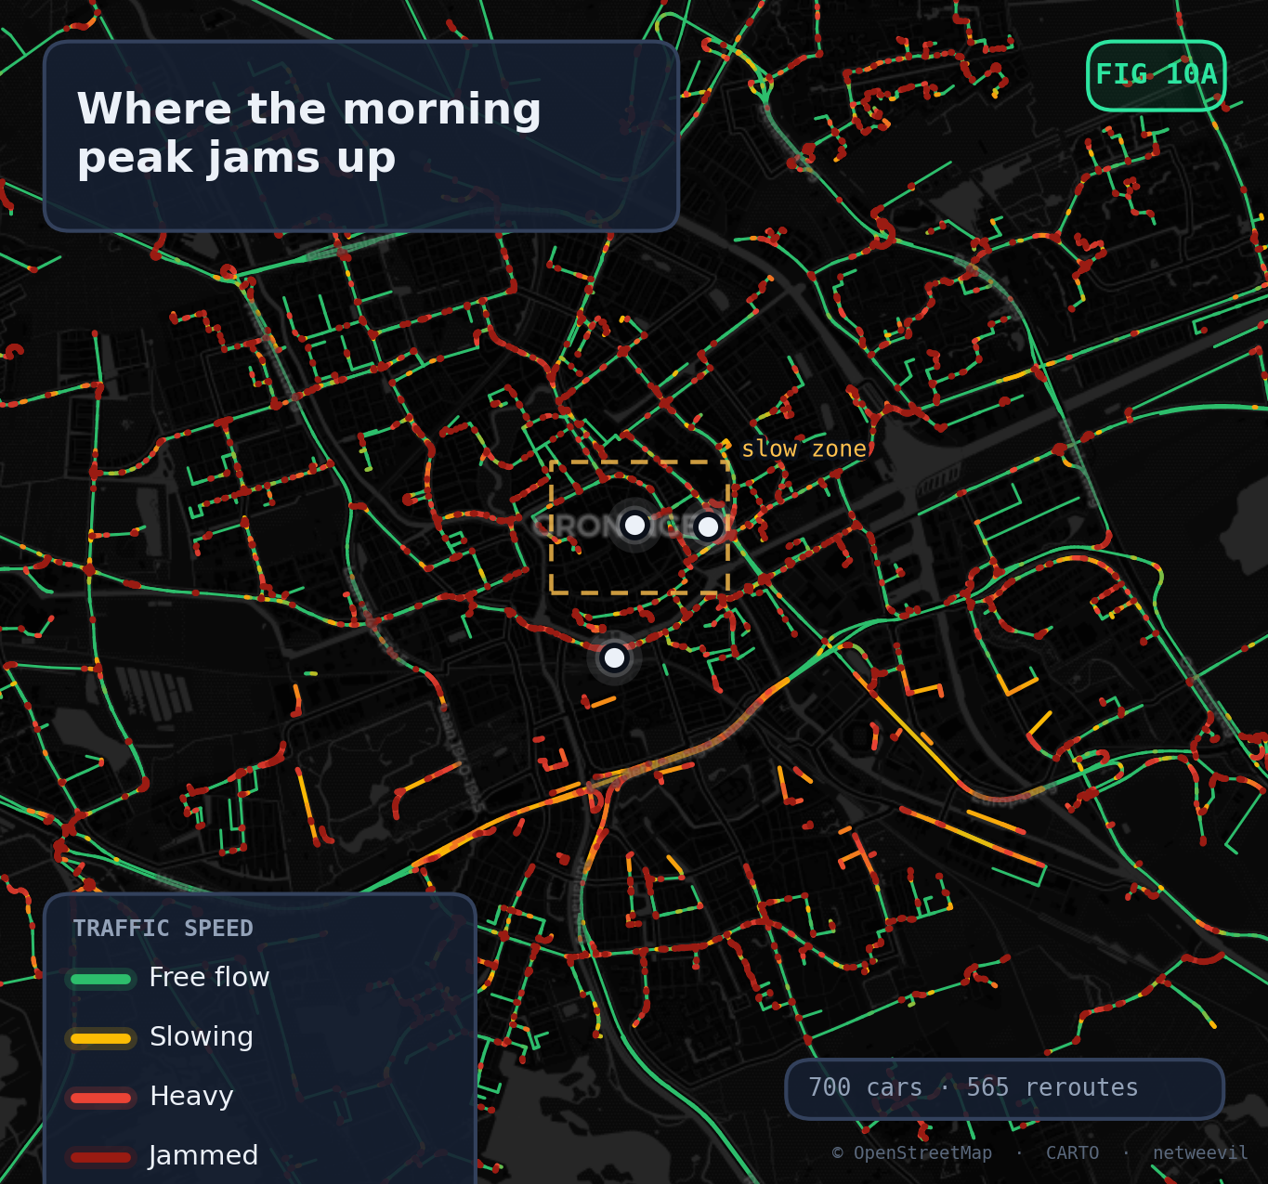
ACT TWO · BEYOND ROUTING
Agent-based traffic, in the same tool
Dispatch a fleet over the real network and watch congestion emerge: queues, rerouting, zones, closures.
From routes to traffic. Routing says what is optimal. Simulation says what happens when 700 drivers all believe that at once.
Scenarios as YAML. Fleets, departure curves, zones and closures are files, so a scenario is reviewable and repeatable.
Playback in QGIS. Frame-by-frame agent positions land as layers you can animate.
netweevil · FOSS4G NL 2026
09 / 19
Notes:
Routing tells you what is optimal. Simulation tells you what happens when seven hundred drivers all believe that at once. The engine includes agent-based traffic simulation on the same network: spillback queues, live rerouting when drivers hit jams, slow zones and closures that can change mid-run. This snapshot is a morning peak over Groningen, edges coloured from free flow to jammed, with the city-centre slow zone outlined. Frames land as layers, so the whole run plays back inside QGIS.

Slide 10
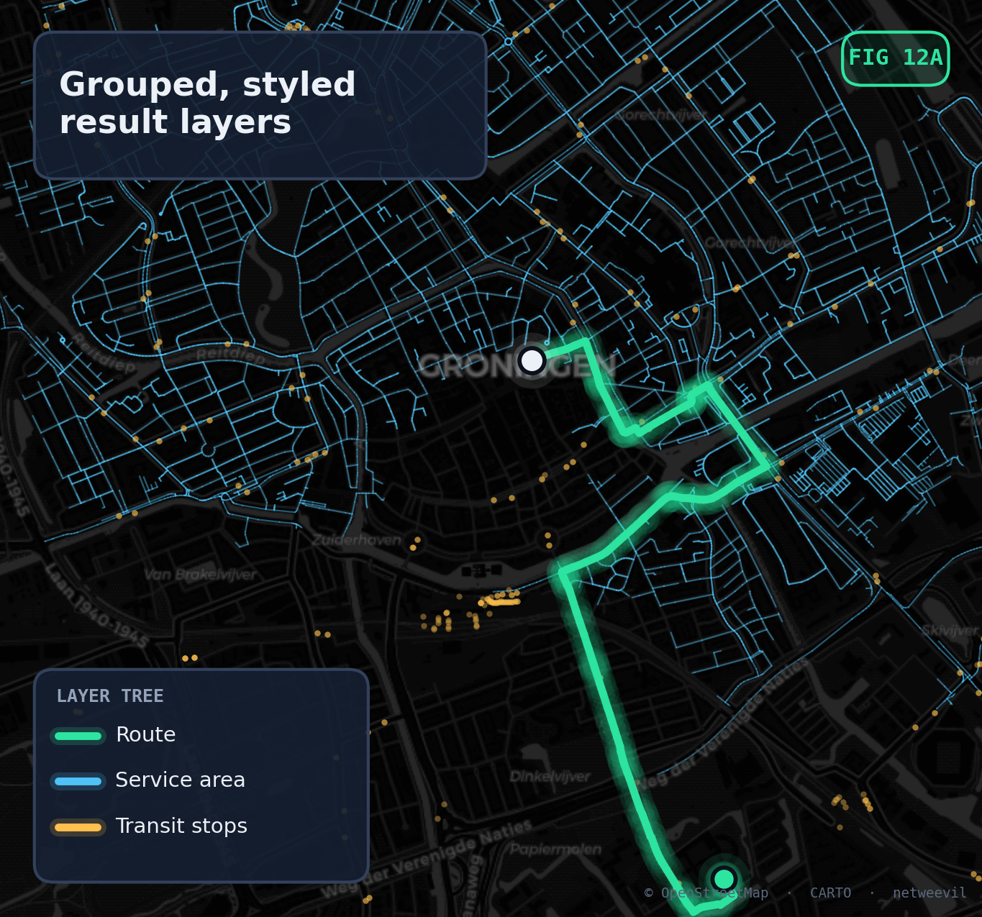
ACT TWO · WHERE ANALYSTS WORK
QGIS native, end to end
Most of the people who ask these questions live in QGIS, so the answers should land there too.
Click to run. Route, OD, matrix, service area, transit and simulation tabs, against a local API.
Grouped, styled layers. Results arrive organised and ready to map. No manual imports, no leftover scratch files.
QGIS 3.28 through 4.99. Qt 5 and Qt 6, packaged as a normal installable plugin.
netweevil · FOSS4G NL 2026
10 / 19
Notes:
Most of the people who asked me those questions live in QGIS, so answers have to land there. The plugin talks to the local API and brings results back as grouped, styled layers: routes, service areas, transit stops, simulation frames. It supports QGIS 3.28 through 4.99 on both Qt 5 and Qt 6, and it is packaged like any normal plugin. For a municipal analyst the engine is invisible; there is a panel, and maps come out.

Slide 11
ACT TWO · RUN IT AGAIN NEXT YEAR
Reproducible by construction
Every run writes a manifest that pins what produced the result. The fifth question from the start, answered structurally rather than by discipline.
Source provenance
Profile hashes
Software versions
Run metadata
OSM extract path and hash, import timestamps, bundle IDs.
The exact compiled cost model behind the run.
Engine and algorithm version pinned to every result.
Request, parameters and timing, captured rather than implied.
No hidden state. Anything you can configure lives in files, payloads or manifests. That is what turns a demo into an instrument you can publish from.
netweevil · FOSS4G NL 2026
11 / 19
Notes:
The fifth question from act one: run it again next year, get the same numbers. That is answered structurally, not by discipline. Every run writes a manifest pinning the source data and its hashes, the exact compiled cost model, the software and algorithm version, and the full request. There is no hidden state in a UI somewhere. That is the difference between a demo and an instrument you can publish from. And that closes the tour. Now the part of the story I have been saving: who actually built all this.

Slide 12
ACT THREE · HOW IT GOT BUILT
So who wrote all this?
Mostly not me. The engine I wanted was never going to be a funded project. It became real this spring as a side effect of AI coding agents getting good.
Software for an audience of one. No predefined schemas, no upstream maintainers to convince. Request and result models shaped exactly like my analyses, because nobody else has to agree.
I stopped typing most of the code. I write the spec, argue with the plan, review the diff, check the output. 37 of the 75 commits in the repo carry a Co-Authored-By: Claude trailer.
The code is often better than what I would write. Not a comfortable sentence, but true. The test discipline and the algorithm work go past what I would have shipped on my own evenings.
Days of work, not years. About a week of actual working days, spread over three and a half months of calendar. The next slide has the receipts.
netweevil · FOSS4G NL 2026
12 / 19
Notes:
Act three. Everything you just saw was built by one analyst, mostly in the evenings, and mostly not typed by me. The engine I wanted was never going to be a funded project; nobody budgets a routing engine for one person. What changed this spring is that the cost side of that equation collapsed. I want to be precise here: I did not vibe-code a router. I wrote specs, argued with plans, reviewed every diff, and verified outputs against tools I trust. But the agent did most of the typing, and honestly, a lot of the engineering is better than what I would have produced alone.

Slide 13
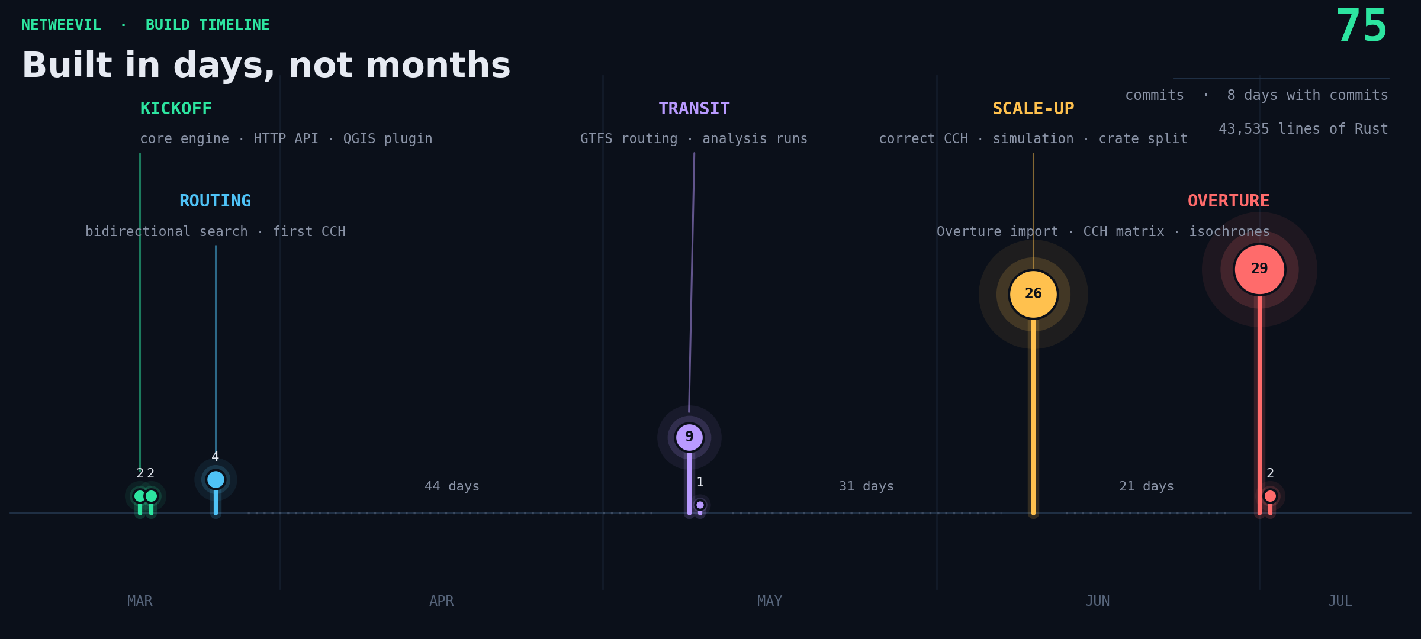
ACT THREE · THE RECEIPTS
Three and a half months of calendar, a week of work
netweevil · FOSS4G NL 2026
13 / 19
Notes:
This is the actual commit history. First commit in March, and then long stretches of nothing, because this is an evenings and weekends project and I have a life. The work concentrates in a few bursts: the core engine and routing first, then the accelerator and profile system, then one long day in June that added GTFS transit and the traffic simulation, and one in July for Overture Maps import. Seventy five commits, eight days with commits on them, forty three thousand lines of Rust. That used to be a team and a year.

Slide 14
ACT THREE · THE PROCESS
Working with agents, in practice
Plan first, code later.
Give the agent a way to verify.
Every feature starts as a written plan we argue about before any code exists. The typing is the cheap part now.
The single biggest lever: tests, fixture corpora, a rendered map the agent can look at. Wrong routes glow on a dark basemap.
Corrections become rules.
Parallel work, small reviews.
When the agent gets something wrong, the fix goes into the project instructions file, not the chat. That class of mistake stops happening.
One session builds GTFS import while another writes the QGIS plugin. My job is direction and review, in small pieces.
"Give Claude a way to verify its output. Once you do that, Claude will iterate until the result is great." Boris Cherny, creator of Claude Code
netweevil · FOSS4G NL 2026
14 / 19
Notes:
How the work actually feels. Every feature starts as a written plan that we argue about before any code exists; the typing is the cheap part now. The single biggest lever is the quote at the bottom, from Boris Cherny, who created Claude Code: give the agent a way to verify its output, and it iterates until the result is great. He puts the gain at two to three times, and that matches my experience exactly. For this engine, verification meant tests, fixture corpora, and rendered maps the agent can look at. When the agent gets something wrong, the correction goes into the project instructions file, not the chat, so the mistake stops recurring. And the work runs in parallel: one session on GTFS import, another on the QGIS plugin. Boris says he runs dozens at once; I am not there yet, but even three changes what an evening is worth. None of this is my invention, and that is the point: the patterns are public, and they transfer straight to geospatial work.

Slide 15
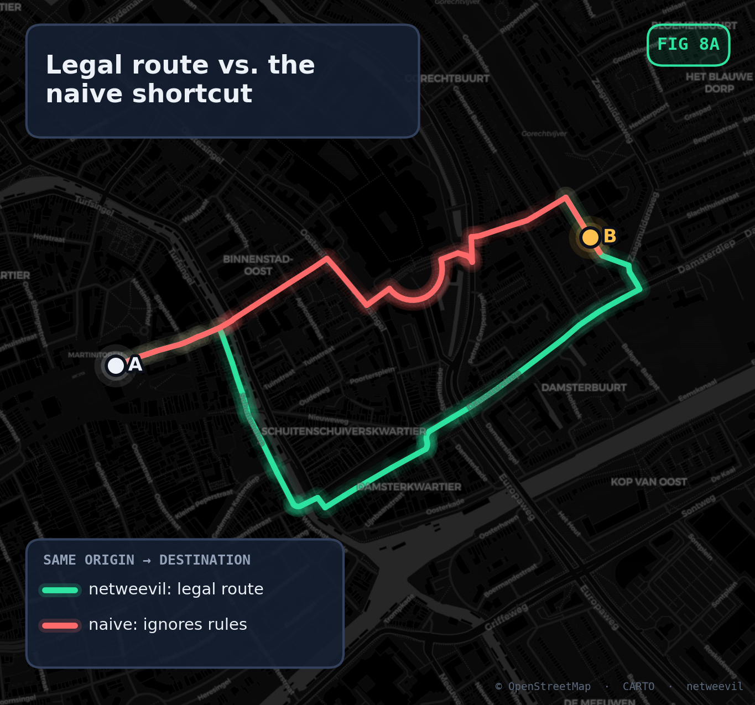
ACT THREE · THE OBVIOUS OBJECTION
Can you trust code an AI wrote?
It is the same question as trusting any router, and it has the same answer: verification, built into the engine.
An exact engine rides along as the oracle. The CCH accelerator is differential tested route for route against brute force. Same answers, 131 ms median down to 2.9 ms on 1.02M edge states.
The hard cases have tests. Via-way turn restrictions, the kind that quietly break routers, are modelled and verified. The red route is what ignoring them looks like.
149 tests and counting. The agent writes tests more patiently than I ever did.
netweevil · FOSS4G NL 2026
15 / 19
Notes:
The obvious objection: can you trust code an AI wrote? My answer is that it is the same question as trusting any router, and the same answer applies: verification, not confidence. The fast path is a customizable contraction hierarchy, and it is differential tested route for route against a brute force engine that ships inside the same binary. Same answers, about 45 times faster. The cases that quietly break routers, via-way turn restrictions, are modelled and on this map: the red route is what you get if you ignore them. And this is not just my hobby standard. Simon Willison recently had an agent do a final review before a release and it found five release blockers for about 150 dollars. Machine verification is cheap now. Blind trust is the only expensive option.

Slide 16
ACT THREE · WHAT THE AGENT DID NOT DO
The honest part
Domain knowledge was the input. I knew what a via-way restriction is and what a wrong isochrone looks like. Agents amplify what you bring. Skip the understanding and you take on debt in your own head, not just in the code.
Review became the bottleneck. I read far more code than I write now. The time did not disappear, it moved. For numbers that end up in policy discussions, that is the right trade.
Geospatial got lucky. Our wrong answers are visible. A route through a canal does not need a stack trace. Every rendered map doubled as a regression test.
"How much better do the models have to get before you'll stop reading the code?" Theo Browne, July 2026. My answer, for this engine: not yet.
netweevil · FOSS4G NL 2026
16 / 19
Notes:
Now the honest part. The agent did not know what a via-way restriction is, or what a wrong isochrone looks like. I did. Agents amplify what you bring, and if you skip the understanding you are taking on debt in your own head, not just in the code. Second, the bottleneck moved: I read far more code than I write now. Theo Browne asked in July how much better the models have to get before we stop reading the code. Maybe he is right for product code. For an engine whose numbers end up in policy discussions, my answer is: not yet. Third, we are lucky in this field: our wrong answers are visible. A route through a canal does not need a stack trace. Every rendered map doubled as a regression test.

Slide 17
THE ESSENCE
"You can outsource your thinking,
but not your understanding."
yacine (@yacineMTB), amplified by Andrej Karpathy
Agents will produce, and produce, and produce. Understanding does not come included.
In geospatial work our numbers steer ambulances, bus lines and policy debates. The engine is mine because I understand it, not because I typed it.
netweevil · FOSS4G NL 2026
17 / 19
Notes:
If you remember one line from this talk, make it this one. It is from yacine, a builder on X, and Andrej Karpathy passed it around for a reason. Agents can produce, and produce, and produce. Understanding does not come included. If you let it erode, you and your project are done; you just do not know it yet. In geospatial work this is not philosophy. Our numbers steer ambulances, bus lines and policy debates. The engine is mine because I understand it, not because I typed it. That is the deal the agents offer, and it is a good deal, but understanding is the part you can never hand over.

Slide 18
WHAT IT MEANS FOR THIS ROOM
Personal instruments, open foundations
Bespoke tools are suddenly affordable. A research group or a municipal team can afford an instrument fitted to their questions, instead of bending the question to fit the tool.
This only works on top of the commons. OpenStreetMap, GTFS, twenty years of routing papers, QGIS. The agents learned from open code. Publishing ours back is the least we owe.
The valuable skill moved. It was never typing speed. It is knowing what to ask for and how to check the answer. That is exactly what this community is good at.
netweevil · FOSS4G NL 2026
18 / 19
Notes:
So what does this mean for this room. Bespoke analysis tools used to be a luxury for well-funded teams. That constraint is gone: a research group or a municipal team can now afford an instrument fitted to their questions instead of bending the question to fit the tool. But none of it works without the commons. The agents learned from open code, and this engine stands on OSM, GTFS, twenty years of routing papers and QGIS. Publishing our tools back is the least we owe. And the skill that matters has moved to exactly where this community is strong: knowing what to ask, and knowing how to check the answer.

Slide 19
IN ONE BREATH
Not a product.
An instrument.
A local engine for the research case: every parameter explainable, every run reproducible, output shaped to the question. Built in days, on top of decades of open source.
Thank you. Questions are the whole point.
netweevil
Elmeri Niemi · Geo Consultant, Geodienst · FOSS4G NL 2026
elmeri.niemi@gmail.com · o.e.niem@rug.nl · me@elmeriniemi.com
Notes:
So, in one breath. Netweevil is not a product and it is not trying to replace OSRM, Valhalla, pgRouting or QNEAT3. It is an instrument: a local engine for the research case, where every parameter has to be explainable, every run reproducible, and the output shaped to the question. It was built in days, on top of decades of open source, by one analyst who understood the problem and a lot of patient machines. Thank you, and I am happy to take questions.

