Slide 1
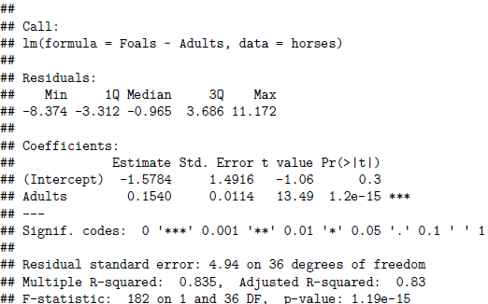




, estimated intercept
$${\hat{β}}_{0}$$
, estimated slope
$${\hat{β}}_{1}$$
Standard Error for : an estimate of the variability in values of b1 we will obtain from different samples
$${\hat{β}}_{1}$$
t statistic for a test of whether β1 = 0
p value for a test of whether β1 = 0
Residual standard deviation
Degrees of freedom: n - 2
$$R^{2}$$

