Slide 1
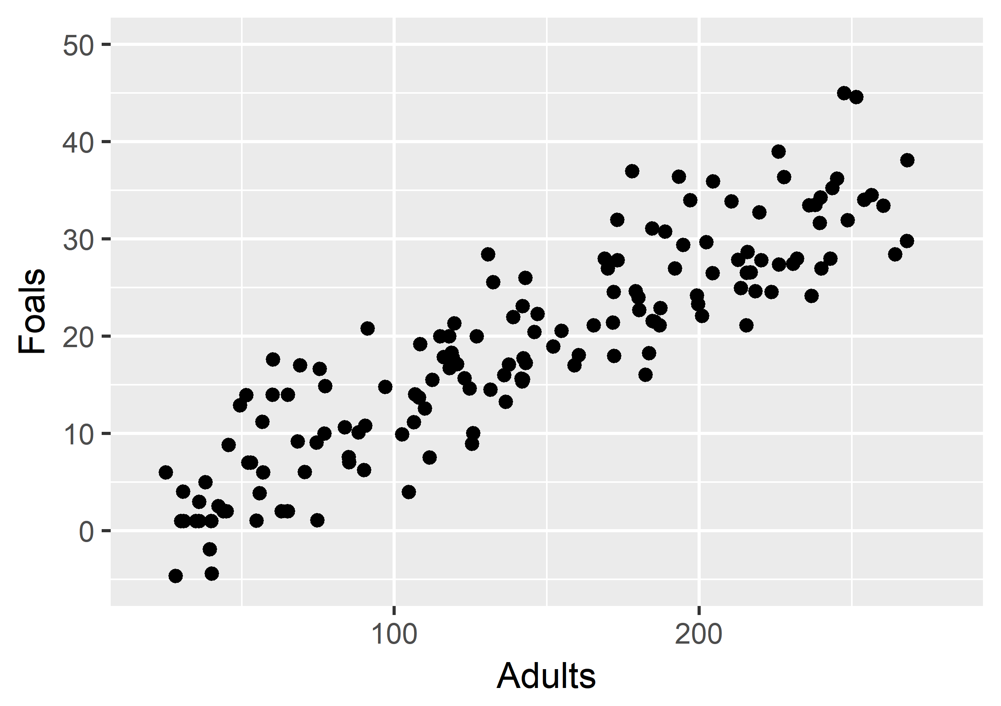
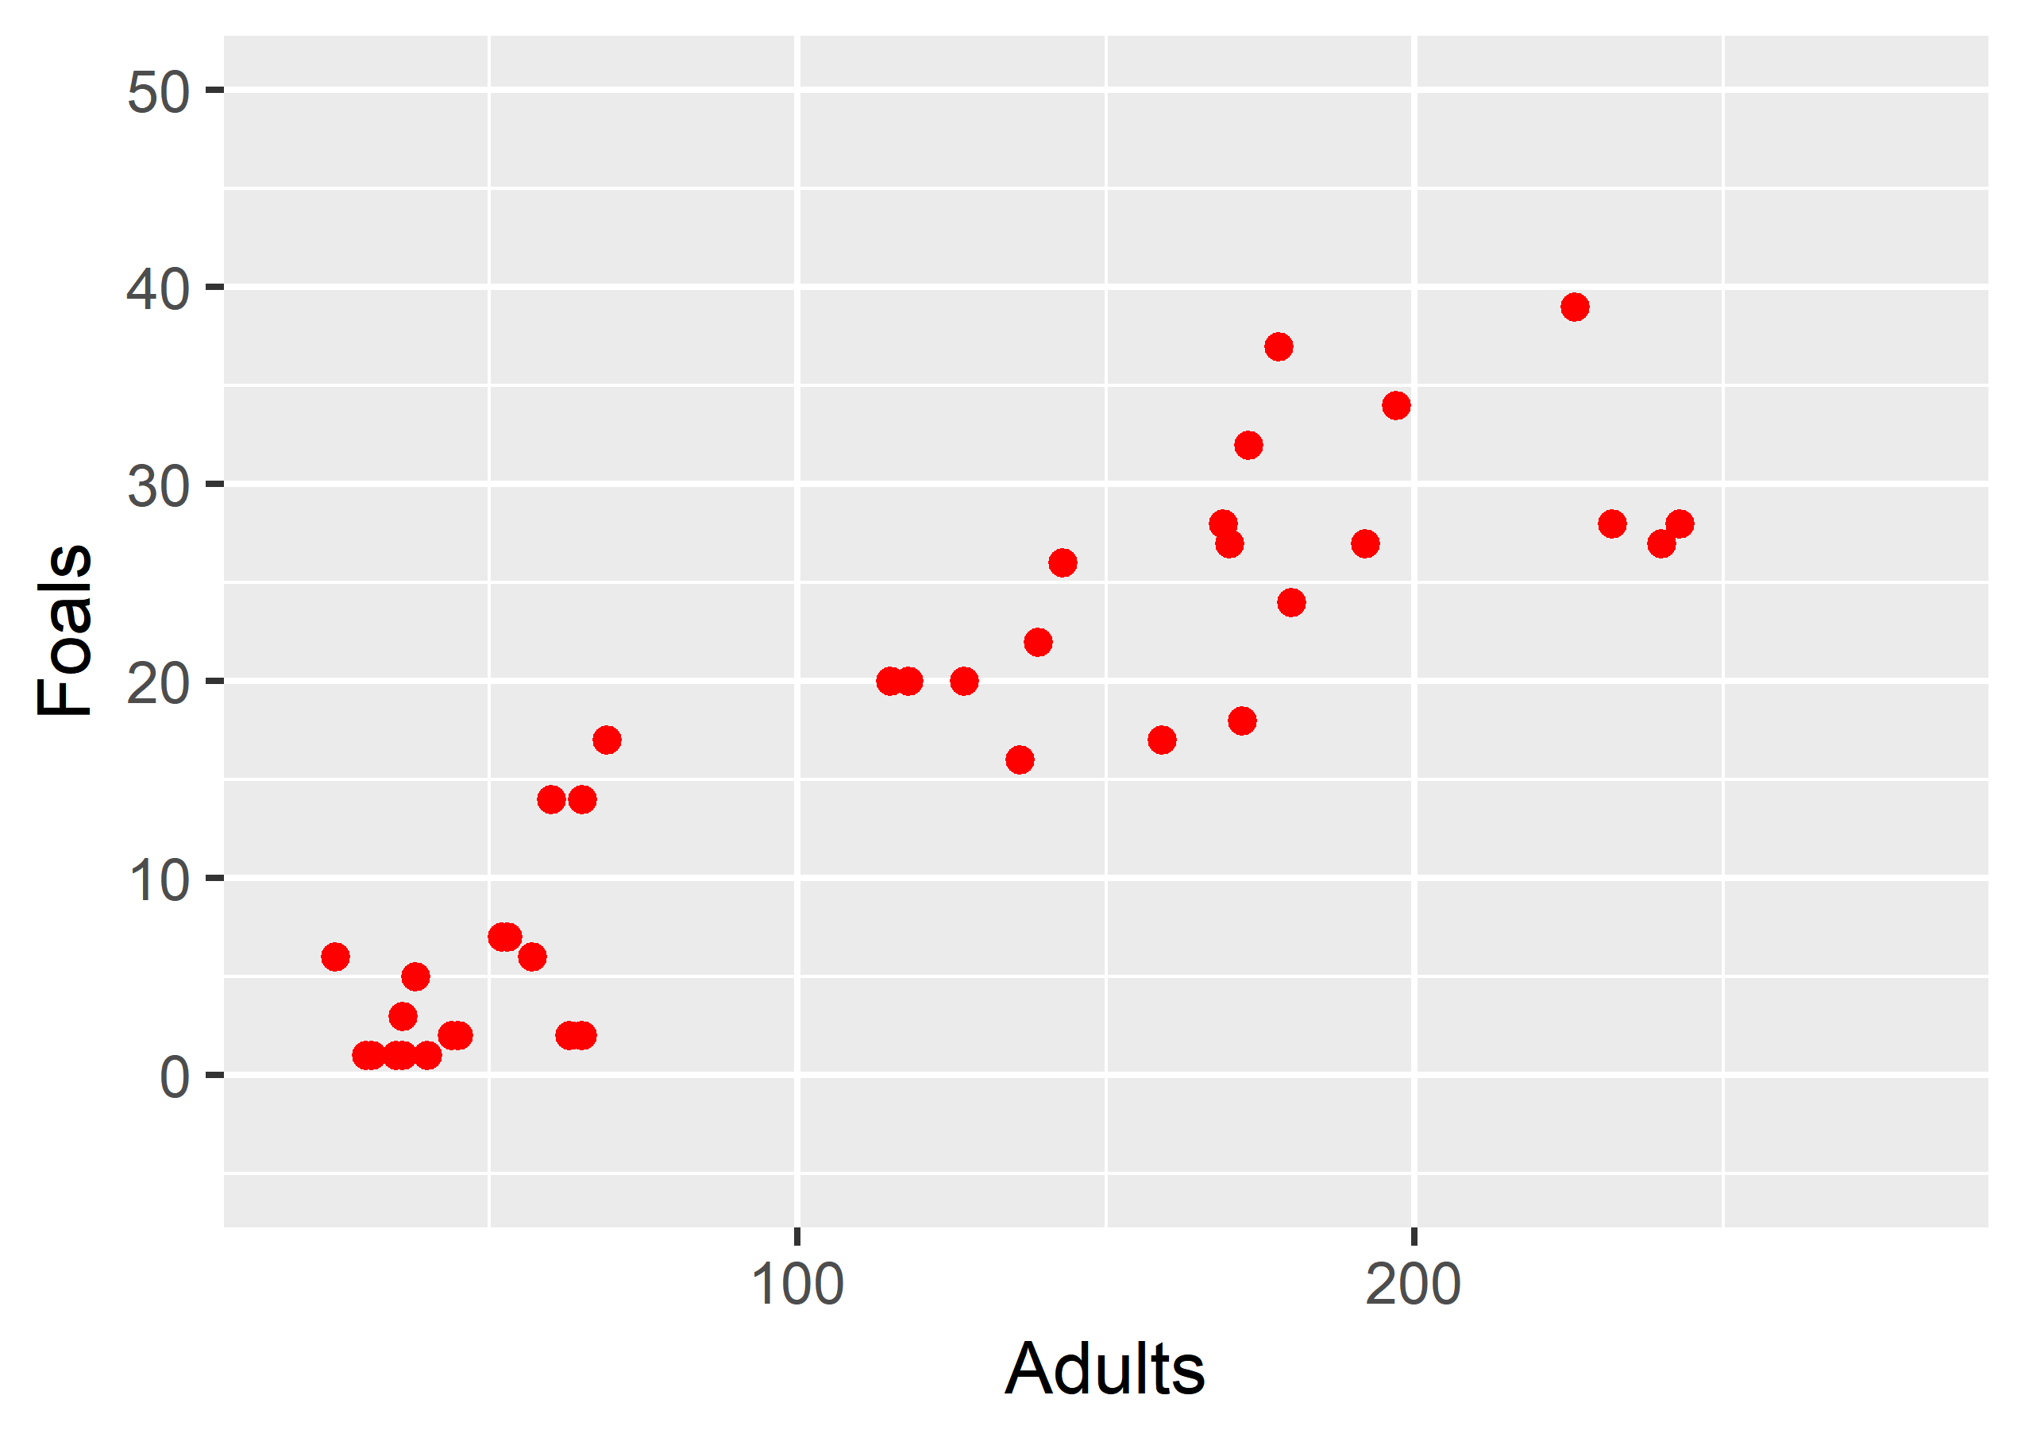
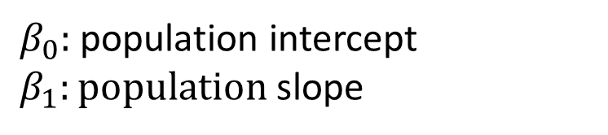
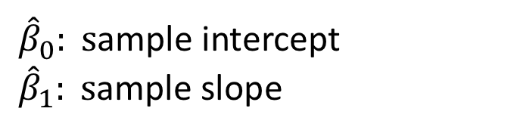
Population
Sample
All herds of horses in the world
A few randomly selected horse herds
Take Sample
Calculate Sample
Statistic
Our Goal: Estimate the Population Parameters
Inference
$β_{0}:$population intercept
$β_{1}:population$ slope
${\hat{β}}_{0}: s$ample intercept
${\hat{β}}_{1}: s$ample slope

