Slide 1
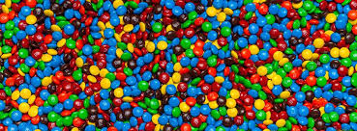
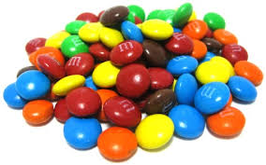
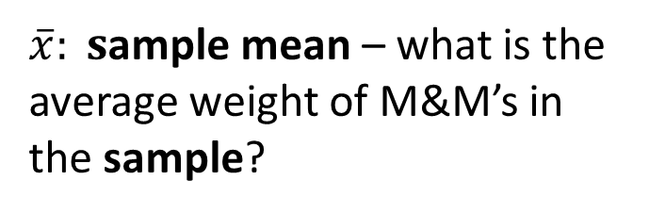
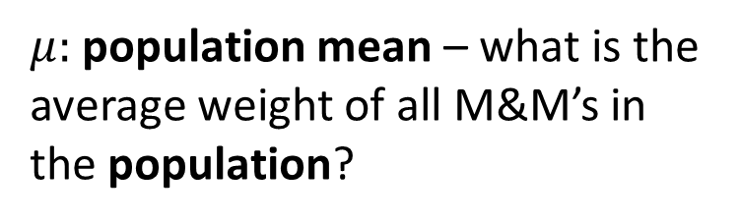
Population
Sample
All M&M’s in the world
A few randomly selected M&M’s
Take Sample
Calculate Sample
Statistic
Our Goal: Estimate the Population Parameter
Inference
$μ:$population mean – what is the average weight of all M&M’s in the population?
$\overline{x}: s$ample mean – what is the average weight of M&M’s in the sample?

