Slide 1
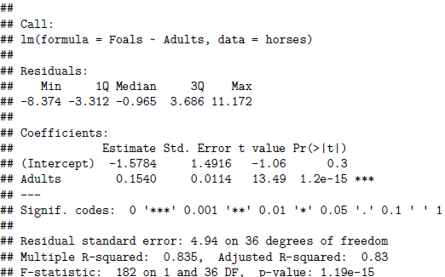

b0, estimated intercept
b1, estimated slope
Standard Error for b1; this is an estimate of the variability in values of b1 we will obtain from different samples
t statistic for a test of whether β1 = 0
p value for a test of whether β1 = 0
Residual standard deviation
Degrees of freedom: n - 2
$$R^{2}$$

